Slide 1

KS3 DRAMA SKILLS TASKS
#1

Slide 2
SKILLS TASK 1
Create a video blog in which you explain at least 5 performance skills.
As a challenge- also provide an example of the skill being used effectively/or an explanation of how these skills can be developed. Submit all work into the Assignment on TEAMS- Not via email.
See next slide for information about performance skills.

Slide 3
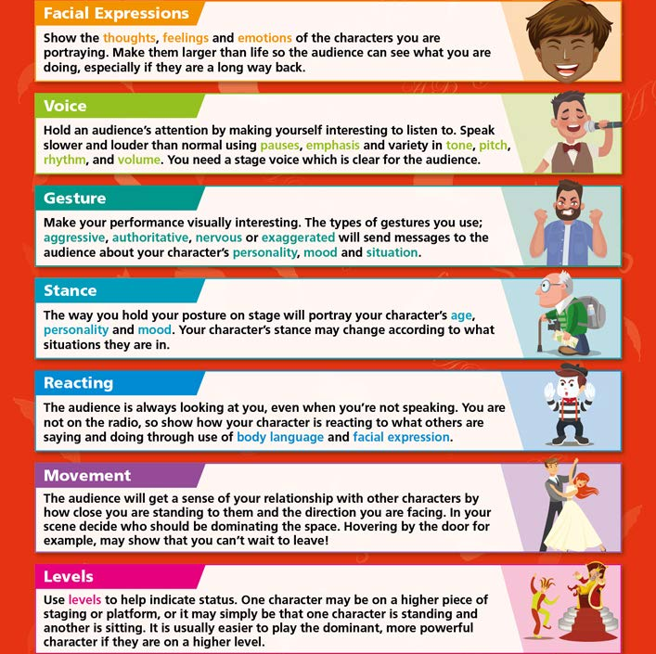
What are performance skills?

