Slide 1

KS3 DRAMA SKILLS TASKS
#2

Slide 2
SKILLS TASK 2
Create a presentation that explains at least 5 drama explorative strategies.
As a challenge- Embed videos into your presentation that shows the strategies being used. You can film yourself doing the techniques or search examples up on YouTube. Submit all work into the Assignment on TEAMS- Not via email.
See next slide for information about drama strategies.

Slide 3
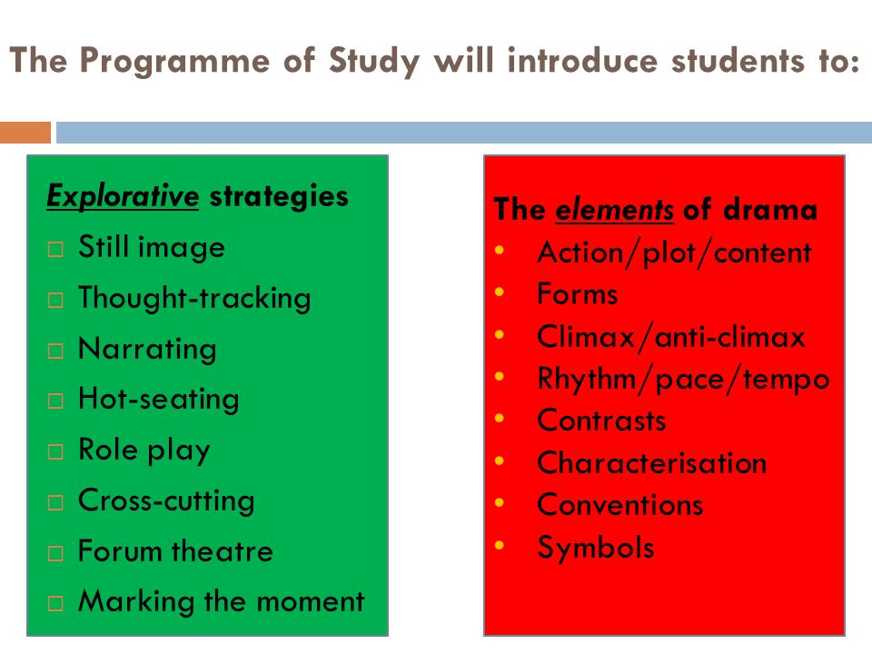
What are THE DRAMA STATEGIES?

