Slide 1

Year 9 drama devised piece
Stimuli:
1.The global Pandemic/ Covid 19
2. BLM

Slide 2
What is a dystopia?
https://www.youtube.com/watch?v=zIpXoohOg44
A dystopia is an imagined community or society that is dehumanizing and frightening, and dystopian stories often tell tales of bravery and defiance in the face of totalitarian governments or survival in a post-apocalyptic landscape. A dystopian society is the opposite of a utopian society.

Slide 3
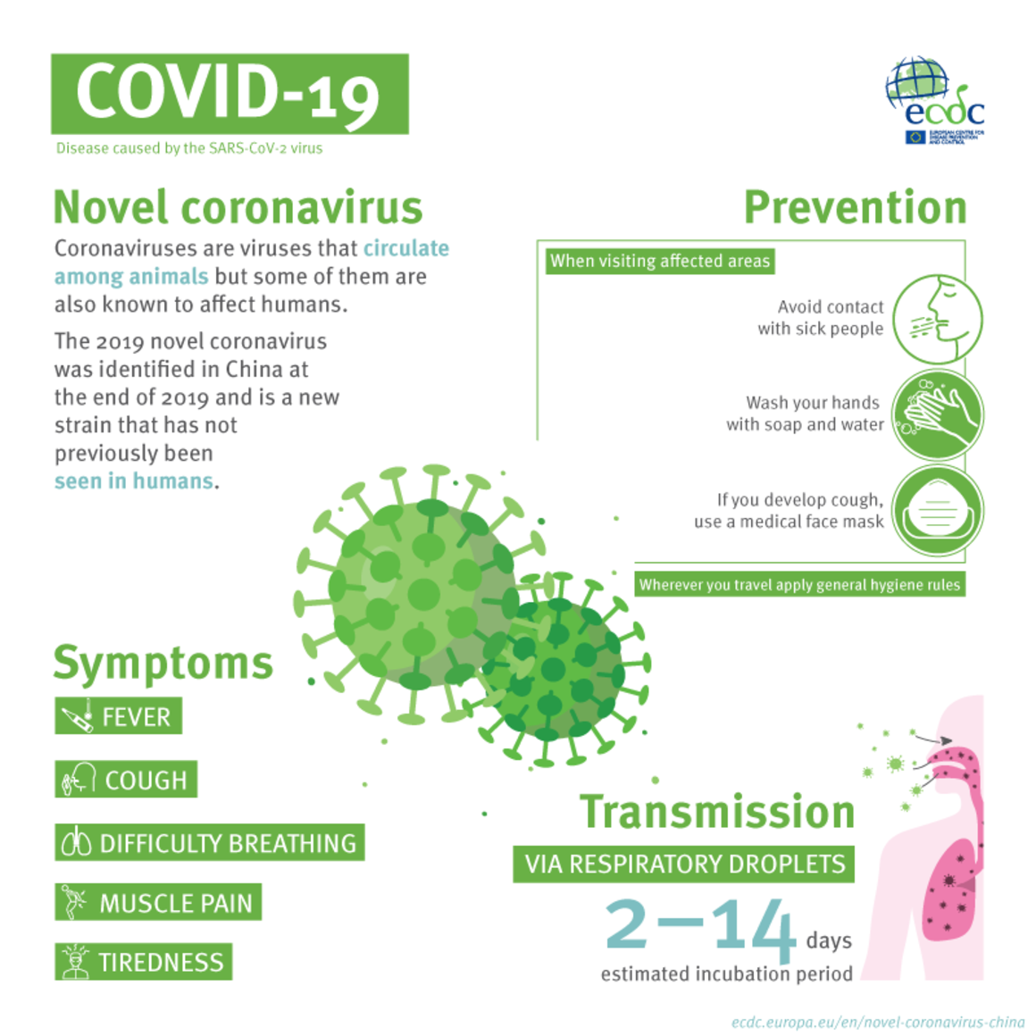
Stimuli:

Slide 4
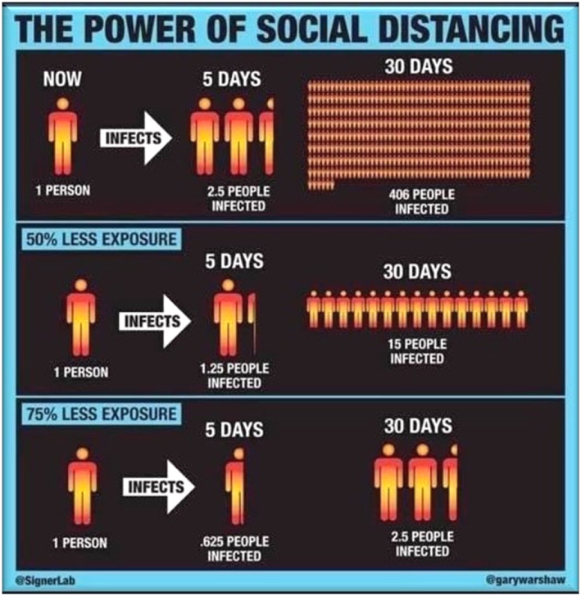


Slide 5

Have we always been social distancing?

Slide 6


Human nature?

Slide 7

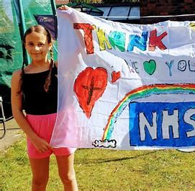
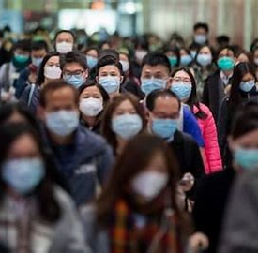

Protection? Coping? Compassion? Hysteria?

Slide 8
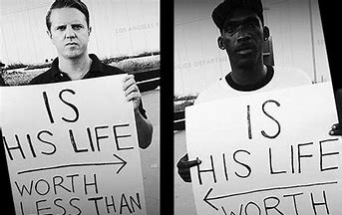
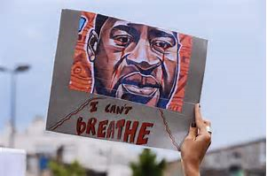
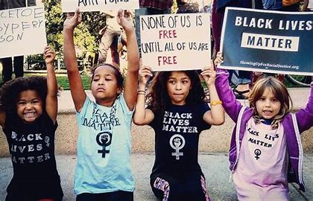
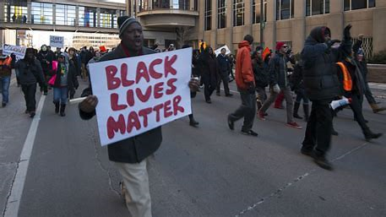
BLM
Tearing each other down? Does that make us stronger?
Fear?
Ignorance?
Brainwashing?

Slide 9
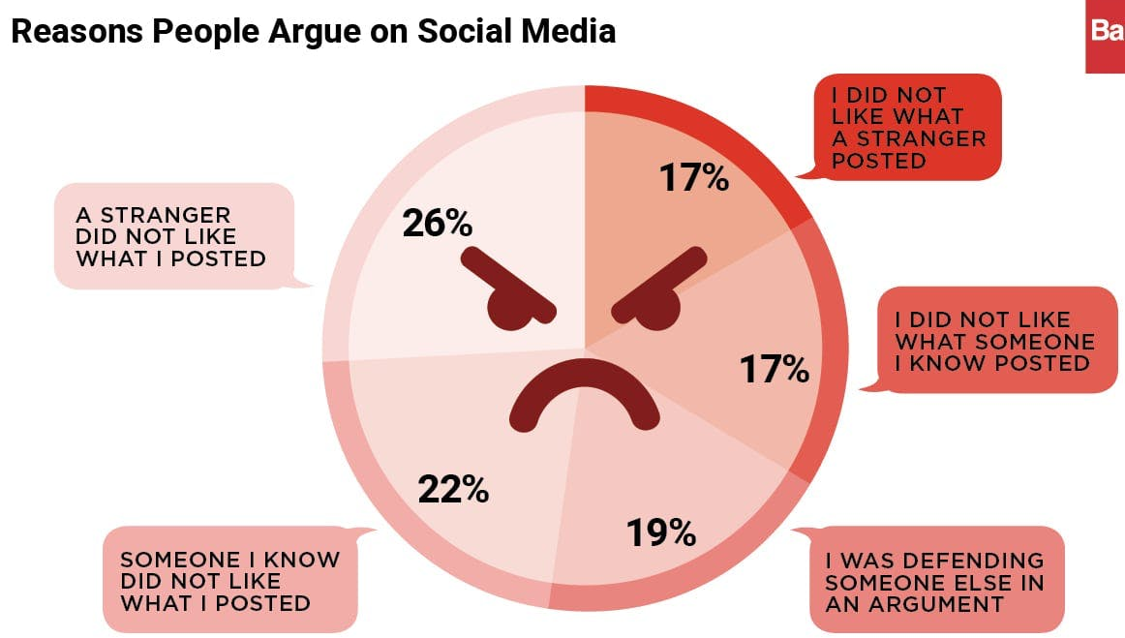
I have a voice…

Slide 10

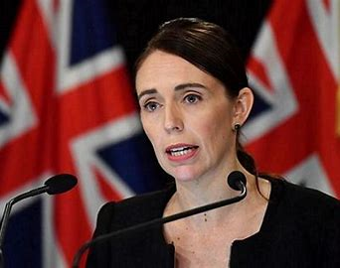
Power?

Slide 11
How to write a dystopian plot:
Dystopian stories are a reflection of present-day anxieties: Dystopian fiction can be a way to educate and warn humanity about the dangers of our own society’s social and political structures.
A strong point of view: Works in the dystopian genre may convey an author’s beliefs.
Imaginative worldbuilding: Dystopian stories require a greater suspension of disbelief and can be very imaginative.
Satire: Dystopian novels can also be satirical critiques. (This is an often-humorous way of poking fun at the powers that be. Sometimes, it is created with the goal to drive social change)
Themes of control and loss of individualism: Dystopian works often cover similar thematic ground. Typical dystopian themes include governmental or technological control and conformity at the expense of individualism.

Slide 12
Top Tips:
Settle on a central theme. The best dystopian writing explores a central theme while building out a dystopian world.
Consider the world around you. Dystopian works are effective and thought-provoking because they reflect elements of our own society.
Build a complex and detailed world. One of the most exciting aspects of science fiction and dystopian books is the opportunity to immerse yourself in a strange and unfamiliar world.

Slide 13

Your ideas…
Come up with at least three different ideas for stories you could use in your devised performance piece when we are back in September.
Write one out in full, as a story line, not a script.
Consider how you can use all the information and stimuli to create an interesting and current plot to use in drama.

