Slide 1
GCSE English Language
Grades 9 - 1

Slide 2
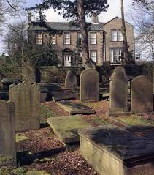
Starter
Write a short paragraph describing what you see in this picture.
What sort of feeling or atmosphere is created by it? Think about the different elements of the photo – what is in the foreground and background for example.

Slide 3
Learning Objectives
To use a range of techniques to make your descriptions of places vivid and memorable.
Convey atmosphere though the language you use.

Slide 4
Example description
You need to be precise when you describe settings or locations, but you also need to convey the ‘feeling’ or mood.
The house is of grey stone, two stories high, heavily roofed with flags, in order to resist the winds that might strip off a lighter covering. It appears to have been built about a hundred years ago, and to consist of four rooms on each story; the two windows on the right (as the visitor stands, with his back to the church, ready to enter in at the front door) belonging to Mr. Bronte’s study, the two on the left to the family sitting-room. Everything about the place tells of the most dainty order, the most exquisite cleanliness. The door-steps are spotless; the small old-fashioned window-panes glitter like looking-glass.
Inside and outside of that house cleanliness goes up into its essence, purity.

Slide 5
Example description
The house is of grey stone, two stories high, heavily roofed with flags, in order to resist the winds that might strip off a lighter covering. It appears to have been built about a hundred years ago, and to consist of four rooms on each story; the two windows on the right (as the visitor stands, with his back to the church, ready to enter in at the front door) belonging to Mr. Bronte’s study, the two on the left to the family sitting-room. Everything about the place tells of the most dainty order, the most exquisite cleanliness. The door-steps are spotless; the small old-fashioned window-panes glitter like looking-glass.
Inside and outside of that house cleanliness goes up into its essence, purity.
What precise ‘factual’ information does the writer provide in the paragraph?
What impression or ‘feel’ is given? What words or phrases tell us this?
How is the overall tone in this description different from the paragraph you wrote as a starter?

Slide 6
Task
Read the following alternative description of the parsonage based on the photo.
The parsonage is a gloomy/bright/lively place to grow up in. The echoey/polished/plush corridors seem never-ending, and the watchful/comfy/looming trees in the graveyard cast long/short/thin shadows on the earth, and the gravestones are covered/smothered/layered with moss and leaves.
Look at the words in black. Write this passage out, selecting the adjectives or verbs which convey a less pleasant or more threatening tone. After, write a sentence for each, explaining the effect of using that word.
E.g. Gloomy means dark and dull. This suggests a damp, shadowy place.

Slide 7

Apply the skill
Continue the description in a similar gloomy style.
For example, write one or two sentences describing the fireplace, a particular gravestone, or something else of your own choice.
Challenge: Include a simile and metaphor in your description.

Slide 8
Writing Task
Write a description based on one of the following images.

Slide 9
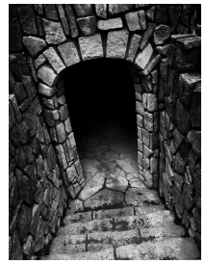

Slide 10
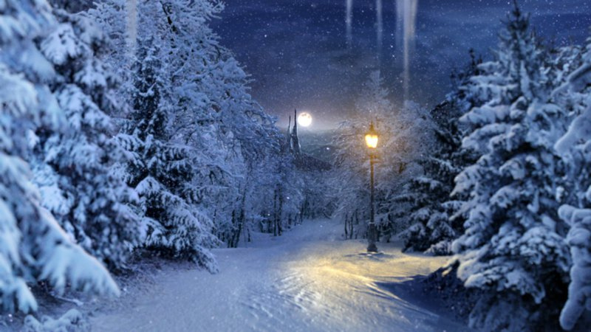

Slide 11
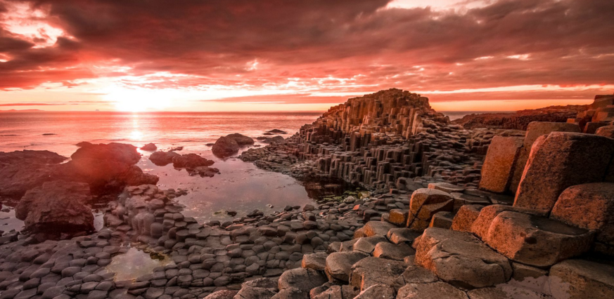

Slide 12
Self Assess
I can sustain a powerful range of ideas through my selection of imagery, figurative language and symbols.
Checklist of success:
Describe things precisely (for example, using numbers, size or scale).
Refer to the weather, if appropriate.
Use powerful and original imagery to create word pictures.
Use imagery and figurative language, where appropriate to enhance descriptions.
Consider sound, smell, texture, taste and sight.
I can describe settings using a wide range of vocabulary, and thoughtfully selected language features and imagery.
I can describe settings using appropriate vocabulary and language features, including imagery in places.
I can describe settings precisely and choose some vocabulary for effect.

Slide 13
Homework
Using the skills from last week and today’s lesson, write a paragraph describing your bedroom. (Half page A4.)

