Slide 1
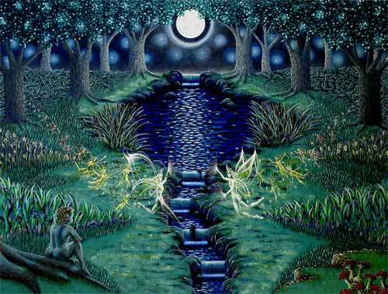
A Midsummer Night’s Dream
W.A.L.T:
Explore themes and characters within a Midsummer Night’s Dream.
Consider the following questions and discuss with your partner:
Would you let your parents choose your friends?
Would you marry someone to make your parents happy?
Should you marry for love or money?
If your friend told you in confidence that they were planning to run away would you tell or keep it a secret?
Should girls be able to ask boys out?

Slide 2
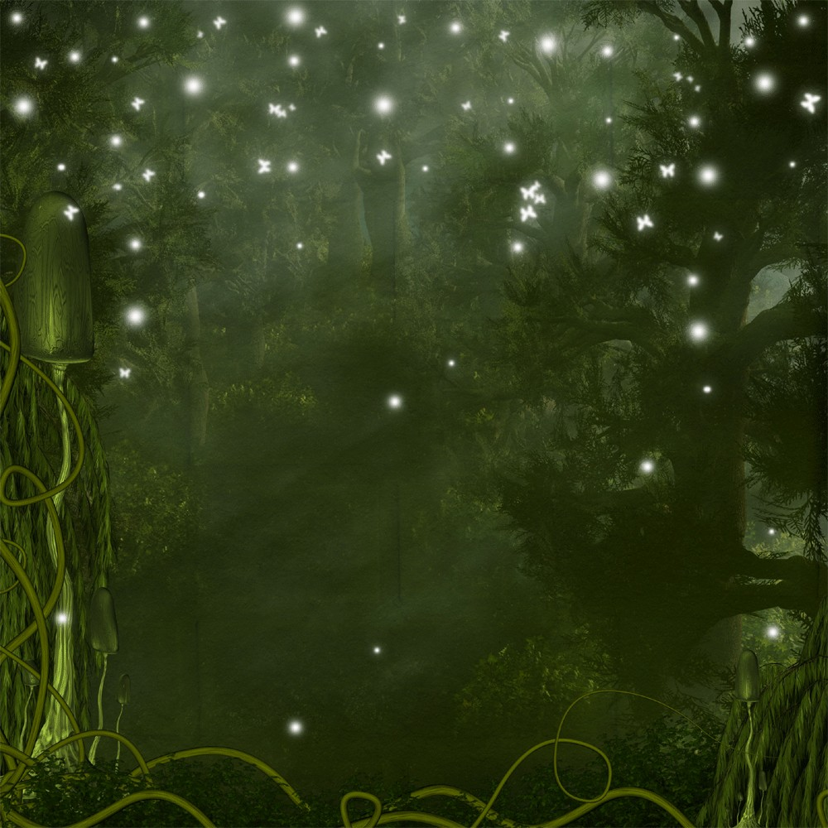
Must
Should
Could
I can explain how the characters should solve their problems.
I can analyse (say why and how) the behaviour of the characters and explain how they should solve their problems.
I can evaluate the characters’ behaviour and the different solutions to the characters’ problems.
I will use my knowledge and understanding of the characters in Act One Scene One to coach the characters.
Notes:
Students copy down Competentce and LO. Encourage students to attempt extension tasks.

Slide 3
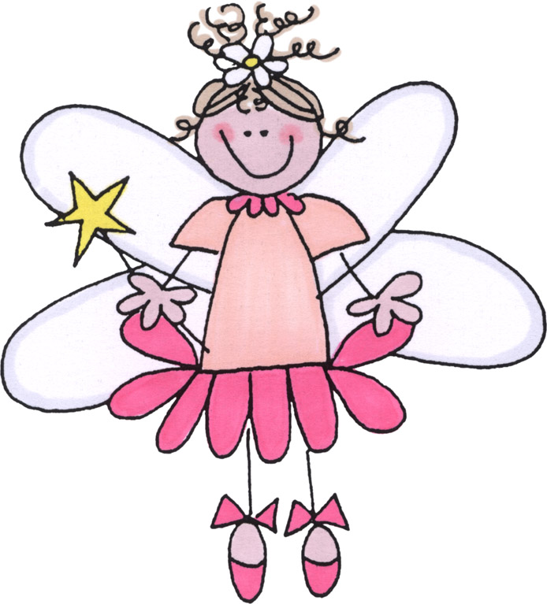
Shakespeare’s play A Midsummer Night’s Dream has fairies in it.
But they’re not like this….

Slide 4
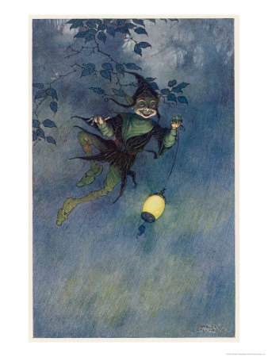
They’re more like this…
They are darker and more mysterious. They aren’t always “good fairies” either. Some of them think of humans as stupid creatures and like to play tricks on them.
Several tricks are played on humans by fairies in A Midsummer Night’s Dream.

Slide 5
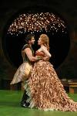


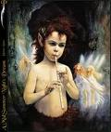
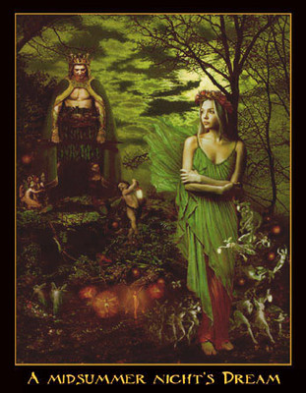
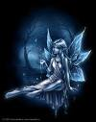


What words or thoughts spring to mind when you look at these images?
LO:
An introduction to themes within a Midsummer Night’s Dream and to watch The Animated Tales for a plot overview.

Slide 6
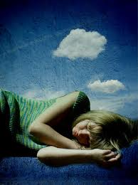
LO:
An introduction to themes within a Midsummer Night’s Dream and to watch The Animated Tales for a plot overview.
In your exercise book, write down a dream that you remember.
Give some detail
Is it a reoccurring dream?
Have you ever had it before?
Why do you think you remembered it?

Slide 7
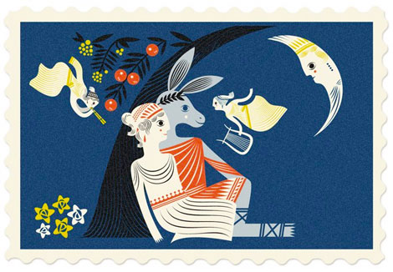
Can you make a prediction about what A Midsummer Night’s Dream may be about?
LO:
An introduction to themes within a Midsummer Night’s Dream and to watch The Animated Tales for a plot overview.

Slide 8
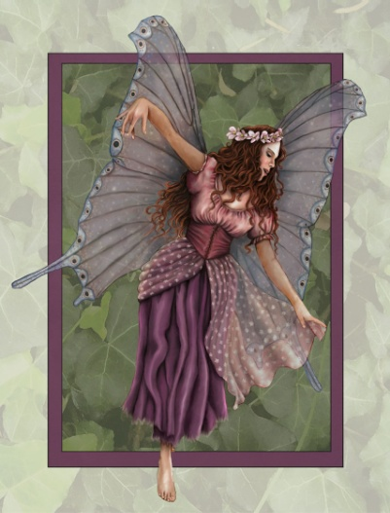
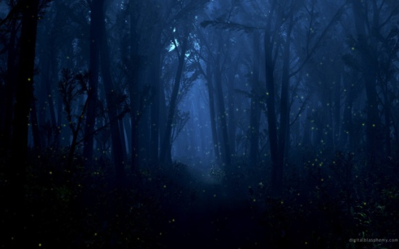
Look at the A3 sheet on your table.
Fill the sheet with as many words as you can that you associate with the words and images on the sheet.
midsummer
unrealistic
dream
night
spooky
I will use my knowledge and understanding of the characters in Act One Scene One to coach the characters.
Notes:
Students copy down Competentce and LO. Encourage students to attempt extension tasks.

Slide 9


midsummer
dream
night

Slide 10
A Midsummer Night’s Dream
Midsummer night is the night before the 24th June and in Shakespeare’s day it was always celebrated with festivals, dances, pageants and general merry making!
I will use my knowledge and understanding of the characters in Act One Scene One to coach the characters.
Notes:
Students copy down Competentce and LO. Encourage students to attempt extension tasks.

Slide 11
A Midsummer Night’s Dream
The characters in the pageants were fairies, goblins, witches and devils who could cast spells, change people into birds or animals and do all kinds of other extraordinary things.
I will use my knowledge and understanding of the characters in Act One Scene One to coach the characters.
Notes:
Students copy down Competentce and LO. Encourage students to attempt extension tasks.

Slide 12
A Midsummer Night’s Dream
Shakespeare followed the custom of his day by setting the play in a fairy world.
Most people at the time believed in witchcraft and the supernatural.
I will use my knowledge and understanding of the characters in Act One Scene One to coach the characters.
Notes:
Students copy down Competentce and LO. Encourage students to attempt extension tasks.

Slide 13
An Enchanted Wood
The play takes place in a wood near the city of Athens in Greece. It is unlikely that Shakespeare ever went to Athens himself but he will have studied Greek and Roman history at school.
I will use my knowledge and understanding of the characters in Act One Scene One to coach the characters.
Notes:
Students copy down Competentce and LO. Encourage students to attempt extension tasks.

Slide 14



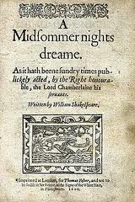
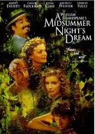
W.A.L.T: explore the characters in A Midsummer Night’s Dream.
Create a separate spider diagram for each of the following words:
Midsummer;
Night;
Dream.
What do each of these words mean to you?
Add your suggestions around each word.

Slide 15
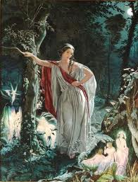
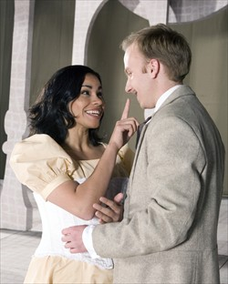
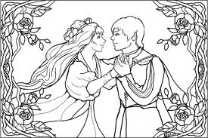
Hermia
She is a beautiful young woman! She is in love with Lysander and is willing to disobey her father and run away with him.

Slide 16
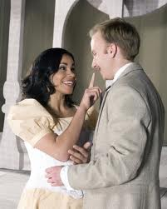
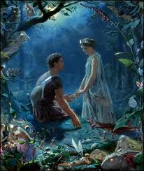
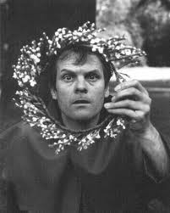
Lysander
A young man of Athens. He is a romantic – and very much in love with Hermia. They run off together!

Slide 17
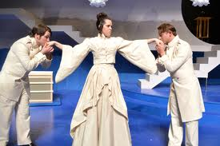
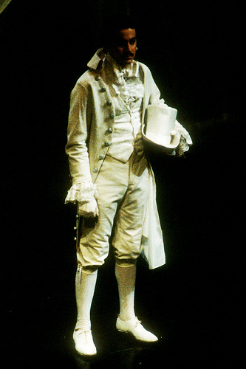
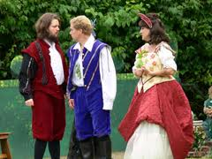
Demetrius
A young man – also in love with Hermia. He is engaged to her. He is angry with Lysander for trying to steal her!

Slide 18
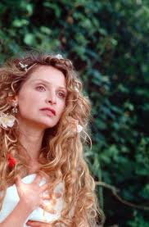
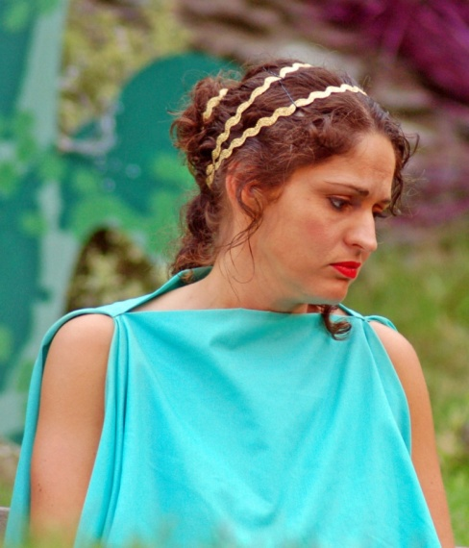
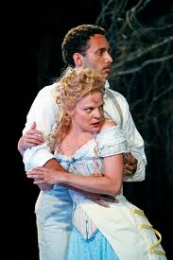
Helena
She is Hermia’s good friend. She lacks confidence about her looks and doesn’t think she can compare to Hermia. She is in love with Demetrius!

Slide 19
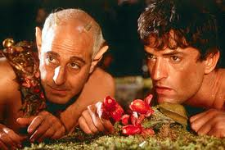
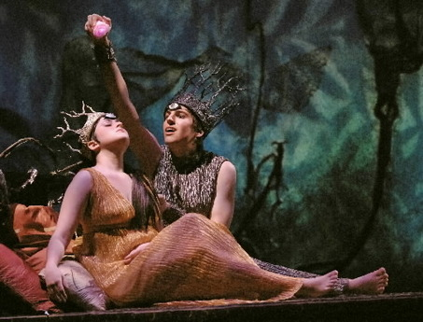
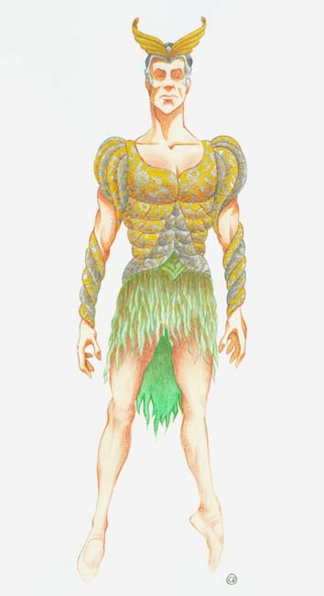
Oberon
He is the King of the Fairies – married to Titania. He is a powerful fairy, who is used to being obeyed.

Slide 20
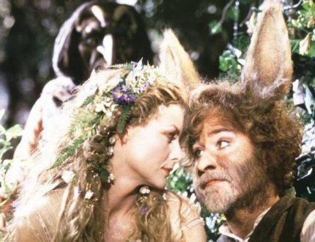
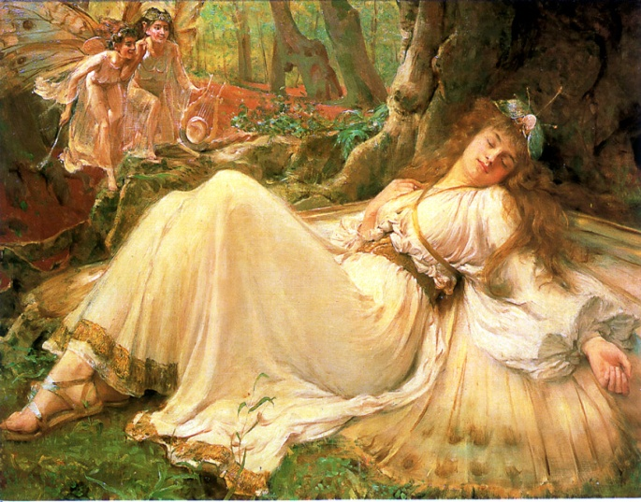
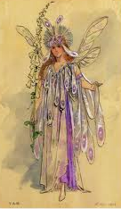
Titania
She is the beautiful Queen of the Fairies (married to Oberon).
She is strong and independent. Oberon and Puck trick her into loving Bottom with the love potion.

Slide 21
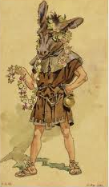
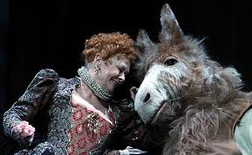
Bottom
He is one of The Mechanicals. He is part of the company producing a play for Duke Theseus’ wedding. He is an over-confident fool!
Puck plays a trick on him and gives him the head of an ass! Titania then falls in love with him for a short while!

Slide 22
Getting to know the characters: basic information
Unscramble the Character Jumble to complete the character sheet.
You must develop a knowledge and understanding of the characters and their problems.
Extension: If you have identified all the characters, add arrows and labels to your sheet that show the relationships between the characters (e.g. who loves who, who is married to who…)
I will use my knowledge and understanding of the characters in Act One Scene One to coach the characters.
Notes:
Students copy down Competentce and LO. Encourage students to attempt extension tasks.

Slide 23
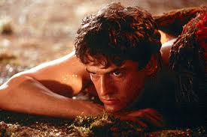
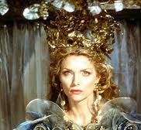
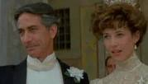
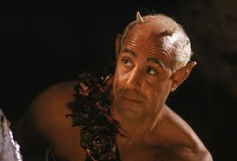
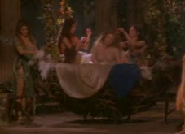
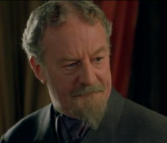
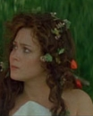
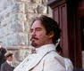
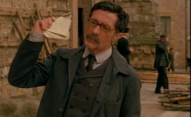

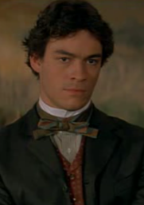
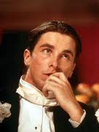
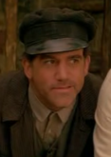
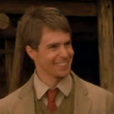
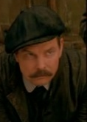
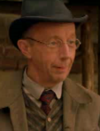
A Midsummer Night’s Dream: The Characters
enboor
naittia
hsutees
pihlytaoo
The Fairies
The Athenians
oesbpmsolsae, obecwb, eesusdrdmta
and oetm
cupk
eugse
mtobto
cnuqie
leehan
meihar
The Mechanicals
erydnlsa
smeidtiu
gnsu
elftu
tnuso
etlgsnairlv

Slide 24
A Midsummer Night’s Dream: The Characters
Oberon
Titania
Theseus
Hippolyta
The Fairies
The Athenians
Peaseblossom, Cobweb, Mustardseed and Mote
Puck
Egeus
Bottom
Quince
Helena
Hermia
The Mechanicals
Lysander
Demetrius
Snug
Flute
Snout
Starvelling

Slide 25
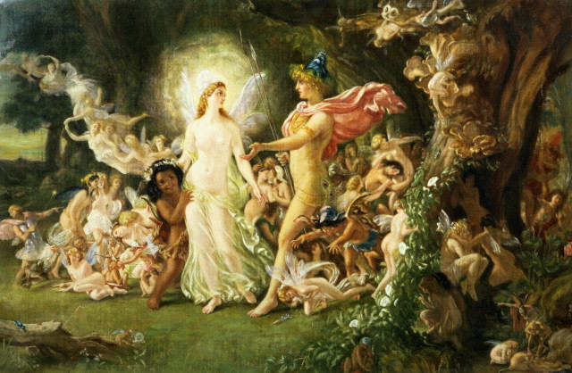
Summary
The play revolves around the adventures of four young lovers, a group of amateur actors and their interactions with the fairies who inhabit a moonlit forest.
LO:
An introduction to themes within a Midsummer Night’s Dream and to watch The Animated Tales for a plot overview.

Slide 26

Summary
The story takes place in Midsummer and is a complex joke featuring Hermia & Lysander and Helena & Demetrius.
LO:
An introduction to themes within a Midsummer Night’s Dream and to watch The Animated Tales for a plot overview.

Slide 27

Summary
Their romantic trickeries are confused and complicated still further by entering the forest where Oberon, the King of the Fairies and his Queen, Titania, live.
LO:
An introduction to themes within a Midsummer Night’s Dream and to watch The Animated Tales for a plot overview.

Slide 28

Summary
Puck is a major character who is full of mischief and tricks.

Slide 29

Summary
Other visitors to the enchanted forest include Bottom the weaver and his friends Snug, Snout, Quince and Flute, the amateur dramatists who want to rehearse their terrible but hilarious version of the play ‘Pyramus and Thisbe’.
LO:
An introduction to themes within a Midsummer Night’s Dream and to watch The Animated Tales for a plot overview.

Slide 30
Class Tasks:
Watch film extract of Act One Scene One.
I will use my knowledge and understanding of the characters in Act One Scene One to coach the characters.

Slide 31
http://www.youtube.com/user/shakespeareanimated?gl=GB&hl=en-GB#p/search/1/eCZndWMALOo
http://www.youtube.com/watch?v=FjHklvgLaN4
LO:
An introduction to themes within a Midsummer Night’s Dream and to watch The Animated Tales for a plot overview.

Slide 32


I am madly in love with Demetrius but he only has eyes for my best friend. I love Demetrius too much to be angry with him. Should I be angry with Hermia?
I am madly in love with Hermia but her father will only let her marry Demetrius. What can I do?
I love Lysander but my father says I must marry Demetrius. Should I abandon my heart and obey my father? Or follow my heart and choose a nunnery or death?
My daughter is disobeying me and won’t follow my wishes. I don’t want to lose her but I can’t let her disobey me like this!
Notes:
Students copy down Competence and LO. Encourage students to attempt extension tasks.

Slide 33
Imagine that you are an agony aunt and one of the characters has written to you asking for advice.
Notes:
Students copy down Competentce and LO. Encourage students to attempt extension tasks.

Slide 34
I am looking forward to hearing from you
Dear Tom,
I will not be able to attend the...
Why don’t you... ?
Best Wishes
idioms
slang
It would be great if...
Yours faithfully
Give my regards to...
Dear Mr Smithers,
I reckon it would be best to...
Contractions – e.g. “we’ve” or “I’m “
I am very grateful for
I am sorry to inform you that...
The statements above apply to formal and informal letters. Draw the table below in your book and sort the boxes above into the correct column.
Informal Letters | Formal Letters
I will use my knowledge and understanding of the characters in Act One Scene One to coach the characters.
Notes:
Students copy down Competentce and LO. Encourage students to attempt extension tasks.

Slide 35
Write a letter advising them what they should do in their situation.
Remember:
To lay it out like a letter
To have a friendly tone
Not to persuade – just offer impartial, helpful advice!
I will use my knowledge and understanding of the characters in Act One Scene One to coach the characters.
Notes:
Students copy down Competentce and LO. Encourage students to attempt extension tasks.

Slide 36
The letter will be marked on the following AF’s:
AF2 – produce writing that is appropriate to task, reader and purpose.
AF4 – construct paragraphs
AF7 – select appropriate and effect vocabulary
I will use my knowledge and understanding of the characters in Act One Scene One to coach the characters.
Notes:
Students copy down Competentce and LO. Encourage students to attempt extension tasks.

Slide 37
Four groups will act out four scenes from Midsummer that illustrate the relationships between the four lovers (Lysander, Demetrius, Helena, and Hermia). You will act out lines from the play at four different points and mini-sculpt the relationship between the four lovers.
LO:
An introduction to themes within a Midsummer Night’s Dream and to watch The Animated Tales for a plot overview.

Slide 38
Once you have read their lines, another student will have the opportunity to sculpt the tableau of the lover's relationship. After all groups have gone (the mini-sculptures will remain in front of the class the entire time), tell the story of the lovers' plight in your own words.
I will use my knowledge and understanding of the characters in Act One Scene One to coach the characters.

Slide 39
http://www.youtube.com/user/shakespeareanimated?gl=GB&hl=en-GB#p/search/1/eCZndWMALOo
http://www.youtube.com/watch?v=FjHklvgLaN4
LO:
An introduction to themes within a Midsummer Night’s Dream and to watch The Animated Tales for a plot overview.

Slide 40
Date
Bad Leaders
LO: I will evaluate the leadership of a variety of characters.
Starter: Using no more than 50 words, explain what has happened in the story so far.
Notes:
Students copy down Competentce and LO. Encourage students to attempt extension tasks.

Slide 41
Must
Should
Could
I can state my opinion about the leadership qualities of the characters.
I can participate in a group speaking and listening activity.
I can explain my opinion about the leadership qualities of the characters and give examples.
I can take a variety of roles in my group.
I can evaluate, compare and contrast the leadership qualities of the characters using examples.
I feel confident in taking a variety of roles in my group.
I will evaluate the leadership of a variety of characters.
Notes:
Students copy down Competentce and LO. Encourage students to attempt extension tasks.

Slide 42
Sum up what you know so far about the play in exactly sixty words! You must include the names of all the characters.
I will evaluate the leadership of a variety of characters.
Notes:
Students copy down Competentce and LO. Encourage students to attempt extension tasks.

Slide 43

Explain everything you know about the story so far. You must use exactly sixty words. Fill each box with one word. You must use all of the boxes. You can use the same word twice!

Slide 44
So far you have met the Athenian noble characters.
This lesson, you will get to know The Mechanicals and The Fairies.
I will evaluate the leadership of a variety of characters.
Notes:
Students copy down Competentce and LO. Encourage students to attempt extension tasks.

Slide 45
The Mechanicals
“The Mechanicals” are a group of skilled manual workers who try their hand at acting. He is likely to have encountered these types of people when he was growing up in Stratford.
I will evaluate the leadership of a variety of characters.
Notes:
Students copy down Competentce and LO. Encourage students to attempt extension tasks.

Slide 46
All over Athens, events are being planned to celebrate the Duke’s wedding. The Mechanicals represent the ordinary folk in Athens. They decide to try out acting and to write a play about the tragedy of two lovers.
I will evaluate the leadership of a variety of characters.
Notes:
Students copy down Competentce and LO. Encourage students to attempt extension tasks.

Slide 47
http://www.youtube.com/user/shakespeareanimated?gl=GB&hl=en-GB#p/search/1/eCZndWMALOo
http://www.youtube.com/watch?v=FjHklvgLaN4
LO:
An introduction to themes within a Midsummer Night’s Dream and to watch The Animated Tales for a plot overview.

Slide 48
The Mechanicals
Peter Quince – A Carpenter (wood)
Snug – A joiner (wood – no nails)
Nick Bottom – A Weaver (fabirc)
Francis Flute – A bellows mender
Tom Snout – A tinker (metal)
Robin Starvelling – A tailor (clothes)
What do you notice about their names? Compare them to the names of the other characters.
The Mechanicals represent normal people in society.
The Mechanicals were designed to provide a lot of comedy in the play, they were traditionally played by clowns, see if you can work out why…
Class Activities:
Watch extract about The Mechanicals.
Class Discussion
I will evaluate the leadership of a variety of characters.
Notes:
This is a meant to be a very funny scene! Quince is terrible at organising the rehearsal and it keeps getting hi-jacked by Bottom who wants to play every part. Discuss with students.

Slide 49
Questions:
Who acts as the leader in the rehearsal?
Evaluate the effectiveness of Quince’s leadership. What makes him a good or bad leader?
Which character is the biggest threat to Quince’s leadership. Explain your answer.
Notes:
Quince is the leader/
Quince shows leadership when he gives out the different parts. He is not an effective leader, however, because he lets Bottom interrupt him all the time.
Bottom is the biggest threat because he believes he can play every part!

Slide 50
The Fairies
The fairies have the most power in the play. However, that does not always mean that they make good leaders.
Read “Act Two” from Graphic Shakespeare.
I will evaluate the leadership of a variety of characters.
Notes:
Students copy down Competentce and LO. Encourage students to attempt extension tasks.

Slide 51
Questions:
Are Titania and Oberon good leaders?
What has happened as a consequence of their bad leadership?
I will evaluate the leadership of a variety of characters.
Notes:
Students copy down Competentce and LO. Encourage students to attempt extension tasks.

Slide 52
As you’ve probably gathered there is a lot going wrong in Athens at the moment…
The Mechanicals rehearsal is a disaster
Nature is upside down because Titania and Oberon won’t stop fighting
The lovers are mismatched and lost in the wood
I will evaluate the leadership of a variety of characters.
Notes:
Students copy down Competentce and LO. Encourage students to attempt extension tasks.

Slide 53

In your groups you must stage a Jeremy Kyle Show with one of the following titles:
My ex-boyfriend fell in love with my best friend!
My dad is forcing me to marry
My husband won’t give me custody of our adopted child
My actors won’t follow instructions
Performance Time!
I will evaluate the leadership of a variety of characters.
Notes:
Students copy down Competentce and LO. Encourage students to attempt extension tasks.

Slide 54
Must
Should
Could
I can state my opinion about the leadership qualities of the characters.
I can participate in a group speaking and listening activity.
I can explain my opinion about the leadership qualities of the characters and give examples.
I can take a variety of roles in my group.
I can evaluate, compare and contrast the leadership qualities of the characters with examples.
I can feel confident in taking a variety of roles in my group.
WWW: I am a _________ learner because I can ______________.
I have met my lesson objective by _________________.
EBI: I developed my competence in positive motivation further by __________________. Next lesson, I am looking forward to_____.
I will evaluate the leadership of a variety of characters.
Notes:
Students copy down Competentce and LO. Encourage students to attempt extension tasks.

Slide 55
Show Schedule:
Jeremy Kyle introduces your main character and asks them to explain their problem.
Jeremy Kyle introduces other characters one by one who give their opinion on the problem.
Jeremy Kyle comes up with a solution and asks each character whether they agree with it.
Jeremy Kyle ends the show with a lasting thought.
Step One: Decide which title to pick:
______________________________
Level 4: convey straightforward ideas about characters and situations, making deliberate choices of speech, gesture,
and movement in different roles and scenarios
Level 5: show insight into texts and issues through deliberate choices of speech gesture, and movement, beginning to sustain and adapt different roles
and scenarios
Step Two: Decide who will play who:
Name | Character
Jeremy Kyle
Level 6: demonstrate empathy and understanding through flexible choices of speech, gesture, and movement, adapting roles convincingly to explore ideas and
issues
Level 7:explore complex ideas and issues through insightful choice of speech, gesture, and movement, establishing roles and applying dramatic approaches with confidence

Slide 56


Play Dough
Bring the story to life!

Slide 57
The Athenians
Theseus, Duke of Athens
Hippolyta, Queen of the Amazons and betrothed of Theseus
Egeus, father of Hermia, forces Hermia to marry Demetrius
Lysander, in love with Hermia and Helena at different times of the play.
Helena, in love with Demetrius
Demetrius, in love with Hermia and Helena at different times of the play.
Hermia, in love with Lysander
Philostrate, Master of the Revels for Theseus

Slide 58
The Supernatural Characters
Oberon, King of the Fairies
Titania, Queen of the Fairies
Puck, a.k.a. Robin Goodfellow, servant to Oberon
Titania's fairy servants (her "train")(Wait on Bottom):
Peaseblossom, fairy
Cobweb, fairy
Moth, fairy
Mustardseed, fairy

Slide 59
The Actors (also called The Mechanicals)
Peter Quince, carpenter, who leads the troupe.
Nick Bottom, weaver; Bottom is turned into a donkey and is loved by Titania, he plays Pyramus in the troupe's production of "Pyramus and Thisbe".
Francis Flute, the bellows-mender who plays Thisbe.
Robin Starveling, the tailor who plays Moonshine.
Tom Snout, the tinker who plays Wall.
Snug, the joiner who plays a Lion.

Slide 60
Date
Bad Leaders
LO: I will evaluate the leadership of a variety of characters.
LO: I will develop my own competence in leadership and coaching in a group speaking and listening activity.
Extension: Using no more than 50 words, explain what has happened in the story so far.
Notes:
Students copy down Competentce and LO. Encourage students to attempt extension tasks.

Slide 61
Must
Should
Could
I can use my competence in leadership to explain how I would direct the scene if I was in charge.
I can apply my understanding of the scene, and my competence in leadership, to explain how I would direct the scene if I was in charge.
I can evaluate, compare and contrast, different ways that you could direct the scene.
I will use my competence in leadership to explain how I would direct Act Three Scene Two.
Notes:
Students copy down Competentce and LO. Encourage students to attempt extension tasks.

Slide 62
Class Reading
I will use my competence in leadership to explain how I would direct Act Three Scene Two.
Notes:
Students copy down Competentce and LO. Encourage students to attempt extension tasks.

Slide 63
For each of the lovers, pick out a key quote that expresses their emotion. Highlight these on your sheet and label them.
I will use my competence in leadership to explain how I would direct Act Three Scene Two.
Notes:
Students copy down Competentce and LO. Encourage students to attempt extension tasks.

Slide 64
As the director, it would be your job to instruct the actors on the following things:
Facial expression
Tone of voice, including volume and pauses
Body language/gestures
Props
Position on stage
Lighting and sound
I will use my competence in leadership to explain how I would direct Act Three Scene Two.
Notes:
Students copy down Competentce and LO. Encourage students to attempt extension tasks.

Slide 65
Fill in the table explaining what your instructions would be for each of the lines the actor has to say.
I will use my competence in leadership to explain how I would direct Act Three Scene Two.
Notes:
Students copy down Competentce and LO. Encourage students to attempt extension tasks.

Slide 66
Use your table as a plan for your reading assessment.
Title: How I would direct Act 3 Scene 2
Paragraph One: Introduction – A brief description of the scene.
Paragraph Two: Hermia.
Paragraph Three: Helena.
Paragraph Four: Lysander.
Paragraph Five: Demetrius.
Paragraph Six: Conclusion
Teacher Note: Produce support sheet. Sentence starters, example paragraph etc.
I will use my competence in leadership to explain how I would direct Act Three Scene Two.
Notes:
Students copy down Competentce and LO. Encourage students to attempt extension tasks.

Slide 67
Must
Should
Could
I can use my competence in leadership to explain how I would direct the scene if I was in charge.
I can apply my understanding of the scene, and my competence in leadership, to explain how I would direct the scene if I was in charge.
I can evaluate, compare and contrast, different ways that you could direct the scene.
WWW: I am a _________ learner because I can ______________.
I have met my lesson objective by _________________.
EBI: I developed my competence in positive motivation further by __________________. Next lesson, I am looking forward to_____.
I will use my competence in leadership to explain how I would direct Act Three Scene Two.
Notes:
Students copy down Competentce and LO. Encourage students to attempt extension tasks.

Slide 68
Character | Emotion | Quotation | Facial Expression | Tone of voice, volume and pauses | Props | Position on Stage | Lighting and Sound
Hermia
Helena
Demetrius
Lysander
Notes:
Reproduce on A3

Slide 69
Date
The Athen’s Chronicle
LO: I will demonstrate my competence in coaching and leadership by working as a group to create The Athens Chronicle.
Extension Task: What would be the headline story for The Athens Chronicle?
Notes:
Students copy down Competentce and LO. Encourage students to attempt extension tasks.

Slide 70
Must
Should
Could
I can show some demonstration of leadership and coaching in a group task.
I can confidently demonstrate leadership and coaching in a group task and reflect on my competence development.
I can demonstrate my competence in leadership and coaching in a variety of ways and evaluate my competence development.
I will demonstrate my competence in coaching and leadership by working as a group to create The Athens Chronicle.
Notes:
Students copy down Competentce and LO. Encourage students to attempt extension tasks.

Slide 71
In today’s task, each table will work as a team to produce an edition of The Athens Chronicle. You must each produce one article for the newspaper. You must decide as a team what the articles will be about. All of the articles must be about the recent events in Athens as performed in Shakespeare’s play.. Below are some examples you may want to use:
Main story: The Royal Wedding
Main story: Strange Events in the Weather
Main story: Egeus’s complaint to Theseus
A gossip column about the lovers
A gossip column about Bottom and Titania
Agony Aunt Page
A review of Pyramus and Thisbe
Bottom’s guide to acting
I will demonstrate my competence in coaching and leadership by working as a group to create The Athens Chronicle.
Notes:
Students copy down Competentce and LO. Encourage students to attempt extension tasks.

Slide 72
Must
Should
Could
I can use my competence in leadership to explain how I would direct the scene if I was in charge.
I can apply my understanding of the scene, and my competence in leadership, to explain how I would direct the scene if I was in charge.
I can evaluate, compare and contrast, different ways that you could direct the scene.
WWW: I am a _________ learner because I can ______________.
I have met my lesson objective by _________________.
EBI: I developed my competence in positive motivation further by __________________. Next lesson, I am looking forward to_____.
I will demonstrate my competence in coaching and leadership by working as a group to create The Athens Chronicle.
Notes:
Students copy down Competentce and LO. Encourage students to attempt extension tasks.

Slide 73
Notes:
An example

Slide 74
Date
The Athen’s Chronicle
LO: I will use my competence in positive motivation to understand why A Midsummer Night’s Dream is relevant to an audience in 2011.
Extension Task: How would the story of A Midsummer Night’s Dream be different if it was told now?
Notes:
Students copy down Competentce and LO. Encourage students to attempt extension tasks.

Slide 75
Must
Should
Could
Students will be able to identify ways in which studying Shakespeare can be fun and relevant.
Students will be able to explain why studying Shakespeare can be fun and relevant.
Students will be able to evaluate the extent to which studying Shakespeare is relevant.
I will use my competence in positive motivation to understand why A Midsummer Night’s Dream is relevant to an audience in 2011.
Notes:
Students copy down Competentce and LO. Encourage students to attempt extension tasks.

Slide 76
There are plenty of reasons why A Midsummer Night’s Dream has nothing to do with our lives in 2011!
Women are allowed on stage now!
Fairies don’t exist!
I will use my competence in positive motivation to understand why A Midsummer Night’s Dream is relevant to an audience in 2011.
Notes:
Students copy down Competentce and LO. Encourage students to attempt extension tasks.

Slide 77
However, there are also plenty of parallels to our lives now. It also makes us think about things that are still relevant to our lives today.
A Midsummer Night’s Dream in 2011
I will use my competence in positive motivation to understand why A Midsummer Night’s Dream is relevant to an audience in 2011.
Notes:
Students copy down Competentce and LO. Encourage students to attempt extension tasks.

Slide 78
Let’s read a modern day version together.
Identify the parallels.
I will use my competence in positive motivation to understand why A Midsummer Night’s Dream is relevant to an audience in 2011.
Notes:
Students copy down Competentce and LO. Encourage students to attempt extension tasks.

Slide 79
Today your task is to produce a teaching and learning activity that would be appropriate for Year 6 students.
The activity should coach younger people. It should teach them about A Midsummer Night’s Dream and why it is still relevant to us today.
A modern day story
A board game based on the play
A quiz
I will use my competence in positive motivation to understand why A Midsummer Night’s Dream is relevant to an audience in 2011.
Notes:
Students copy down Competentce and LO. Encourage students to attempt extension tasks.

Slide 80
Let’s return to Lesson One and your originally ideas about Shakespeare.
I will use my competence in positive motivation to understand why A Midsummer Night’s Dream is relevant to an audience in 2011.
Notes:
Students copy down Competentce and LO. Encourage students to attempt extension tasks.

Slide 81
Must
Should
Could
Students will be able to identify ways in which studying Shakespeare can be fun and relevant.
Students will be able to explain why studying Shakespeare can be fun and relevant.
Students will be able to evaluate the extent to which studying Shakespeare is relevant.
WWW: I am a _________ learner because I can ______________.
I have met my lesson objective by _________________.
EBI: I developed my competence in positive motivation further by __________________. Next lesson, I am looking forward to_____.
I will use my competence in positive motivation to understand why A Midsummer Night’s Dream is relevant to an audience in 2011.
Notes:
Students copy down Competentce and LO. Encourage students to attempt extension tasks.

Slide 82
Spring 2011: The royal wedding of Prince William and Kate Middleton approaches. Across the UK, and, indeed, the globe, people are preparing for the celebrations.
For four young teenagers in London, however, all is not well. Shakespare once wrote, “The course of true love never did run smooth” and he was certainly right! A few months ago Helen had noticed a young man called Jamie. She really fancied him, they flirted all the time at school and would often talk all evening on Facebook chat. Things were going well until Helen introduced Jamie to her friend Gemma. Jamie fell head over heels for Gemma! Gemma’s dad, Mr Egeus, was one of the teachers at school; as an A* student he liked Jamie a lot. Mr Egeus heard that Jamie had a soft spot for Gemma and was very pleased. So pleased in fact, that he banned Gemma from going out with anyone apart from Jamie. Helen was devestated; it looked like Gemma and Jamie would be getting together.
As it turned out, though, Gemma didn’t like Jamie that much
Teacher Note: Finish modern retelling!

