Slide 1
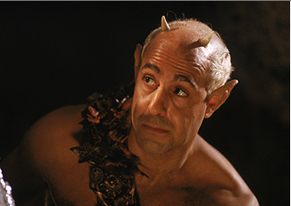
In the forest outside Athens, a fairy meets with Robin Goodfellow. They discuss the conflict between Oberon, king of the fairies, and Titania, the queen of the fairies, about which of them should get to keep a beautiful Indian changeling boy as their attendant. The boy's mother was a worshipper of Titania's, and died giving birth to him. She raises him for her sake.
Look at the quote and the translation on the next slide. Answer the questions.

Slide 2
Modern translation
“The king’s having a party here tonight. Just make sure the queen doesn’t come anywhere near him, because King Oberon is extremely angry. He’s furious because she stole an adorable boy from an Indian king. She’s never kidnapped such a darling human child before, and Oberon’s jealous. He wants the child for himself, to accompany him on his wanderings through the wild forests. But the queen refuses to hand the boy over to Oberon. Instead, she puts flowers in the boy’s hair and makes a fuss over him.”
Shakespeare’s language
“The king doth keep his revels here tonight.
Take heed the queen come not within his sight.
For Oberon is passing fell and wrath
Because that she, as her attendant hath
A lovely boy stolen from an Indian king.
She never had so sweet a changeling.
And jealous Oberon would have the child
Knight of his train, to trace the forests wild.
But she perforce withholds the lovèd boy,
Crowns him with flowers, and makes him all her joy.”
What impression are we given of the relationship between Titania and Oberon during this exchange between the fairies?
This discussion is taking place before we meet the characters, how does this affect our view of them?

Slide 3
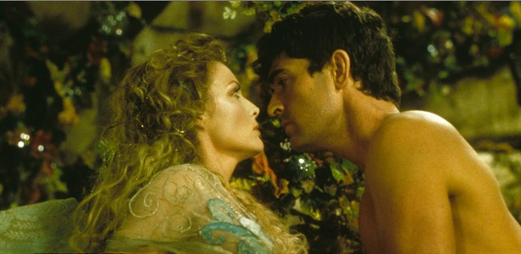
“Ill met by moonlight, proud Titania!”
What do you think is the significance of the word ‘proud’ – how does this fit with the gender
hierarchy?
It is important to note that Titania humiliates Oberon here by emasculating him by declaring
she will not share his bed or talk to him.
How does this differ from the social order of this time?

Slide 4
In a few sentences - Describe the mood and tone as Oberon and Titania are introduced to the audience. Use the quotes below to help you.
“Tarry, Rash wanton! Am not I thy Lord?”
“What, jealous Oberon? Fairies, skip hence.
I have foresworn his bed and company.”
Translation - “Wait just a minute, you brazen hussy. Aren’t you supposed to obey me, your lord and husband?”
Translation - “What, are you jealous, Oberon?—Fairies, let’s get out of here. I’ve sworn I’ll never sleep with him or talk to him again.”

