Slide 1

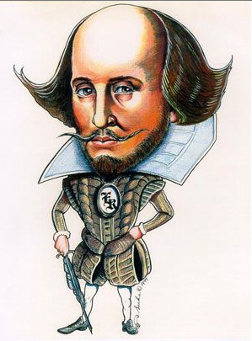
Shakespeare in Production
Learning Objectives
CORE: Identify the distinctive features of the theater experience during Shakespeare’s time, including the structural features of the theater itself, the actors’ performance, and the audience.
CHALLENGE: To make thoughtful comment on social factors that influence theatre production in the Elizabethan era.

Slide 2
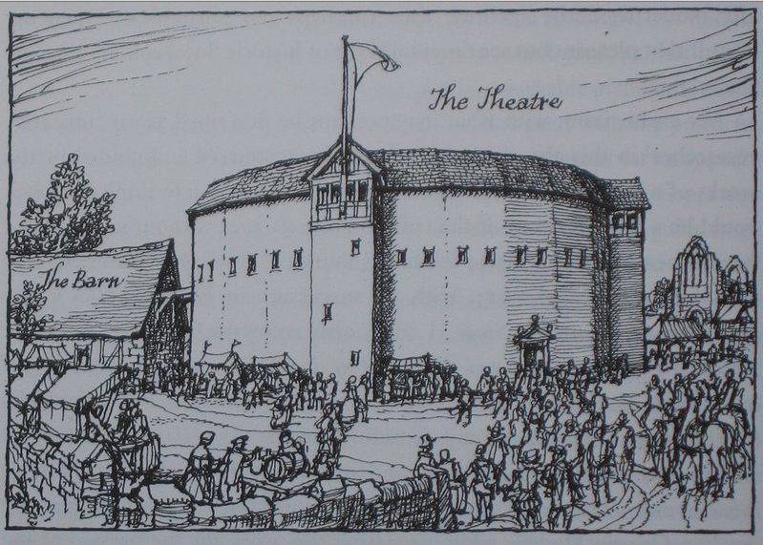
Build an Elizabethan Theatre!
Your group has been enlisted by a wealthy patron to build a theatre. The year is 1599:
🎭 Who will help you?
🎭 What will it look like? Layout inside? Exterior appearance?
🎭 What do you need?
🎭 Where will you build? Why?
🎭 When will it be ready?
🎭 Why are you building it? What is its purpose?
🎭 How many patrons could you welcome to your theatre?
🎭 How might the process be difficult compared to building a theatre today?
🎭 What will it be called?
Notes:
Students to draw up their design of interior and exterior with annotations to show thoughtful consideration of the questions. This should be drawn up on A3 or sugar paper and be ready for presentation to the class with justification for their choices.

Slide 3
Introducing…
Notes:
Students should present their builds and explain their choices to the class – each presentation should last a few minutes.

Slide 4
There is little evidence about when and where A Midsummer Night’s Dream was originally performed. Shakespeare’s plays were originally performed at The Theatre, an open-air playhouse in Shoreditch, London. After a dispute with the landlord, the theatre was dismantled and the timber used in the construction of the Globe.

Slide 5
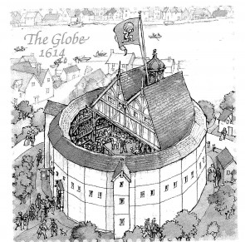

Slide 6
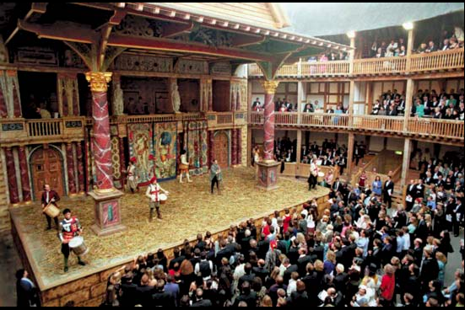
Fat Questions!
🎭 What do you notice about the building, the staging and the audience?
🎭How is it different from other theatres you may have attended?
🎭How might the audience experience differ?
Your responses should be no fewer than 15 words!
Notes:
Encourage students to think about the theatre being open air and the duration of performances.
http://www.shakespearesglobe.com/about-us/virtual-tour

Slide 7
The Globe Theatre
Visiting The Globe
Elizabethan theatre was a popular form of entertainment that even poorer people could enjoy. The cheapest tickets allowed you to stand in the yard in front of the stage – these tickets cost one penny. People with these tickets were called groundlings.
Special effects and scenery were limited, but there was always music and beautiful costumes.
Audiences were encouraged to interact with the actors. This created a rowdy and exciting atmosphere.
Many of Shakespeare’s plays were first performed at The Globe Theatre, which was built in 1599 on the bank of the Thames in London.
This theatre could hold around 3,000 people and staged two performances a day. It was built out of wood, with a thatched roof covering the more expensive seats.
The original Globe burnt down in 1613 after a spark from a cannon fired during a performance set fire to the roof. The theatre was rebuilt and stayed standing until it was torn down by Puritans during the Civil War.
Today, a working replica stands in the place of the original Globe.

Slide 8
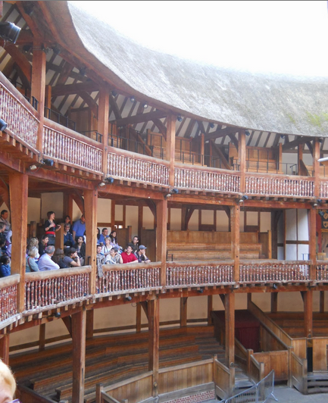
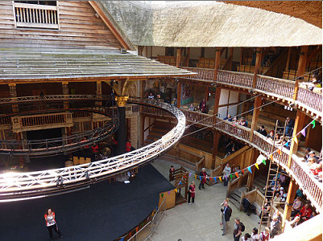
Nobles
For around five pennies, nobles and the upper classes could watch from the balcony seats. The highest of nobility could pay to sit in the seats directly above the stage.
Notes:
A link from the movie ‘Shakespeare in Love’ to demonstrate the Globe experience for a theatre-goer. The Globe would have held 2000 – 3000 audience members.
https://www.youtube.com/watch?v=3Ii5PLxnNpk

Slide 9
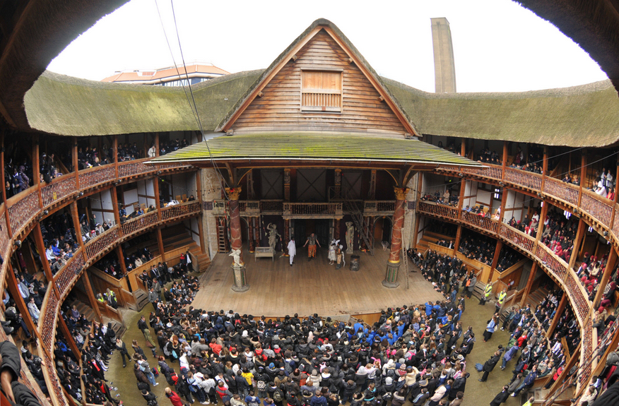
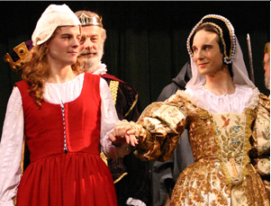
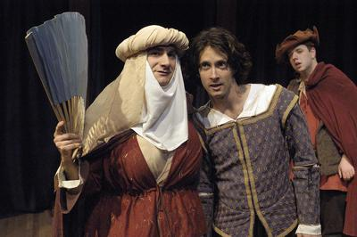
The Players
🎭 Reflecting on previous learning, why do you think women were not permitted on stage?
🎭 Who do you think may have played the parts of the young ladies? Explain.
🎭 What effect would an all-male cast have on performance and the audience’s response to performance?

Slide 10
Costume
Colour symbolism
Colour can be used to make powerful statements. Certain colours evoke characteristics or emotions and can be used to give clues about a character.
For example, the colour white is widely associated with purity, innocence, and goodness. The colour red often symbolises passion or confidence. Black is worn for mourning and may be associated with evil. Green and brown can be used to emphasise a connection to nature, while blue might connect a character to water or air.
Clothes help us to express who we are. Directors and costume designers think carefully about how to interpret a character. Costume is used to help communicate that interpretation to the audience.
When talking about costume, it can be useful to consider some of the following things:
Is the design traditional or modern? Do the clothes evoke a certain time period?
What colours are used? What do these colours make you think of?
Is the character in uniform or wearing their own clothes? Are they in disguise?
Are two or more characters dressed similarly? If so, what else might they have in common?

Slide 11
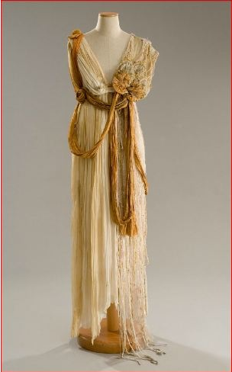
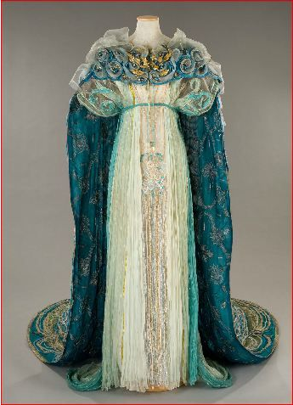
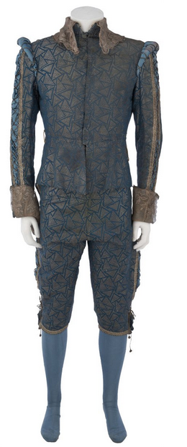
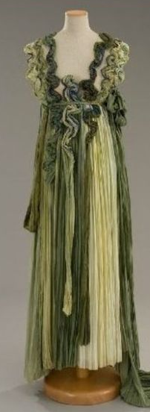
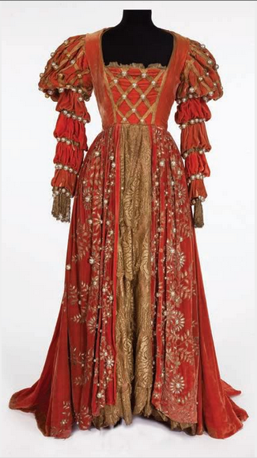
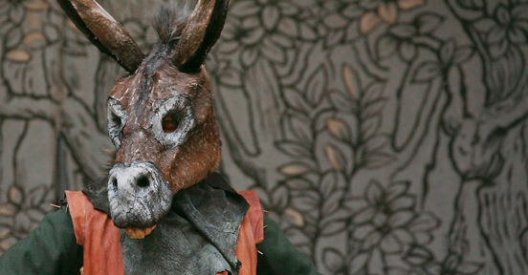
These costumes are from a production of the play you will be studying.
🎭 What predictions can you make about A Midsummer Night’s Dream on the basis of costume?

Slide 12
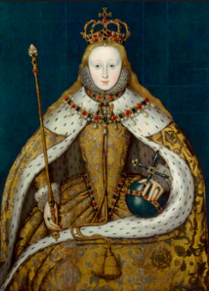
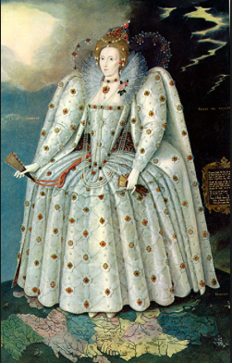
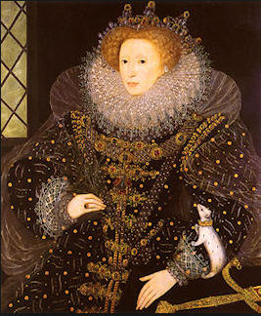
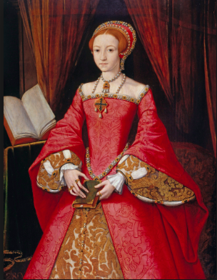
Elizabeth I was the reigning monarch at this time in Britain.
♕What do these portraits suggest about her ‘role’ as monarch? Reflect upon your knowledge of social hierarchy and costume in your answer.

