Slide 1
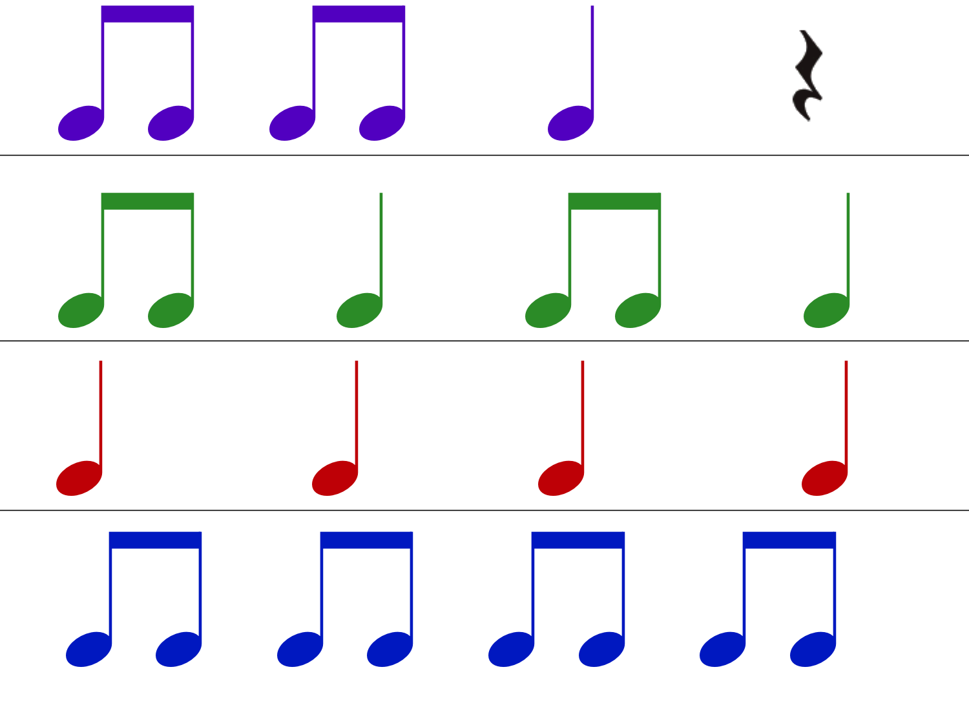
Glossary
lyric poem poem with a musical rhythm, focusing on thoughts and emotions rather than story-telling or description
iambic a verse form with four ‘feet’ (or tetrameter pairs of syllables) in a line
sestet a stanza of six lines

Slide 2
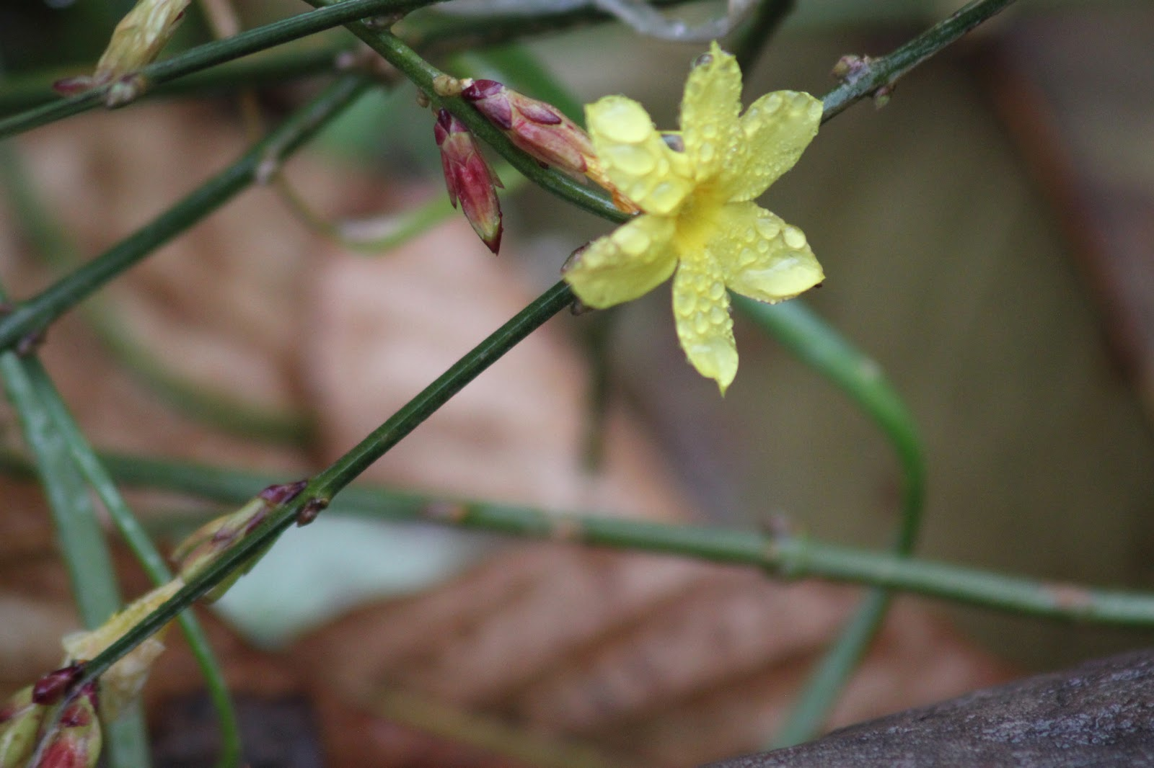
Glossary
climes climates
aspect appearance
tress lock of hair
eloquent expressive

Slide 3
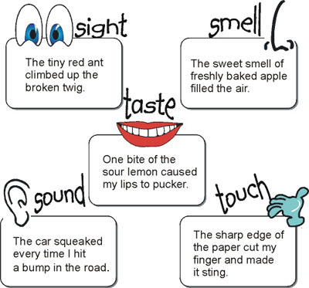

‘She Walks in Beauty’ Lord Byron
Learning objective:
to understand how Byron uses imagery and contrast to describe his subject.
Exploring language:
You are going to consider Byron’s imagery and language of contrast.
Write down what you think each stanza or verse means.

Slide 4
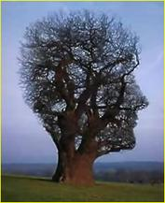
‘She Walks in Beauty’ Lord Byron
Learning objective:
to understand how Byron uses imagery and contrast to describe his subject.
The poem uses the extended metaphor of light/dark and day/night to describe the woman’s physical beauty and then stretches this idealised image still further to encompass her inner beauty – grace/thoughts/mind/heart – where the poet concludes that goodness and innocence dwell.

Slide 5
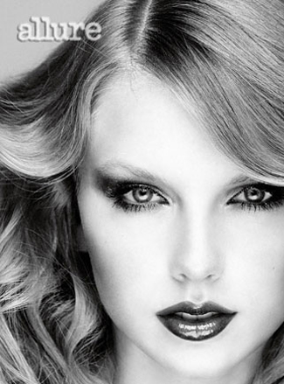
‘She Walks in Beauty’ Lord Byron
Learning objective:
to understand how Byron uses imagery and contrast to describe his subject.
Look at the quotations on Worksheet A3.3 and come up with an appropriate suggested meaning.
Compare your first impressions with your developing understanding of the nature of the allure of this unnamed woman.

