Slide 1

‘A Child to his Sick Grandfather’ Joanna Baillie
Learning objective:
to understand how the poet portrays emotions within family relationships.
to understand how the poet uses language to portray emotions within family relationships

Slide 2
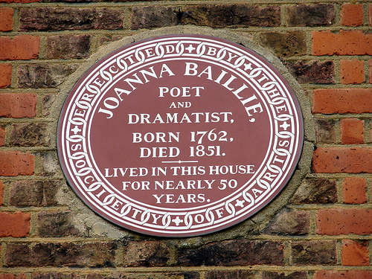
‘A Child to his Sick Grandfather’ Joanna Baillie
Learning objective:
to understand how the poet portrays emotions within family relationships.
to understand how the poet uses language to portray emotions within family relationships
Introduction:
Context:
Joanna Baillie was a revered Scottish dramatist and poet of the late 18th/early 19th century, so she was writing during the early Romantic era.
Her work exerted a strong influence on leading Romantic poets Shelley and Byron.
Upon moving to London in 1784, Baillie was encouraged to write poetry by her aunt, Ann Hunter, who gained her access to the literary society of London. Baillie offered this world a new way of looking at drama and poetry and, at a time when creative women’s voices were rarely heard, many contemporary writers held her in the highest esteem.
This poem is taken from her first published collection: Poems: Wherein it is Attempted to Describe Certain Views of Nature and of Rustic Manners (1790).

Slide 3
‘A Child to his Sick Grandfather’ Joanna Baillie
Learning objective:
to understand how the poet portrays emotions within family relationships.
to understand how the poet uses language to portray emotions within family relationships
First reading:
Read the poem on page 7 of the Poetry Anthology (also attached separately on this assignment) while listening to the attached Audio A2.
Look at the glossary as you are reading to ensure the meaning of some of Baillie’s Scottish or archaic vocabulary is clear.
stocked wearing stockings or long socks
corse body, corpse
wot know
weal welfare, well-being
doff take off
aye ever, always (Scottish)
partlet hen
nod i.e. nod off, start to doze
sestet a stanza of six lines

Slide 4
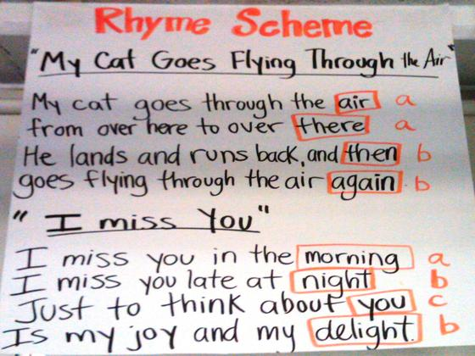
‘A Child to his Sick Grandfather’ Joanna Baillie
Learning objective:
to understand how the poet portrays emotions within family relationships.
to understand how the poet uses language to portray emotions within family relationships
Can you identify the regular rhyme scheme?

Slide 5

‘A Child to his Sick Grandfather’ Joanna Baillie
Learning objective:
to understand how the poet portrays emotions within family relationships.
to understand how the poet uses language to portray emotions within family relationships
The regular rhyme scheme is (AABBCC).
A six-line verse is known as a sestet.

Slide 6

‘A Child to his Sick Grandfather’ Joanna Baillie
Learning objective:
to understand how the poet portrays emotions within family relationships.
to understand how the poet uses language to portray emotions within family relationships
What is the overall tone of the poem?
Focus, in particular, on identifying the different emotions presented in the poem through the poet’s use of language and word choices.
Write a list of words and phrases from the poem that show the different emotions.

Slide 7

‘A Child to his Sick Grandfather’ Joanna Baillie
Learning objective:
to understand how the poet portrays emotions within family relationships.
to understand how the poet uses language to portray emotions within family relationships
You should recognise the different emotions presented by the poet as:
nostalgia and regret for the lost past filtered through the lens of deep affection from the child for his grandfather in the present as his faculties decline in old age.
This emphasis on powerful emotion was a favourite theme with the Romantic poets and we will explore this in greater depth later.

Slide 8

‘A Child to his Sick Grandfather’ Joanna Baillie
Learning objective:
to understand how the poet portrays emotions within family relationships.
to understand how the poet uses language to portray emotions within family relationships
Development:
Using Worksheet A2.1, write down several examples from the poem of the grandfather as he is remembered in the past and how he is now.
Is there a contrast between these two presentations? How does the poet’s use of language effectively convey the changes that have taken place?

