Slide 1
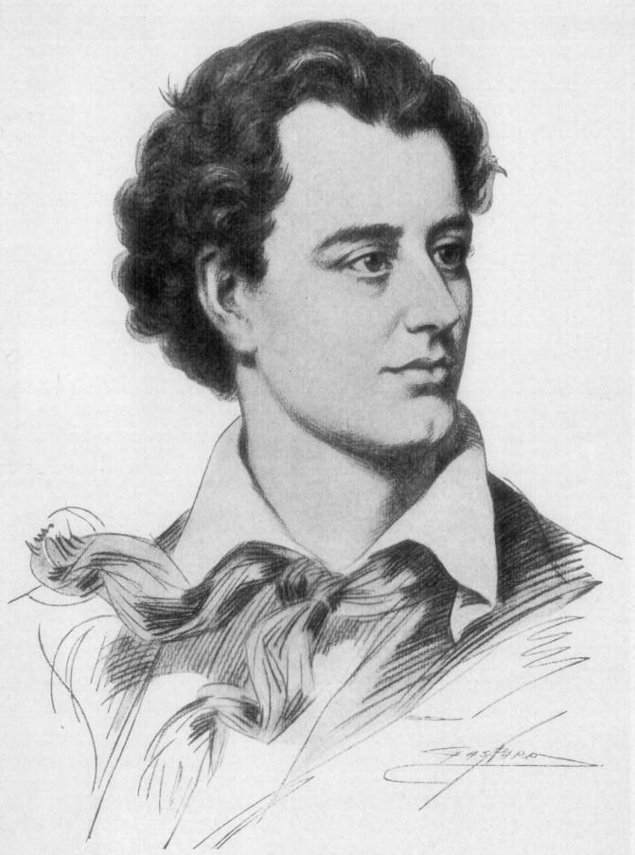
‘She Walks in Beauty’ Lord Byron
Learning objective:
to understand how Byron uses imagery and
contrast to describe his subject.
Introduction: The first four poems in this collection
all date from the Romantic period of literary history.
Lord Byron was one of the most notorious and
flamboyant of the Romantic poets.

Slide 2
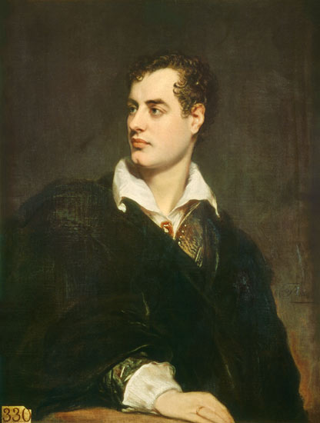
‘She Walks in Beauty’ Lord Byron
Learning objective:
to understand how Byron uses imagery and contrast to describe his subject.
Byron’s life
•Born 1788, died 1824
•Like Shelley and Coleridge, Byron was a Romantic poet,
focusing on emotion and sentiment in reaction against the
logic and reason that was rising to prominence across Europe with
a surge in scientific research and rationalism.
•The Romantics formed a political and social movement that rallied
against the emotionless path they felt many were taking.
•Byron was a man who was scandalously renowned in his day for
the many lovers he had, of both sexes.
•To many, he came to represent the Gothic anti-hero: ‘mad, bad and
dangerous to know’. This was one reason why he left England for foreign
shores in 1816.
•As an aristocrat of independent wealth, Byron enjoyed travelling. He lived in Italy for seven years before joining the Greeks’ fight for independence against the Ottoman Empire.
•It was while fighting in Greece that he caught the fever that would kill him at the age of just 36.

Slide 3
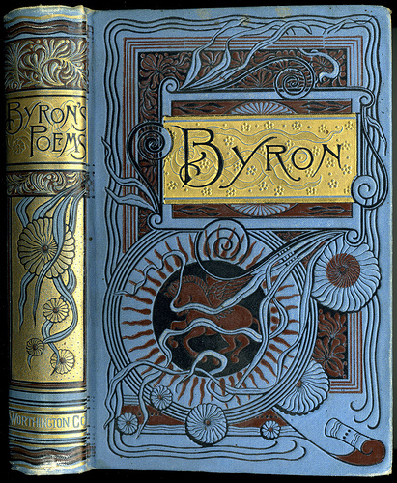
‘She Walks in Beauty’ Lord Byron
Learning objective:
to understand how Byron uses imagery and contrast to describe his subject.
You could add that this poem, ‘She Walks in Beauty’,
like the others in Byron’s collection, Hebrew Melodies,
was intended to be set to music and is thus a
‘lyric poem’. It is a good example of emotion taking
precedence over rational thought.

Slide 4

‘She Walks in Beauty’ Lord Byron
Learning objective:
to understand how Byron uses imagery and contrast to describe his subject.
Describe your ideal person to love to the person in one paragraph.
Did you put many physical features above
personality?

Slide 5
‘She Walks in Beauty’ Lord Byron
Learning objective:
to understand how Byron uses imagery and contrast to describe his subject.
Read the poem on page 8 of the Poetry Anthology while listening to Audio A3. Attached.
Identify the regular rhyme scheme and rhythm. You should also be able to identify the form. Have a look at the next slide to see if you were right.

Slide 6
‘She Walks in Beauty’ Lord Byron
Learning objective:
to understand how Byron uses imagery and contrast to describe his subject.
Regular rhyme scheme (ABABAB) and rhythm (iambic tetrameter).
Sestet form.
iambic a verse form with four ‘feet’ (or tetrameter pairs of syllables) in a line
Sestet - a stanza of six lines

Slide 7
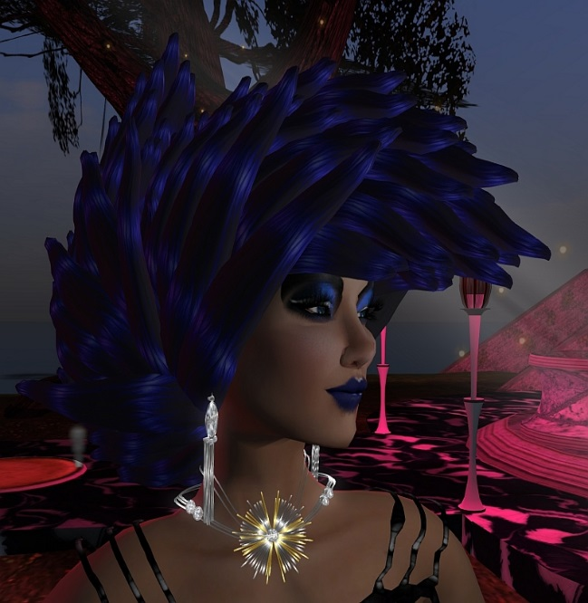
‘She Walks in Beauty’ Lord Byron
Learning objective:
to understand how Byron uses imagery and contrast to describe his
subject.
Development: What are your first impressions of the woman being described?
Why does the poet compare her to both dark and light?
Highlight the poem to identify contrasting features of the woman’s beauty. Is her beauty merely skin deep, or is there something more that Byron discerns in her?
Write your own short description of the woman in the poem. Use a thesaurus to find synonyms of words that describe her.

