Slide 1
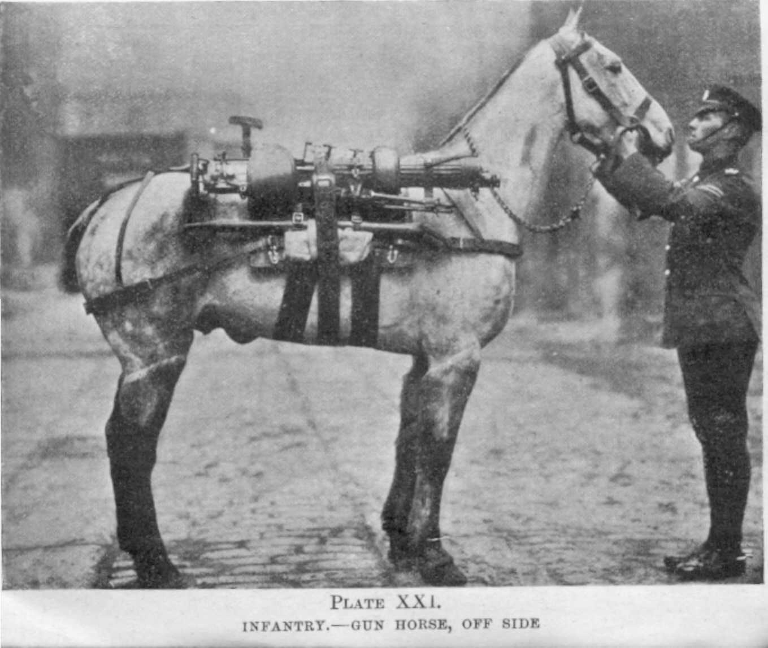
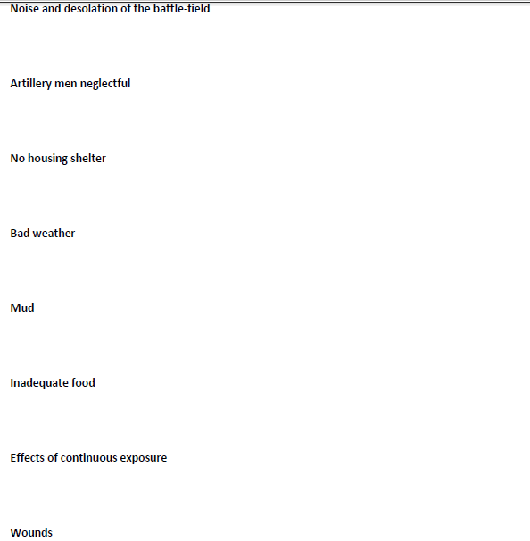
‘Problems faced by the gun horses’
Using the 5 senses to describe a horrific experience from a gun horse’s perspective

Slide 2

You need to use:
varied sentence lengths (some long and some short)
Varied punctuation (semi colons, brackets, colons, speech marks etc.)
all 5 senses
paragraphs
Exciting adjectives
Adverbs at the start of some paragraphs
Connectives at the start of some paragraphs
Damn it! I hate this weather. It’s raining again and there is mud up to my fetlocks. My knees are scarred from rubbing against the harness too; the pain is unbearable today. I am sure an infection has developed. Oh I wish I was back on the farm in Devon.
Bang! Another bomb has exploded. They are all around me. All I hear is the constant bombardment of shells hitting the ground around me.
Sadly, I miss the sensation of….
Also, I the aroma of ….
There should be 70 words in every paragraph and at least 5 paragraphs( but no more than 8) in total.

