Slide 1


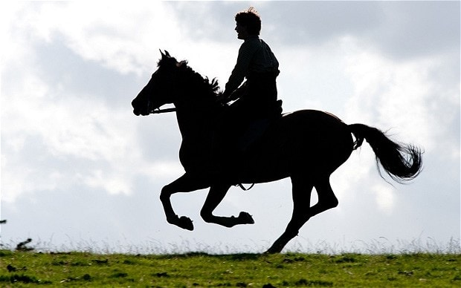
Tuesday, 05 May 2020
Chapter 14 –death and sadness.
Lo: To analyse the emotions the writer wants us to feel.
Starter
Think of a time you were sad. What happened?
Lo: To analyse the emotions the writer wants us to feel.

Slide 2

Let’s read on…Read Chapter 14
Lo: To analyse the emotions the writer wants us to feel.

Slide 3
Chapter 14
Now you have read this chapter what title would you give it and why?
Summarise the events of chapter 14 in 3 sentences.
The horse who lived
Two goodbyes
Lo: To analyse the emotions the writer wants us to feel.
The parting of ways
In the line of duty

Slide 4
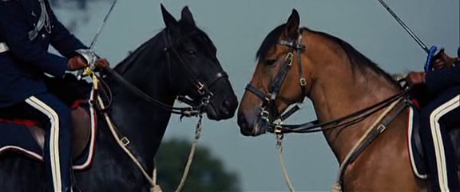
Looking at the quote, how does Joey feel about Topthorn’s death?
‘in my grief I only wanted to stay with him to comfort him’
Lo: To analyse the emotions the writer wants us to feel.

Slide 5
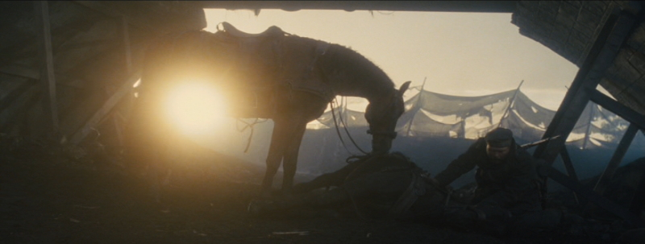
Looking at the quote, how does Joey feel about Topthorn’s death?
‘Topthorn lay dead at my feet and I would not abandon him.’
Lo: To analyse the emotions the writer wants us to feel.

Slide 6
How does Joey feel about Topthorn’s death?
Point
Evidence
Explanation
Lo: To analyse the emotions the writer wants us to feel.

Slide 7
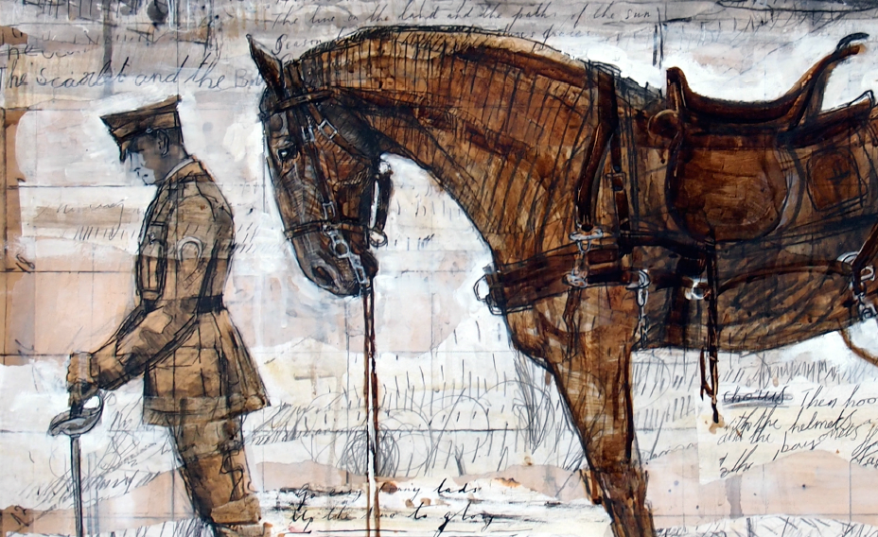
Use the picture as inspiration to write your piece of descriptive writing.

