Slide 1

Learning Objectives
Core: To develop an understanding of plot and character in AMND.
Challenge: To reflect upon the theme of order and disorder and make appropriate notes on theme

Slide 2

Think
Think about the relationship between parent and child – what are the common things that parents and children disagree about? Make a spider diagram of ideas.

Slide 3
‘Order and Disorder’, said the speaker, ‘they each have their beauty.’ Orson Scott Card.
What does order and disorder mean?
What can the impact of order and disorder be?
What can you remember about the Elizabethan hierarchy?

Slide 4
Order and Disorder
Order | Disorder
Go back through Act 1, Scene1 of the play and make a list of quotes/characters or events that show order or disorder.

Slide 5
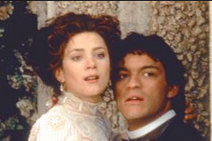
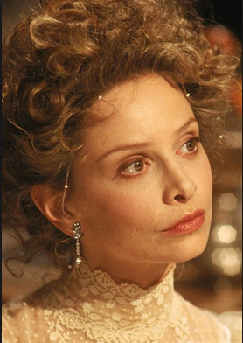
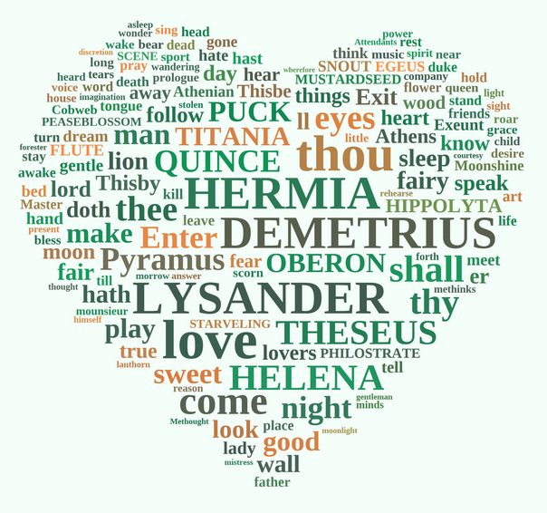
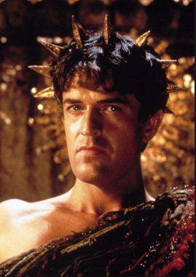
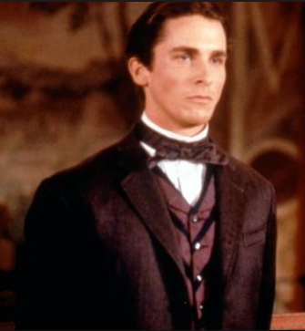
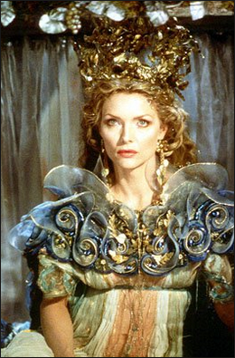
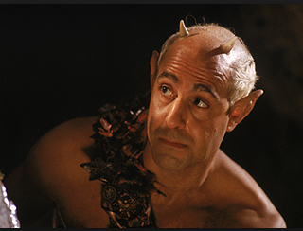
Predictions? What do you think will happen next.
Notes:
Copy back to back with slide 5 and enlarge to A3

