Slide 1

Have a look at the three quotes on the next slide.

Slide 2
“Shall we their fond pageant see?
Lord, what fools these mortals be!”
“Then will two at once woo one –
That must needs be sport alone;
And those things do best please me
That befall prepost’rously. ”
“Did you not tell me I should know the man
By the Athenian garments he had on?
And so far blameless proves my enterprise
That I have ‘nointed an Athenian’s eyes;
And so far am I glad it so did sort,
As this jangling I esteem a sport. ”

Slide 3
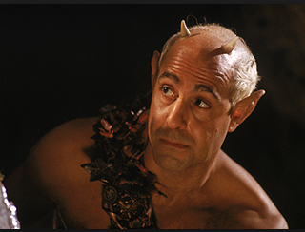
P.E.E
Look at the following question: How far do you hold Robin responsible for the disorder that follows his use of the love potion? Is he the real master of disorder or a mere minion?
Now read the PEE below.
Robin does seem to be enjoying the disorder that he has created. He talks about how the two characters will both pursue one girl. He thinks the situation will be funny when he says, That must needs be sport alone “ He also admits that preposterous situations are his favourite thing, when he says,” And those things do best please me /That befall prepost’rously.” Although he is clearly enjoying the chaos his love potion is causing, he is still only following Oberon’s orders, even though he gets things mixed up.

Slide 4
Write your own P.E.E
Using the quotes, answer the following question: far do you hold Robin responsible for the disorder that follows his use of the love potion? Is he the real master of disorder or a mere minion?

