Slide 1
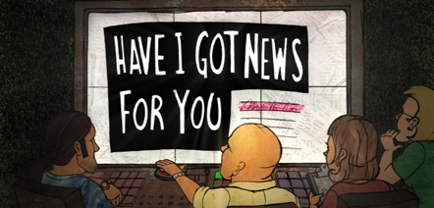

AMND BIG Writing
Learning Objectives
Core: To understand the structure and layout of a newspaper.
Challenge: To understand how stylistic features affect the audience.

Slide 2
Unscramble the words below. They are all linked to the layout of a newspaper report. The answers are on the next slide.
ELENDHIA
YNLEBI
GMEIA
ITPCNOA
SMLUNCO
DTEMAHAS
BGNESDUHAIS
Notes:
Headline
By-Line
Image
Caption
Columns
Masthead
Subheadings

Slide 3
Layout
ELENDHIA
YNLEBI
GMEIA
ITPCNOA
SMLUNCO
DTEMAHAS
BGNESDUHAIS
HEADLINE
BY-LINE
IMAGE
CAPTION
COLUMNS
MASTHEAD
SUBHEADINGS
Notes:
Headline
By-Line
Image
Caption
Columns
Masthead
Subheadings

Slide 4
Guess the stories behind the headlines below: The answers are on the next slide.
Everybody Was Kung Fuel Fighting!
You Couldn’t Bake It Up!
From Russia with Gloves

Slide 5
Guess the stories behind the headlines below:
Everybody was Kung Fuel fighting: Fights break out on the forecourts of petrol stations as the public are panicked by fuel price hikes.
You couldn’t bake it up: Small village baker told to rename her novelty Pig Tarts as they do not contain pork. She has also been told to rename her Paradise Slice as they do not come from paradise.
From Russia with Glove: UK hit by Siberian weather causing enormous snow storms.

Slide 6
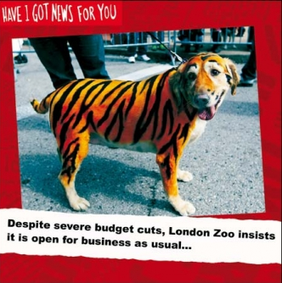
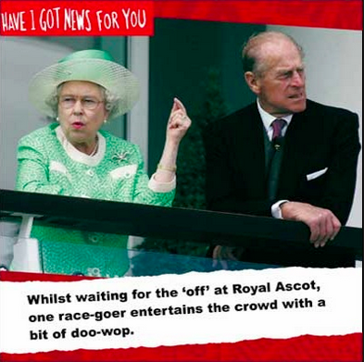
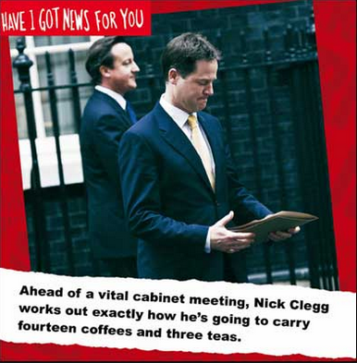
What is the purpose of captions?

Slide 7
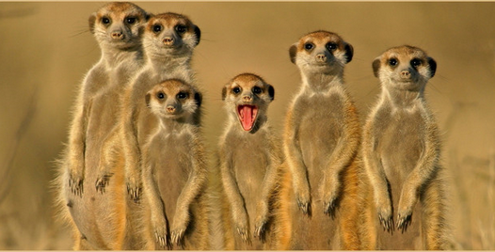
Devise a funny caption for the image below.

Slide 8
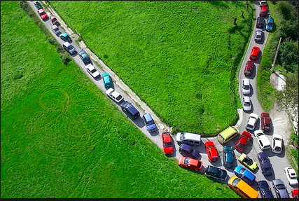
Devise a funny caption for the image below.

Slide 9
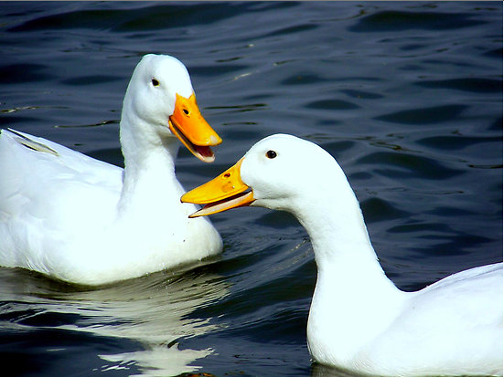
You’ll never guess what…
When friends are eager to share a story or piece of gossip, what information do they tend to share first?

Slide 10
On the next slide is a chart. Use the newspaper report attached to this assignment and fill out the chart to explore which features of a newspaper it uses.
In the example column – write down a quote or explanation of what the article is using. For example: A picture of a child. Large bold font in red.
In the comment column think about what effect it
Is trying to create. Humour? To evoke a strong emotion? To convince you of something?

Slide 11
