Slide 1

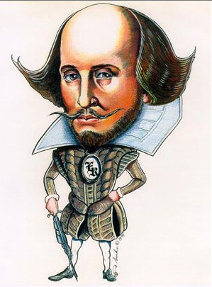
Shakespeare in Production
Learning Objectives
CORE: Identify the distinctive features of the theater experience during Shakespeare’s time, including the structural features of the theater itself, the actors’ performance, and the audience.
CHALLENGE: To make thoughtful comment on social factors that influence theatre production in the Elizabethan era.

Slide 2
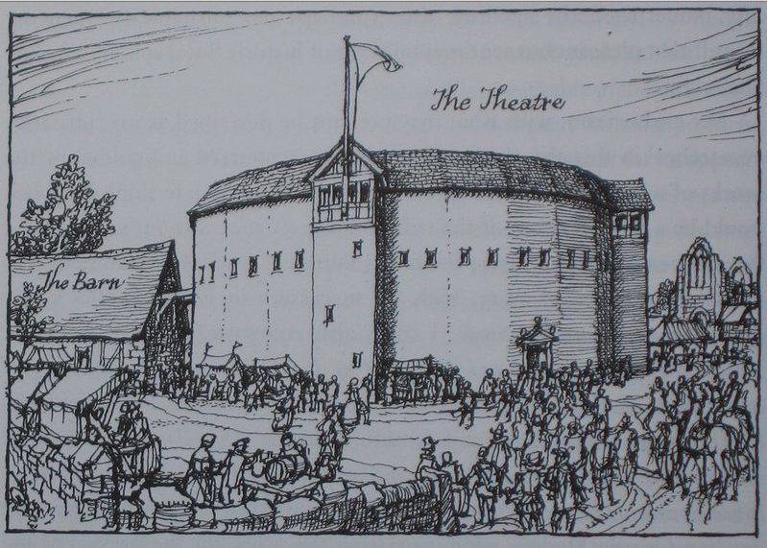
Research what Elizabethan theatres were like.
You can use the following resources or find your own:
https://www.bbc.co.uk/bitesize/guides/z2wp34j/revision/1
https://www.bbc.co.uk/bitesize/guides/zt2ycdm/revision/1

Slide 3
Build an Elizabethan Theatre!
Draw up your design of the interior and exterior of a theatre, with annotations to show thoughtful consideration of the questions below. Take a photo of your work and upload it to assignments.
You have been enlisted by a wealthy patron to build a theatre. The year is 1599:
🎭 Who will help you?
🎭 What will it look like? Layout inside? Exterior appearance?
🎭 What do you need?
🎭 Where will you build? Why?
🎭 When will it be ready?
🎭 Why are you building it? What is its purpose?
🎭 How many patrons could you welcome to your theatre?
🎭 How might the process be difficult compared to building a theatre today?
🎭 What will it be called?

Slide 4
There is little evidence about when and where A Midsummer Night’s Dream was originally performed. Shakespeare’s plays were originally performed at The Theatre, an open-air playhouse in Shoreditch, London. After a dispute with the landlord, the theatre was dismantled and the timber used in the construction of the Globe.

