Slide 1
A Midsummer Night’s Dream
Learning Objectives:
Core: To make predictions about plot and theme.
Challenge: To respond to text imaginatively, making connections with prior learning.

Slide 2
Based on the title only, what impression do you have of the play?
A Midsummer Night’s Dream
Consider the words associated with those used in the title.

Slide 3
Based on the title only, what impression do you have of the play?
Ideas you may have had:
Midsummer – Celebrated on June 23rd, lighting of bonfires, merry-making, celebrating summer solstice
Night – Darkness, spooky, vulnerability, quiet, mystery, slumber, sense of sight impaired and other senses heightened…
Dream – Illusion, involuntary, uncontrollable, delusion, fantasy, imagination
Consider the words associated with those used in the title.
Notes:
Midsummer – Celebrated on June 23rd, lighting of bonfires, merry-making, celebrating summer solstice
Night – Darkness, spooky, vulnerability, quiet, mystery, slumber, sense of sight impaired and other senses heightened…
Dream – Illusion, involuntary, uncontrollable, delusion, fantasy, imagination…

Slide 4
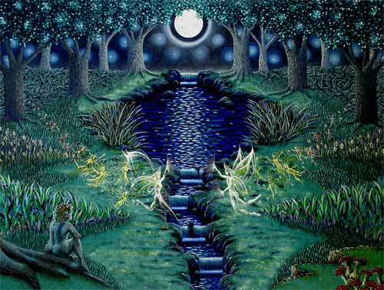
A Midsummer Night’s Dream
Consider the following questions:
Would you let your parents choose your friends?
Would you marry someone to make your parents happy?
Should you marry for love or money?
If your friend told you in confidence that they were planning to run away would you tell or keep it a secret?
Should girls be able to ask boys out?

Slide 5

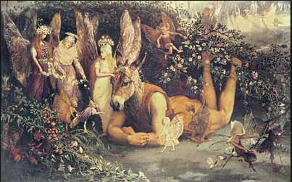
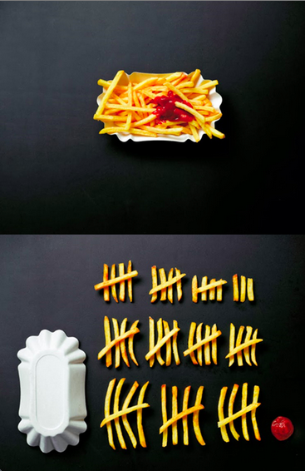

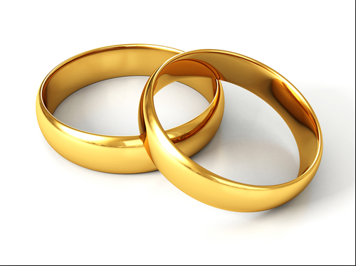
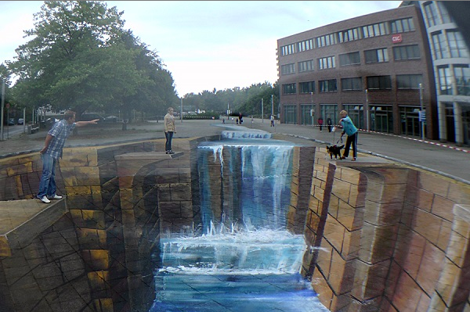
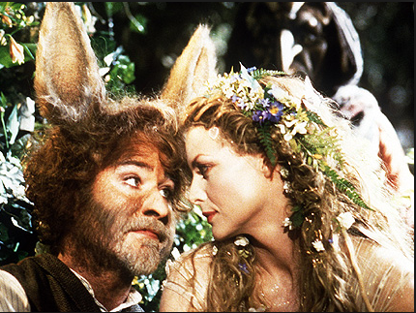

What words or thoughts spring to mind when you look at these images?

Slide 6

Mnemonics
Devise a job description for an agony aunt. What essential qualities are needed when giving advise?

Slide 7
WRITING TO ADVISE?
THEN USE…
A – Audience –choose formal or informal language
G – Give Good reasons for following your advice
O – Objective viewpoint – Don’t take sides
N - New paragraphs for new ideas
Y – You – using personal pronouns makes the
reader feel you are interested in him
A – Authority – pretend to be an expert on problems
U – Understanding – Show you understand the reader’s
situation
N – Never be Negative – Make the reader feel like No. 1!
T – Tone – use the right tone, friendly and supportive

Slide 8
A Midsummer Night’s Dream
Read the following letter to an agony aunt. Imagine that you are the agony aunt and write your reply. Your purpose is to advise!
Dear Miss Midsummer,
I am really in love with this guy from Athens but he doesn’t love me. We used to go out a while ago but now he is in love with my best friend. I tell him how much I still love him but it only seems to make him angry. What should I do to get his attention?
Helena x

Slide 9


FiSH
RAP: Reflect and Progress
Swap your books with a neighbour.
Read their letter of advice to Helena and use the acrostic on the board as your marking criteria.
Reflect on your learning and your predictions earlier in the lesson, have your predictions in term of theme and plot changed in any way?

