Slide 1
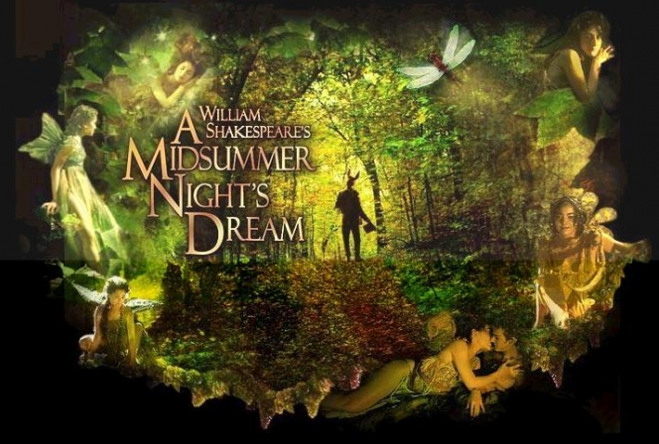
Into the Woods
Learning Objectives
Core: To be able to comment on Shakespeare’s specific choice of language.
Challenge: To compare Shakespeare’s choice of language in Act 2 Scene 1 with Act 1 Scene 1.

Slide 2
Read lines 2-31 on the next slide. The modern translation has been put alongside it to help you. Draw a picture of what you visualize. What pictures/images can you see when you read these lines?

Slide 3
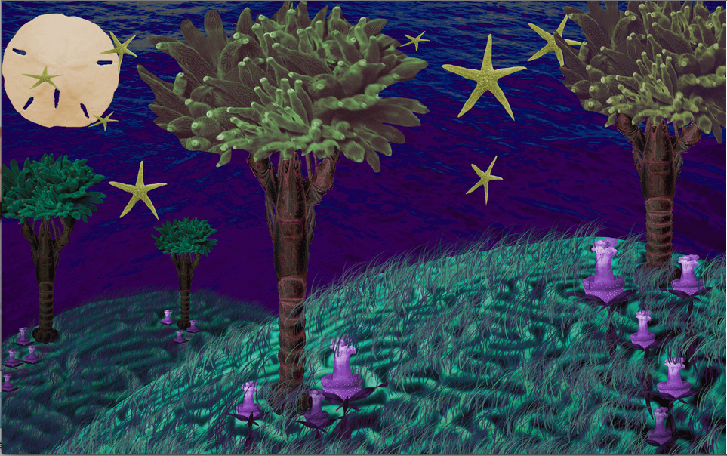
Into the Woods
Shakespeare
Over hill, over dale,
Thorough bush, thorough brier,
Over park, over pale,
Thorough flood, thorough fire.
I do wander everywhere
Swifter than the moon’s sphere.
And I serve the fairy queen
To dew her orbs upon the green.
The cowslips tall her pensioners be.
In their gold coats spots you see.
Those be rubies, fairy favors.
In those freckles live their savors.
I must go seek some dewdrops here
And hang a pearl in every cowslip’s ear.
Translation
I go over hills and valleys, through bushes and thorns, over parks and fenced-in spaces, through water and fire. I wander everywhere faster than the moon revolves around the Earth. I work for Titania, the Fairy Queen, and organize fairy dances for her in the grass. The cowslip flowers are her bodyguards. You’ll see that their petals have spots on them—those are rubies, fairy gifts. Their sweet smells come from those little freckles. Now I have to go find some dewdrops and hang a pearl earring on every cowslip flower.

Slide 4
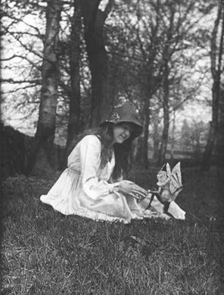
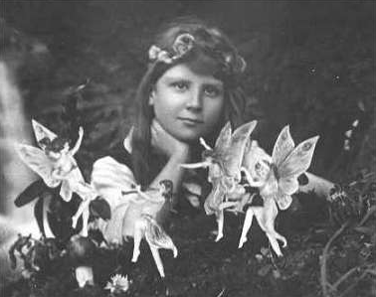
Do you Believe in Fairies?
People have long wanted to believe in the existence of fairies. In 1917, two girls took photographs of themselves with ‘fairies’ in the woods near their house. For decades, eminent scientists have believed these photographs to be authentic/real.
🍄What do you think?
🍄Why do you think the supernatural has such a hold on the imagination?

Slide 5
Compare and contrast this fairy world with the courtly world presented in Act 1.
Are there any similarities or differences between the worlds?
Features | The Court | The Fairies
Characters
Nature of disorder or conflicts
Setting

