Slide 1
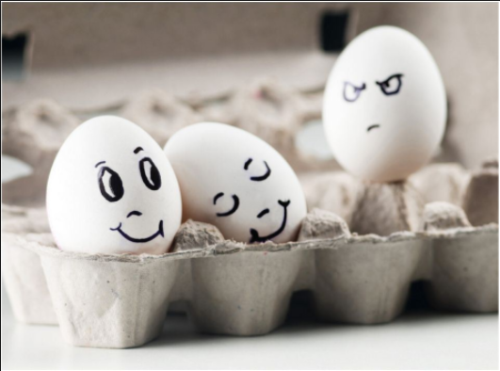
Look at the quote below from Sonya Teclai. Do you agree or disagree with this quotation? Why?
“Jealousy isn’t a female trait. Jealousy is an insecure trait. Insecurity doesn’t discriminate.”
Sonya Teclai

Slide 2
Re-read the following quotation from Titania.
“Then I must be thy lady. But I know
When thou hast stol’n away from Fairyland,
And in the shape of Cronin sat all day
Playing on pipes of corn, and versing love
To amorous Phillida. Why art thou here
Come from the farthest step of India? –
But that, forsooth, the bouncing Amazon,
Your buskined mistress and your warrior love,
To Theseus must be wedded; and you come
To give their bed joy and prosperity.”
“If you’re my lord and husband, I must be your lady and wife, so you’re supposed to be faithful to me. But I know for a fact that you snuck away from Fairyland disguised as a shepherd, and spent all day playing straw pipes and singing love poems to your new girlfriend. The only reason you left India was to come here and see that butch Amazon Hippolyta. She was your boot-wearing mistress and your warrior lover, and now that she’s getting married to Theseus, you’ve come to celebrate their marriage.”

Slide 3
Re-read the following quotation from Oberon.
“ How canst thou thus, for shame, Titania,
Glance at my credit with Hippolyta,
Knowing I know thy love to Theseus?
Didst not thou lead him through the glimmering night
From Perigenia, whom he ravished.
And make him with fair Aegles break his faith,
With Ariadne, and Antiopa?”
“How can you stand there shamelessly talking about me and Hippolyta, when you know that I know about your love for Theseus? Weren’t you the one who made him desert Perigouna in the middle of the night, right after he’d ravished her? And weren’t you the one who made him cheat on all of his other girlfriends, like Aegles, Ariadne, and Antiopa?”

Slide 4

Order and Disorder: Write a PEE paragraph exploring the disorder in Oberon and Titania’s relationship. You should consider:
Context – You could talk about gender and how women were seen in society.
Language – Pick out a word or phrase and think about the connotations of it.
Theme – How can you link your thoughts to the theme of jealousy?

