Slide 1
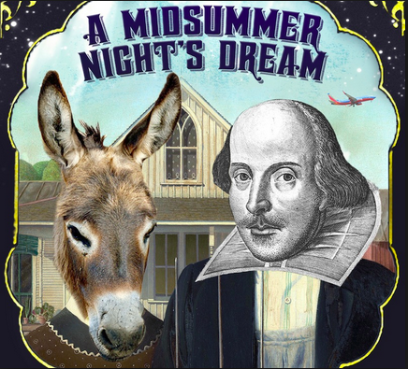
Robin…Master of Disorder?
Learning objectives
Core: To reflect on roles in light of theme.
Challenge: To make analytical comment on character and language.
Notes:
Act 2 Scene 1
Lines 148 -268

Slide 2
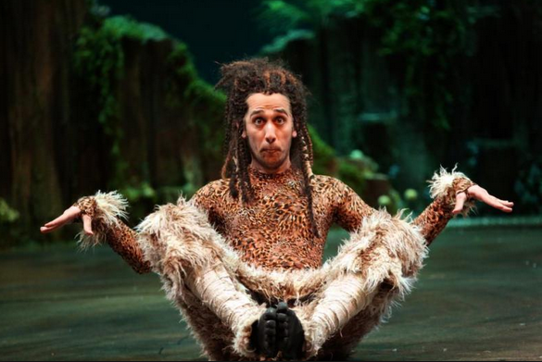
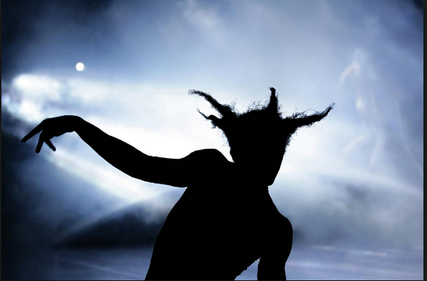
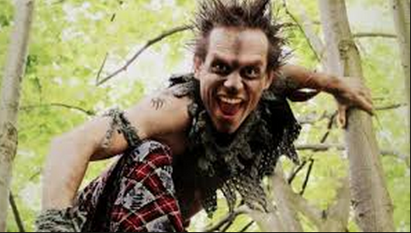
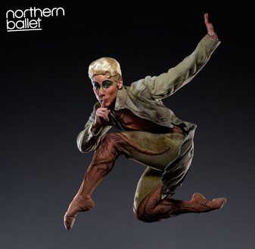
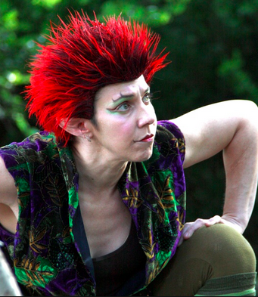
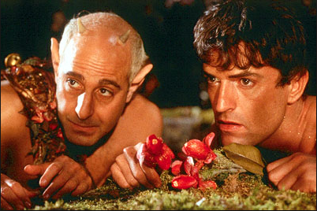
What do these representations of Robin reveal to us about his character?

Slide 3
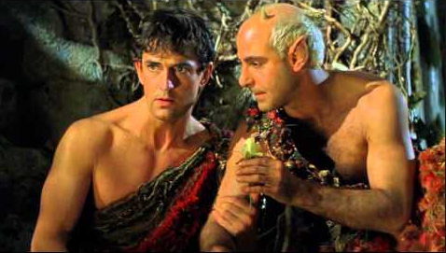
Is Robin really the master of disorder or is he just simply following orders?
Fetch me that flower, the herb I showed thee once; The juice of it on sleeping eyelids laid Will make man or woman madly dote Upon the next live creature that it sees.
I’ll put a girdle round about the earth in forty minutes!
Robin…Mere Minion?

Slide 4
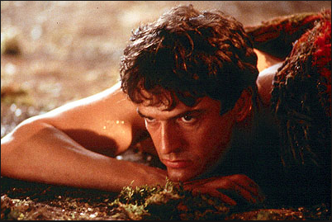
Having once this juice I’ll watch Titania when she is asleep, And drop the liquor of it in her eyes: The next thing then she, waking, looks upon – Be it on lion, bear or wolf, or bull, On meddling monkey, or on busy ape – She shall pursue it with the soul of love…I’ll make her render up her page to me.
How would an Elizabethan audience react to this plan?
How would a contemporary audience react to this plan?
What does Oberon seek to achieve?
Why is it important to him?

Slide 5
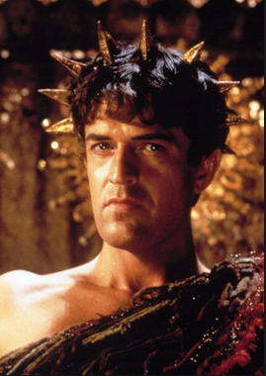
What thou seest when thou dost wake,
Do it for thy true love take;
Love and languish for his sake.
Be it ounce or cat or bear,
Pard, or boar with bristled hair
In thy eye that shall appear
When thou wak’st, it is thy my dear.
Wake when some vile thing is near!
Discuss Shakespeare’s use of rhyme here. Why is it important that Oberon should speak in rhyme at this point?
Why does Oberon use animal symbolism? Write a list of the animals that are included and suggest what each may represent.
What impression do we have of his character from his words and actions?
Do you think his final line is supposed to be sinister, amusing, vengeful, evil or something else?

