Slide 1

Act 1 Scene 1
Athens – Theseus’ Palace
Learning Objectives
CORE: To develop skills of independent analysis.
CHALLENGE: To identify key word choices and analyse their significance with increasing confidence.

Slide 2
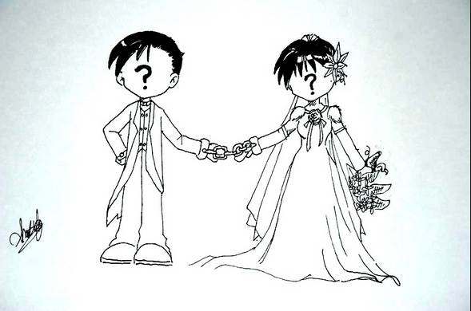
Think about what is happening in this image?

Slide 3
Answer the questions with your own thoughts or do some research if you are not sure.
💍 What made an Elizabethan gentleman attractive as a marriage match?
💍How do you think the bride would feel about entering into an arranged marriage?
💍What do you think the consequences would be when a bride resists an arranged marriage in Elizabethan society?

Slide 4
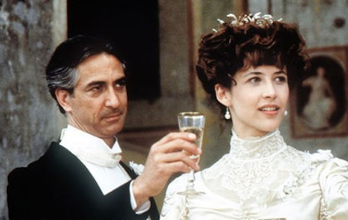
Da-Da-Da-Dum…
Hippolyta and Theseus have been at war and are now to marry to cement the new peace. Theseus regrets that time is moving slowly before he can marry Hippolyta, and orders preparations for their wedding.

Slide 5
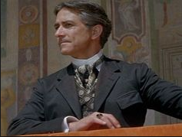
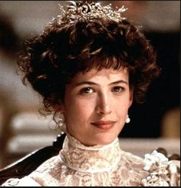
Language
Read lines 1-19.
Make a list of what you consider to be the three most important words or phrases that Theseus uses.
Make a list of what you consider to be the three most important words or phrases that Hippolyta uses.
Then write a few sentences to describe what the language reveals about the characters and their situation.
Challenge: look for patterns (such as those to do with the moon, or ‘slow’ versus ‘quickly’). These patterns and the discussion between Theseus and Hippolyta give an idea of what the play is about.

Slide 6
How do the characters view Theseus? BE AWARE – UNDER THE MODERN TRANSLATION IN THE SPEECH BUBBLES, LIES THE TRUE TEXT. her?
“I beg the ancient privilege of Athens;
As she is mine, I may dispose of her;
Which shall be either to this gentleman
Or to her death, according to our law.”
- Egeus
“I ask you to let me exercise the right that all fathers have in Athens. Since she belongs to me, I can do what I want with her—as the law says: I can either make her marry Demetrius—or have her killed.”
- Egeus
“To you your father should be as a god,
One that composed your beauties; yea, and one
To whom you are but as a form in wax
By him imprinted, amd within his power
To leave the figure, or disfigure it.”
- Theseus
“What do you have to say for yourself, Hermia? Think carefully, pretty girl. You should think of your father as a god, since he’s the one who gave you your beauty. To him, you’re like a figure that he’s sculpted out of wax, and he has the power to keep that figure intact or to disfigure it. Demetrius is an admirable man.”
- Theseus
“I do entreat your grace to pardon me. I know not by what power I am made bold,
Nor how it may concern my modesty
In such a presence here to plead my thoughts.”
- Hermia
“Your grace, please forgive me. I don’t know what makes me think I can say this, and I don’t know if speaking my mind to such a powerful and noble person as yourself will damage my reputation for modesty.”
- Hermia
Sum Theseus up in three words.
How would an Elizabethan audience
respond to Hermia being outspoken?
How might we describe her?
Notes:
BE AWARE – UNDER THE MODERN TRANSLATION IN THE SPEECH BUBBLES, LIES THE TRUE TEXT – THESE ARE ANIMATED TO PROVIDE A CONTEMPORARY TRANSLATION.
Ask students to sum Theseus up in three words.
How would an Elizabethan audience respond to Hermia being outspoken? How might we describe her?

