Slide 1

The Order of Disorder
Learning Objectives
Core: To be able to analyse character in light of theme.
Challenge: To be able to analyse the language attributed to characters by the playwright and their effect on audience.

Slide 2
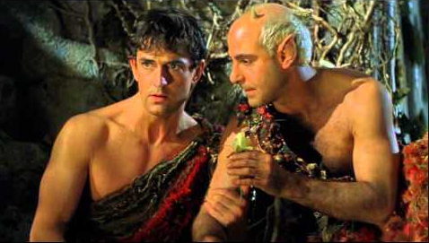
Re-read Act 3, Scene 2.
Master of Disorder?
How now, mad spirit? What night-rule now about this haunted grove?
Translation - Well, crazy spirit? What havoc have you wreaked in this part of the forest?
Write a summary of the havoc Robin has wreaked in no more than 50 words.

Slide 3
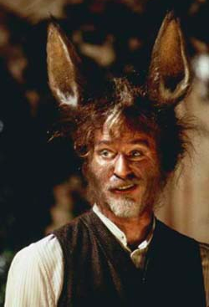
Bottom’s Transformation
What does Robin reveal about his impression of ‘mortals’ in lines 6 – 30. PEE - Use evidence from the text in support of your answer.

Slide 4
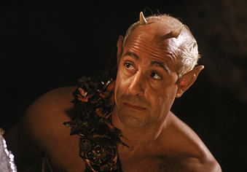
Think – Re-read the quote below.
“Then fate o’errules, that one man holding troth,
A million fail, confounding oath and oath.”
Translation “So fate takes charge because for each man who is a faithful lover, a million fail, breaking their word time after time.”

Slide 5
Think
“Then fate o’errules, that one man holding troth,
A million fail, confounding oath and oath.”
Robin has drugged the wrong Athenian and now, Lysander is declaring his love for Helena. Oberon realises Robin’s error and tells him: “Thou hast mistaken quite, And laid the love juice on some true love’s sight.”
Look up the word ‘fickle’ in a dictionary and then answer the two questions below.
Are men fickle?
Are men fickle in love, and, if so, are they more fickle than women?

