Slide 1
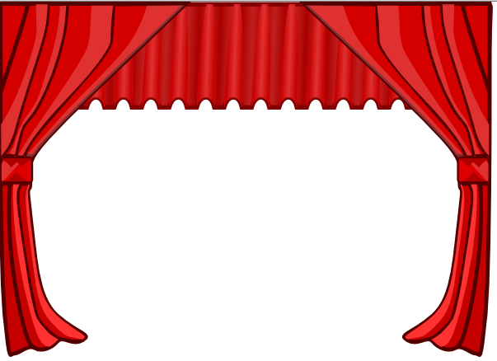
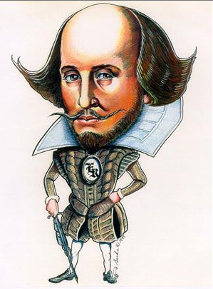
Shakespeare in Production
Learning Objectives
CORE: Identify the distinctive features of the theater experience during Shakespeare’s time, including the structural features of the theater itself, the actors’ performance, and the audience.
CHALLENGE: To make thoughtful comment on social factors that influence theatre production in the Elizabethan era.

Slide 2
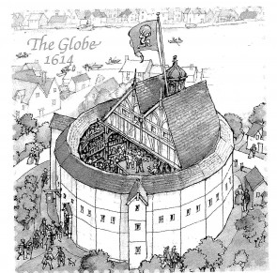

Slide 3
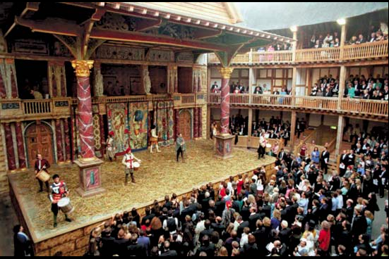
Fat Questions! Look at the picture of the Globe on the previous slide. If you have the technology, then you could also go here: www.shakespearesglobe.com/about-us/virtual-tour
🎭 What do you notice about the building, the staging and the audience?
🎭How is it different from other theatres you may have attended?
🎭How might the audience experience differ?
Your responses should be no fewer than 15 words!
Notes:
www.shakespearesglobe.com/about-us/virtual-tour

Slide 4
The Globe Theatre
Visiting The Globe
Elizabethan theatre was a popular form of entertainment that even poorer people could enjoy. The cheapest tickets allowed you to stand in the yard in front of the stage – these tickets cost one penny. People with these tickets were called groundlings.
Special effects and scenery were limited, but there was always music and beautiful costumes.
Audiences were encouraged to interact with the actors. This created a rowdy and exciting atmosphere.
Many of Shakespeare’s plays were first performed at The Globe Theatre, which was built in 1599 on the bank of the Thames in London.
This theatre could hold around 3,000 people and staged two performances a day. It was built out of wood, with a thatched roof covering the more expensive seats.
The original Globe burnt down in 1613 after a spark from a cannon fired during a performance set fire to the roof. The theatre was rebuilt and stayed standing until it was torn down by Puritans during the Civil War.
Today, a working replica stands in the place of the original Globe.

Slide 5
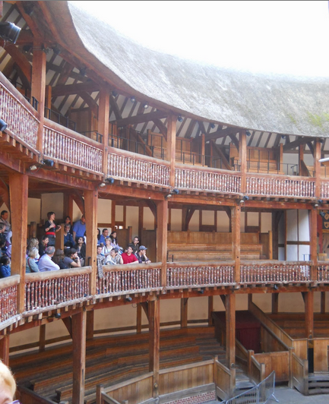
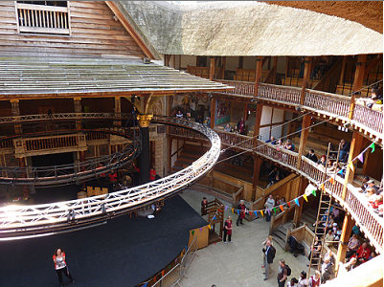
Nobles
For around five pennies, nobles and the upper classes could watch from the balcony seats. The highest of nobility could pay to sit in the seats directly above the stage.
Notes:
https://www.youtube.com/watch?v=3Ii5PLxnNpk

Slide 6
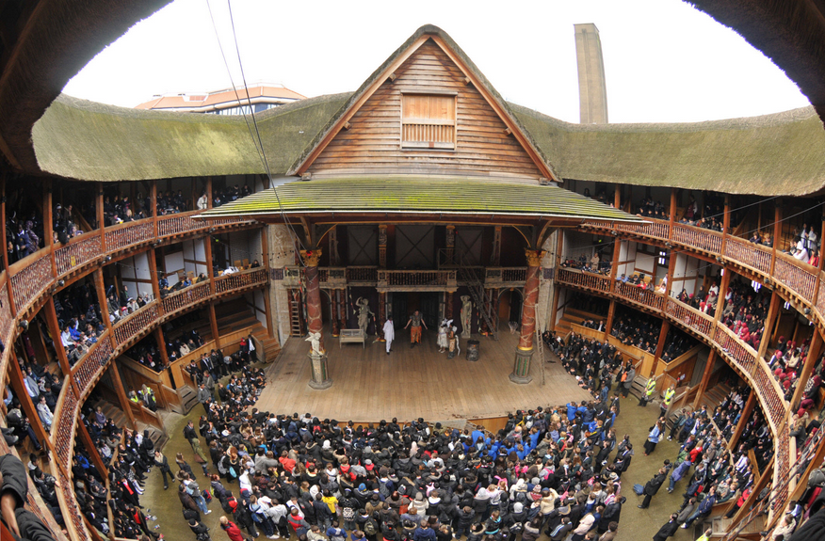
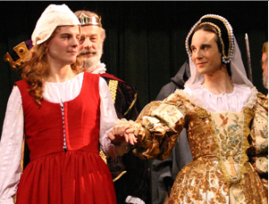
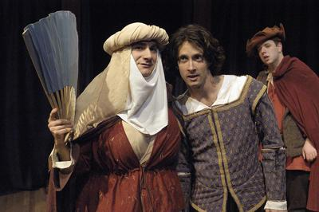
The Players
🎭 Reflecting on previous learning, why do you think women were not permitted on stage?
🎭 Who do you think may have played the parts of the young ladies? Explain.
🎭 What effect would an all-male cast have on performance and the audience’s response to performance?

Slide 7
Costume
Colour symbolism
Colour can be used to make powerful statements. Certain colours evoke characteristics or emotions and can be used to give clues about a character.
For example, the colour white is widely associated with purity, innocence, and goodness. The colour red often symbolises passion or confidence. Black is worn for mourning and may be associated with evil. Green and brown can be used to emphasise a connection to nature, while blue might connect a character to water or air.
Clothes help us to express who we are. Directors and costume designers think carefully about how to interpret a character. Costume is used to help communicate that interpretation to the audience.
When talking about costume, it can be useful to consider some of the following things:
Is the design traditional or modern? Do the clothes evoke a certain time period?
What colours are used? What do these colours make you think of?
Is the character in uniform or wearing their own clothes? Are they in disguise?
Are two or more characters dressed similarly? If so, what else might they have in common?

Slide 8
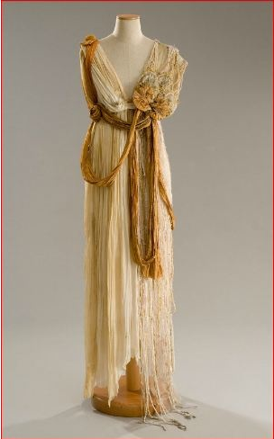
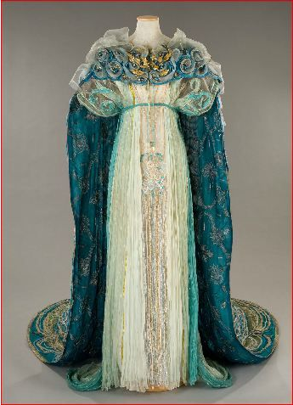
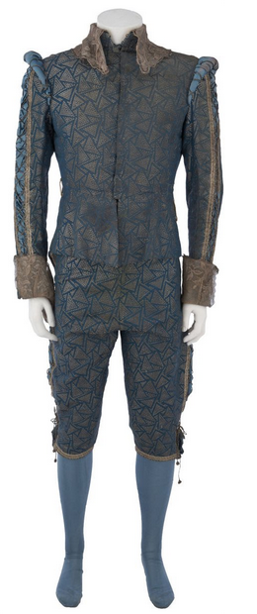
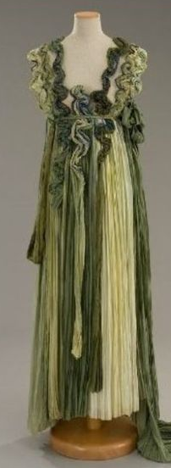
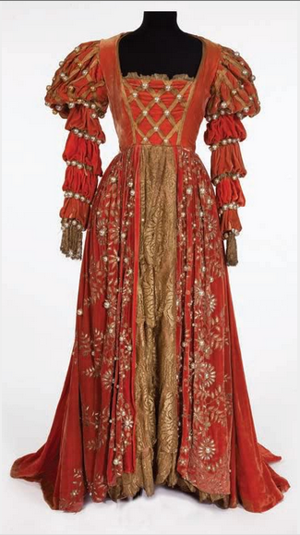
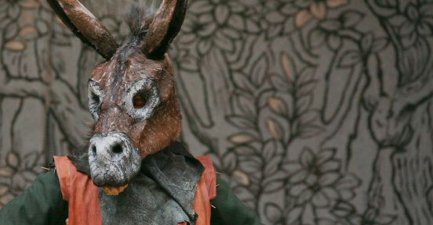
These costumes are from a production of the play you will be studying.
🎭 What predictions can you make about A Midsummer Night’s Dream on the basis of costume?

Slide 9
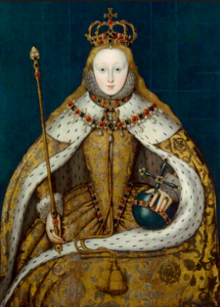
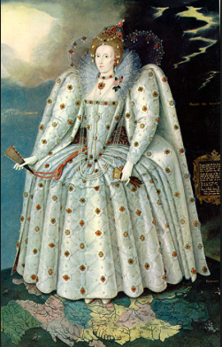
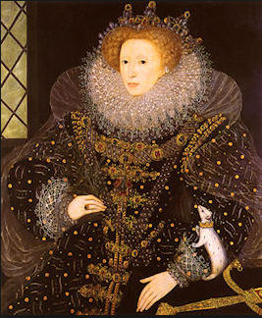
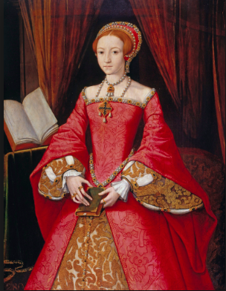
Elizabeth I was the reigning monarch at this time in Britain.
♕What do these portraits suggest about her ‘role’ as monarch? Reflect upon your knowledge of social hierarchy and costume in your answer.

