Slide 1
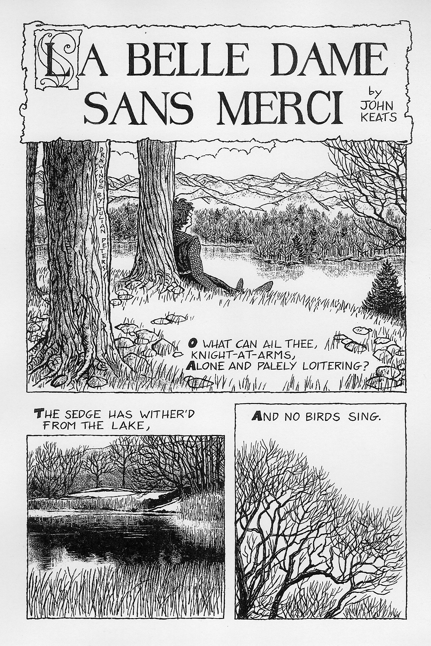
Let’s listen to the poem.
Click on the audio link attached to this assignment.

Slide 2
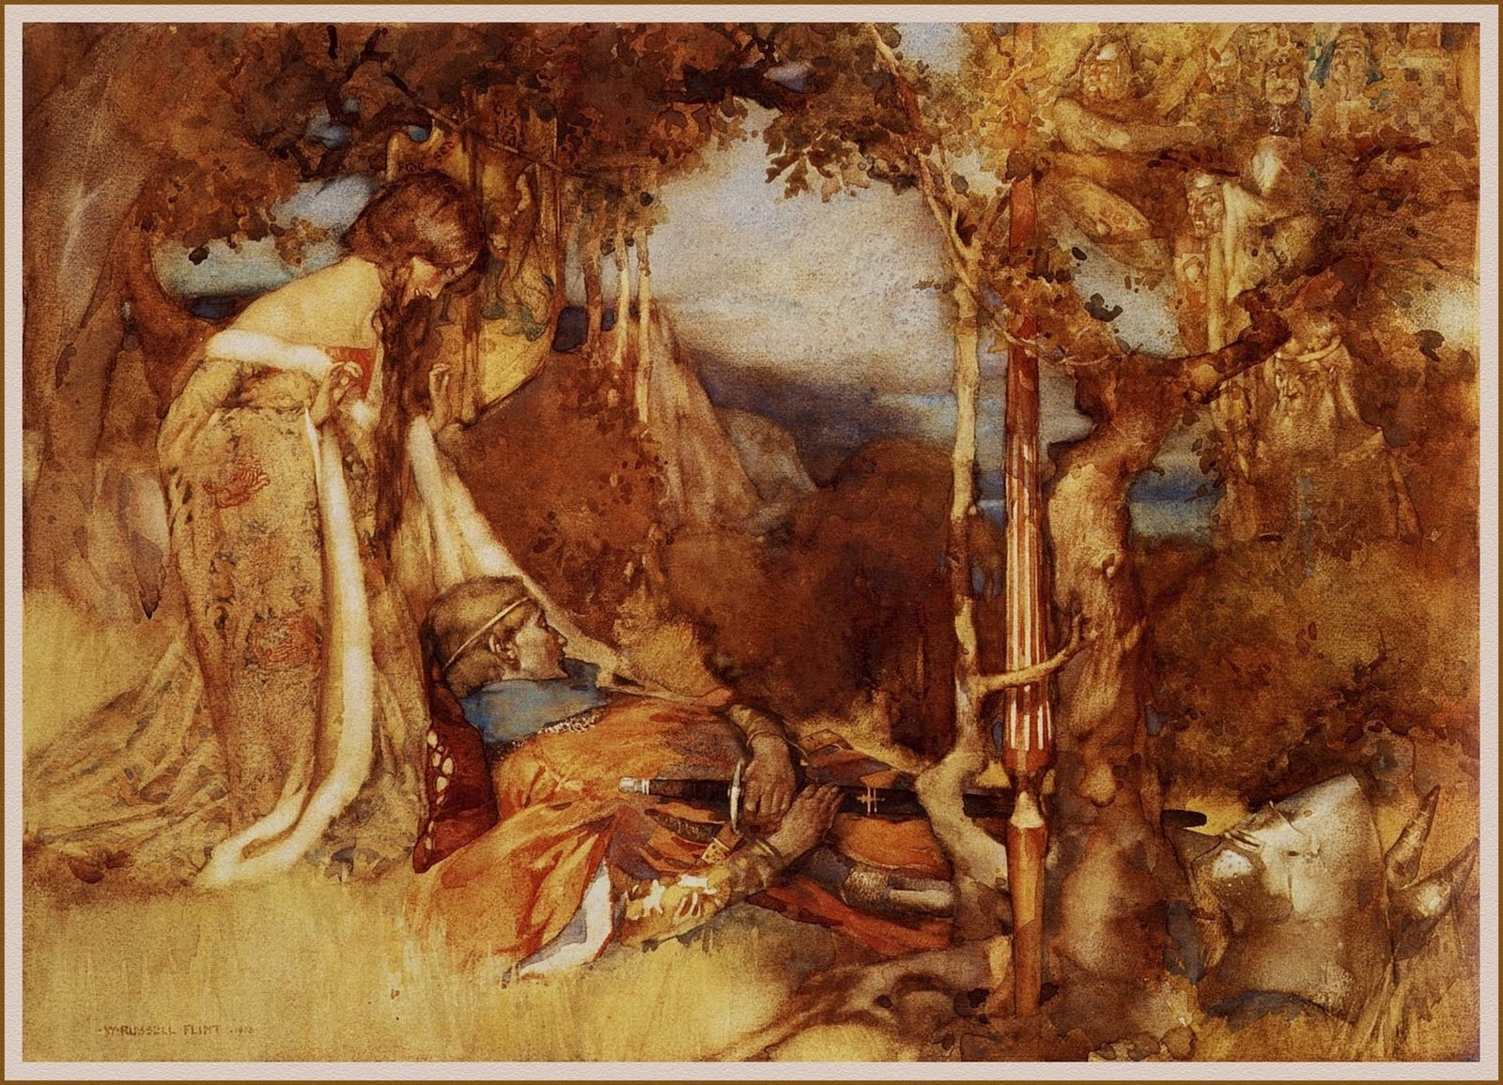
Identify the two voices in the poem.
On a word document – Write down who you think the two voices in the poem belong to.

Slide 3
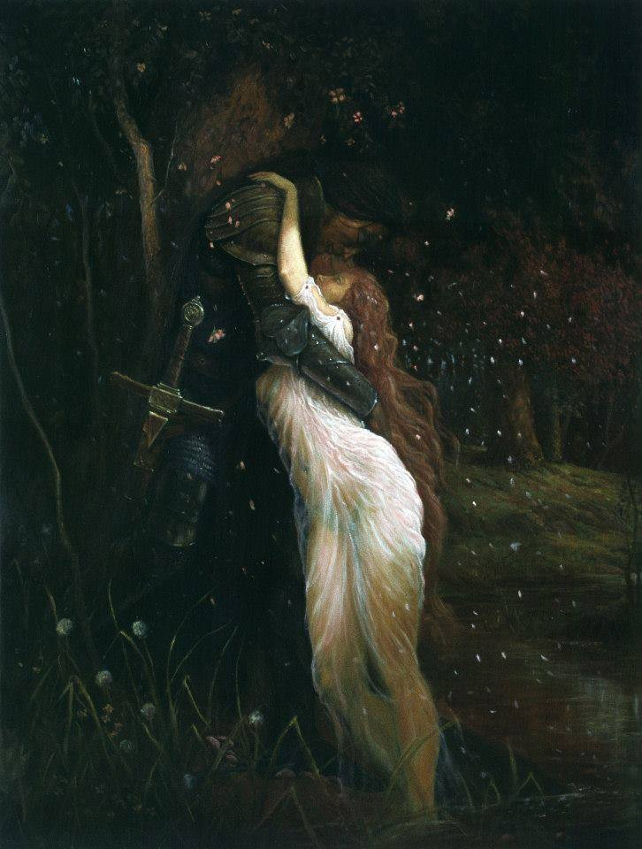
Answer: The first is the identity-less voice questioning the knight in stanzas 1–3, and the second is the knight’s response in the remaining stanzas.
Understand that this is not a true monologue, but rather closer to two monologues, focused mainly on the knight describing ‘La Belle Dame’.

Slide 4
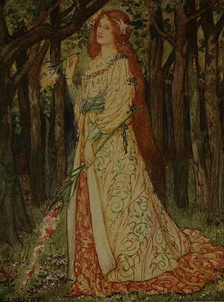
The title of the poem, translates as ‘The Beautiful Woman Without Mercy’ –
Write down why you think Keats describe the ‘Belle Dame’ in this way?
Write down why you think the lady’s voice never appear in the poem?

Slide 5
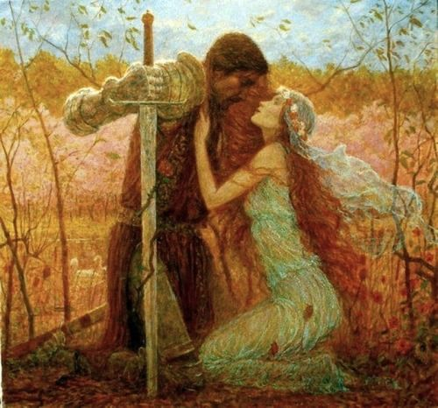
Examples of the modern day femme fatale made popular in film noir films :
As you watch, try and create a list of the characteristics of a femme fatale.
https://www.youtube.com/watch?v=eUpIbZuWl6Q
Write down what qualities ‘La Belle’ shares with these modern day Femme fatales.

Slide 6
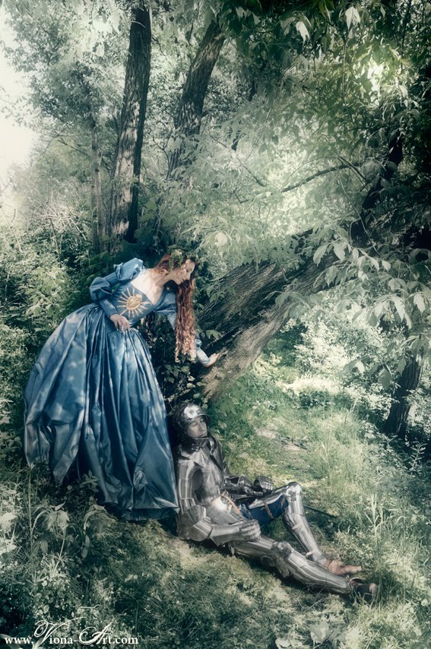
Consider how the femme fatale differs from the traditional ‘damsel in distress’.
Go through the poem again and underline what makes La Belle a femme fatale-like character.
Now write a couple of paragraphs to show your findings. You should refer to aspects of the text to illustrate your point (e.g. she lulled me to sleep – she has put him under a spell; literal in this instance).

