Slide 1


Wednesday 24th June
Spoken Language
Research Skills

Slide 2
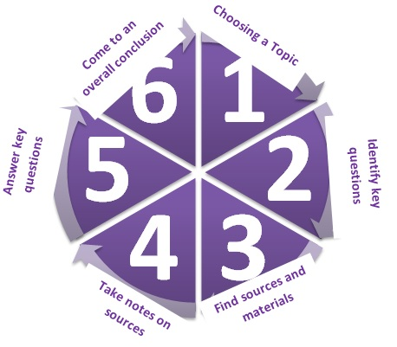
Have a look at the diagram of the research process below.

Slide 3


Rank these questions from most to least interesting
What forces shape the writing of the author JK Rowling?
Is there such a thing as absolute evil?
Why is the media an issue in relation to body image?
How is a star created?

Slide 4

Research
All of these questions are things that are answered through research.
TASK!
Come up with a definition of what you think research is.
Now let’s look at the Dictionary definition to see how accurate you were…

Slide 5

Research is…
The systematic investigation into and study of materials and sources in order to establish facts and reach new conclusions.
Notes:
Systematic investigation – studying, or looking at something, in a way that has a definite order and rules. For example, if you wanted to know how well equipped this class was, you could investigate systematically by tallying how many have pens at the start of the day, every day, for two weeks.
Study – reading into something in detail; looking it up; looking for several layers of meaning.
Materials and sources – Anything that can be used to help you answer your research question – it could be interview answers, a book, website, survey, magazine article, historical artefact… anything!

Slide 6
Think: What are the different ways you could research your chosen topic?
Do aliens exist?

Slide 7

What are you really interested in?
It is really important that you select a topic you know really well.
Why?
If you choose something you already know a lot about than you don’t need to rely on your notes. Remember this is a Spoken Language assessment NOT a Reading Assessment!

Slide 8
What are you really interested in?
So brainstorm some ideas and topics you are interested in. It is okay to do some research on these, but remember do not copy out chunks of writing- you will be tempted to read this out during the assessment.
When Mrs Ovenden was asked what she would do her Spoken Language Assessment on she replied:
“Obviously something topical like Lockdown, I personally enjoy the more abstract topics, but only if they are done well. I remember a student doing a talk on ‘what is reality?’ It was very good. My talk would definitely be on something I know a lot about!”

Slide 9

Planning and Taking Notes
Planning a piece of research needs three things:
A clear structure.
Relatively brief and clear notes.
Your own words!
Know what you’re doing? Then Get Researching! 25 minutes, then go to next slide. Remember to save the site addresses of anything you have found.

Slide 10
Accuracy and Reliability
All research needs to be accurate and reliable, and therefore all materials and sources used should strive to be these things.
Accurate = There are no mistakes or errors – it is true.
Reliable = You can trust it.
Rate each resource you have found from 1-10 on a scale of reliability and a scale of accuracy.

Slide 11

Coming to a conclusion
Look at all the information you have found out and prepare a 30 second-1 minute conclusion to your findings.

Slide 12
Reflection
Which part of the research process do you think is most important? Why?

