Slide 1
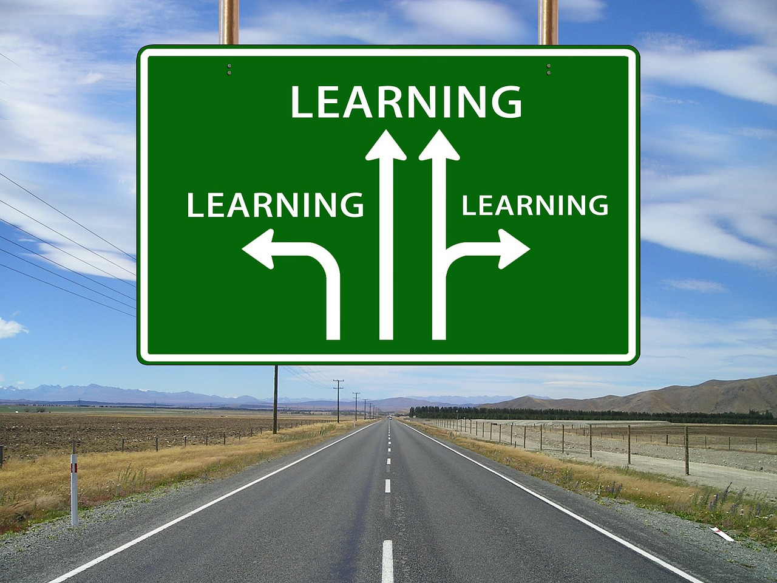

Differentiated learning outcomes • All students must understand and use the basic conventions of speech writing – attention-grabbing opening, lists and pairs (PASS). • Most students should appreciate and use writing in speeches that is fit for purpose, audience and form making good use of the conventions of speech writing – first and second person pronouns, present tense (MERIT). • Some students could create powerful voices in speech writing that use tone, content, structure and language appropriately (Distinction).

Slide 2

Exploring skills speeches are written to be spoken and to have an immediate impact on listeners. For example, speeches are likely to make greater use of shorter sentences, repetition and signposting than many texts designed to be read. Being aware of the effect of what you say on your audience is essential. Being able to manipulate this form is a key skill in many aspects of life. As a warm up, give examples of powerful speeches you have heard or heard of, then write down what makes these speeches memorable.

Slide 3
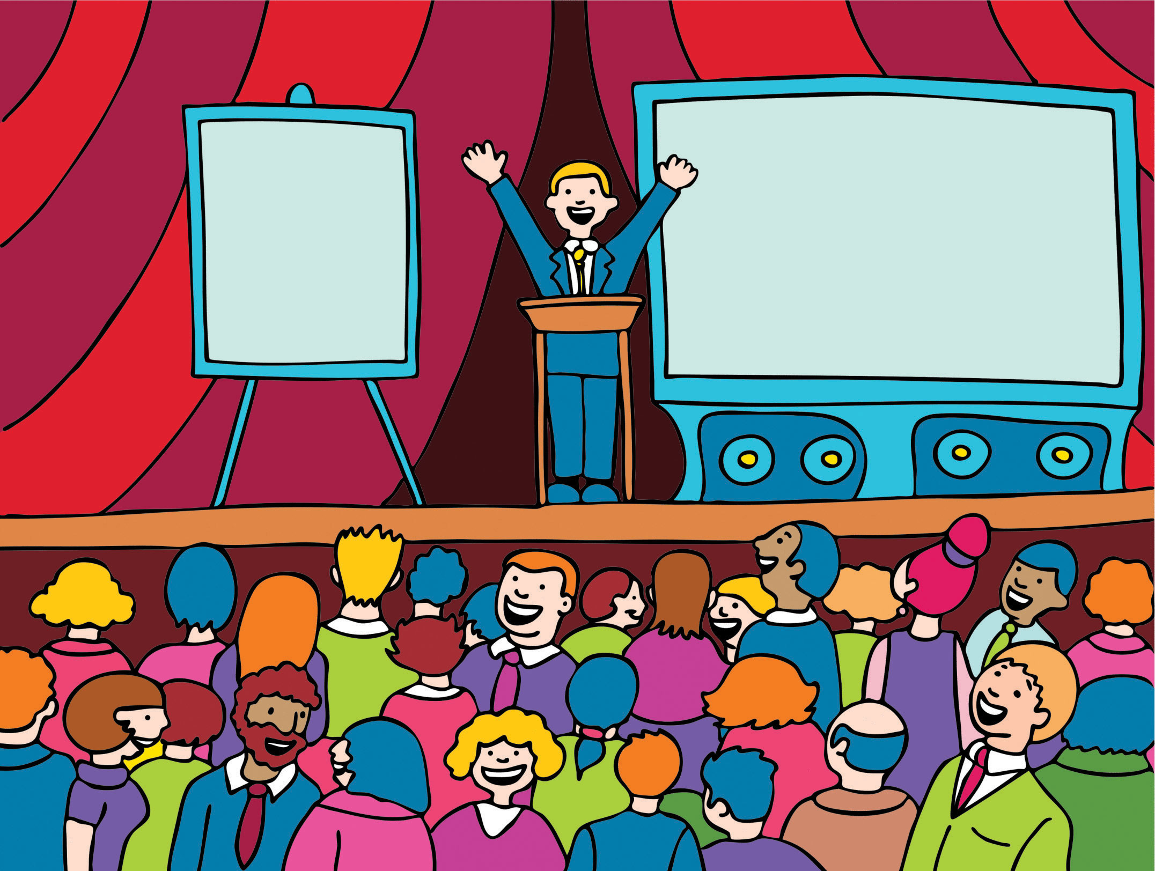
Exploring skills Read the short speech on the next slide and annotate the features. Look at the use of first and second person pronouns, lists, reasons, persuasive devices such as rhetorical questions and emotive language.

Slide 4
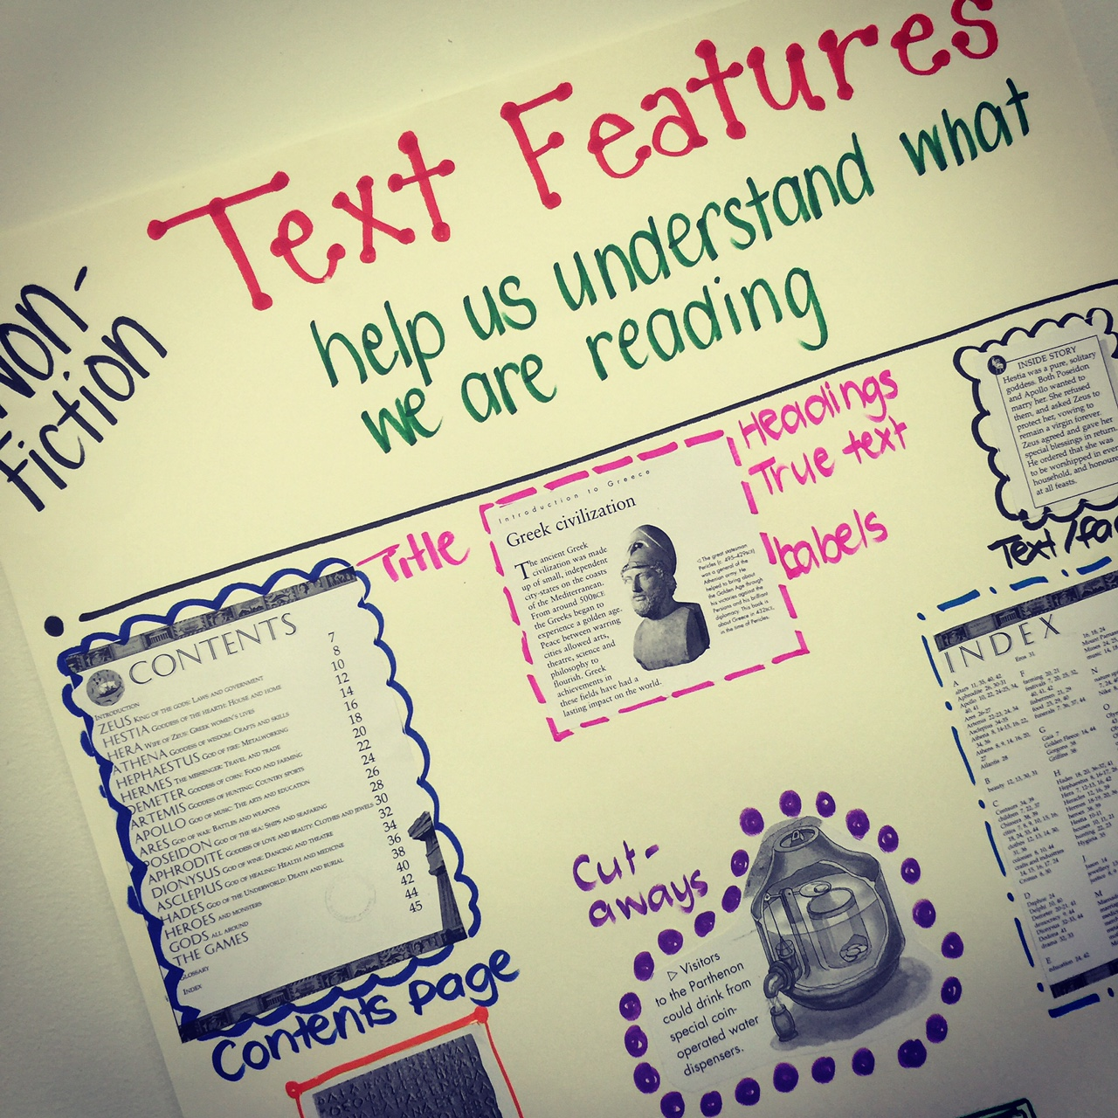
What features can you identify?
3.1a
I’m here, interrupting your tasty school lunch, for a simple reason – to ask you to vote for me. Most of you know me well, I think. I’ve shown you I can be trusted as a friend and relied on as a student in class. I’ll listen to your worries, report your wishes and represent you faithfully on the school council. Let’s face it – would anyone else do the same?

Slide 5

Opening to a speech in school
3.1b
What was the speaker’s purpose?
Who do you think the audience is? How does this speech ‘speak directly’ to them?
What examples of informal language are there?
What examples of humour or personal references are there?

Slide 6
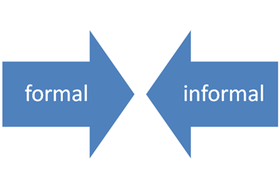

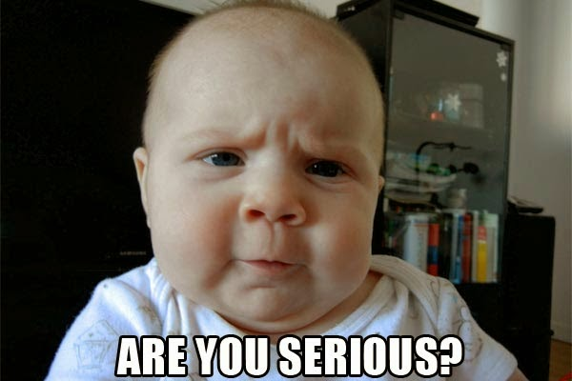
Is the speech friendly and informal or hard-hitting and serious? the speech is ‘conventional’ in that it uses many of the features you would expect to find in a speech written for that purpose and that audience. What is ‘effective’? evaluate the choices made by the writer using the sentence starter, ‘I think the writer’s choice of language is effective here because...’ Comment on the appropriateness for audience and purpose.

Slide 7

Building skills Look at the topic sentence ‘I’m here ... to ask you to vote for me’ see how this topic sentence sets the agenda that is followed in all the following sentences.

Slide 8

Read the whole text. what information is shared in this speech and what impact might it have on the intended listeners?

Slide 9
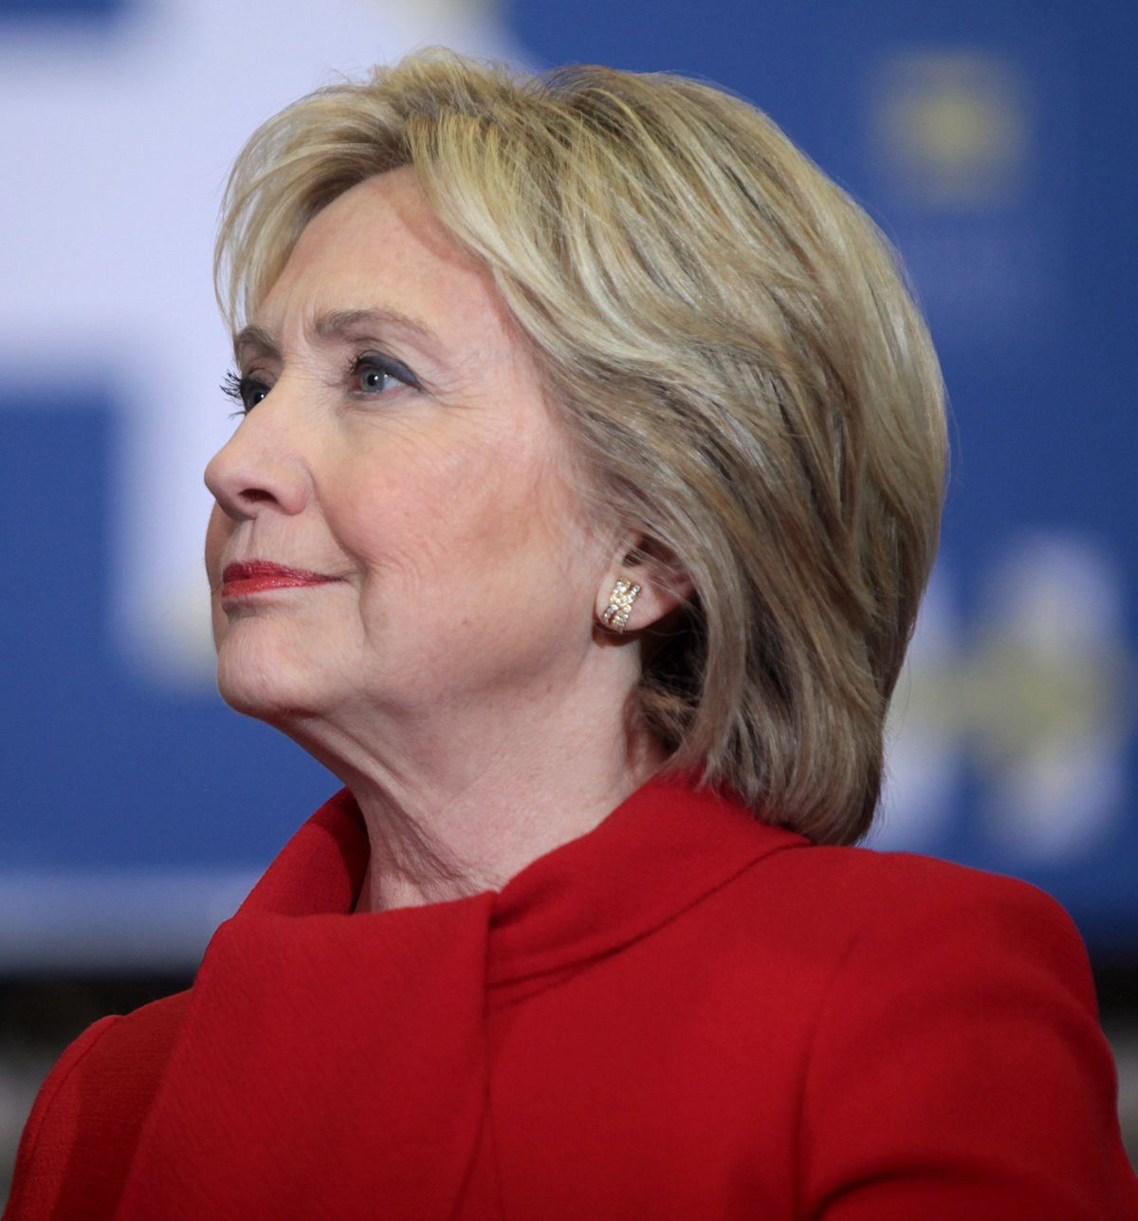
Opening to Hillary Clinton’s speech
3.1c
How does the list in paragraph 1 immediately engage with the audience?
What other examples of the annotated features can you find in the text? (For example, lists, images, repetition.) What is the effect of each technique?
How would you describe the speech’s overall effect? Is it hard-hitting, inspiring, emotional, funny?
How are the two speeches different and which is the most effective for its purpose and audience, and why?

Slide 10


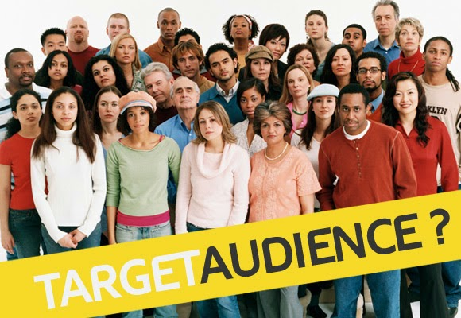
Developing skills read through the Clinton speech again answer the following questions: 1.what is Hilary Clinton’s message? (her purpose) 2.Whom is she talking to? (her audience) 3.How do we know this is a speech rather than a written report in a magazine? (the form) Think about the use of tenses, grammar and the type of sentences being used. As you answer each question, identify the features or techniques that make the speech effective for the purpose, audience and form.

Slide 11
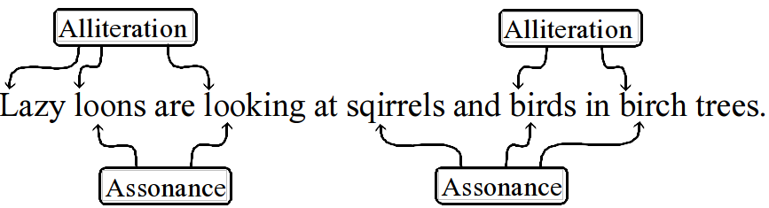


Have a look at the next few slides which shows the speech and highlights the purpose in red (to celebrate achievements), the audience in green (all women across the world) and the features of speeches in blue (for example, knocking down the opposing arguments). Can you see any familiar features of persuasive writing in the text, e.g. alliteration, emotive language and rule of three.

Slide 12
Mrs. Mongella, Under Secretary Kittani, distinguished delegates and guests: I would like to thank the Secretary General of the United Nations for inviting me to be part of the United Nations Fourth World Conference on Women. This is truly a celebration – a celebration of the contributions women make in every aspect of life: in the home, on the job, in their communities, as mothers, wives, sisters, daughters, learners, workers, citizens and leaders. It is also a coming together, much the way women come together every day in every country. We come together in fields and in factories. In village markets and supermarkets. In living rooms and board rooms.
3.1d
References to audience Purpose of speech

Slide 13
3.1e
Typical speech features Purpose of speech
Whether it is while playing with our children in the park, or washing clothes in a river or taking a break at the office water cooler, we come together and talk about our aspirations and concerns. And time and again, our talk turns to our children and our families. However different we may be, there is far more that unites us than divides us. We share a common future. [...]
By gathering in Beijing, we are focusing world attention on issues that matter most in the lives of women and their families: access to education, health care, jobs and credit, the chance to enjoy basic legal and human rights and participate fully in the political life of their countries.

Slide 14
3.1f
Typical speech features References to audience
There are some who question the reason for this conference. Let them listen to the voices of women in their homes, neighbourhoods, and workplaces. There are some who wonder whether the lives of women and girls matter to economic and political progress around the globe. Let them look at the women gathered here and at Huairou – the homemakers, nurses, teachers, lawyers, policymakers, and women who run their own businesses.

Slide 15

Plenary – Write down one or two things you have learnt about writing a speech. Write down one thing you would like to know more about or are still unsure of.

