Slide 1
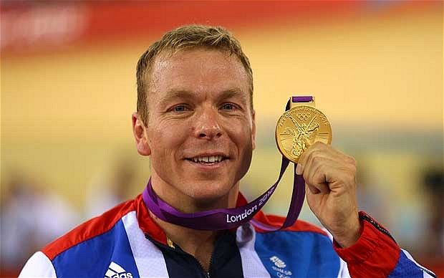
Who is this?

Slide 2
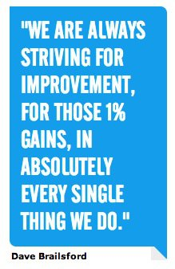
How can we apply this idea to us in English now?

Slide 3

Speech Writing
LO: To be able to use example responses to identify improvements we could make to our own writing.
Read through your speech from last lesson and write down 1 small thing you could do that would improve it..

Slide 4

Self-Assessment
Use the assessment sheet to make a list of 5 things that your speech must have to be successful.

Slide 5

Use the assessment sheet to assess where you think your vocabulary is currently.
Identify 1 paragraph that you want to redraft.

Slide 6


Identify which words and phrases you want to improve.
Use a thesaurus to select more ambitious vocabulary – check the meaning in the dictionary if you aren’t sure it means the same thing

Slide 7

Now rewrite your paragraph using the improved vocabulary you have created.

Slide 8
Use the self assessment sheet to assess where you think your vocabulary is in the paragraph you have just redrafted.

Slide 9
Continue to redraft and improve your speech.
When you are happy with it, create 3 questions around your topic that you would be happy answering.
Send your speech and questions to your teacher!

