Slide 1

Spoken Language
Monday 22nd June – Group A
This is for everyone working from home on
Monday 22nd June.
If you are in Group B and coming into school
for English on the 29th June, you will need to
have done this lesson!
It is really important that you read and complete
everything on this power point, because it is for your GCSE Spoken Language
Assessment when we return to school.

Slide 2
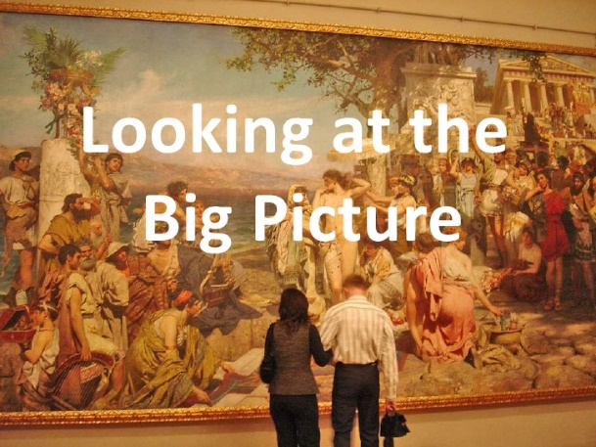






1. Read this slide.
Monday 22nd June
Overview of what you are going to be doing.
The Big Picture – What is Spoken Language and what should I expect?
What does success look like? Exploring what makes a good talk.
Becoming an expert – Researching your topic.
Creating your script - Writing your talk/Preparing for questions.
Making it better - Redrafting and improving.
Practice makes perfect - Practice and delivery of your talk.

Slide 3

Spoken Language
Monday 22nd June
2. Read this slide
The Spoken Language assessment is part of your:
GCSE (9-1)
English
Language
Spoken language will be reported as a separate grade on the your certificate.
The Exam Board is: Pearson Edexcel

Slide 4
Spoken Language
Monday 22nd June
3. Read this slide.
Spoken Language Endorsement
Internally assessed under controlled conditions 0% of the total GCSE (But you can’t get your GCSE English Language without doing it).
Overview of content ● Developing spoken language skills.
Overview of assessment ● The component is internally assessed under controlled conditions, and externally monitored by Pearson. ● Candidates must undertake a prepared spoken presentation on a specific topic in a formal setting, listen and respond to questions and feedback, and use spoken English effectively. ● There are no marks for the Spoken Language endorsement. Students are awarded a grade (Pass, Merit or Distinction).

Slide 5
Monday 22nd June
Assessment Objectives
Spoken Language
4. Read this slide
SPOKEN LANGUAGE | *AO7 | Demonstrate presentation skills in a formal setting | N/A
 | *AO8 | Listen and respond appropriately to spoken language, including to questions and feedback to presentations | N/A
 | *AO9 | Use spoken Standard English effectively in speeches and presentations | N/A
 |  | Total | 100%

Slide 6
5. Read this slide
Monday 22nd June
Learning Outcomes
Learning Outcomes | Students will:
 | present information and ideas: selecting and organising information and ideas effectively and persuasively for a prepared spoken presentation; planning effectively for a specific purpose and audience; making a presentation and speech
 | respond to spoken language: listening to and responding appropriately to any questions and feedback
 | spoken Standard English: expressing ideas using Standard English whenever and wherever appropriate.

Slide 7
6. Read this slide
Monday 22nd June
Content:
You must demonstrate your presentation skills in a formal setting, listen and respond to questions and feedback, and use spoken English effectively.
Presentation:
The spoken language presentation you are completing is going to be a speech or talk, followed by questions from the audience.
The presentation should be prepared and last no longer than 10 minutes, including questions.
Audience: You must give your presentation to an audience, which must always include a teacher.
The size and composition of the audience should be determined by a teacher, in discussion with you.

Slide 8
7. Read this slide
Monday 22nd June
Assessment criteria
You will be assessed from recordings.
There are no marks for the Spoken Language endorsement. You will be awarded a grade (Pass, Merit or Distinction) using the assessment criteria.
If you do not reach a pass or do not attempt the assessment, then this must be recorded as Not Classified. This grade will appear on your certificate.

Slide 9
Monday 22nd June
Understanding the criteria
The Criteria you will be assessed on is on the next slide. Look at the differences between a PASS, MERIT and DISTINCTION.
Write down what you think the main differences between the grades are.
For example: for a PASS your talk has to be at least straightforward. For a MERIT it has to be challenging. For a distinction it has to be sophisticated.
Look for the words that are different in each grade boundary.

Slide 10
General criteria
In order to achieve a particular grade, you must meet all of the criteria for that grade.
General criteria
To be awarded a Pass, Merit or Distinction a Learner must: • be audible, and • use Spoken Standard English which, for the purposes of the spoken language assessment, means that a Learner must: be intelligible, and generally use language appropriate to the formal setting of the presentation.
Pass | Merit | Distinction
In addition to the general criteria, to be awarded a Pass a Learner’s performance in his or her spoken language assessment must meet all of the following criteria – ● expresses straightforward ideas/information/ feelings, ● makes an attempt to organise and structure his or her presentation, ● makes an attempt to meet the needs of the audience, and ● listens to questions/feedback and provides an appropriate response in a straightforward manner. | In addition to the general criteria, to be awarded a Merit a Learner’s performance in his or her spoken language assessment must meet all of the following criteria – ● expresses challenging ideas/information/ feelings using a range of vocabulary, ● organises and structures his or her presentation clearly and appropriately to meet the needs of the audience, ● achieves the purpose of his or her presentation, and ● listens to questions/feedback responding formally and in some detail | In addition to the general criteria, to be awarded a Distinction a Learner’s performance in his or her spoken language assessment must meet all of the following criteria – ●expresses sophisticated ideas/information/feelings using a sophisticated repertoire of vocabulary, ●organises and structures his or her presentation using an effective range of strategies to engage the audience, ● achieves the purpose of his or her presentation, and ● listens to questions/ feedback, responds perceptively and if appropriate elaborates with further ideas and information.

Slide 11
Spoken Language
Monday 22nd June
Plenary
Write down what you think your strengths are already and what areas you think you will need to work on.
Use the general criteria to help you.

