Slide 1
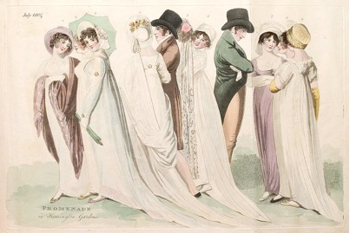
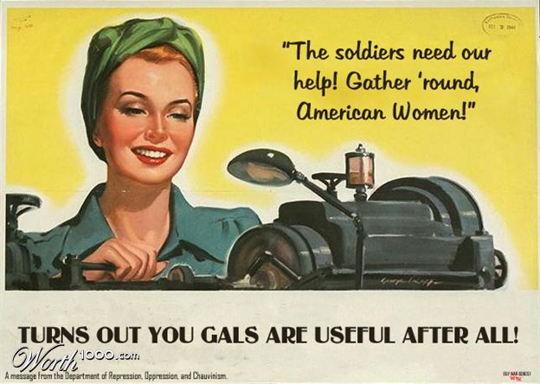
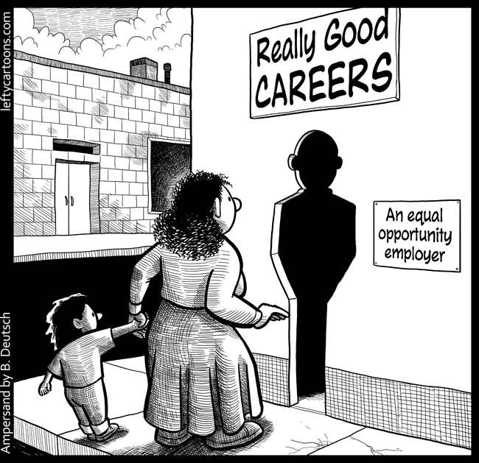
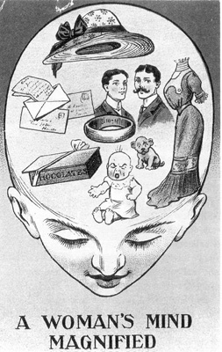
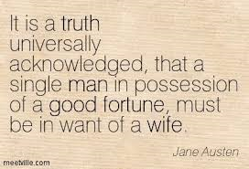
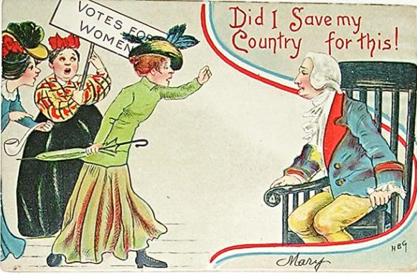
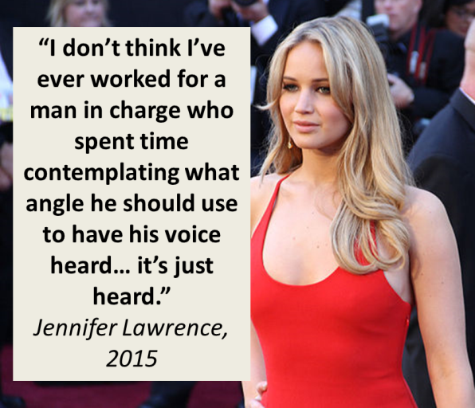
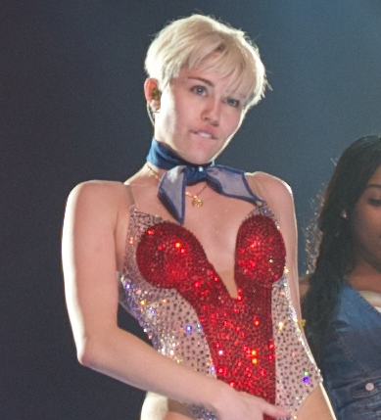
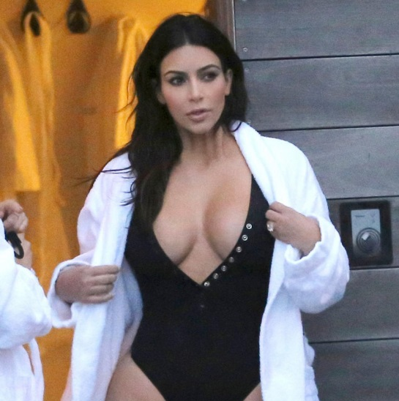
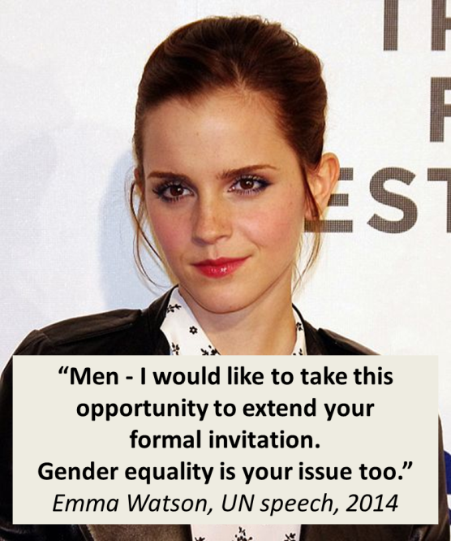
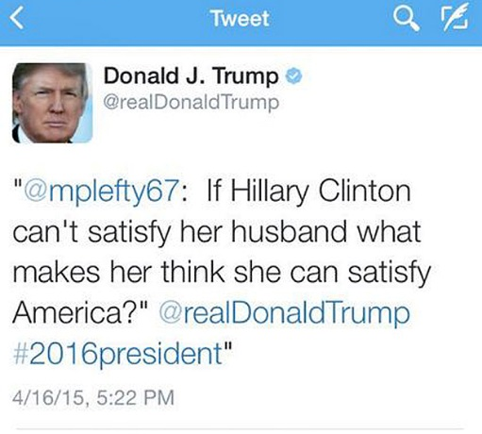
How have perceptions of women changed in the last 200 years?
© https://goo.gl/rxHzOx
© https://goo.gl/F7SjyX
© https://goo.gl/c1JeNb
© https://goo.gl/IQJJJh

Slide 2

L/O:
to analyse a 19th century fiction extract: Pride and Prejudice
Read the extract from Jane Austen’s Pride and Prejudice:
narrator
Mrs Bennet
Mr Bennet
What is the tone of the extract?
What do they talk about?
What do you notice about the dynamic between
Mr and Mrs Bennet?
What elements of people’s perceptions of women
at the time can you spot in the extract?

Slide 3
L/O:
to analyse a 19th century fiction extract: Pride and Prejudice
Short answer questions:
Reading Comprehension, Analysis of Language and Structure
1.) In the two paragraphs, before the characters speak, identify a phrase which explains the position of women in society at the time.
(1 mark)
2.) In the extract, up to the line ‘This was invitation enough’, find two ways it is implied that Mr Bennet is not interested in the conversation.
(2 marks)
3.) In the rest of the extract, how does the writer use language and structure to show the changes in Mrs Bennet’s mood?
(6 marks)

Slide 4
L/O:
to analyse a 19th century fiction extract: Pride and Prejudice
Long answer question:
4.) In this extract, there is an attempt to portray the dynamics of a married couple. Evaluate how successfully this is achieved.
Support your view with detailed reference to the text.
(15 marks)
Watch this adaptation of the extract.
Do you think it effectively captures the Bennets’ dynamic?
Why/why not?
What would you do differently?
https://www.youtube.com/watch?v=fMt1Fu7-Pp4 – Pride and Prejudice – BBC from 1:05

Slide 5

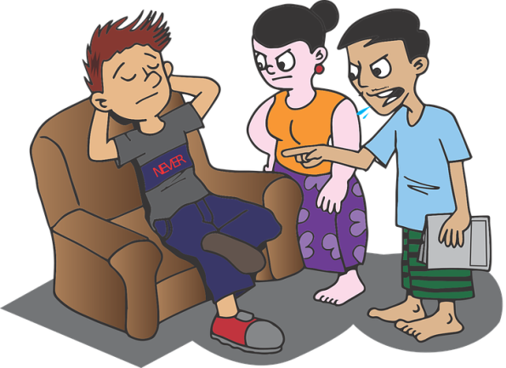
L/O:
to analyse a 19th century fiction extract: Pride and Prejudice
Imaginative Writing
EITHER
5.) Write about a time when you felt excited and optimistic about a future event.
Your response could be real or imagined.
OR
6.) Look at the images provided.
Write about a time when you felt frustrated during a conversation with someone.
Your response could be real or imagined. You may wish to base your response on one of the images.
(40 marks)

