Slide 1
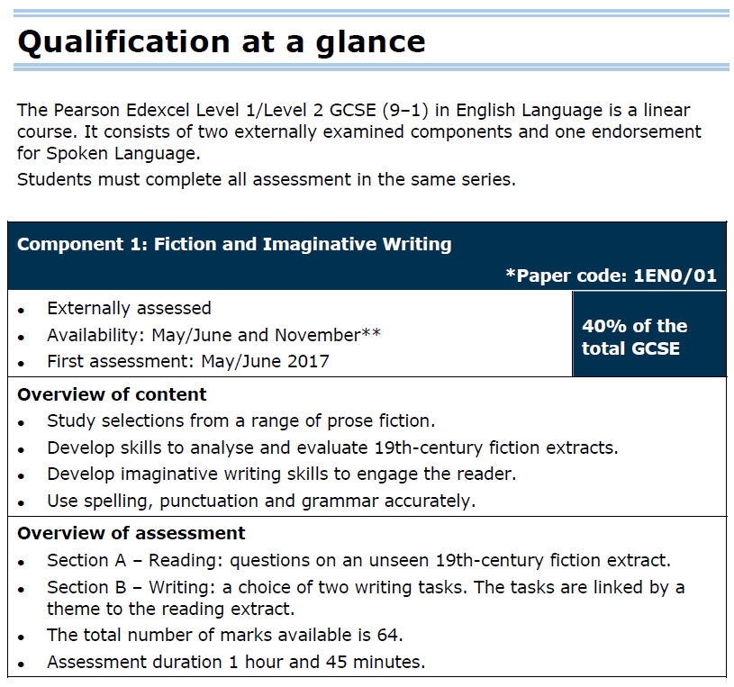
L/O:
to explore how the writer uses language and structure for effects.
English Language
Exam 1:
Have you ever read any
19th century fiction?

Slide 2
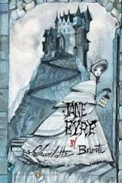
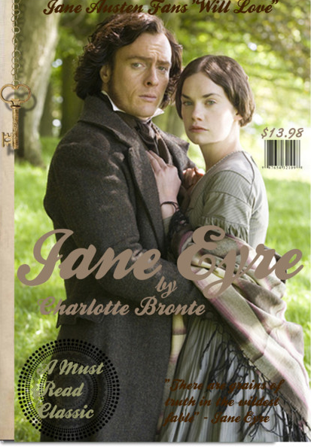
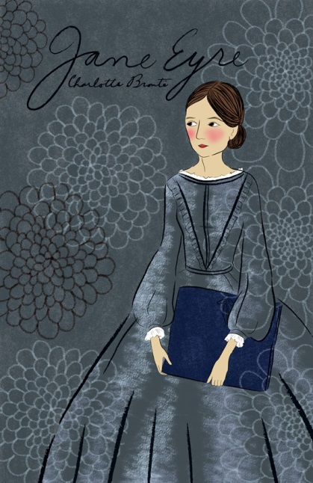
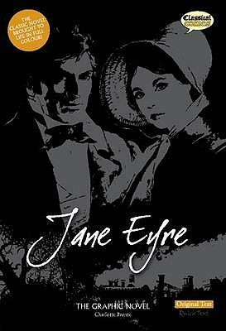
Look at the book covers for Jane Eyre by Charlotte Brontë.
What do you think the book is about?
©Classical Comics www.classicalcomics.com
https://www.youtube.com/watch?v=8IFsdfk3mlk
What other ideas can you add from the trailer for the film?

Slide 3

L/O:
to understand more about the format of the Fiction (Reading) section of the English Language GCSE
Short answer questions:
Reading Comprehension, Analysis of Language and Structure
1.) In the paragraph beginning ‘You have no business…’, identify a phrase which explains why John doesn’t like Jane.
(1 mark)
2.) In the paragraph beginning ‘He ran headlong…’, give two ways it is implied that Jane isn’t fully aware of her actions.
(2 marks)
3.) In the first half of the extract, up to ‘…declared aloud’, how does the writer use language and structure to show the changes in Jane’s mood?
(6 marks)

Slide 4

L/O:
to understand more about the format of the Fiction (Reading) section of the English Language GCSE
Charlotte Brontë’s novel Jane Eyre, published in 1847, tells the story of an orphan girl who lives as a young girl with her wealthy aunt, Mrs Reed, and her cousins, John, Eliza and Georgiana.
In the opening chapter, Jane is reading a book.
Read the extract.
What does the reader learn about John and Jane’s relationship?

Slide 5
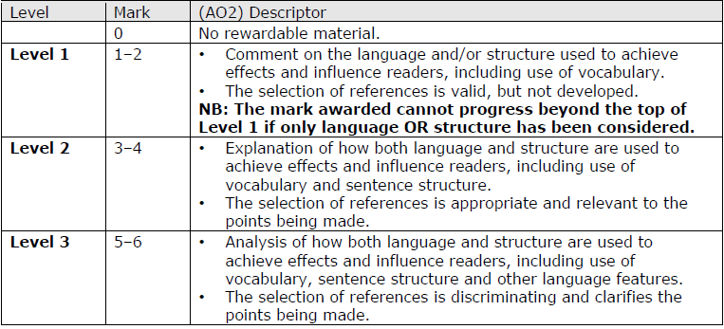

L/O:
to understand more about the format of the Fiction (Reading) section of the English Language GCSE
3.) In the first half of the extract, up to ‘…declared aloud’, how does the writer use language and structure to show the changes in Jane’s mood?
(6 marks)
Highlight how the wording changes between the levels
Analysis of language and structure
References

Slide 6
L/O:
to understand more about the format of the Fiction (Reading) section of the English Language GCSE
Long answer question:
Analysis of Language and Structure
4.) In this extract, there is an attempt to create tension between two characters. Evaluate how successfully this is achieved.
Support your view with detailed reference to the text.
(15 marks)

Slide 7
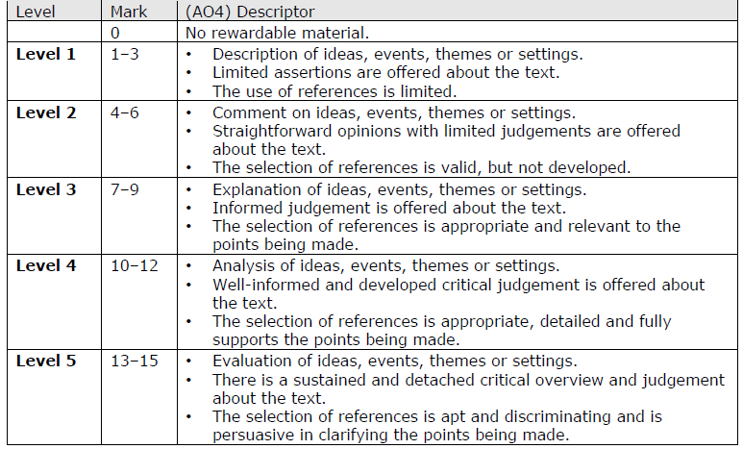
L/O:
to understand more about the format of the Fiction (Reading) section of the English Language GCSE
ideas, events, themes or settings
opinions/judgements about the text
references
Highlight how the wording changes between the levels

Slide 8
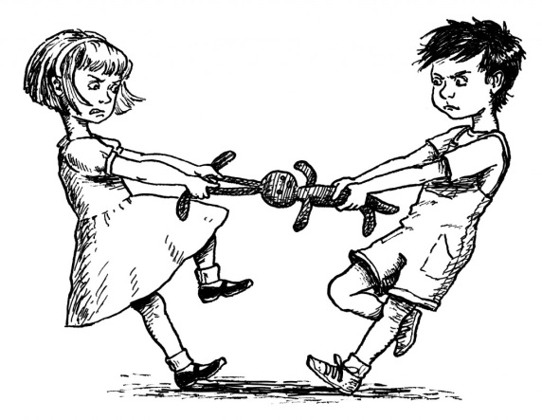
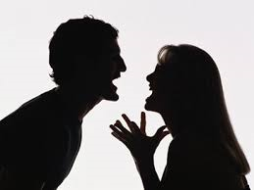
Imaginative Writing
EITHER
5.) Write about a time when you or someone you know felt you were unfairly blamed for something.
Your response could be real or imagined.
OR
6.) Look at the images provided.
Write about a time when you felt angry.
Your response could be real or imagined. You may with to base your response on one of the images.
(40 marks)

