Slide 1
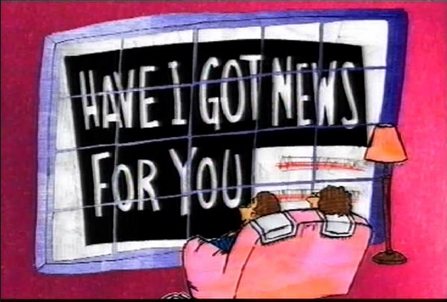

AMND BIG Writing
Learning Objectives
Core: To understand the style and tone of newspaper writing.
Challenge: To consider language, structure and punctuation choices when writing a newspaper article.

Slide 2
Looking at style
The language which you use when writing your articles is very important. Newspapers have a style all their own.
Look at the extracts on the next two slides.

Slide 3
Brutal Attack on Pensioner
Emotive adverbs and adjectives.
Direct speech
Personal details given
A lonely pensioner was brutally beaten up by a mugger, just yards from her own front door. All she had on her was £7.00.
“I was just walking home from my weekly lunch at the local Day Centre,” says widow Mary Evans, 86, of South Court, Devenish.
It wasn’t even dark, only 3pm on a September afternoon. And this isn’t a big city. Are we safe anywhere these days?
D.C. Matthew Johns of Green Lane Police Station, Wilborough said, “This is a really nasty attack on a defenceless old lady. It’s not even as though she had anything on her worth stealing.”
So, now we can’t even feel safe in our own street. When are the government going to wake up and realise they’ve got to do something about it? After all, we’re the ones who put them there. Shouldn’t they earn their keep by looking after us and making sure that old ladies don’t have to live in fear?
Use of contractions
Sub-heading breaks up text.
Not safe in our own streets
Rhetorical questions.
Short sentences and very short “paragraphs” throughout.

Slide 4
Random Street Crime is Rising
Brief personal details.
Grammatical accuracy.
Direct speech.
A national survey conducted by the Police Federation, reveals that we really are less safe on the streets than we were ten years ago.
The recent, well-publicised attack on an elderly pensioner, Mrs Mary Evans, aged 86 of Devenish, brought the issue of street muggings back to the public’s attention. The publication of this report will simply confirm what many ordinary people have felt for some time: that police efforts to control street crime have failed.
“It is now a matter of urgency that the government should recognise that it is its responsibility to tackle this issue. It cannot be right that the elderly should have to take their lives in their hands every time they step beyond their own front doors,” said Help The Aged’s spokesperson Helen Smith.
We claim to be a civilised country, yet it seems that our streets are not as safe as we should like to think. Perhaps it is time to reassess the priorities of the police force and target the unglamorous side of community policing: drugs seizures are undoubtedly important, but so is the day to day safety of vulnerable members of the community.
Sophisticated sentence structure.
Formal vocabulary.

Slide 5
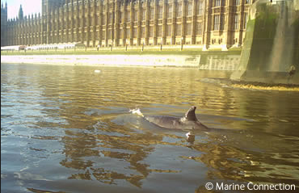
A seven-tonne whale makes its way up the River Thames in central London.
Write a positive and negative headline for the same story.

Slide 6
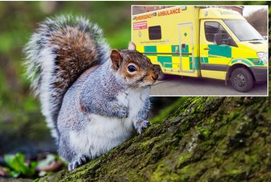
A concerned member of the public calls 999 and requests an ambulance for a squirrel that has been knocked down.
Write a humorous headline for this story.

Slide 7
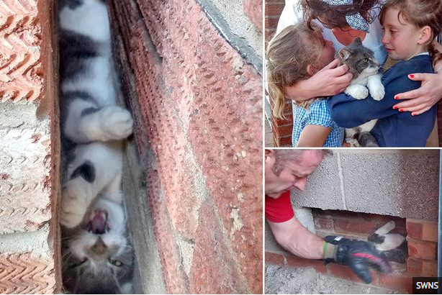
Cat trapped upside down in a wall for two hours is rescued by a fireman with a chisel.
Write a headline that contains alliteration for this story.

Slide 8

900 refugees drowned in the Mediterranean trying to flee to Italy from Libya.
Write an emotional headline for this story.

Slide 9
Sentence Structure and Punctuation
Learning Objectives
CORE: To understand how a range of punctuation can be used.
CHALLENGE: To develop relevant information with some imagination.

Slide 10
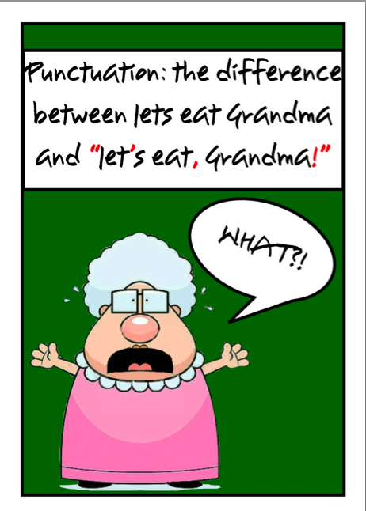
How might you punctuate the following?
Lets eat Grandma

Slide 11
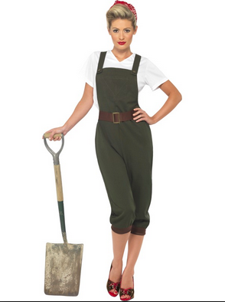
How might you punctuate the following?
A woman without her man is nothing

Slide 12
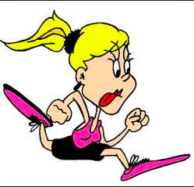
How might you punctuate the following?
We should run over Mum

Slide 13

Do we really need to Punctuate?
📹Imagine you are a news anchor and you are delivering a news bulletin through a piece to camera.
📹Write your bulletin on a topic of your choice WITHOUT any punctuation.
📹Read the bulletin aloud to someone else and discuss any obstacles that you have had as a result of not having punctuation. Ask the person you read it to, how it affected them.

Slide 14
Do we really need to Punctuate?
Rewrite your bulletin, putting in the punctuation.
📹Now, re-read the bulletin to someone and discuss:
Whether you have noticed any changes. If so, what are they?
How has the audience been affected?
How has the punctuation been effective?
Notes:
Feedback as a whole class.

