Slide 1

Learning Objectives
Core: To develop an understanding of plot and character in AMND.
Challenge: To reflect upon the theme of order and disorder and make appropriate notes on theme.

Slide 2
A Midsummer Night’s Dream
Create a character file for each character we have met in Act 1, Scene 1.
Write down any basic information about who they are and what they do in Act 1, Scene 1.
Try and link their character to the theme of order and disorder.
You can use the following slides to help you or you can create your own.

Slide 3
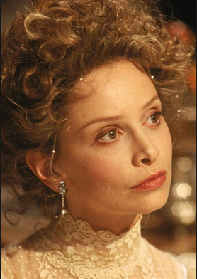
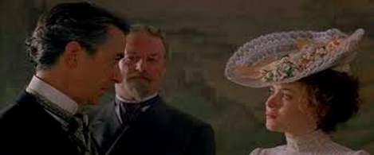
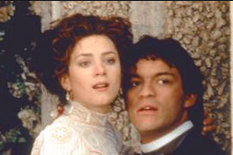
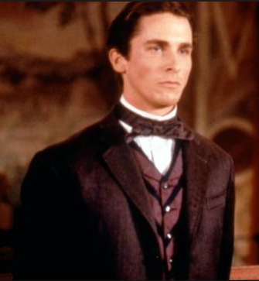
Character Tracking Sheet
Helena
……………………………………………………………………………………………………………………………………………………………………………………………………………………
Theseus
………………………………………………………………………………………………………………………Egeus
……………………………………………………………………………………………………………………..
How does each character represent order and disorder?
Lysander
………………………………………………………………………………………………………………………………
Hermia ……………………………………………………………………………………………………………………………….
Demetrius
…………………………………………………………………………………………………………………………………………………………………………

Slide 4
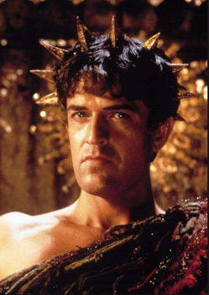
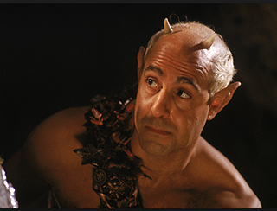
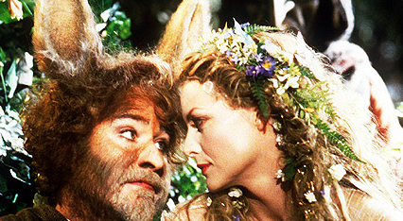
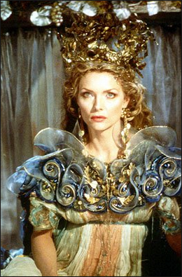
Oberon
…………………………………………………………………………………………………………………………………………………………………………………………………………
Puck
…………………………………………………………………………………………………………………………………………………………………………
How does each character represent order and disorder?
Titania
……………………………………………………………………………………………………………………………………………………………………………………………………………………
Bottom
……………………………………………………………………………………………………………………………………………………………………………………………………………………

