Slide 1
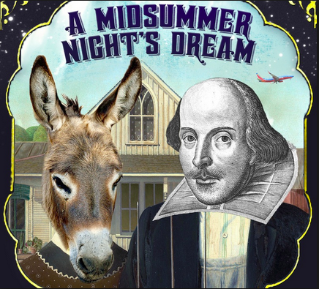
Robin…Master of Disorder?
Learning objectives
Core: To reflect on roles in light of theme.
Challenge: To make analytical comment on character and language.
Notes:
Act 2 Scene 1
Lines 148 -268

Slide 2
Have another look at these quotes from Robin Goodfellow (Puck)
Fetch me that flower, the herb I showed thee once; The juice of it on sleeping eyelids laid Will make man or woman madly dote Upon the next live creature that it sees.
I’ll put a girdle round about the earth in forty minutes!
Having once this juice I’ll watch Titania when she is asleep, And drop the liquor of it in her eyes: The next thing then she, waking, looks upon – Be it on lion, bear or wolf, or bull, On meddling monkey, or on busy ape – She shall pursue it with the soul of love…I’ll make her render up her page to me.
What thou seest when thou dost wake,
Do it for thy true love take;
Love and languish for his sake.
Be it ounce or cat or bear,
Pard, or boar with bristled hair
In thy eye that shall appear
When thou wak’st, it is thy my dear.
Wake when some vile thing is near!

Slide 3
Robin…Master of Disorder or Mere Minion?
Look back over all your work from last lesson.
Write a PEE paragraph exploring who is ultimately responsible for the chaos that is about to ensue. Is it Robin or is he merely Oberon’s puppet?
Notes:
Can set for home work if time is short.

