Slide 1
Narrative or Descriptive Writing
English Language Paper 1 – Question 5/6

Slide 2
Starter: Sentence improvers
Improve the following sentences…
He was fast asleep on the floor
The rat ran past the man
The soldier could hear gunfire
The grey sky looked miserable
The smell of soup was strong

Slide 3
Noun phrase:
A word or a group of words containing a noun and functioning in a sentence as subject and object.
Example:
The corner house is for sale.
adjective

Slide 4
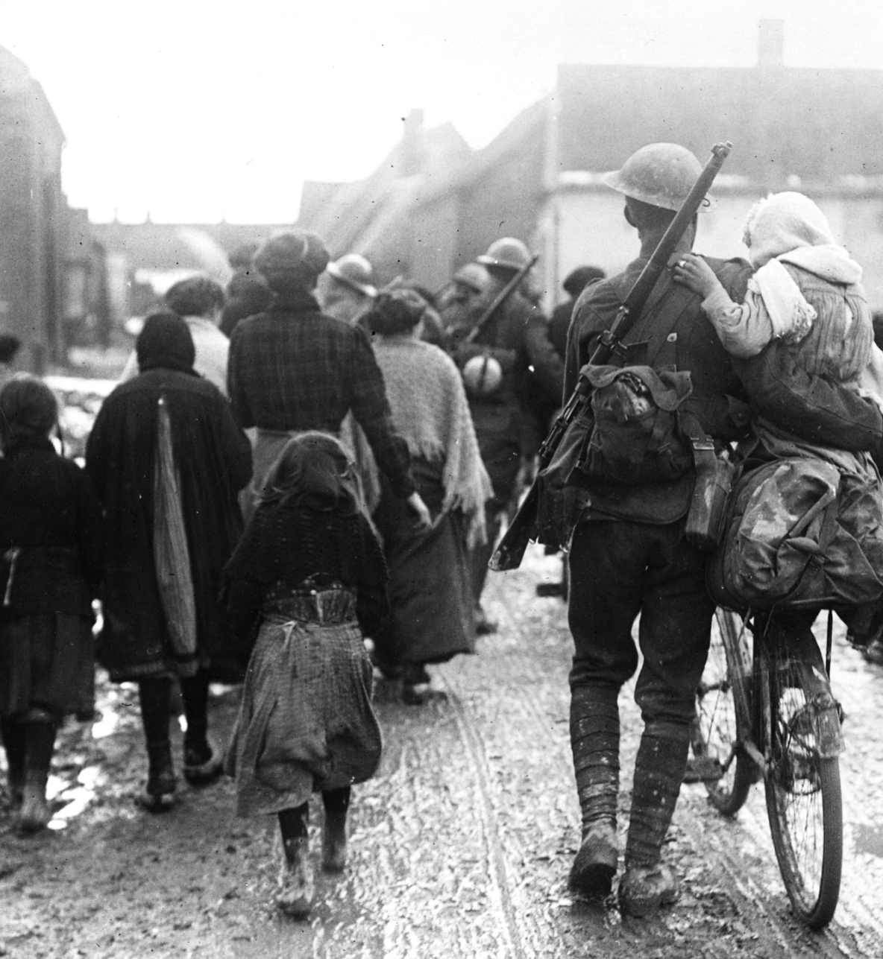
Writing task – Opening Paragraph
Sentence 1: Must start with an adverb and contain a noun phrase
Sentence 2: Must contain 3 words
Sentence 3: Must contain a simile
Sentence 4: Must contain one of the five senses
Sentence 5: Must have a synonym of the word ‘sad’ in it

Slide 5


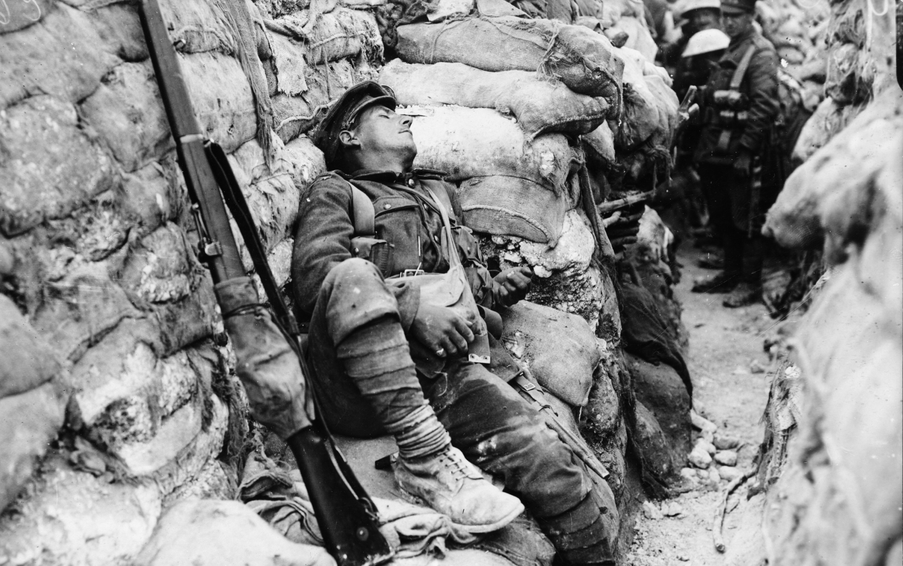

GCSE ENGLISH LANGUAGE
Sample Paper 1 Question 5/6
15 minute writing challenge
You have a copy of the image in front of you
Circle 4 points that you wish to focus on and label them 1-4
The area which has been circled as number 1 will be the focus of your opening paragraph
Spend 25 minutes crafting your response to this image
Self-assessment
Check your work for full stops, capital letters, commas and paragraphs.
Write a description or story suggested by this picture
(24 marks for content and organisation
16 marks for technical accuracy)
[40 marks]
:

