Slide 1
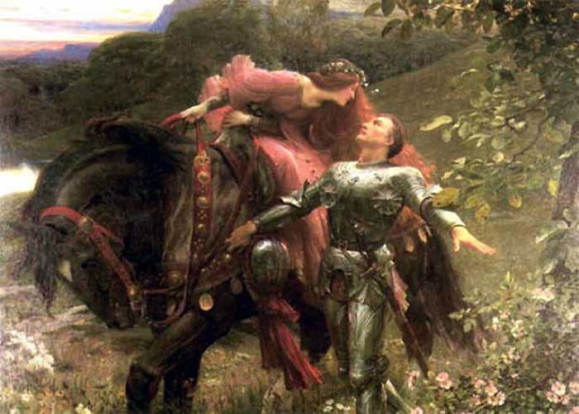
La Belle Dame Sans Merci
By John Keats
1795-1821

Slide 2
Learning Objective:
LO: analyse the language used by a writer to create meanings and effects, using relevant subject terminology where appropriate.

Slide 3
La Belle Dame Sans Merci
The Beautiful Lady Without Mercy
What do we understand from the title of the poem?

Slide 4
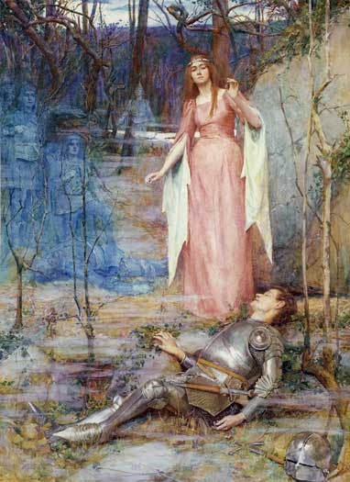
VI.
I set her on my pacing steed,
And nothing else saw all day long,
For sidelong would she bend, and sing
A faery’s song.
VII.
She found me roots of relish sweet,
And honey wild, and manna dew,
And sure in language strange she said—
“I love thee true.”
VIII.
She took me to her elfin grot,
And there she wept, and sigh’d fill sore,
And there I shut her wild wild eyes
With kisses four.
IX.
And there she lulled me asleep,
And there I dream’d—Ah! woe betide!
The latest dream I ever dream’d
On the cold hill’s side.
X.
I saw pale kings and princes too,
Pale warriors, death-pale were they all;
They cried—“La Belle Dame sans Merci
Hath thee in thrall!”
XI.
I saw their starved lips in the gloam,
With horrid warning gaped wide,
And I awoke and found me here,
On the cold hill’s side.
XII.
And this is why I sojourn here,
Alone and palely loitering,
Though the sedge is wither’d from the lake,
And no birds sing.
I.
O WHAT can ail thee, knight-at-arms,
Alone and palely loitering?
The sedge has wither’d from the lake,
And no birds sing.
II.
O what can ail thee, knight-at-arms!
So haggard and so woe-begone?
The squirrel’s granary is full,
And the harvest’s done.
III.
I see a lily on thy brow
With anguish moist and fever dew,
And on thy cheeks a fading rose
Fast withereth too.
IV.
I met a lady in the meads,
Full beautiful—a faery’s child,
Her hair was long, her foot was light,
And her eyes were wild.
V.
I made a garland for her head,
And bracelets too, and fragrant zone;
She look’d at me as she did love,
And made sweet moan.

Slide 5
AO3: Context

Slide 6
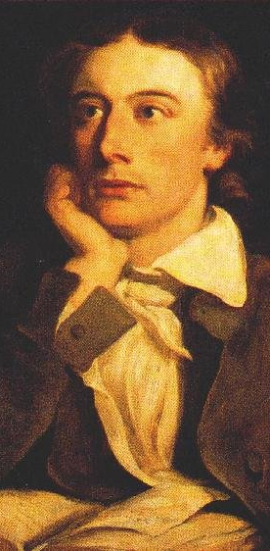
1795-1821
Romantic Poet
John Keats
Keats was the youngest of the Romantics. He was born in East London, where his father managed stables. He was mostly self-taught and trained to be an apothecary at the age of fourteen. When he started writing poetry, most critics dismissed him as an upstart due to his lack of formal education.
Keats’ mother died of tuberculosis when he was fourteen. Keats nursed his brother through the same illness; he died in 1818. A short while after, Keats himself showed signs of the disease and, knowing he was going to die, went to live in Italy where, it was thought, the warmer weather would prolong his life. He wrote ‘La Belle…’ with the shadow of death hanging over him, in physical and emotional agony.
Keats fell in love with Fanny Brawne and they were engaged to be married, however were kept apart because of his financial problems, then his illness. She remained loyal to him until his death.
He died at the age of 25. He was only beginning to write his best poetry, so he asked that his gravestone bear the words, ‘Here lies one whose name was writ in water’ – he didn’t think he’d lived up to his potential, thought his life was too short to be memorable, and that his poetry was like ‘words written in water’.

Slide 7
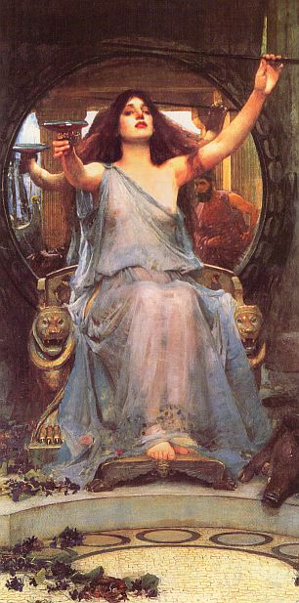
La Belle Dame
The title of the poem comes from a 15th century poem by Alain Chartier, a French poet. It consists of 100 stanzas of dialogue between a male lover and the lady he loves (‘l’Amant et la Dame). Their dialogue is framed by the narrator-poet who is grieving for his own recently deceased love.
The male lover in this poem is alone on horseback, driven to wander by Sadness, and robbed of feeling by Death. The lady eventually refuses to return his feelings of love.
The beautiful lady without pity is a popular character in folk tales, classical literature, Renaissance poetry and medieval ballads. She is a femme fatale, a siren, a Circe-like figure who attracts lovers only to destroy them with her supernatural powers. These are figures without pity whose function is to entrap.

Slide 8
AO2: Language and Imagery

Slide 9
This image creates a medieval setting
Consonance draws our attention to ‘palely’, linking it via internal rhyme to ‘ail thee’
I.
O WHAT can ail thee, knight-at-arms,
Alone and palely loitering?
The sedge has wither’d from the lake,
And no birds sing.
II.
O what can ail thee, knight-at-arms!
So haggard and so woe-begone?
The squirrel’s granary is full,
And the harvest’s done.
Marsh plants
Sick and depressed
The condition of the trees and lakes reflect the mood of the knight. They are withering and silent, like he is haggard and ailing. He must also be silent as he does not reply until a later stanza.
There are hints of a time of year suggesting it is autumn. Squirrel/harvest are the clues. This is significant because this is the end of the time of fertility, linking thematically to the cycle of life. The poem is also cyclical and represents the knight’s entrapment. Reoccurring
Notes:
Trees/lake – they are withering and silent, like he is haggard and ailing. He must also be silent as he does not reply until a later stanza.
Time of year = autumn. Squirrel/harvest are the clues. This is significant because this is the end of the time of fertility, linking thematically to the cycle of life. The poem is also cyclical and represents the knight’s entrapment.

Slide 10
A symbol of death; he is pale
III.
I see a lily on thy brow
With anguish moist and fever dew,
And on thy cheeks a fading rose
Fast withereth too.
IV.
I met a lady in the meads,
Full beautiful—a faery’s child,
Her hair was long, her foot was light,
And her eyes were wild.
He is dying
The voice shifts here: the knight tells his tale
A meadow
Supernatural
Long hair – sensuality
Light of foot – graceful or quick and unpredictable
Wild eyes – supernatural? Or a promise of wild sex?

Slide 11
V.
I made a garland for her head,
And bracelets too, and fragrant zone;
She look’d at me as she did love,
And made sweet moan.
VI.
I set her on my pacing steed,
And nothing else saw all day long,
For sidelong would she bend, and sing
A faery’s song.
A belt of flowers.
This seems to suggest an erotic encounter.
This suggests sexual confidence
Notes:
The knight may have put the lady on his horse, or this may be a euphemism for his penis – in this case ‘all day long’ suggests an extended session of lovemaking.

Slide 12
Manna = food from heaven; God provided this for the Israelites as they wandered in the desert after being freed from slavery.
She is supernatural and has access to heavenly food
2. This links to the man being enslaved by the lady.
Paradox? Her language is strange but he understands it.
VII.
She found me roots of relish sweet,
And honey wild, and manna dew,
And sure in language strange she said—
“I love thee true.”
VIII.
She took me to her elfin grot,
And there she wept, and sigh’d full sore,
And there I shut her wild wild eyes
With kisses four.
Grotto/cave

Slide 13
A gentle, almost onomatopoeic word
IX.
And there she lulled me asleep,
And there I dream’d —Ah! woe betide!
The latest dream I ever dream’d
On the cold hill’s side.
X.
I saw pale kings and princes too,
Pale warriors, death-pale were they all;
They cried—“La Belle Dame sans Merci
Hath thee in thrall!”
Repetition reinforces the importance of this dream – the ‘latest’ (i.e. last) he will have
Exclamation of extreme grief; note he interrupts himself to utter it
A shift in tone
Repetition of ‘pale’ echoes ‘dream’ and links the two
Consonance links these words, suggesting cause/effect – the shared fate of the knight
Harsh sound of their cry – this wakes him in the next stanza
Notes:
They are her previous ‘victims’ – the paleness represents death; it could also represent the shadow of TB hanging over Keats. ‘Pale’ also links to the first description of the knight. He is now one of them.

Slide 14
dusk
XI.
I saw their starved lips in the gloam,
With horrid warning gaped wide,
And I awoke and found me here,
On the cold hill’s side.
XII.
And this is why I sojourn here,
Alone and palely loitering,
Though the sedge is wither’d from the lake,
And no birds sing.
Love and illness/death are linked via this ‘horrid warning’
Death approaches
The closing lines are repeated from stanza 1 but spoken by a different voice
What is the effect of this?
What is the poet saying here?
Notes:
Closing lines/repetition = emphasising the fate of the knight; we have returned to the first image. This also encloses the poem and creates a sense of his entrapment.

Slide 15

Imagery: Flowers
Line 9: Lilies are often associated with death, so the ‘lily’ on the knight’s ‘brow’ (forehead) suggests that he is close to death. Lilies are also pale white, so reflect the knight’s colour.
Line 11: Roses are associated with love – the knight’s ‘rose’ is ‘fading’ and ‘wither[ing]’. This implies the end of a romantic relationship. It also describes the knight’s complexion as the ‘rose’ in his cheeks fades.
Lines 17-18: The knight makes a ‘garland’ and ‘bracelet’ of flowers for the lady. These seem to suggest that he is in love with her, the flowers representing his regard.
Line 18: A ‘fragrant zone’ is a belt made from flowers; it could also be a euphemism for the lady’s genitals.

Slide 16
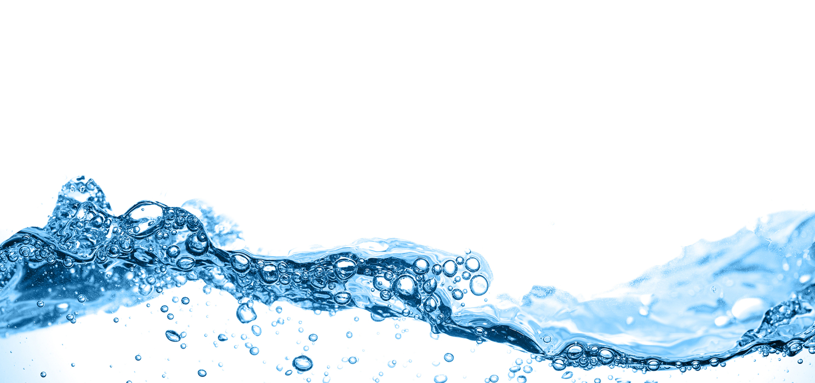
Imagery: Water
Medieval romances often associate women with water; traditionally, men are weakened by their contact with these women.
Line 3: death and ‘wither[ing]’ are associated with the ‘lake’. It is worth considering that lakes, unlike rivers, do not flow – they can stagnate.
Line 10: the knight’s face is ‘moist’ with ‘fever dew’.
Line 26: the knight tells us that the lady fed him ‘manna dew’. It is unusual for manna to be presented as a liquid; this links to the ‘fever’ that the knight has.

Slide 17
AO2: Form / Structure

Slide 18
VI.
I set her on my pacing steed,
And nothing else saw all day long,
For sidelong would she bend, and sing
A faery’s song.
VII.
She found me roots of relish sweet,
And honey wild, and manna dew,
And sure in language strange she said—
“I love thee true.”
VIII.
She took me to her elfin grot,
And there she wept, and sigh’d fill sore,
And there I shut her wild wild eyes
With kisses four.
IX.
And there she lulled me asleep,
And there I dream’d—Ah! woe betide!
The latest dream I ever dream’d
On the cold hill’s side.
X.
I saw pale kings and princes too,
Pale warriors, death-pale were they all;
They cried—“La Belle Dame sans Merci
Hath thee in thrall!”
XI.
I saw their starved lips in the gloam,
With horrid warning gaped wide,
And I awoke and found me here,
On the cold hill’s side.
XII.
And this is why I sojourn here,
Alone and palely loitering,
Though the sedge is wither’d from the lake,
And no birds sing.
I.
O WHAT can ail thee, knight-at-arms,
Alone and palely loitering?
The sedge has wither’d from the lake,
And no birds sing.
II.
O what can ail thee, knight-at-arms!
So haggard and so woe-begone?
The squirrel’s granary is full,
And the harvest’s done.
III.
I see a lily on thy brow
With anguish moist and fever dew,
And on thy cheeks a fading rose
Fast withereth too.
IV.
I met a lady in the meads,
Full beautiful—a faery’s child,
Her hair was long, her foot was light,
And her eyes were wild.
V.
I made a garland for her head,
And bracelets too, and fragrant zone;
She look’d at me as she did love,
And made sweet moan.
Can you identify the rhyme scheme?

Slide 19
I.
O WHAT can ail thee, knight-at-arms,
Alone and palely loitering?
The sedge has wither’d from the lake,
And no birds sing.
II.
O what can ail thee, knight-at-arms!
So haggard and so woe-begone?
The squirrel’s granary is full,
And the harvest’s done.
III.
I see a lily on thy brow
With anguish moist and fever dew,
And on thy cheeks a fading rose
Fast withereth too.
IV.
I met a lady in the meads,
Full beautiful—a faery’s child,
Her hair was long, her foot was light,
And her eyes were wild.
V.
I made a garland for her head,
And bracelets too, and fragrant zone;
She look’d at me as she did love,
And made sweet moan.
A
B
C
B
The simplicity of the poem’s structure contrast with its complex interpretations.
A
B
C
B
Each stanza has three lines of iambic tetrameter, then a fourth dimetric line (i.e. two feet or beats). This gives the ballad a slow, steady rhythm and ensures that the shorter last lines of each quatrain hurtle us forward to the next.
A
B
C
B
A
B
C
B
A
B
C
B

Slide 20
The Ballad
A ballad is an old fashioned form of poem that typically tells a story. They were primarily an oral form of poetry, designed to be performed, memorised and passed on to friends. Keats – along with other Romantics – tries to mimic this style in his written work, taking advantage of the deceptively simple form.
Ballads, as they were meant to be performed out loud, sound like songs. The rhythm of the words, the rhyme scheme, the alliteration and repetition give them a music-like harmony.
Keats uses a number of stylistic features of the ballad, such as simplicity of language, repetition and absence of detail. In line with tradition, Keats does not identify his questioner, or the knight, or the lady.
Like some of the old ballads, it deals with the supernatural.
Keats uses a question-and-response form, also borrowed from ballads. In the first three stanzas the speaker asks the knight questions; the rest of the poem is taken up with his response.

Slide 21
AO4/5: Links and Interpretations

Slide 22
How can we link this to other poems we have read? How does it link to attitudes towards love – or lust?
The motives of the lady are only described from the knight’s point of view. We are never told why she cries in her ‘elfin grot’. Some readers suggest he has hurt or injured her in some way. Is this a valid reading?
Some readers see the poem as Keats’ personal rebellion against the pains of love.
‘La Belle Dame…’ is about being abandoned by the one you love. The lady abandons him without pity and the knight’s solitude is the framing image of the poem.
What do these readings offer us?

Slide 23
AO1: What kind of love is presented in this poem?
Think about:
The characteristics of love
The representation of the people involved
The feelings of the speaker
Any imagery or language used
The way the structure and form reflects this
You can either:
Write a side of A4 to explain your answer.
Write a detailed plan of your answer.
Make sure you include and analyse quotations from the text.

