Slide 1
The Living World – Small Scale Ecosystems
Do Now
Write your own definition of an ecosystem
Key words
Producer
Consumer
Decomposer
Recycling
Food chain
Food web
Nutrient cycle
Ext – What examples of ecosystems do you know?
Aim
To understand small scale ecosystems

Slide 2
Definition
An ecosystem is a community of plants and animals living together in a habitat. The lives of the plants and animals are closely linked to each other and the climate and soil of the area that they live in.
Exist on a range of scales – small scale (e.g. pond) to larger scale (a lake or woodland). The largest ecosystems are called biomes and they exist on a global scale (e.g. tropical rainforests).

Slide 3
https://www.youtube.com/watch?v=WuejxJttBqo

Slide 4
Small scale ecosystems
Ecosystems can be small-scale, covering a small area (such as a pond) or large-scale covering a large area (such as a tropical rainforest).
The world is divided up into ten major ecosystems. These large-scale ecosystems are called biomes.

Slide 5
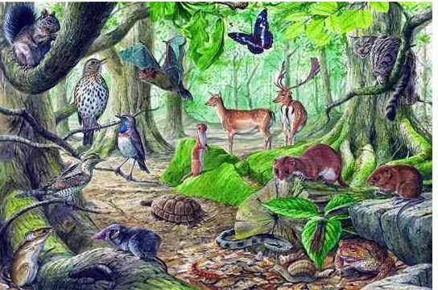
A small ecosystem - Woodland

Slide 6
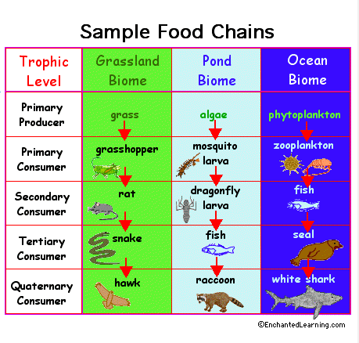

Slide 7
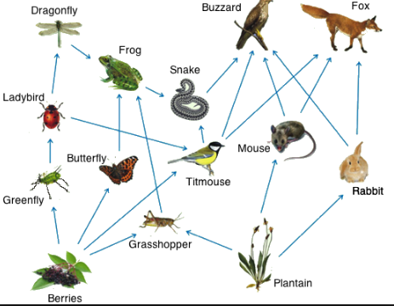
Food web

Slide 10
Task
Think of examples of other ecosystems
What factors will effect ecosystems?
Ext – What different habitats exist within each ecosytem?

Slide 11
Freshwater Pond
A freshwater pond is a small ecosystem for plants and animals.
The amount of light, water and oxygen will vary across the pond
Plants like reeds grow
Ducks and small insects will live on the surface
In deeper parts of the pond there will be fish

Slide 12
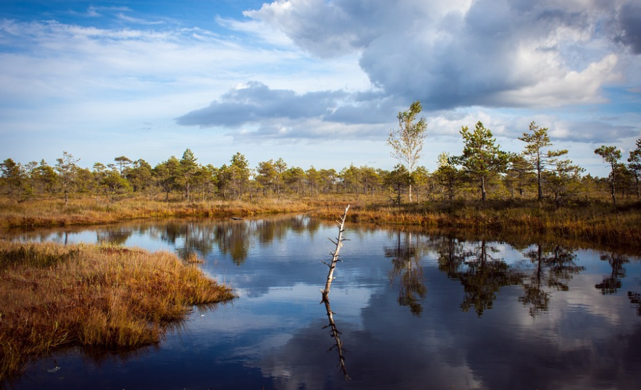
Draw a pond and label using the handout

Slide 13
Task
1 – Describe your pond ecosystems
2 – Why are ducks a good example of a consumer?
3 – What will happen to the ecosystem if it becomes polluted?
4 – Where do mots decomposers live?
Ext – Exam question “Explain and describe the features of a small ecosystem (4 marks)

Slide 14
What have we learnt today?
Aim
To understand small scale ecosystems
What we will learn next…
How does change effect ecosystems?

