Slide 1
Power and the People
Unit 2: Early Modern Britain, c1450 – c1800

Slide 2
The English Civil War
This is the second unit of our final GCSE topic, Power and the People.
There was a war in England, The King and his supporters vs. Parliament and their supporters. This term we are going to learn about this Civil War, if you are unable to complete the activities, you can make notes and revision resources. Research online etc.
For each Lesson you will need to read each Chapter and complete the Activity and Think boxes. You can submit your work in whatever format suits you, for example Microsoft Word or PowerPoint. Please submit via Microsoft Teams.

Slide 3
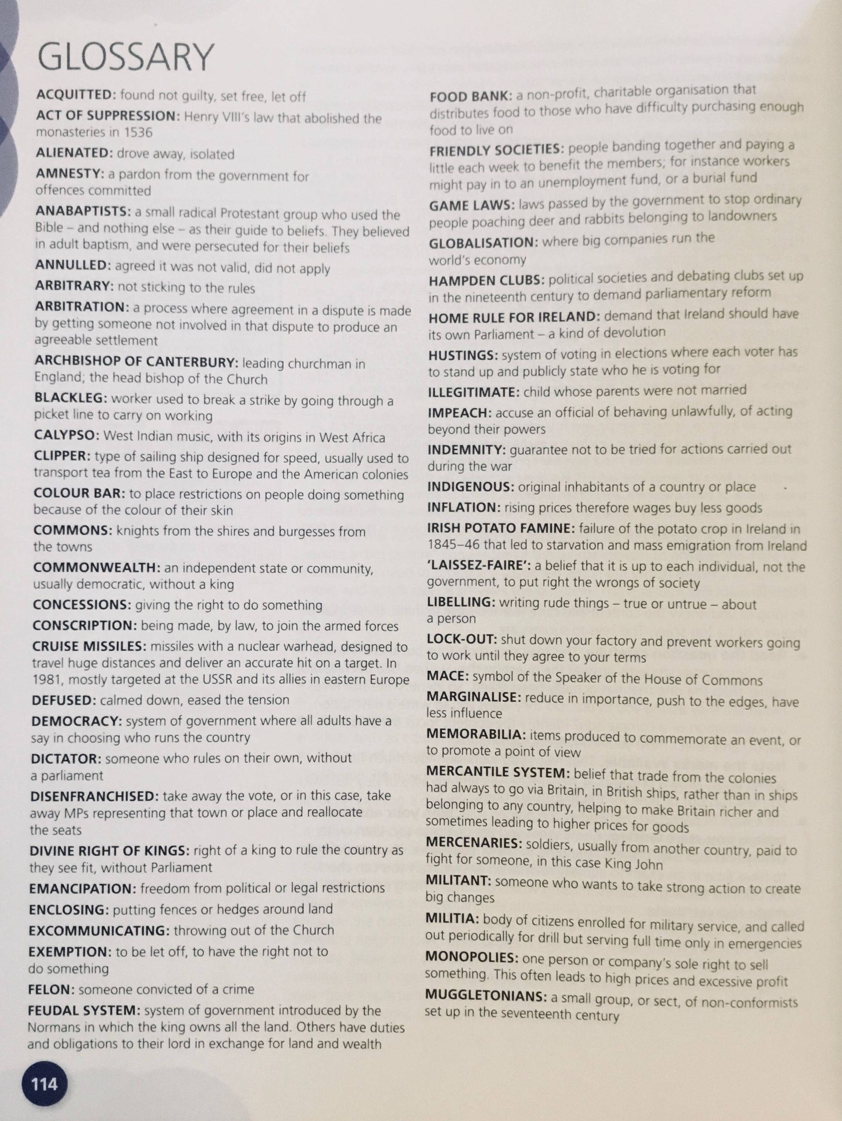
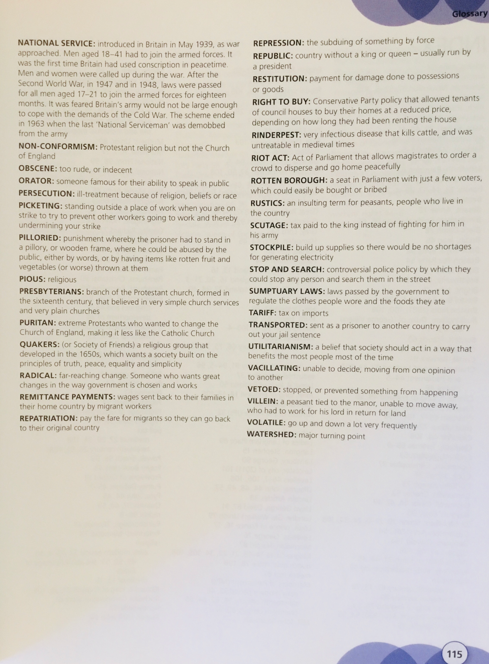

Slide 4
Part 3
The Roundheads (Parliament and the Puritans) defeated the Cavaliers (The King and his supporters). The King was put on trial and sentenced to Death!
1. Read through this section and make notes about the Kings Trial.
2. The leader of The Roundheads was Oliver Cromwell. Write a paragraph about how he was a hero, another about how he was a villain, and finally a conclusion, what do you think?

Slide 5
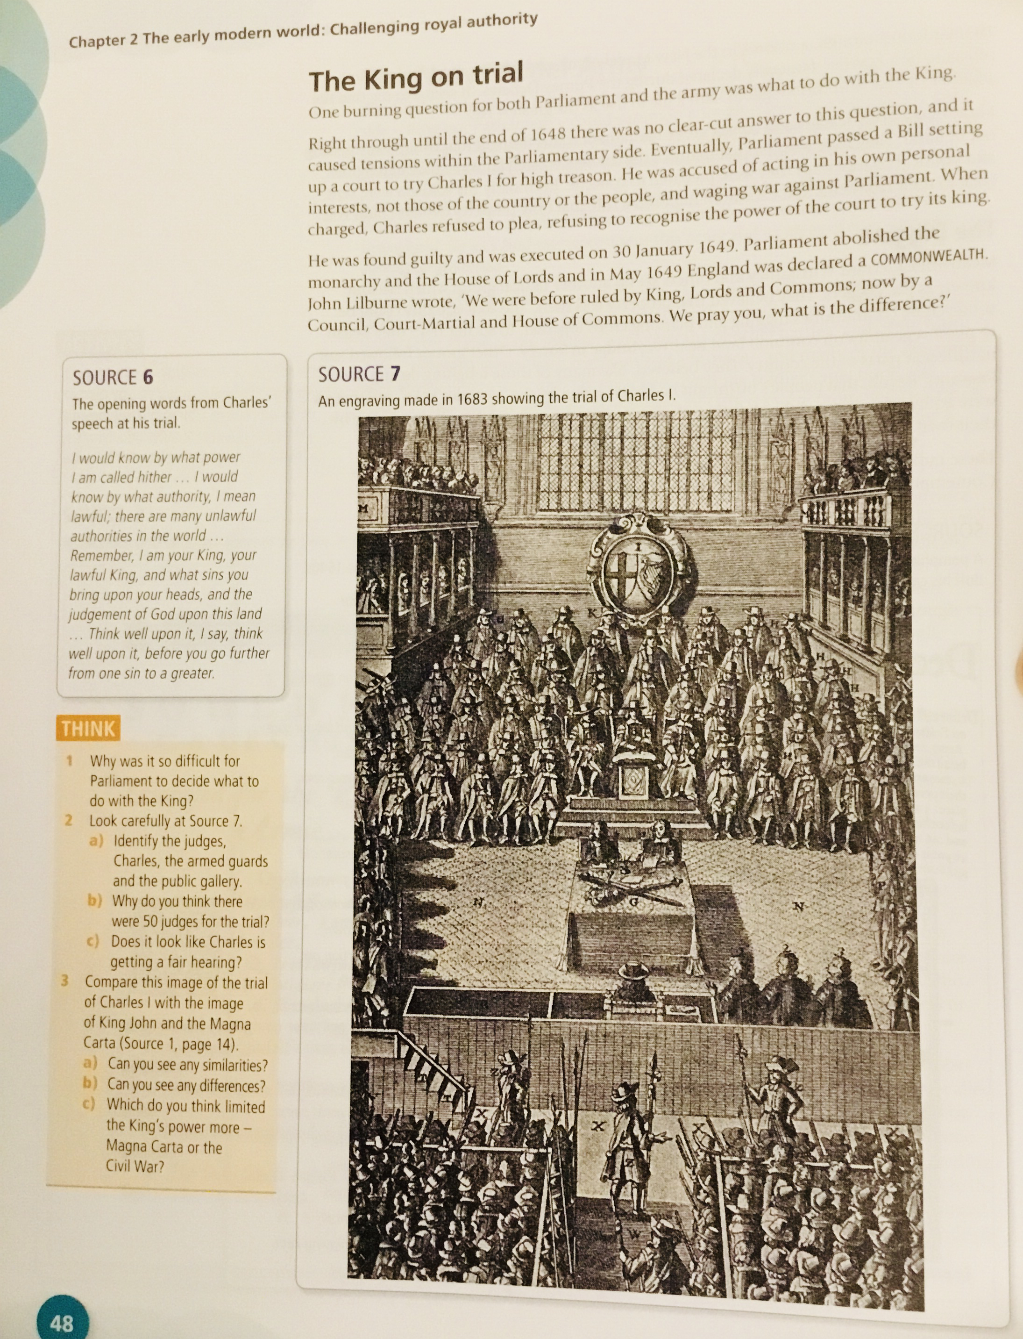
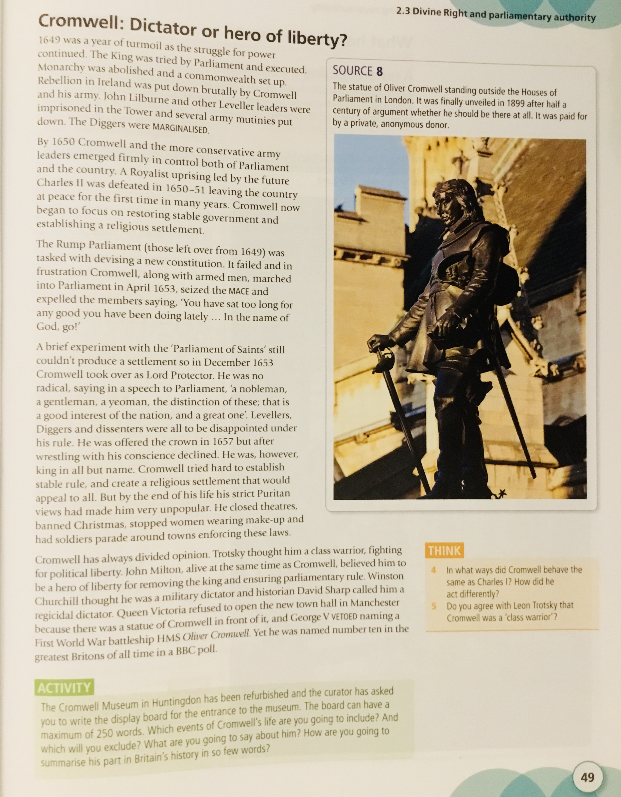

Slide 6
Part 4 the Death of Cromwell and the return of The King. Make revision notes, on the final part of the English Civil War.

Slide 7
