Slide 1
Year 11 GCSE History

Slide 2
Gathering Further Evidence of Levels.
Good morning Year 11,
Moving forwards, the best thing to do is produce work to send to AQA as evidence to support your grade. Therefore I have compiled a set of questions for you all to work through.
If possible - Please submit this work via Microsoft Teams.
You could word process it on Microsoft Word, or you could write it by hand and take a photo and send it.
Whatever you decide to do, please make sure it is in your own words – do not copy and paste anything!

Slide 3
America 1920 – 1973
Opportunity and Inequality

Slide 4
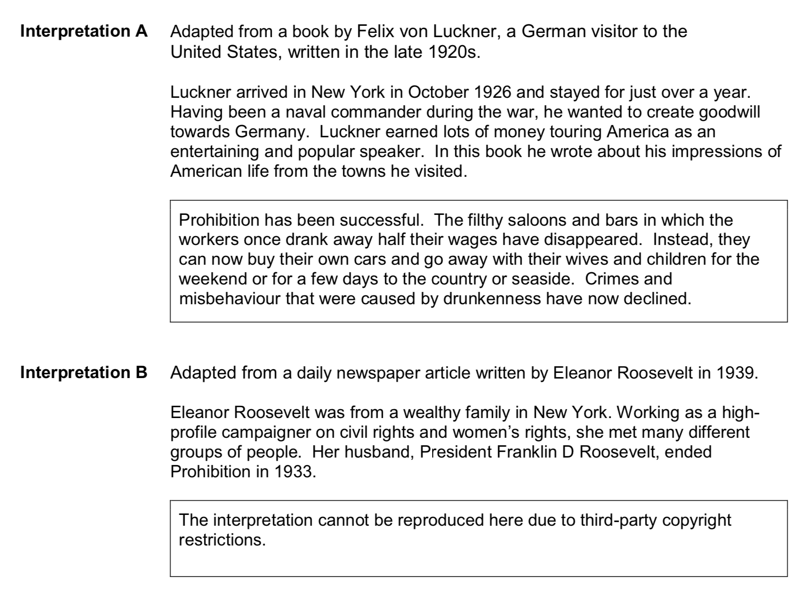
Interpretations

Slide 5
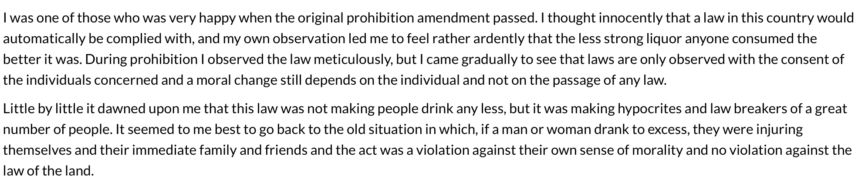
Interpretation B

Slide 6
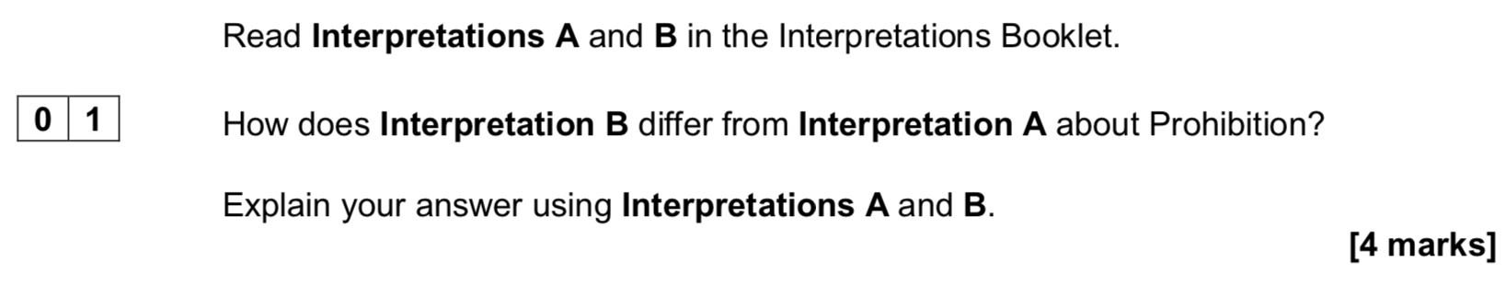

Slide 7
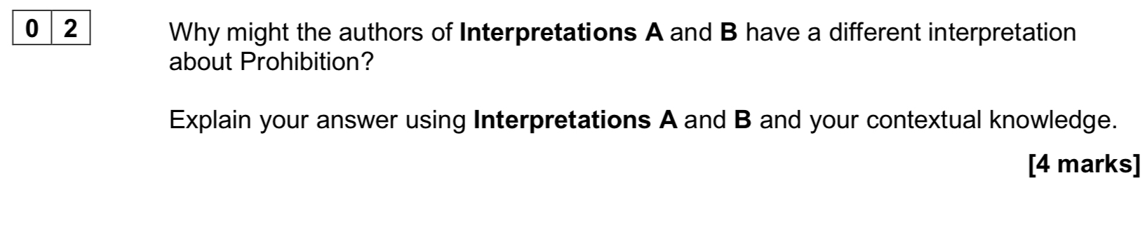

Slide 8
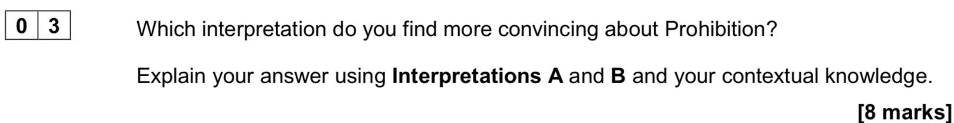

Slide 9
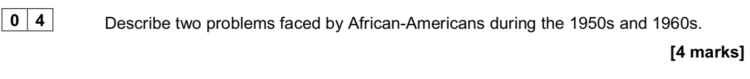

Slide 10
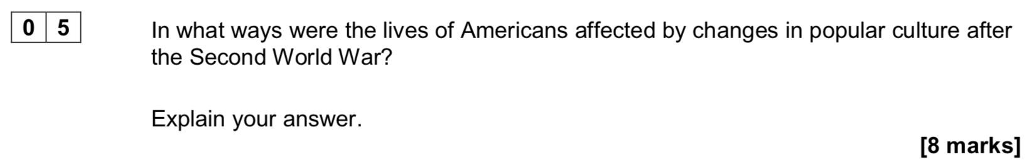

Slide 11
