Slide 1
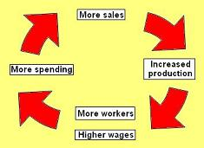
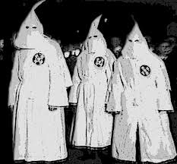
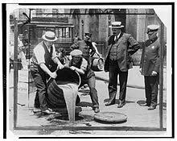

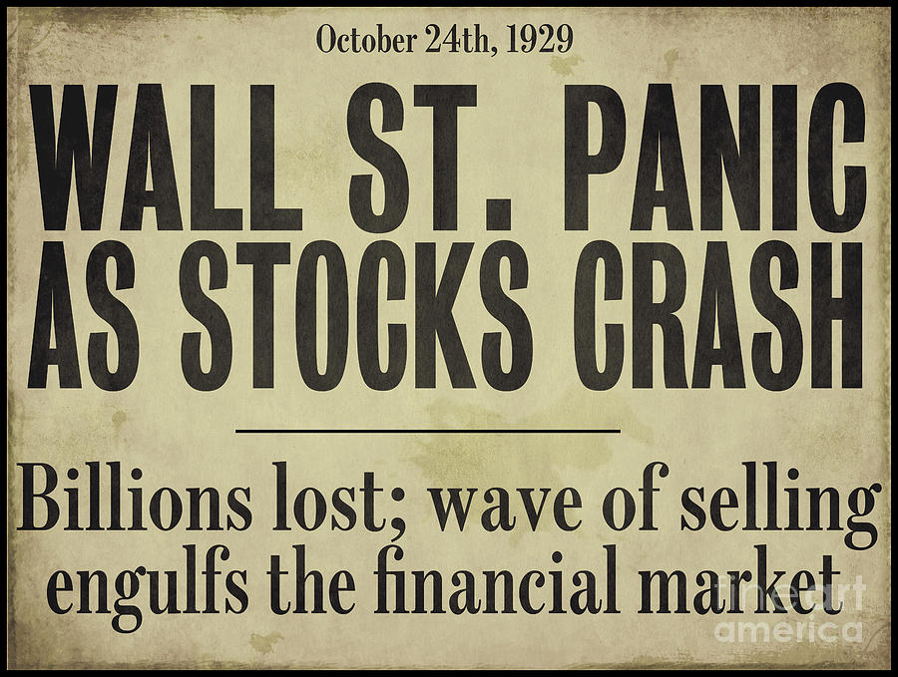
USA 1920s: The Boom
2. Problems in society
Racism
The Red Scare 1919- a fear that Communist ideas would spread from Russia. Led to…
Immigration Quotas 1921. These favoured WASPS from Britain, Germany and Scandinavia. They discriminated against Eastern Europeans, Russians and Asians.
Sacco and Vanzetti were 2 Italian immigrants who were accused and given the death penalty for a crime they probably didn’t commit. The judge was biased and they were not given a fair trial because they were immigrants.
The KKK was against immigrants, Jews, Catholics and African Americans. They had 5 million members and were mainly in the Southern states of the USA. Some police, politicians and other powerful people were members. They intimidated and lynched people.
Poverty: 60% of Americans lived below the poverty line in the 1920s
Farmers- overproduced crops= low prices= poverty
African Americans and Immigrants- racism and discrimination meant they couldn’t get well paid jobs= poverty
Old industry workers such as coal miners- demand for these products was falling= low wages= poverty
5. Prohibition
Why
- National mood & patriotism
USA entered WW1=mood
turned against alcohol. Many
breweries had German connections.
- Campaigns- Anti-Saloon League argued alcohol was damaging society.
- Practical - a ban on alcohol would boost supplies of grains such as barley.
Religious - alcohol went against God's will.
- Moral - wrong for Americans to enjoy alcohol while the country's young men were at war.
What
Introduced in 1920, prohibition banned the sale, transportation and production of alcohol.
Problems enforcing the law:
There were not enough prohibition agents, each one had to cover 100,000 sq miles of land! They were also paid poorly and this made them open to bribes
Gangsters such as Al Capone got rich quick by supplying speakeasies with booze imported illegally from Canada. They bribed officers, judges, juries etc to turn a blind eye. They became powerful. Organised crime became a huge problem as they expanded into gambling, protection rackets& other crimes.
Why did it end?
The St Valentines’ Day massacre 1929 showed gangsterism had gone too far. There were public demands for the gangsters to be dealt with
Trust in the police, government and law enforcement was at an all time low
In 1932 FDR promised to end prohibition as part of his election campaign
1. Why did the USA boom in the 1920s?
Resources- the USA had lots of natural resources like timber and oil
War- WW1 had got the USA off to a flying start. While Europe was rebuilding, America could be producing goods
Technology- the USA was the world leader in new forms of technology such as the assembly lines
Mass production techniques using the assembly line- US products could be produced faster and cheaper than anywhere else in the world. Henry Ford’s Model T is an example of this. Other products were then made using these techniques
Advertising let everyone know what products were available to buy and encouraged more people to buy them
Policies of the Republicans - taxes were low and the government didn’t regulate the stock market or businesses (Laissez Faire), which allowed huge profits to be made. US goods were cheaper due to Tariffs on foreign goods.
Credit allowed people to buy products they probably couldn’t have been able to afford otherwise. This created a greater demand for products
Confidence- the American people were confident to invest and take risks in new businesses, products and on the stock market
New affordable products: Fridges, hoovers, radios, cars. Cars meant that glass, rubber, leather, road building, diners, steel all boomed too. Other features of the boom: Talkies (films with words), skyscrapers, jazz music
4. The end of the Boom: The Wall St Crash 1929
Overproduction: too many goods being made and not enough people to buy them
The overproduced goods couldn’t be sold abroad because the Republican government had ruined trade with tariffs
Speculation (“buying on margin” with borrowed money) on the stock market was unstable
Panic selling and loss of confidence in the
stock market- people wanted out and no one
wanted their shares so they lost value fast
3. Women in the 20s
All women got the vote in 1920. Some women had worked during WW1. They had a taste of independence and jobs and didn’t want to go back to their old, restricted lives.
Some younger and wealthier women became Flappers- they drove cars, smoked, danced, wore short skirts, drank alcohol and partied. The older generation saw this as shocking and worried about young peoples’ morals.

Slide 2
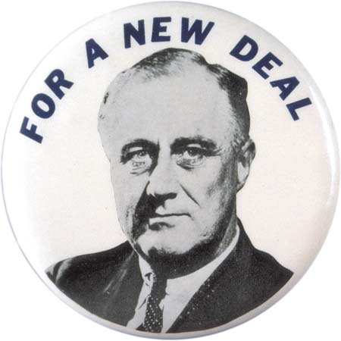
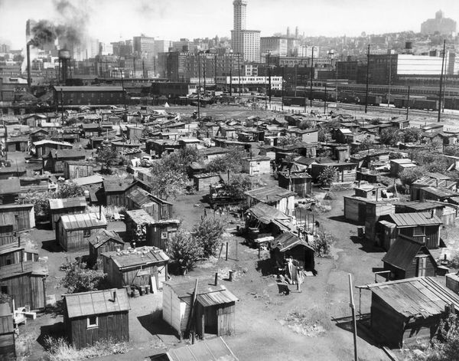
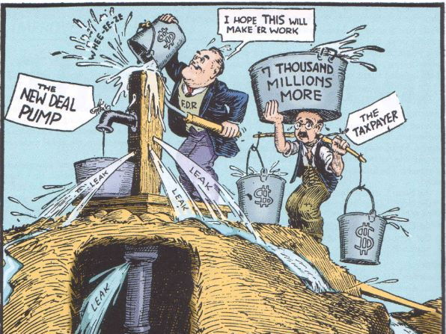
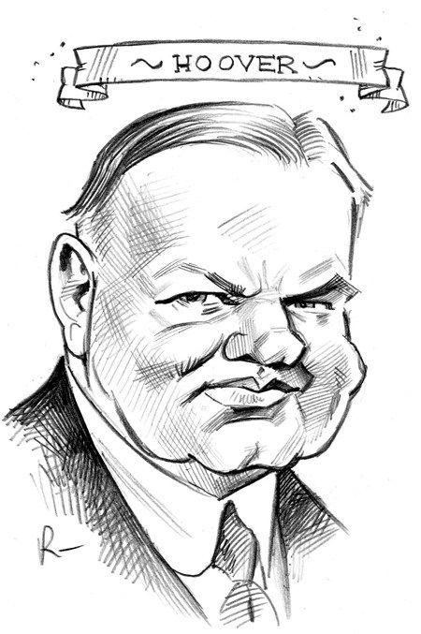
USA 1930s: The Depression
4) The 1932 election
Roosevelt Vs Hoover
Democrats: FDR’s campaign: Upbeat and positive, he travelled all over the USA meeting people and making them feel like he was listening and cared about them. He promised a “New Deal”- he didn’t say what this involved apart from relief, recovery and reform
Republicans: Hoover’s campaign: Hid in the White House after the Bonus Army. Hoped America would just “turn the corner” people were fed up with his lack of action.
Result: Roosevelt won 42/48 states
7) Which was better in solving the problems of the depression?
The New Deal
Provided relief for those in need
Gave the US people confidence in the government again
Built projects of lasting value
Got the economy going again
Got many people back to work
Didn’t help African Americans or women
When funding was reduced in 1937, unemployment rose again = it was a temporary fix
Cost
WW2
US joined the war after Pearl Harbour.
Factories and farms focussed on helping America in the war.
Lend Lease got the economy back on track
Conscription and work in the factories – unemployment fell to 0%
GNP doubled
Permanent fix to the depression
1)How did the Wall St Crash lead to the Great Depression? - From 1929 to 1932, 5,000 banks went out of business
Businesses couldn’t borrow money from banks so they cut production and laid off workers
By 1933 24.9% of people were unemployed. These people couldn’t pay their rent/mortgage so it led to homelessness and poverty
Homeless people set up Hoovervilles, shanty towns named after the president to mock the lack of help he was providing
The Republican government was slow to act and believed in “rugged individualism”- people working their own way out of poverty
5) FDR’s first 100 days: Action he took
Closed the banks and only opened responsible ones
Fireside chats- FDR spoke on the radio to build confidence
Established the Alphabet Agencies to tackle some of the problems:
AAA: paid farmers to produce less. Overproduction solved. farmers money doubled between 1932-39.
TVA: Dams to create electricity and sort the Dust Bowl out. This improved the lives of 7 million people.
CCC: created work for 2.5 million people aged 18-25 giving them $1 a day to plant trees or other jobs
PWA and the WPA: created work for 4 million people creating projects of lasting value e.g. building bridges and schools
NRA: blue eagle symbol products= better working conditions for workers and introduced trade unions
2) The Dust Bowl was happening at the same time as the Depression and made life even harder for farmers. They had to abandon their farms and many became migrant workers.
3) How did President Hoover try to help?
In 1932 Hoover gave $4 million to the states to open soup kitchens.
He created jobs by building the Hoover Dam.
He gave $300 million to the states to provide support for the unemployed, but only $30 million was used by the Republican states because they believed more strongly than Hoover in rugged individualism.
Many people believed that Hoover’s efforts were too weak and had come too late.
The Bonus Army incident destroyed Hoover’s reputation further
“In Hoover we trusted now we are busted”
6) Opposition to the New Deal
Too much interference in businesses. - The Supreme Court announced that the AAA and NRA were unconstitutional. - Republicans said it cost too much and went against “rugged individualism” - Francis Townsend and Huey Long felt that the New Deal did not help enough. Criticised for being short term solutions and wasting money.
FDR tried to put more Democrats into the Supreme Court to support him but this failed and he was accused of being a dictator

Slide 3
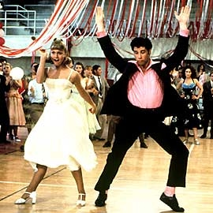
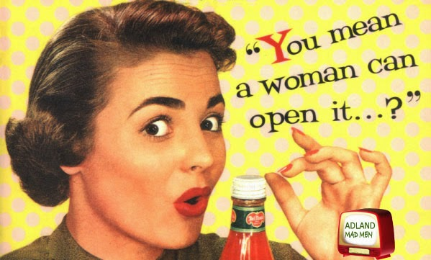
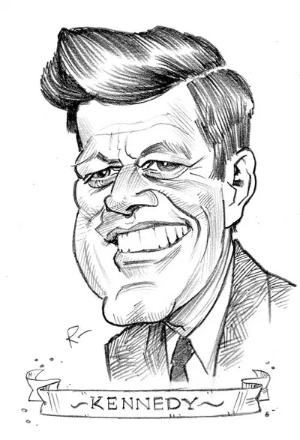
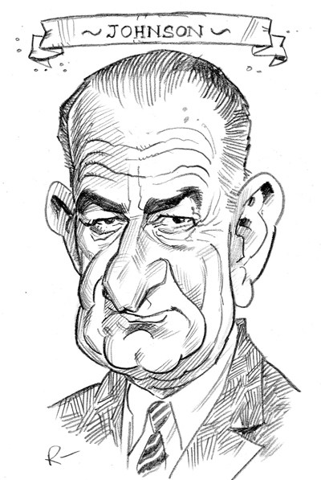
USA Post War 1945-1973
The American Dream= opportunity exists for all, belief that with hard work everyone can achieve prosperity and happiness
1) Civil Rights Movement- Events, achievements and limitations
2)1950s pop culture: Rock and roll music, teenagers, cars, TVs, Elvis Presley, comic books, shopping malls
5) Women and the
Feminist Movement
in the 1960s and 70s
Women had experienced more independence and better paid jobs during WW2
In the 50s and 60s many women felt frustrated and stuck being wives and mothers and limited to certain jobs
In the 60s…
Women saw the success of the Civil Rights Movement and wanted equality for women
1963 Betty Friedan “The Feminine Mystiques” book- best seller inspired many
1966 NOW (National Organisation of Women) established
In the 70s
laws were passed giving women the right to be treated equally at work, to gain access to higher education and equal pay. The Equal Pay Act was not successful.
In 1973 the Supreme Court legalised abortion in all states in the Roe Vs Wade case
1953: Brown vs Board Education | Law changed to desegregate schools, but many states ignored the law. By 1956, 6 southern states still had segregated schools
1957 Little Rock | 9 black pupils tried to attend a school for whites.. National Guard soldiers were sent to prevent the black children from entering the school. The President sent 1,000 soldiers to enforce the law. By 1960, out of a total of 2 million black school children in the state of Arkansas, only 2,600 were going to the same school as white children.
1958 Montgomery bus boycott | The law stated that if a white person got on a bus, black people should give up their seat. Rosa Parks refused to do this & she was arrested and imprisoned. The NAACP held a boycott by refusing to use the buses. Martin Luther King led this. Buses were then desegregated.
1960 Sit ins | Series of nonviolent protests at cafes which led to the Woolworth store chain removing its policy of racial segregation
1961 Freedom Rides | Segregation continued on buses that took people from one state to another. Black people travelled on buses across the country from one state to the next without getting off the bus. There was violence but segregation was ended in 1963.
Martin Luther King | MLK believed in peaceful protest without using violence. Events above gained support for the protesters when racist whites responded with violence.
Malcolm X | Malcolm X didn't think peaceful methods did enough to help black people. His ideas became the foundation of more radical groups: Black Panthers. He told people to use violence to demand more rights. In the 1960s riots happened in a number of cities in the USA.
3) 1950s: McCarthyism (second Red Scare)
Senator McCarthy encouraged anti-communist feelings. He accused people of being communists. With no evidence against them, hundreds of people were accused of secretly working for the Soviet Union. The Communist Party was banned from the USA. McCarthy ruined people’s lives. After McCarthy had accused 45 army officers of being communists, he was asked to prove this – he had no evidence and so he lost his job. The court case was broadcast on television.
4) JFK: New Frontier
Aims: to eliminate poverty & inequality, solve the USA’s problems during the 1960s which were the decline of towns due to unemployment, poverty and increased crime and civil rights matters.
New Frontier policies: an ambitious system of health insurance called Medicare, medical help for the elderly and a Civil Rights Bill, introduce an education law to give more money to schools, increase benefits, raise the minimum wage to $1.25 and established training schemes for the unemployed. JFK did not have a good relationship with Congress, and his ideas were rejected.
LBJ: The Great Society
Johnson was the new President following the assassination of JFK. LBJ continued to develop JFK’s ideas. Johnson wanted to create a Great Society. Operation Headstart gave money to schools in cities to provide a better education for the poor. In 1966 Johnson persuaded Congress to agree to an act that would provide free medical care for the elderly. In 1964 the Civil Rights Act was passed.
6) What had been achieved by 1973?
1963 Equal Pay Act failed
1964 Civil Rights Act outlawed discrimination based on race, colour, religion, sex, or national origin but some attitudes were slow to change, especially in the South.
New Frontier and Great Society had made some changes to poverty and education
Abortion was legal
However, the American Dream was far from being achieved by all.

Slide 4




Paper 1 exam technique: USA 1920-73
USA Qs 1, 2 and 3: Interpretation Qs (In, out, in)
Q1: How are the interpretations different? (4)
Read what is in the box only. Sum up the overall message of interpretations A and then B. Point out how they are different. Aim for 2 differences. Do not copy the source. You do not need any of your knowledge here.
Q2: Why are the interpretations different? (4)
Read what is outside of the box only (provenance). For A, explain why that person would have that opinion by using your own knowledge of the context (what was happening at the time). Then do this for B. Do not copy the provenance.
Q3: Which of the interpretations if more convincing? (8)
Focus what is in the box for both A and B. You are testing the content of the interpretation for accuracy using your own knowledge. Choose something that A mentions and develop and explain it using your own specific knowledge. Do the same with B. Then decide which of the interpretations fits best with your knowledge and explain why in a sentence or 2. Do not copy long quotes from the interpretation.
USA Qs 4,5 and 6: Knowledge Qs
Q4: Describe two… (4)
Write a paragraph. Describe one point related to the question using specific examples (PEAKED), then describe another point in the same way. Do not spend longer than 5 mins on this question.
Q5: In what ways…Explain your answer. (8)
Read the question carefully and highlight any key words like “change” “impact” “effects” “reasons why”.
Write 1 PEE paragraph explaining one point, making sure you include specific examples (PEAKED) and focusing on the key word in the question. Remember to explain, do not just describe what happened. Then write another PEE paragraph explaining this point in the same way as the first.
Q6. 2 Bullet points Q. Explain your answer with reference to both bullet points. (12)
Use the same technique as in Q5. Write 1 PEEL paragraph explaining the first bullet point, making sure you link back to the question. Then do the same for the second bullet point. Finally write a concluding paragraph that compares the impact of both bullet points and reaches a decision that is explained.
PEE/PEEL paragraphs structure
P oint
E xample
E xplanation
L ink to Q
Has your answer PEAKED with specific detail? Have you included at least one…
Place/Person’s name
Event
Amount
Key term
Example
Date
You giving a specific answer and not being vague!
Rule of 5: 5 mins per 4 marks
4 mark Q= 5 mins
8 mark Q= 10 mins
12 mark Q= 15 mins

