Slide 1
The Tudors
We will continue to focus on the Tudors 1485 – 1603, and learn about Tudor life, Monarchs and religion. For each Lesson you will need to read the chapter in the slides on the PowerPoint and complete all of the tasks in the Blue Work Box Section. You can complete your work on any program you wish, for example Microsoft Word or PowerPoint, and then submit each lesson via Microsoft Teams.

Slide 2
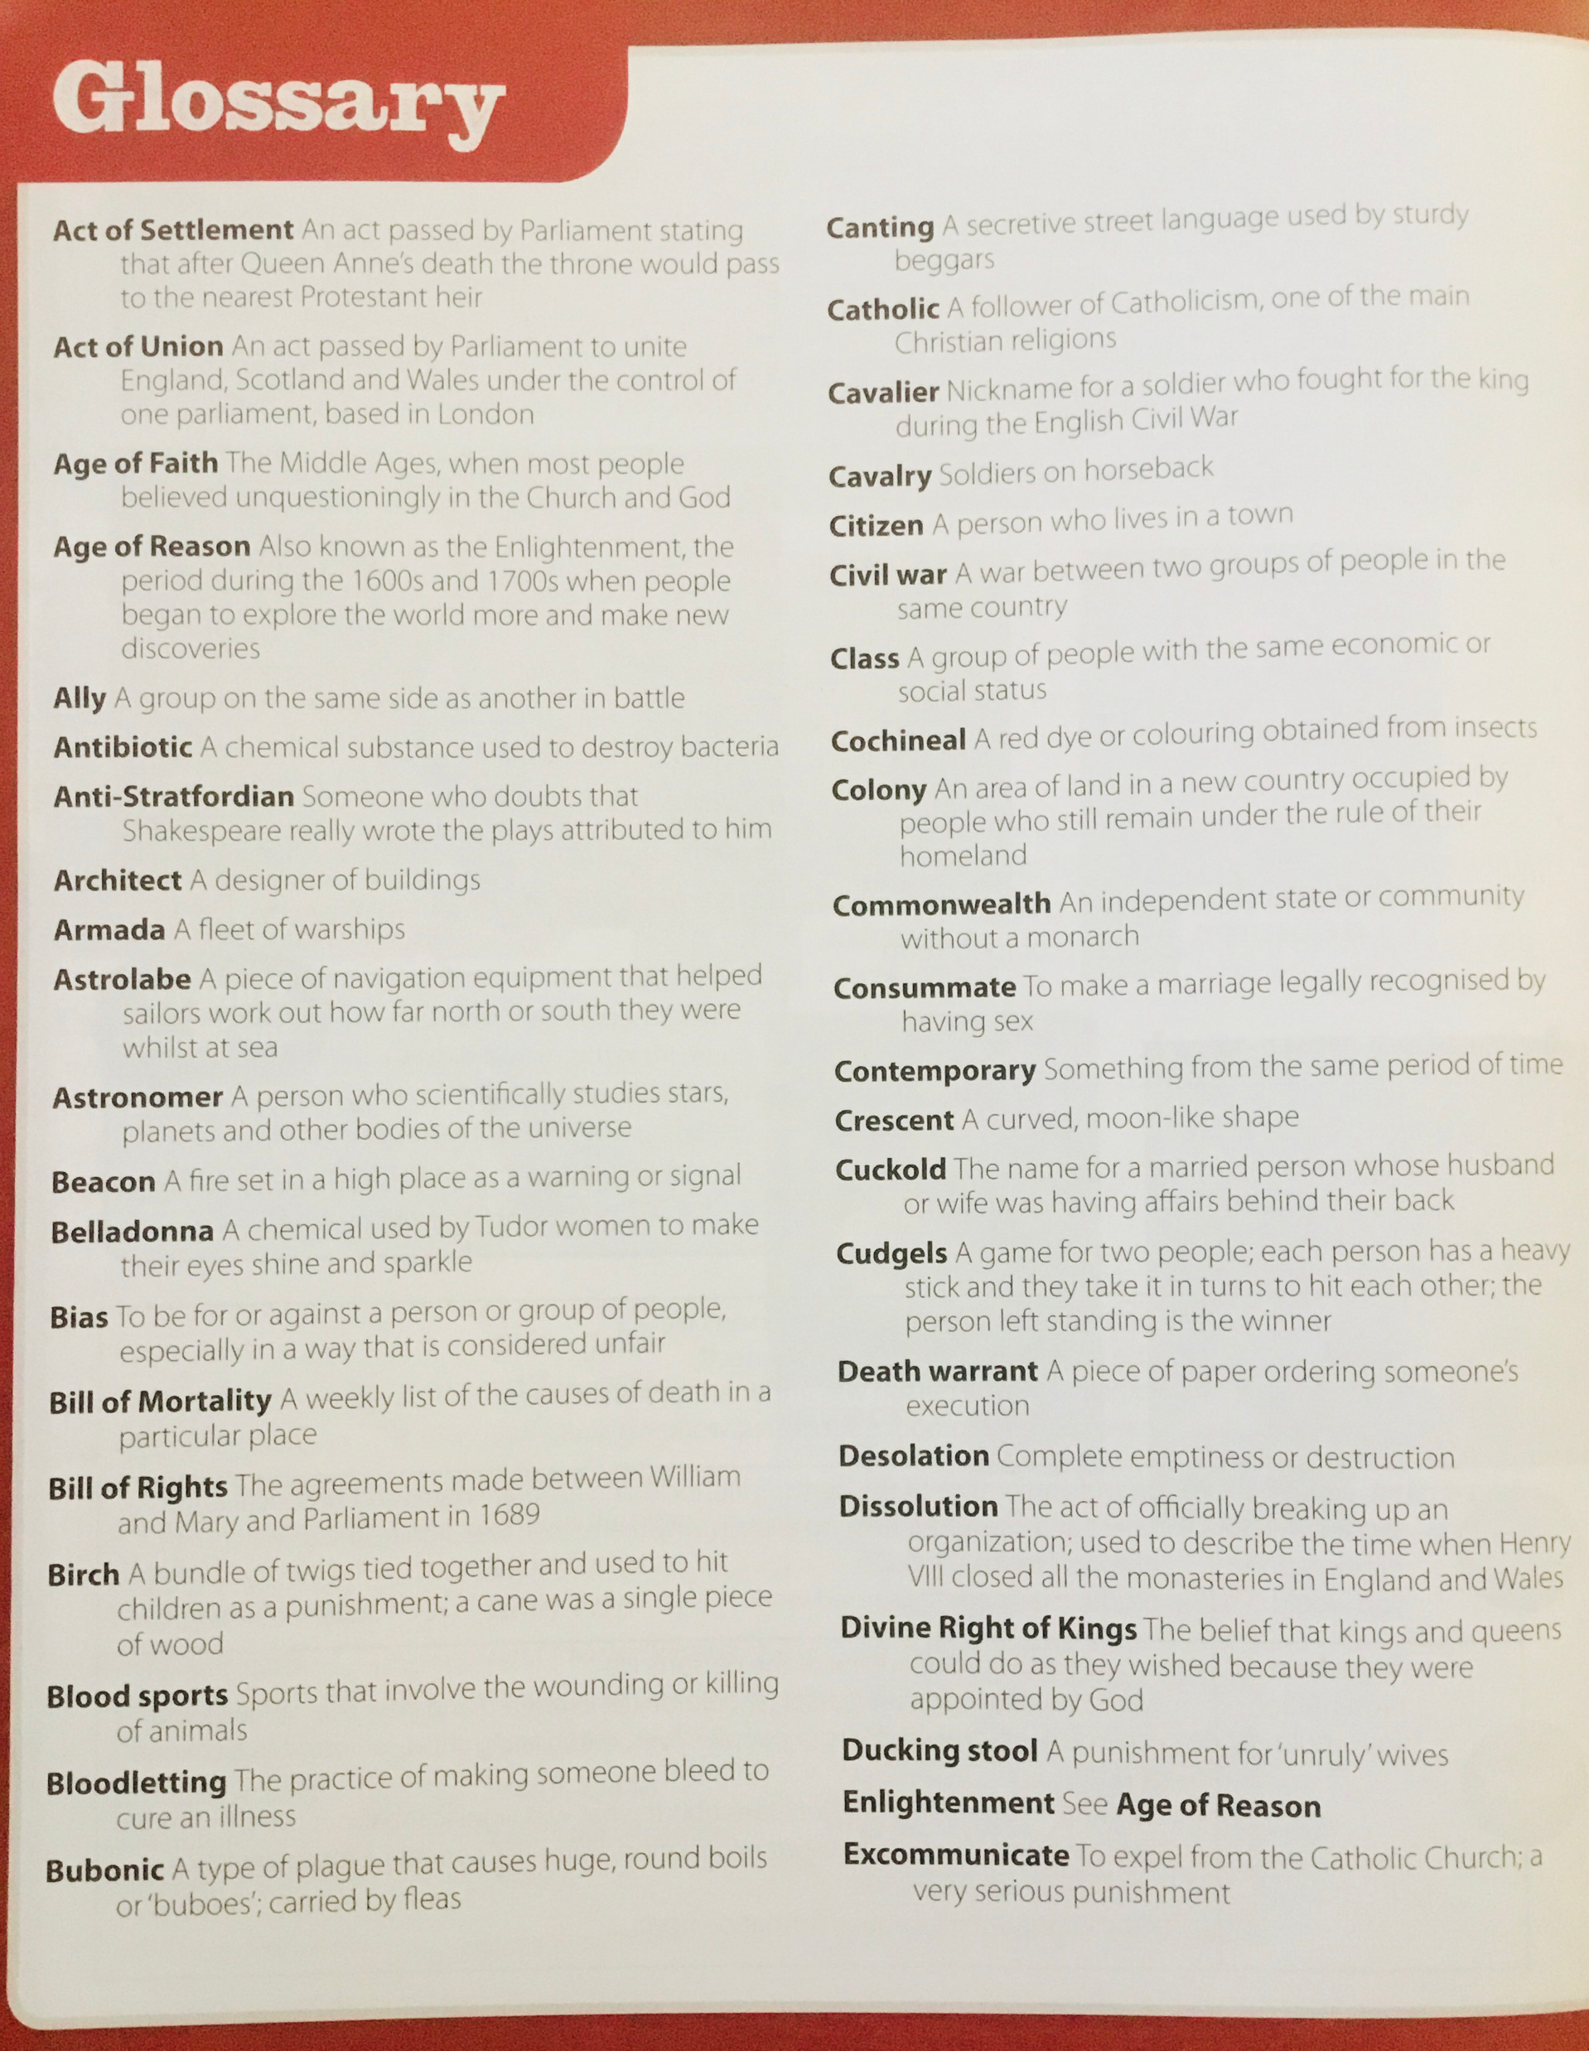
Glossary… You may need to refer to this throughout the topic to help you with words you may not understand. Good luck!

Slide 3
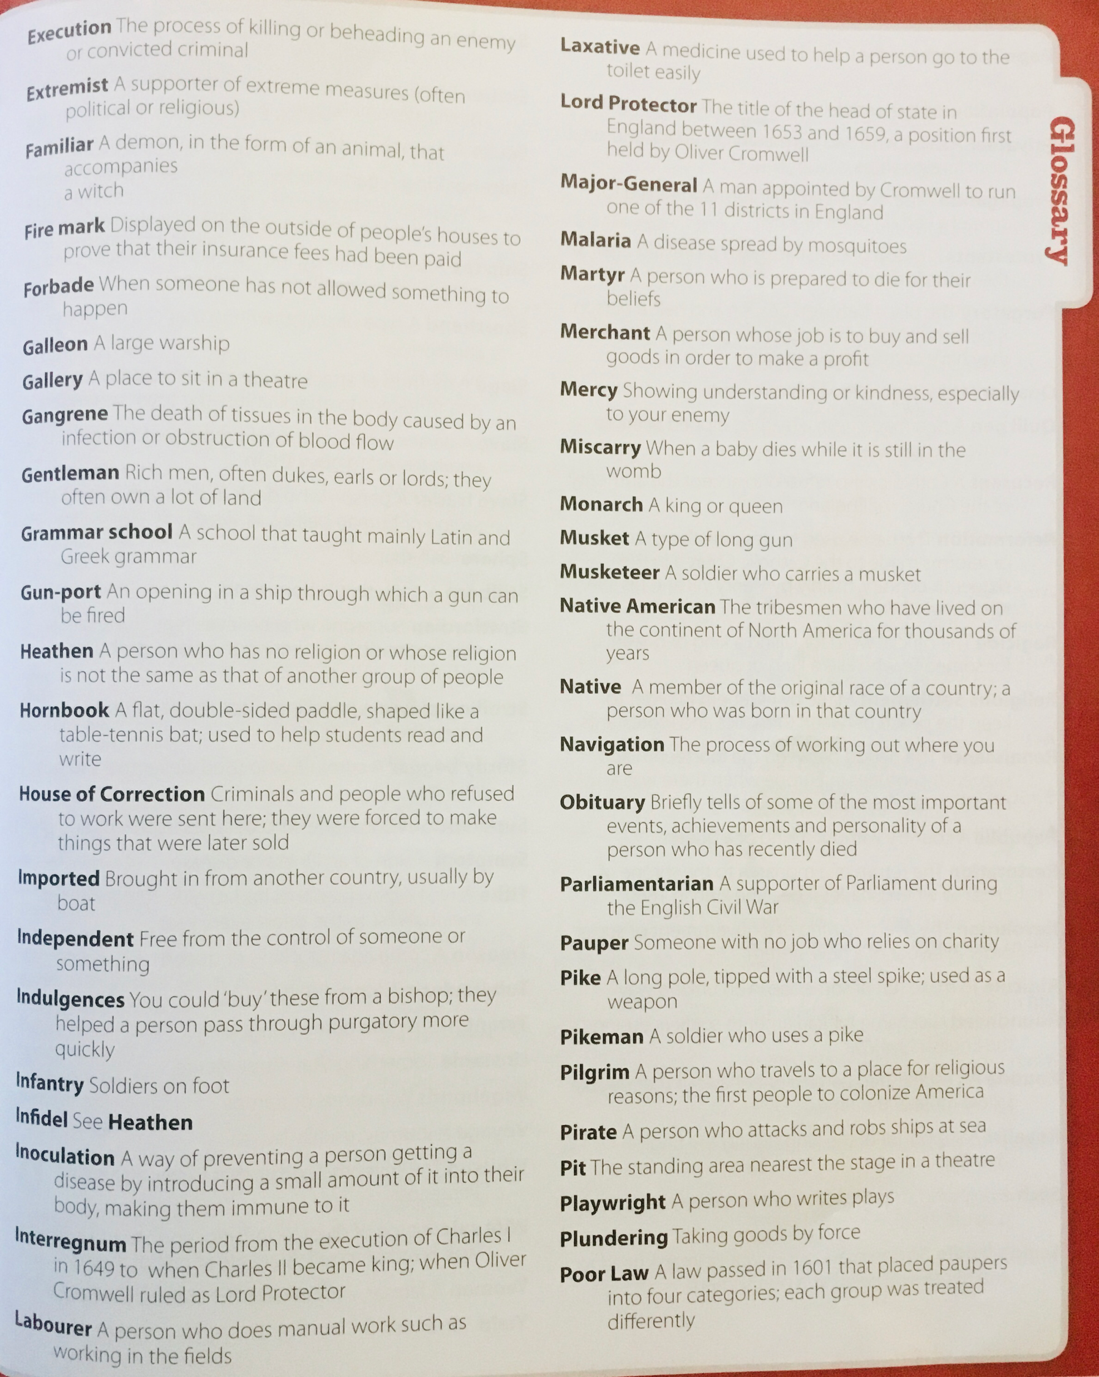
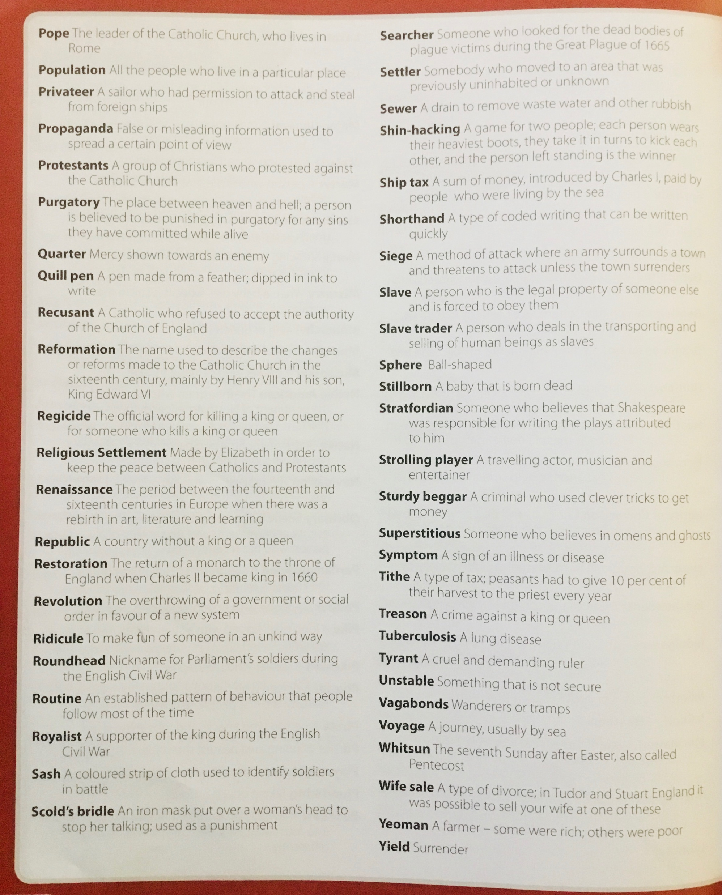

Slide 4
Lesson 5

Slide 5
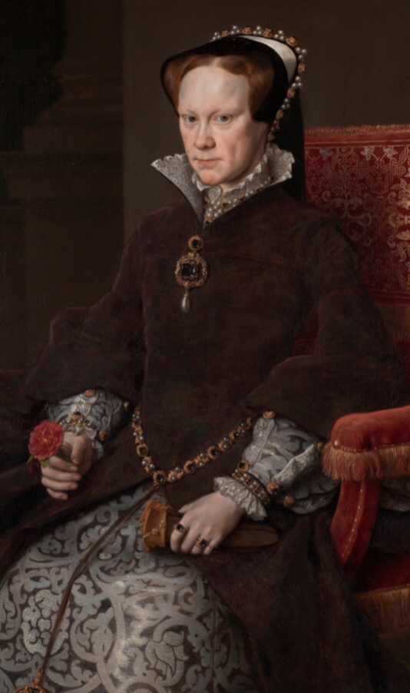
The Tudor Monarchs
Today we will focus on Edward!
Henry VII
Henry VIII
Edward VI
Mary I
Elizabeth I

Slide 6
