Slide 1
The Tudors
We will continue to focus on the Tudors Period 1485 – 1603, however let’s move on from Kings and Queens, what about other people?
This lesson we will be learning about a famous artist/designer/inventor who lived during this time, however they did not live in England.
Next Lesson we will be learning about another famous person who was English, and wrote some plays you may well have heard of.
Read through the chapter and answer the questions/activities.

Slide 2
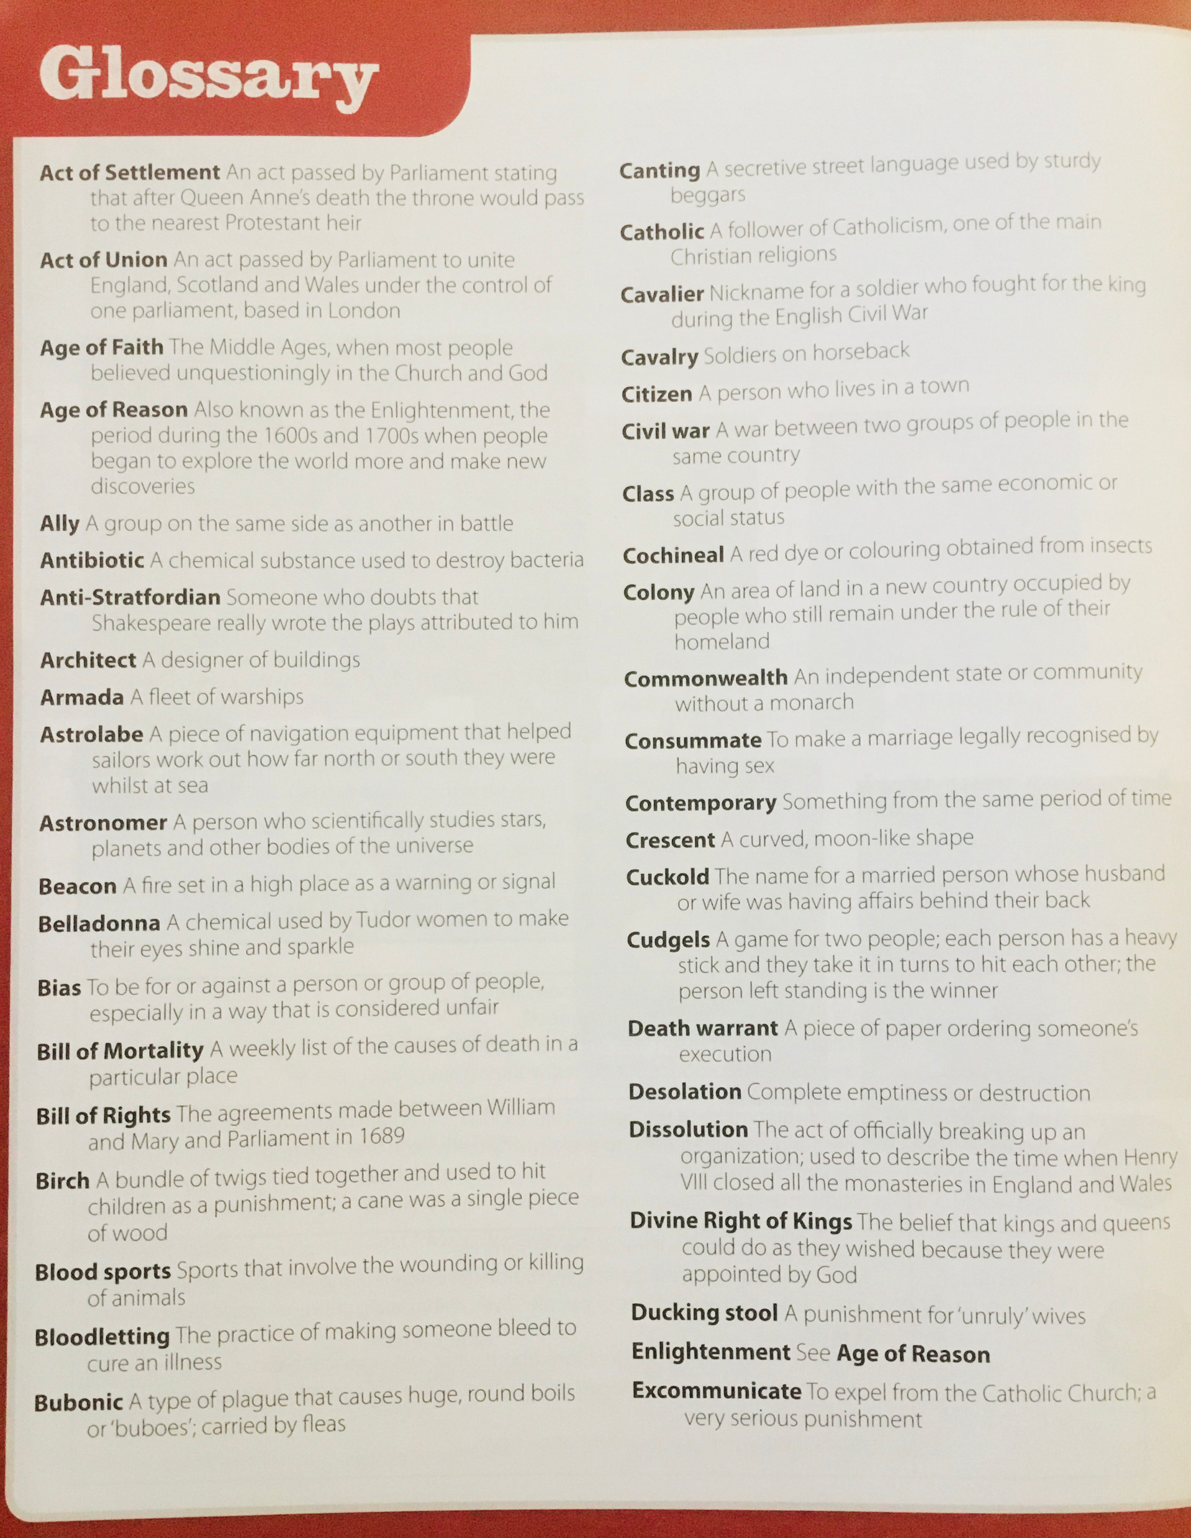
Glossary… You may need to refer to this throughout the topic to help you with words you may not understand. Good luck!

Slide 3
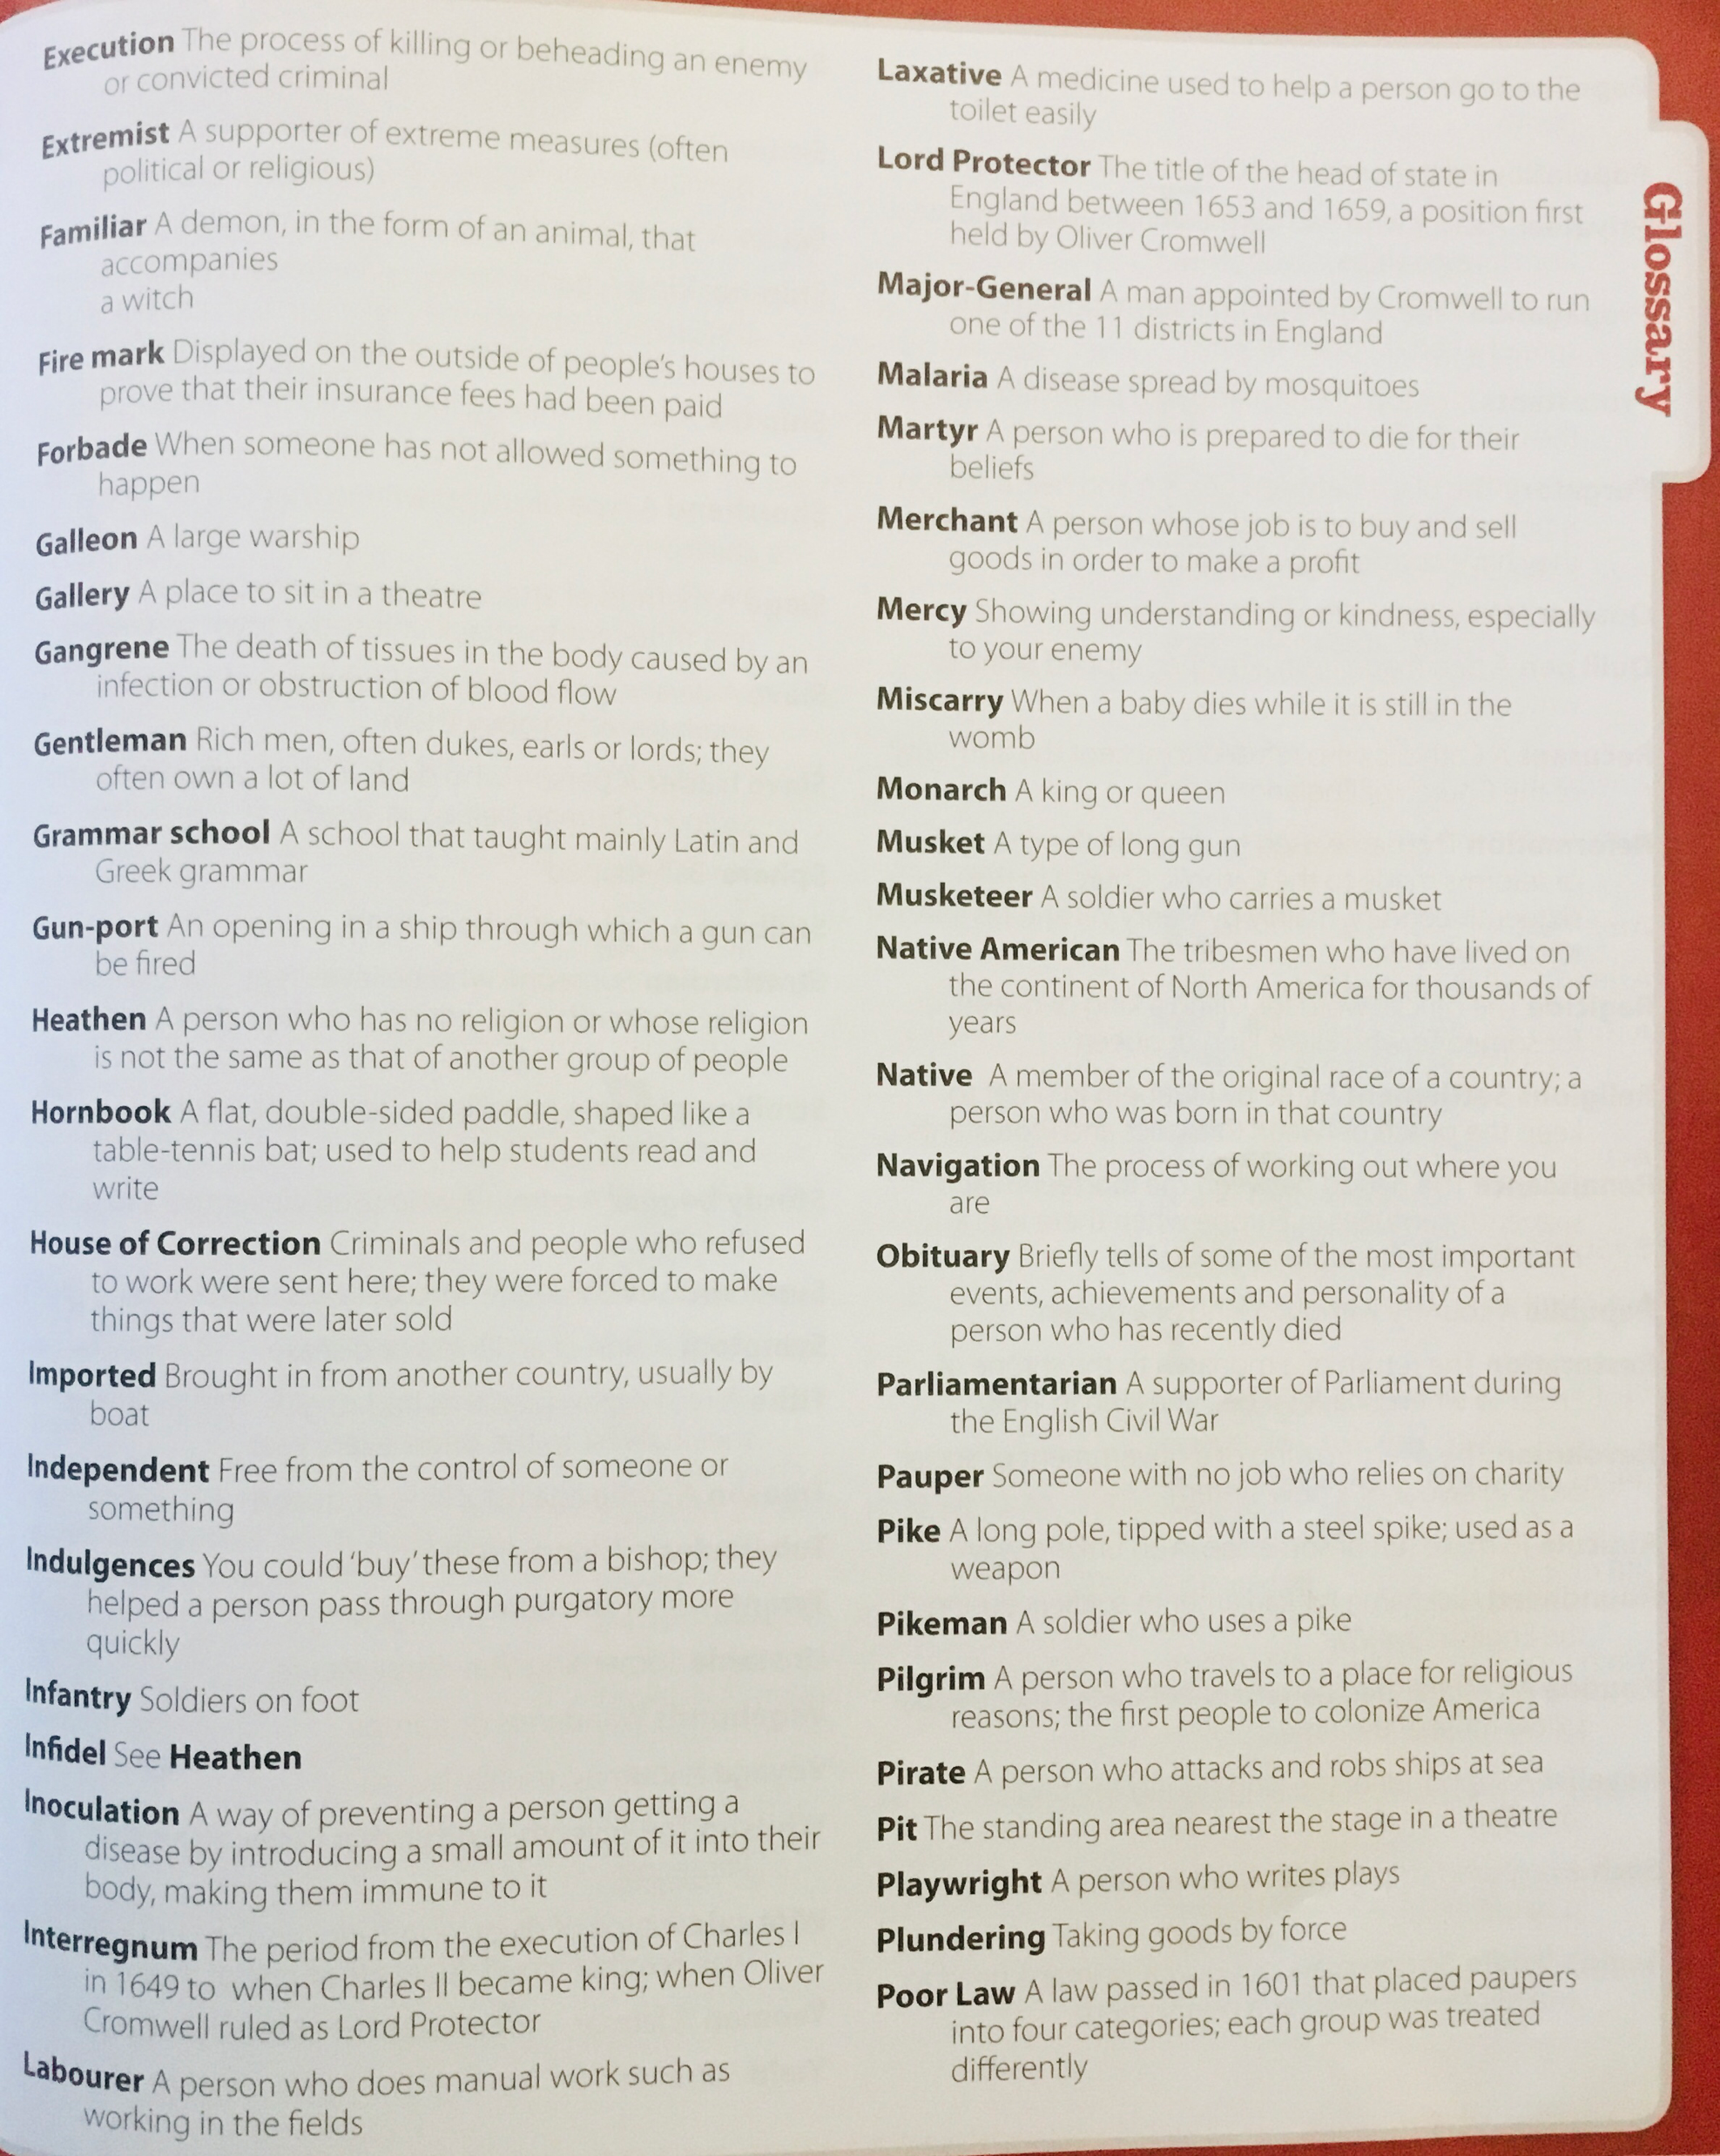
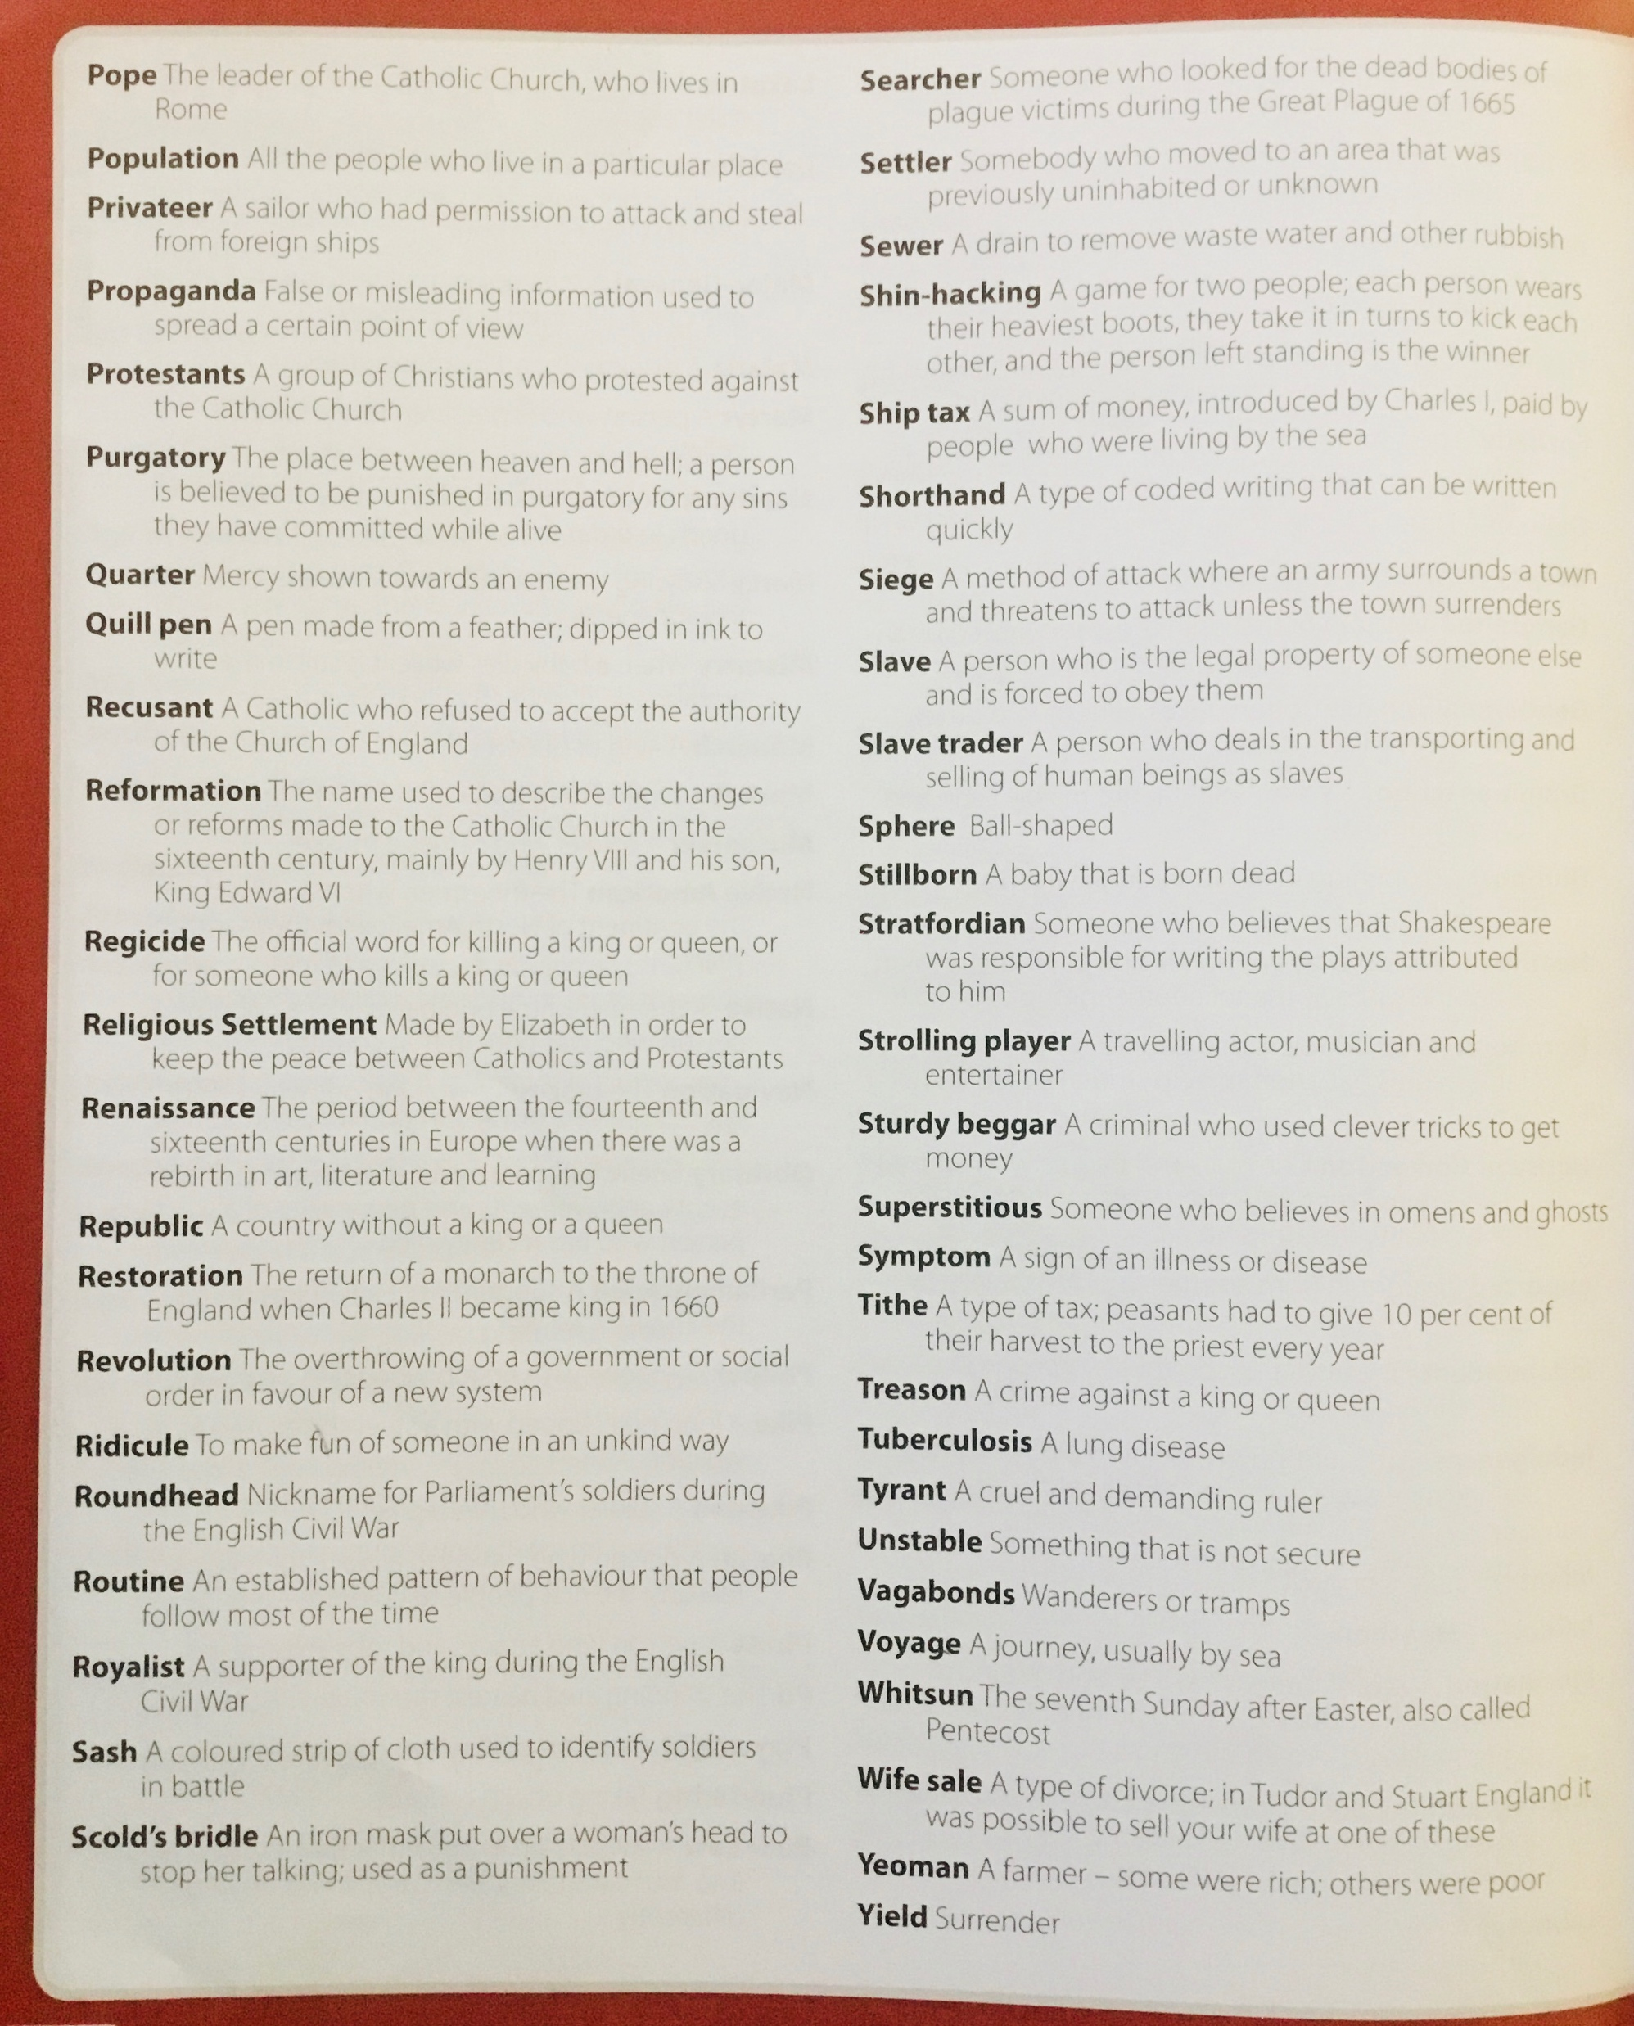

Slide 4
