Slide 1
What was life like during the reign of Elizabeth I?
We are going to continue our Study of Elizabeth Tudor by finding out about society during her time as Queen of England.
Activities…
For each lesson you will need to type up your answers and ideas, and then email them to your teacher. It would also be a good idea to include the Learning Objectives for each lesson.
Complete all of the Activity and Discuss Boxes for each lesson, you can submit the work in whatever way is easiest, for example PowerPoint or Word etc.
All of your work will then be checked and filed – so don’t fall behind!
Good luck!

Slide 2
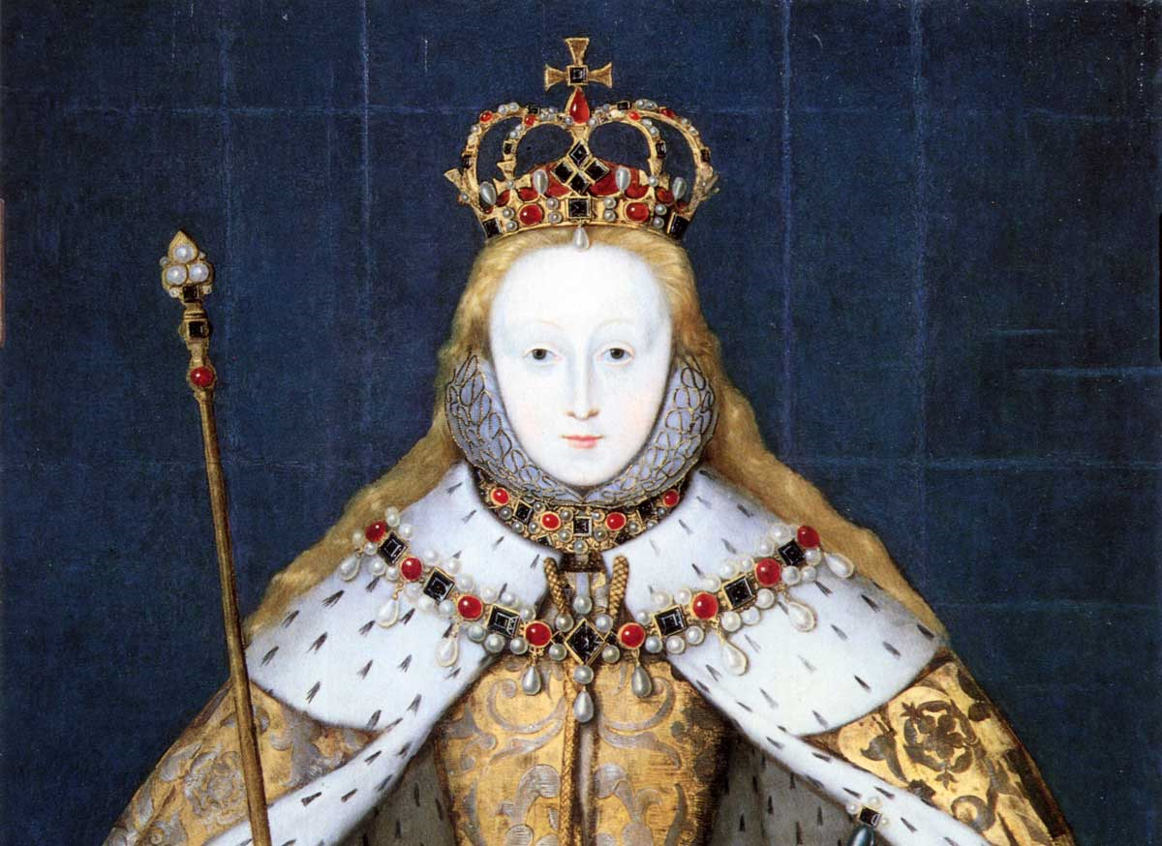
Lesson 14

Slide 3
Glossary
I have included the Glossary Section, incase you need to look up words that you do not understand, or are not familiar with.
You do NOT need to know every word, just the Key Words that come up in the Elizabeth topic.

Slide 4
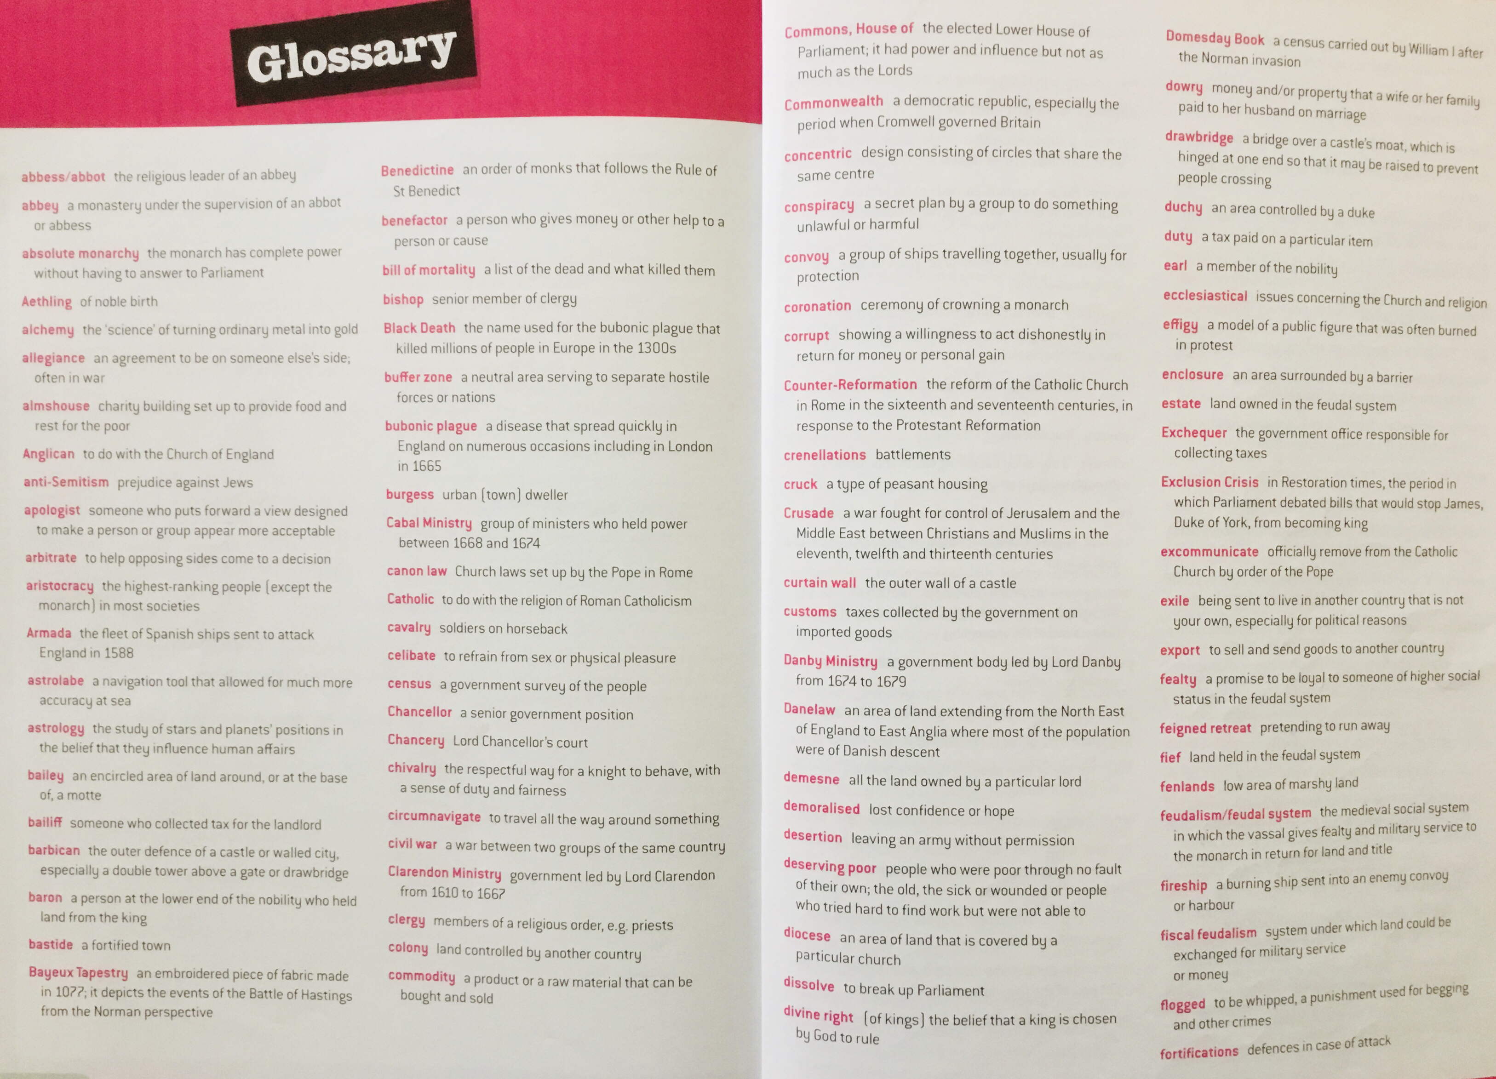

Slide 5
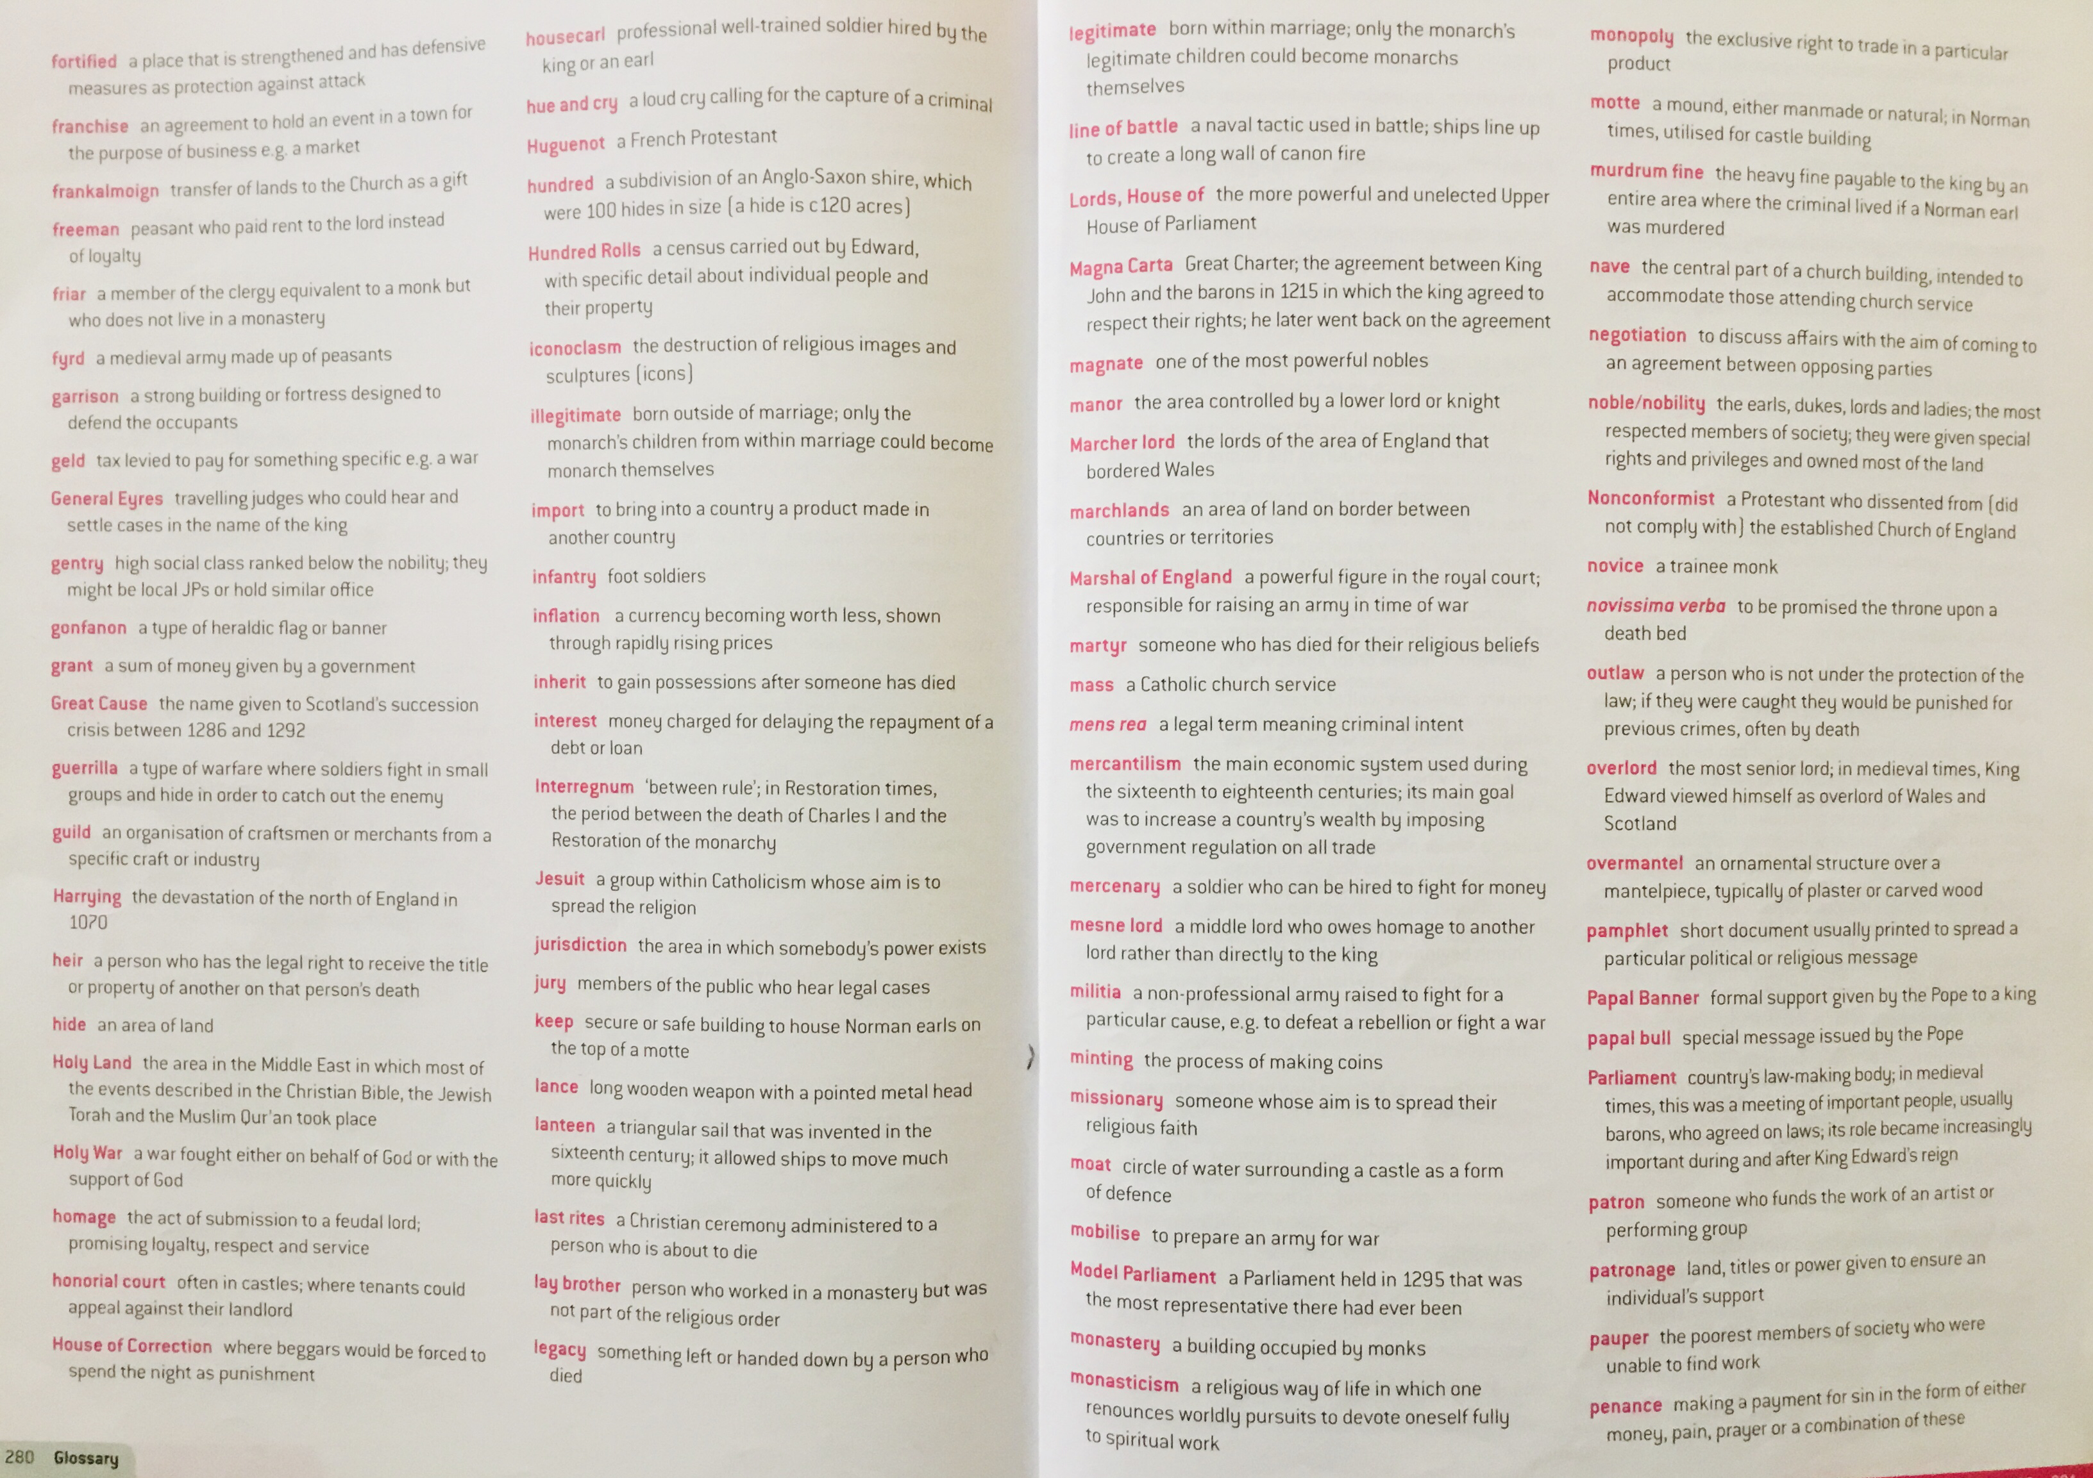

Slide 6
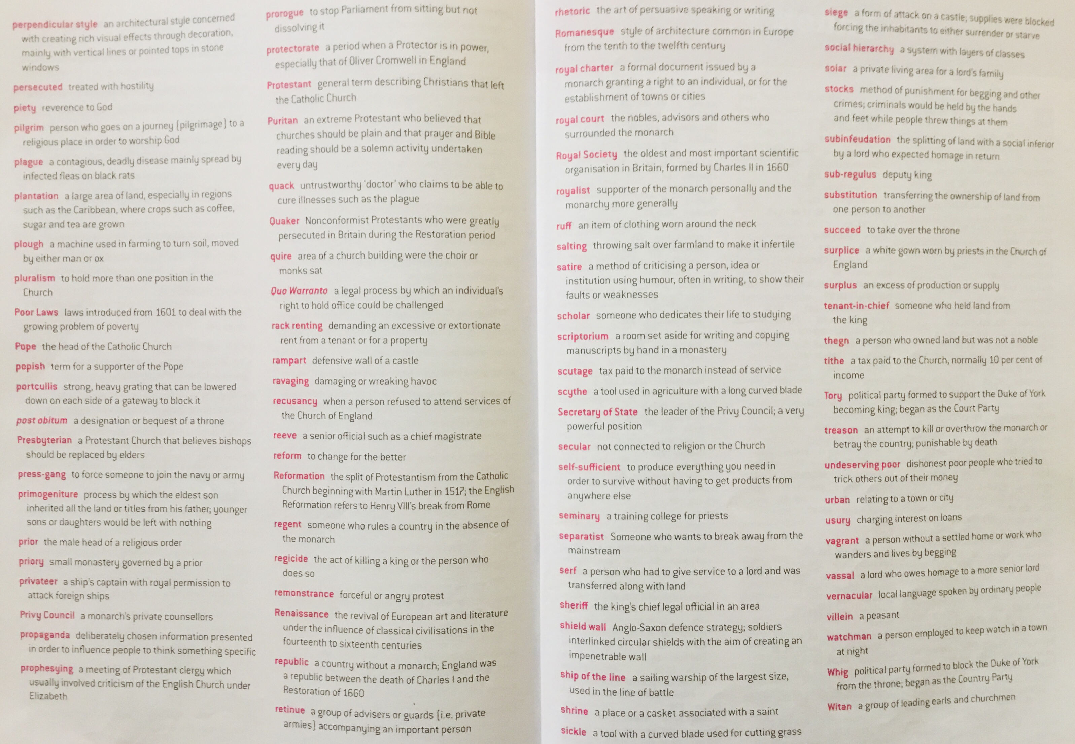

Slide 7
