Slide 1
What was life like during the reign of Elizabeth I?
We are going to continue our Study of Elizabeth Tudor by finding out about society during her time as Queen of England.
Activities…
For each lesson you will need to type up your answers and ideas, and then email them to your teacher. It would also be a good idea to include the Learning Objectives for each lesson.
Complete all of the Activity and Discuss Boxes for each lesson, you can submit the work in whatever way is easiest, for example PowerPoint or Word etc.
All of your work will then be checked and filed – so don’t fall behind!
Good luck!

Slide 2
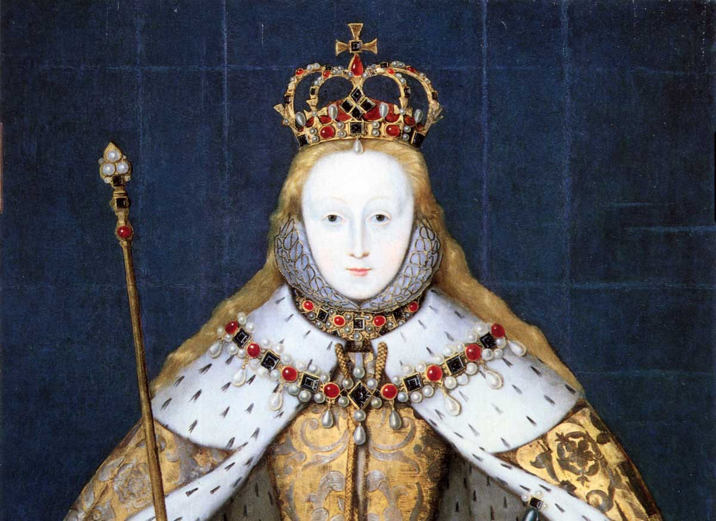
Lesson 3

Slide 3
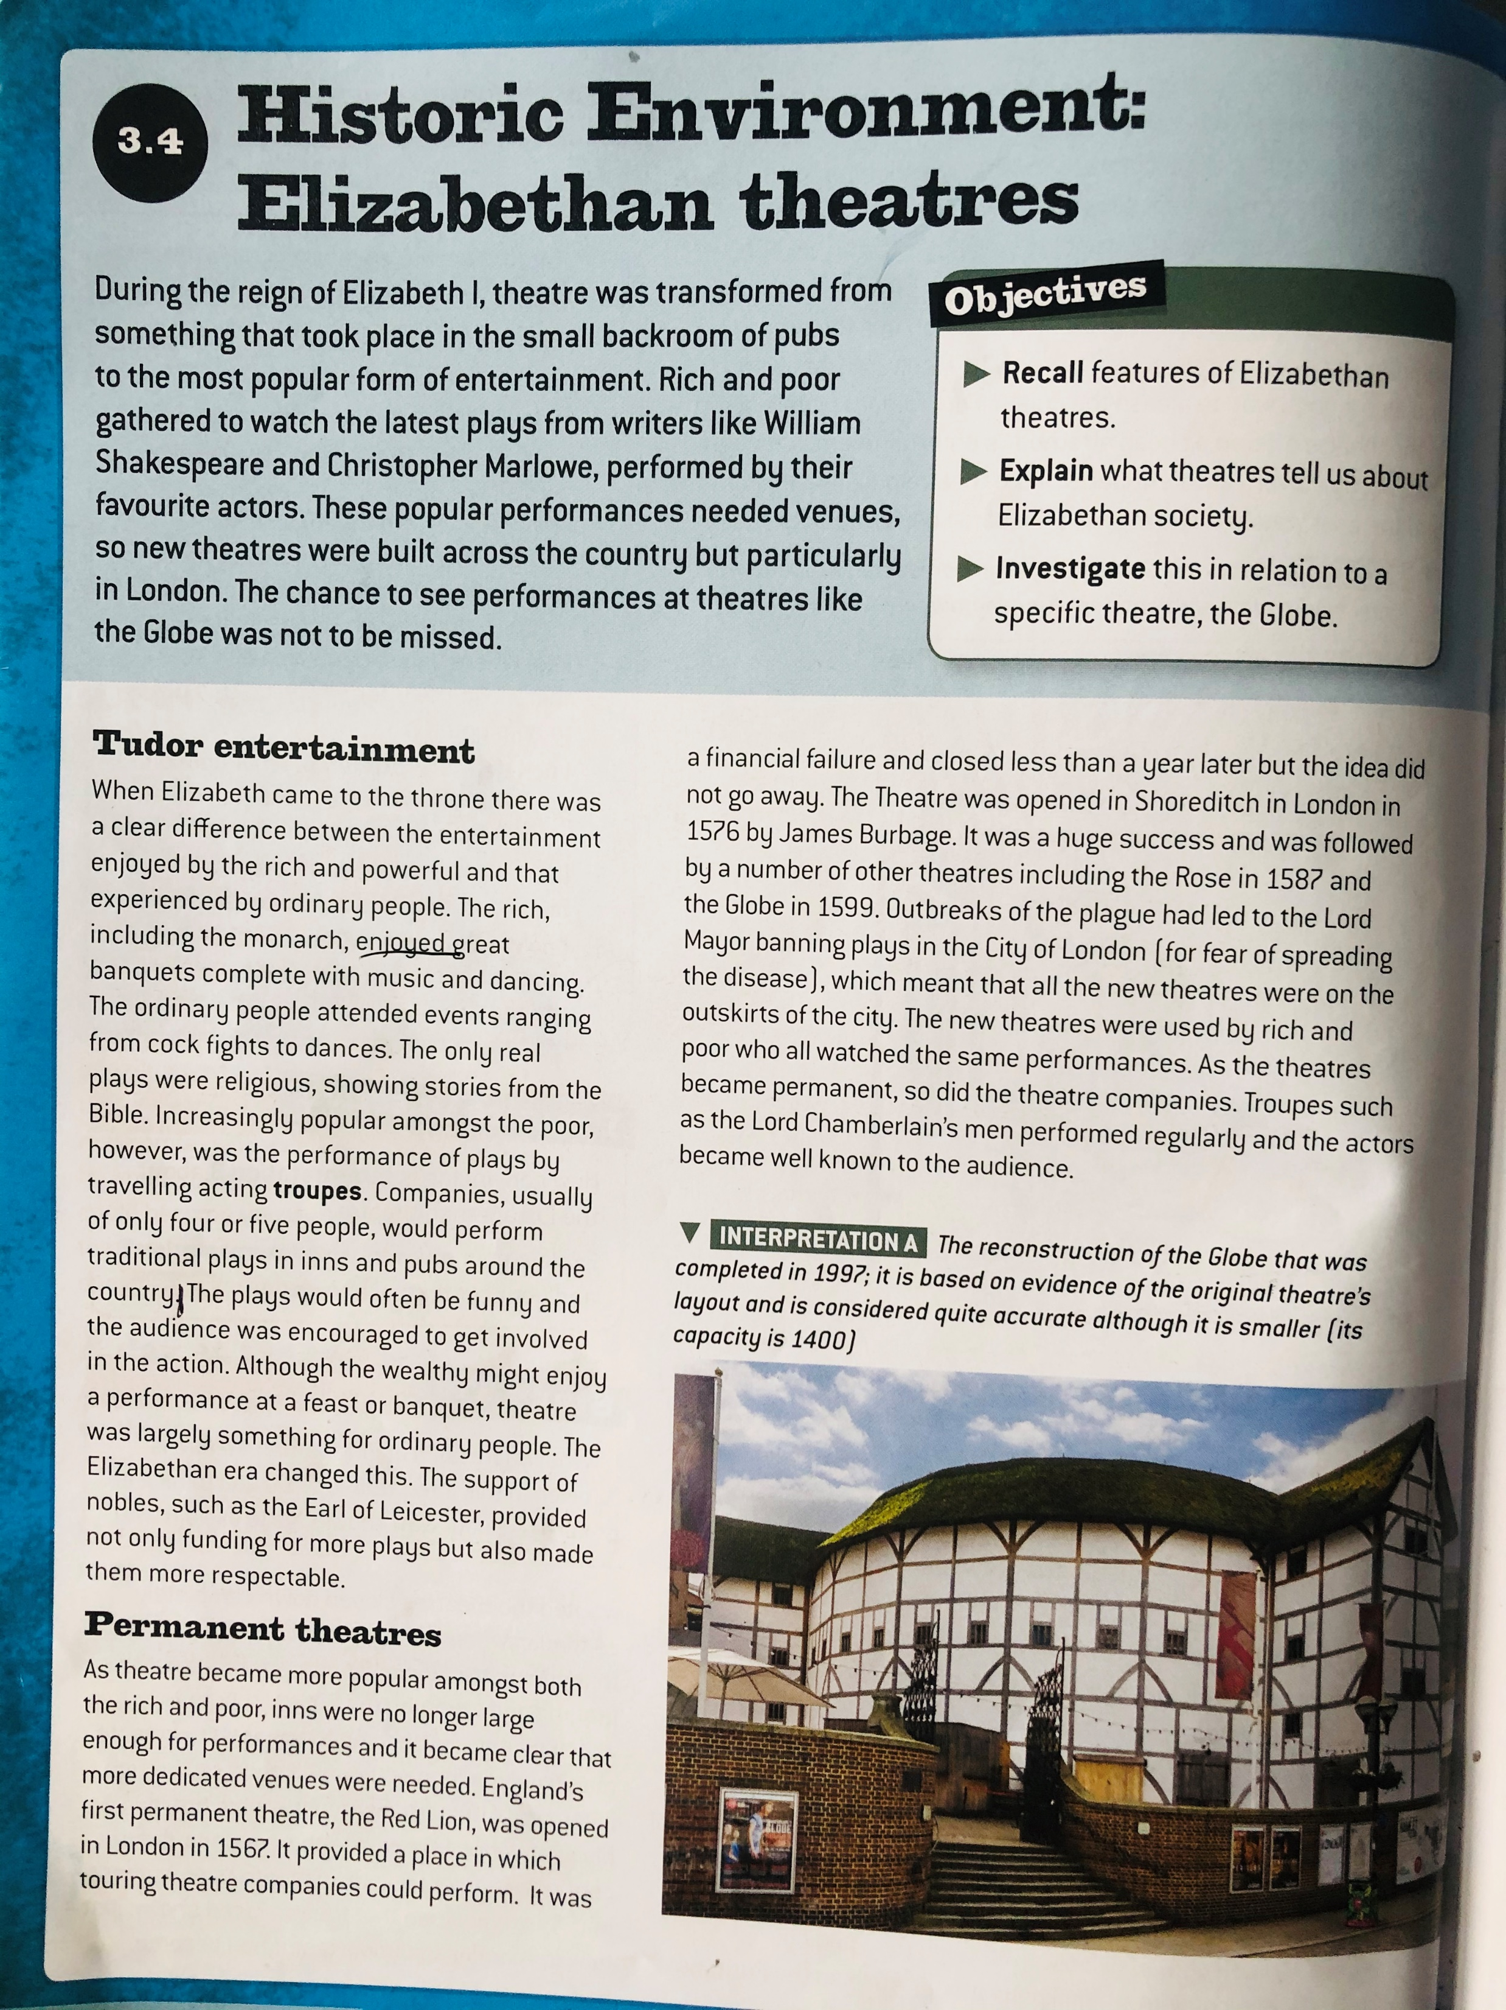
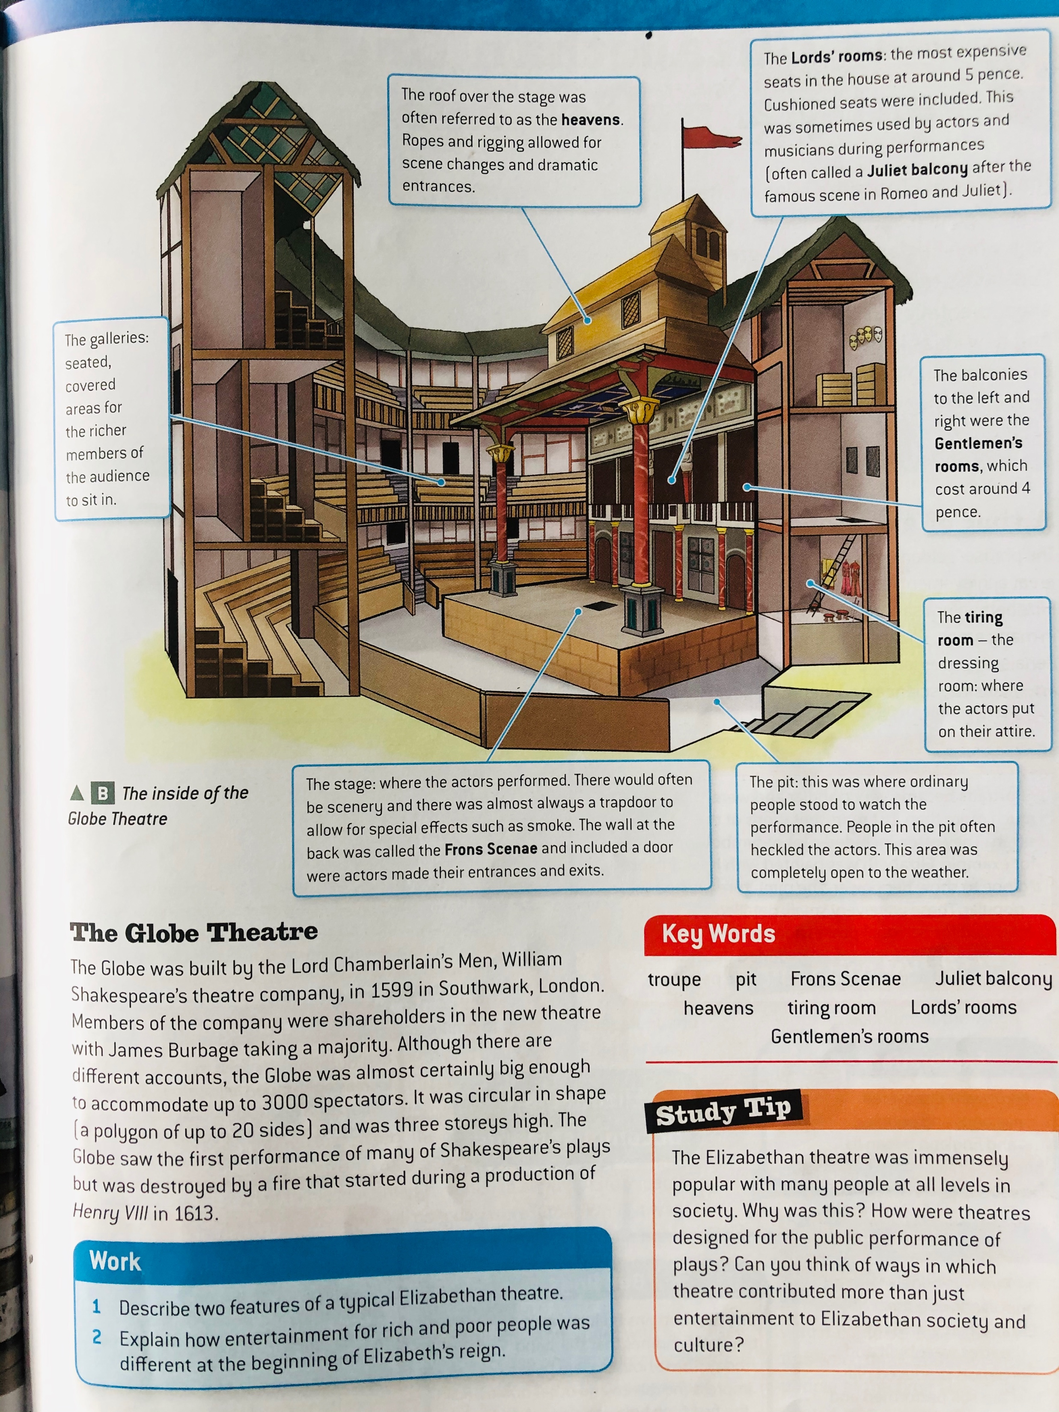

Slide 4
Work 25/03/2020
1) Features of the theatre
Galleries: seated, covered for the richer members of the audience to sit in.
The stage: where the actors performed.
The roof over the stage was often referred to as the heavens. Ropes and riggings allowed for the scene changes and dramatic entrances.
The Lord's rooms: the most expensive seats in the house at around 5 pence.
The balconies to the left and right were the Gentlemen's rooms, which cost around 4 pence.
The tiring room- the dressing room: where the actors put on their attire.
The pit: where ordinary people sat to watch the play.
2) The rich enjoyed banquets and parties and dances in the theatres as well as ordinary only watched plays even though they were encouraged to join and be a part of it, so no matter if your rich or poor you still get to have fun and be entertained.

