Slide 1
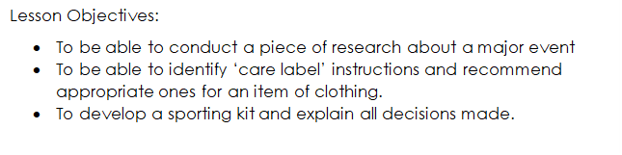

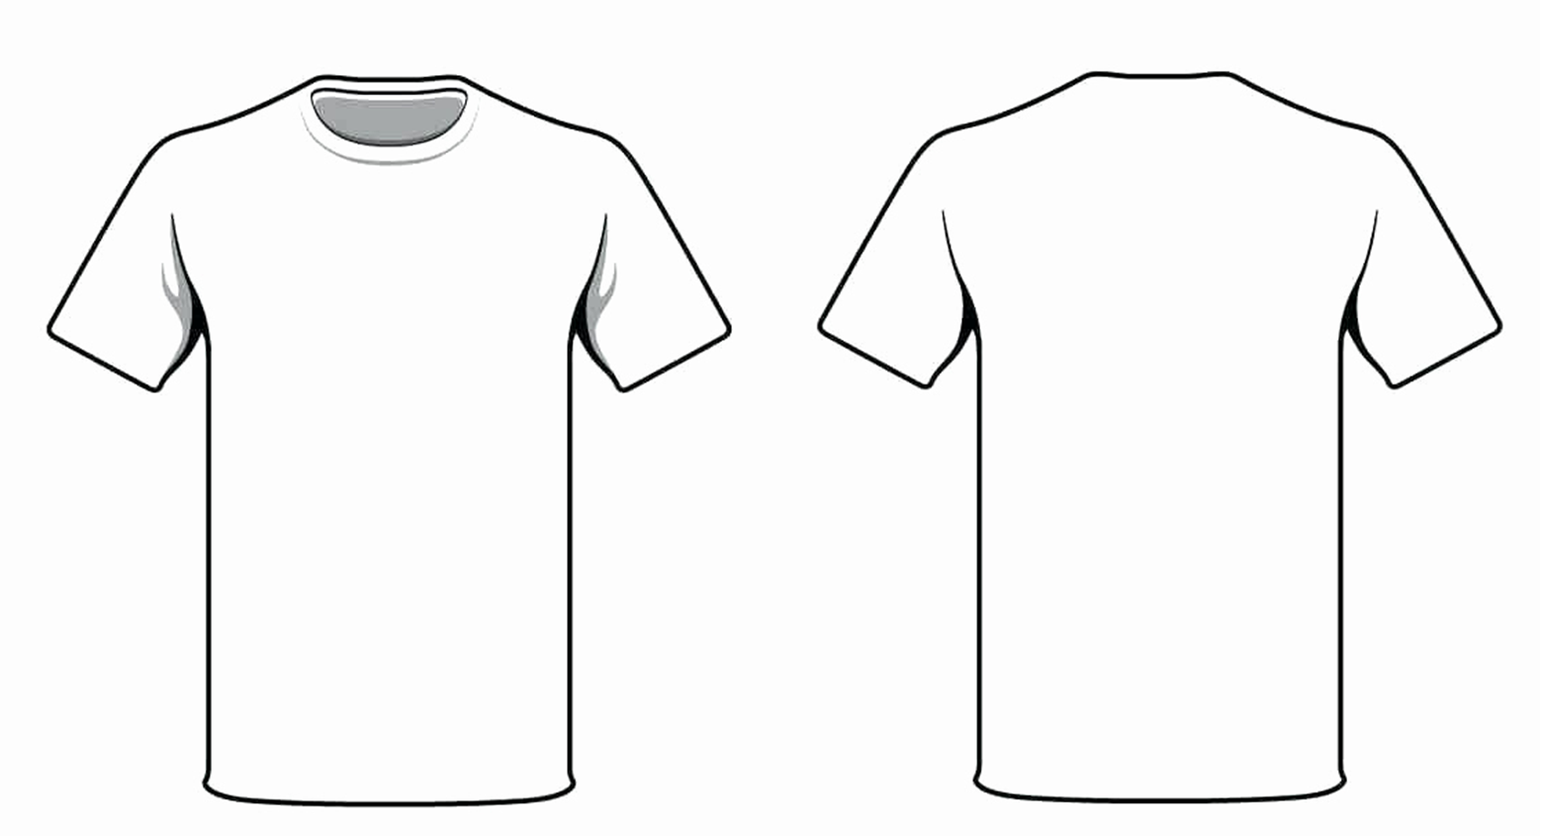
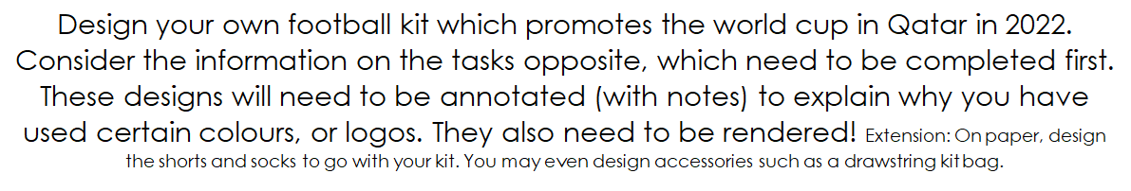
The Brief

Slide 2
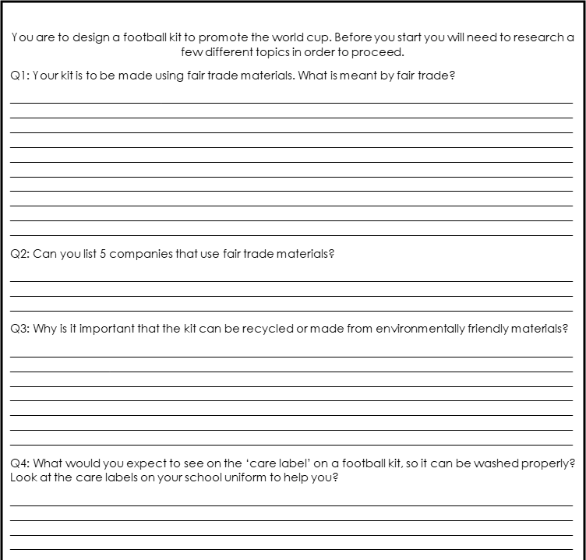
Lesson 1
Answer questions 1-6
Don't forget to sketch out other logos you find online.

Slide 3
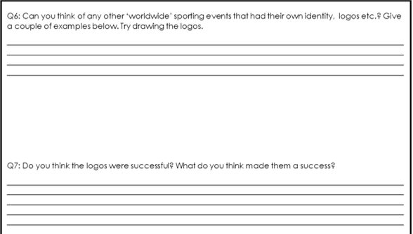
Q5
Q6

Slide 4
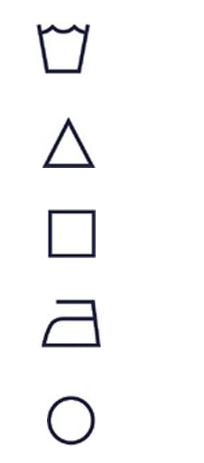

CARE LABLES
The world of care labels can be a confusing place. There are many symbols, all with slightly different meanings. Take a look at the inside of your top (usually at the bottom somewhere)... See if you can figure out how to care for your garment from the symbols shown... Confused? Keep reading and all will become clear.
Lesson 2
Complete slides 4,5 and 6 ​
Why do we have Care Labels?
Imagine a world without them?! Your favourite tracksuit or jumper would be at risk of shrinking for a start! If you do your own washing you will know that they help us look after our garments by telling us how to wash and care for them but why use symbols and not words? Take a minute to think...
Give at least 3 reasons why we have care labels:

Slide 5
5 symbols on care lables
Name each symbol
1.
2.
3.
4.
5.

Slide 6
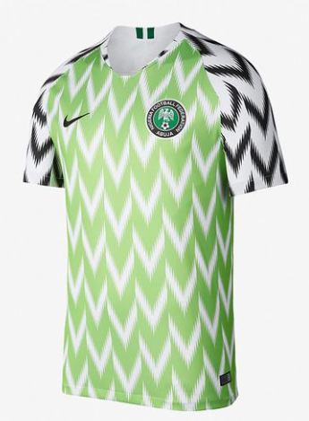

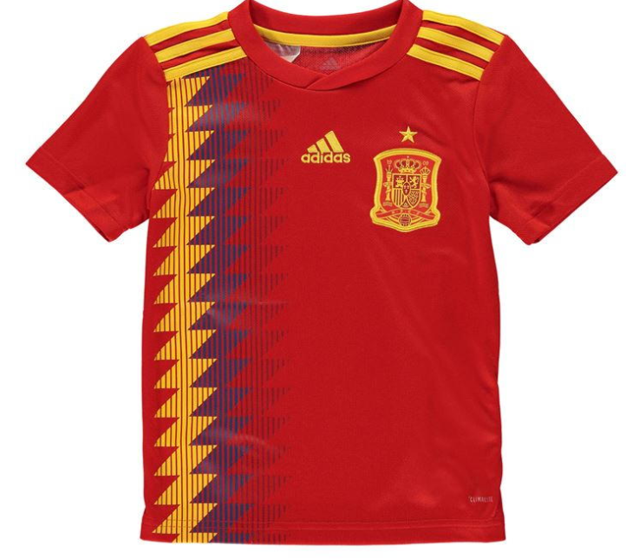
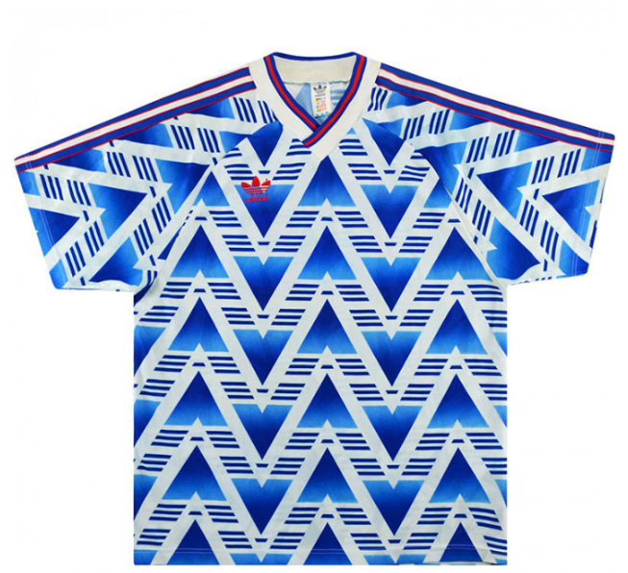
Use the internet to find inspiration!
You want your kit to stand out, to be colourful, innovative.
Find 5 images online that you will use to inspire your design.
Explain why you select these 5 images.

Slide 7
Lesson 3 Complete the design for your football kit. Include colour.

