Slide 1
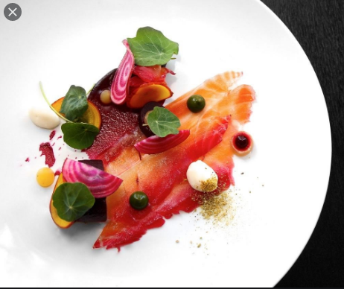
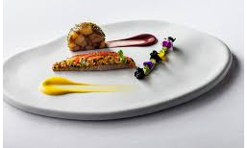
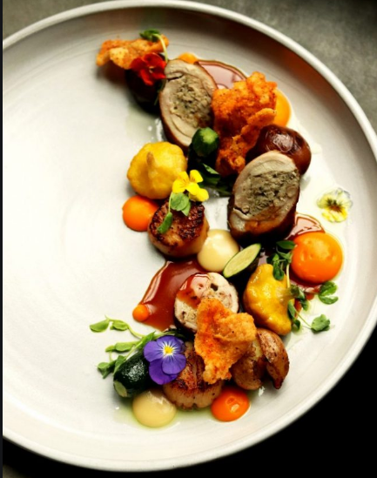

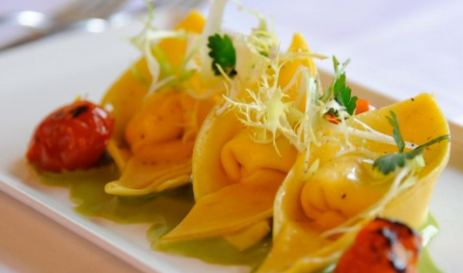
KS4 Hospitality and Catering
Mini Coursework Practice Project
“Quarantine Cuisine” Part 1
30th March – 24th April 2020

Slide 2
Your Brief:
You are being asked to stay at home for an extended period of time. During this time you have the opportunity to develop your cooking skills and work on creating exciting recipes from what is available in your fridge, freezer and cupboard.
You need to create a two course menu (starter and main course, or main course and desert). The dishes you create should showcase your creativity, you need to analyse the nutrition in your dishes to discuss if they meet healthy eating guidelines for teenagers and adults.
Follow the instructions on the different slides. Remember to document all of your work and save it to hand in for assessment on 3rd April.

Slide 3
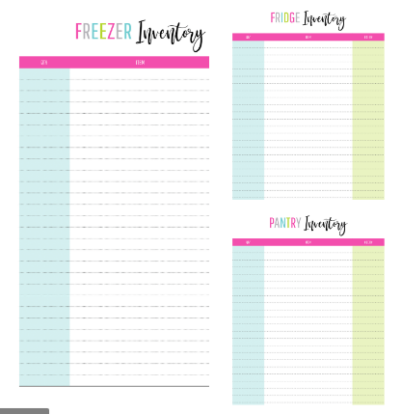
Fridge, freezer and cupboard inventory
Complete an inventory of the food in your fridge, freezer and cupboard
Put food into categories e.g.
Meat/poultry/fish and other proteins
Fruits and vegetables
Dry foods, grains, starches
Dairy foods
Canned foods
*Be sure to compile a list of food inventory, so I can see why you have chosen your dishes for practical.
This is a good way to go through the fridge and cupboards to check for items with a shorter shelf life or already expired!

Slide 4
Find out about the nutritional needs of teenagers
Check out these websites
https://www.foodafactoflife.org.uk/14-16-years/healthy-eating/nutritional-needs-through-life/#NNTL
https://www.johnmuirhealth.com/health-education/health-wellness/childrens-health/nutrition-teens.html
https://www.nhs.uk/live-well/eat-well/healthy-eating-for-teens/
https://www.nutrition.org.uk/nutritionscience/nutrients-food-and-ingredients/nutrient-requirements.html?start=5
Write a page showing what you have learnt about:
Teenagers calorie needs
Main nutrient concerns for teenagers
  What nutrients do they need?
  Why do they need them?
  Where do we find these nutrients in food?

Slide 5
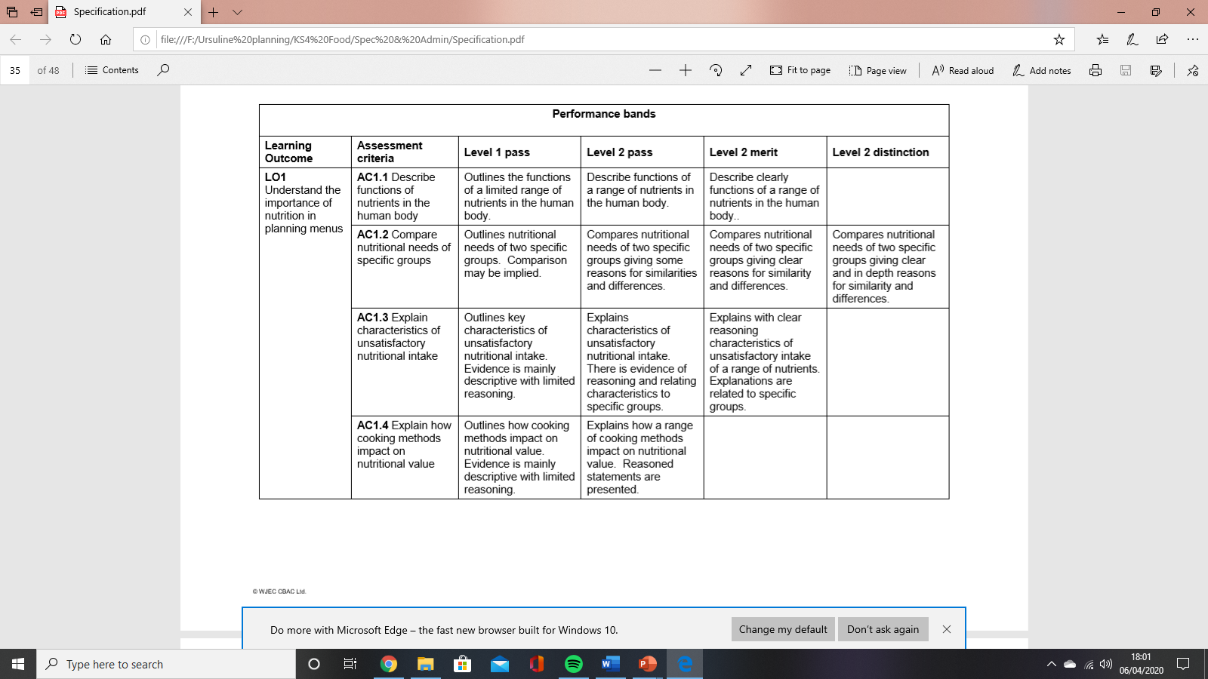
Find out about the nutritional needs of teenagers
Check out these websites
https://www.foodafactoflife.org.uk/14-16-years/healthy-eating/nutritional-needs-through-life/#NNTL
https://www.johnmuirhealth.com/health-education/health-wellness/nutrition-diet/tips-eating-healthy.html
https://www.nhs.uk/live-well/eat-well/
Write a page showing what you have learnt about:
Adults calorie needs
Main nutrient concerns for adults
  What nutrients do they need?
  Why do they need them?
  Where do we find these nutrients in food?
https://www.nutrition.org.uk/nutritionscience/nutrients-food-and-ingredients/nutrient-requirements.html?start=5

Slide 6
Compare the nutritional needs of teenagers and adults
Now you have information about the nutritional needs of teenagers and adults and know
why they need these nutrients, you need to compare the nutritional needs of the two
Groups and explain where their needs are different and where their needs are the same.
You can present this work in a table, as a poster or as a piece of writing, but you need to
explain where their needs are the same or different and what the reasons are for this.
All three parts of this work need to be handed in for assessment:
The nutritional needs of teenagers
The nutritional needs of adults
A comparison of the nutritional needs of adults and children.

Slide 7
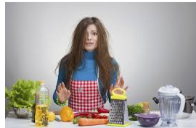

Half term homework:
Cook your two favourite recipes – Trial your menu!
Practice cooking your chosen recipes.
Use YouTube to look up techniques you are unsure of.
Take photos of your dishes
Keep them as evidence.
WWW?
EBI?

