Slide 1
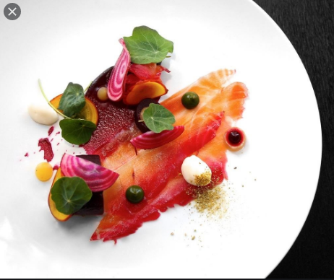
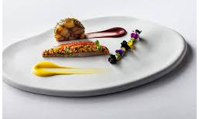
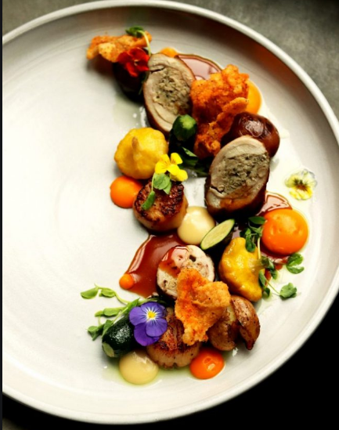
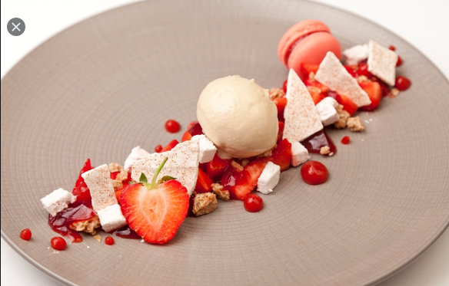
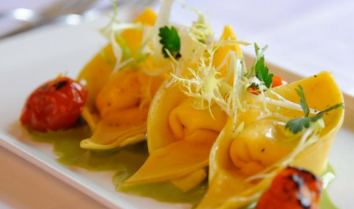
KS4 Hospitality and Catering
Mini Coursework Practice Project
“Quarantine Cuisine” Part 2
27th April – 7th May 2020

Slide 2
Your Brief:
You are being asked to stay at home for an extended period of time. During this time you have the opportunity to develop your cooking skills and work on creating exciting recipes from what is available in your fridge, freezer and cupboard.
You need to create a two course menu (starter and main course, or main course and desert). The dishes you create should showcase your creativity, you need to analyse the nutrition in your dishes to discuss if they meet healthy eating guidelines for teenagers and adults.
Follow the instructions on the different slides. Remember to document all of your work and save it to hand in on 7th May.

Slide 3

Research dishes to cook
Don’t forget recipe books you have at home!
https://www.bbcgoodfood.com/
Check out these websites
http://allrecipes.co.uk/
https://www.superprof.co.uk/blog/online-resources-learning-to-cook/
Find four recipes that are suitable for teenagers and adults that use ingredients that you have at home
Try to find recipes that have ingredients with the key nutrients for teenagers and adults
Remember you have been asked to prepare a starter and main course or a main course and a dessert (a dessert in eaten with a spoon or fork, cakes can be picked up and eaten with your fingers, be careful you choose a dessert and not a cake)
Document your recipes – copy and paste the ingredients and instructions, or print them out.
Do you need to modify the recipe based on what food is available?
Remember to read THE METHOD, as well as the ingredients list. Will you be able to make the dishes you have chosen?

Slide 4
Explain factors to consider when proposing dishes for menus
You need to explain why the recipes you have chosen are suitable for this assessment.
For each recipe you need to consider and write about the following:
Time of year e.g. seasonality of commodities, seasonal events, is the food you want to use available?
Skills of staff – are you able to cook the food you have chosen? Do you have the skills needed? If not, is this something you can learn?
Equipment available – do you have the correct equipment to make the food you have chosen? If not, can it be adapted?
Time available. You can take between three and four hours to prepare and cook both of these dishes. Have you given yourself enough to do?
Type of provision e.g. service, location, size, standards. Have you chosen recipes that are suitable for your family?
Finance e.g. costs and what is available.
Customer needs. Will what you have chosen to cook be suitable for your family meal?
You can present this information in any form you wish (table or paragraph) but you must look at all four recipes.

Slide 5
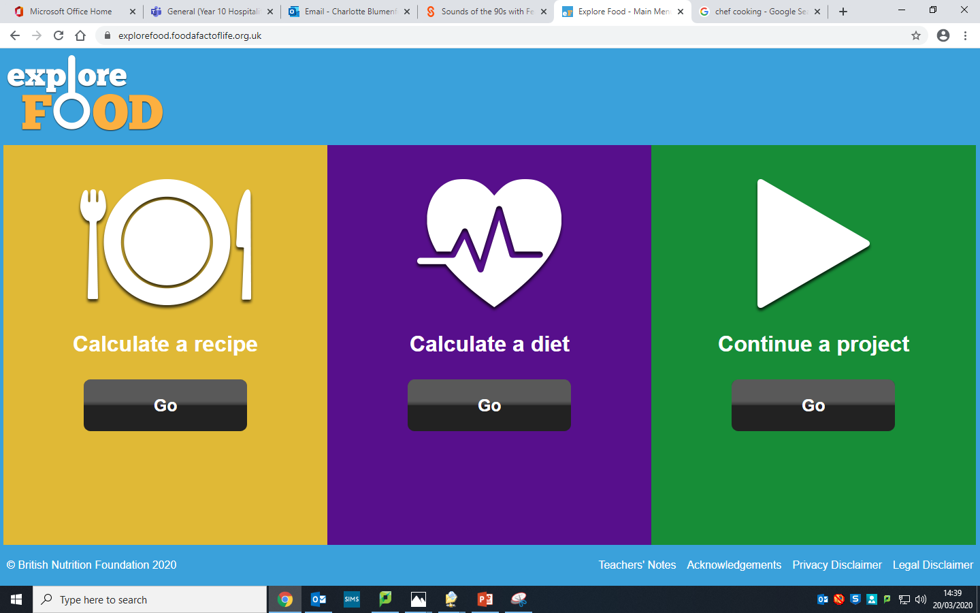
Complete a nutritional analysis of your 4 chosen dishes.
Explain how dishes meet customer needs
Use this website
https://explorefood.foodafactoflife.org.uk/
1) Click on calculate a recipe

Slide 6
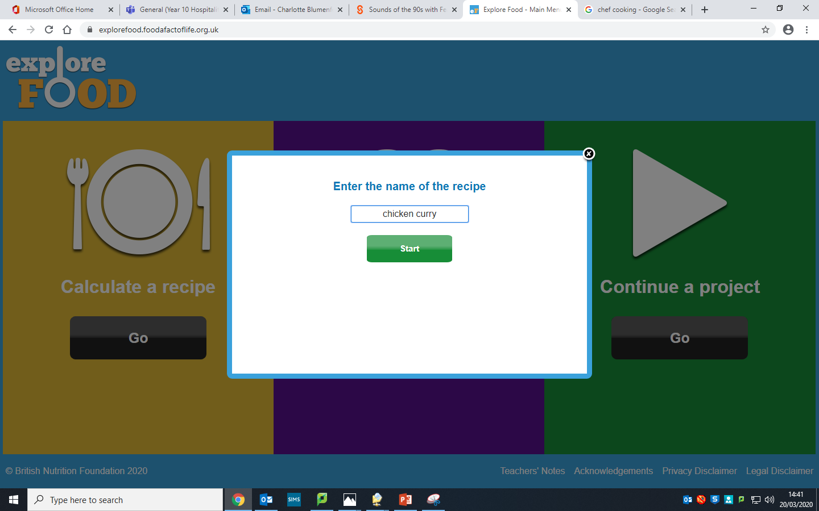
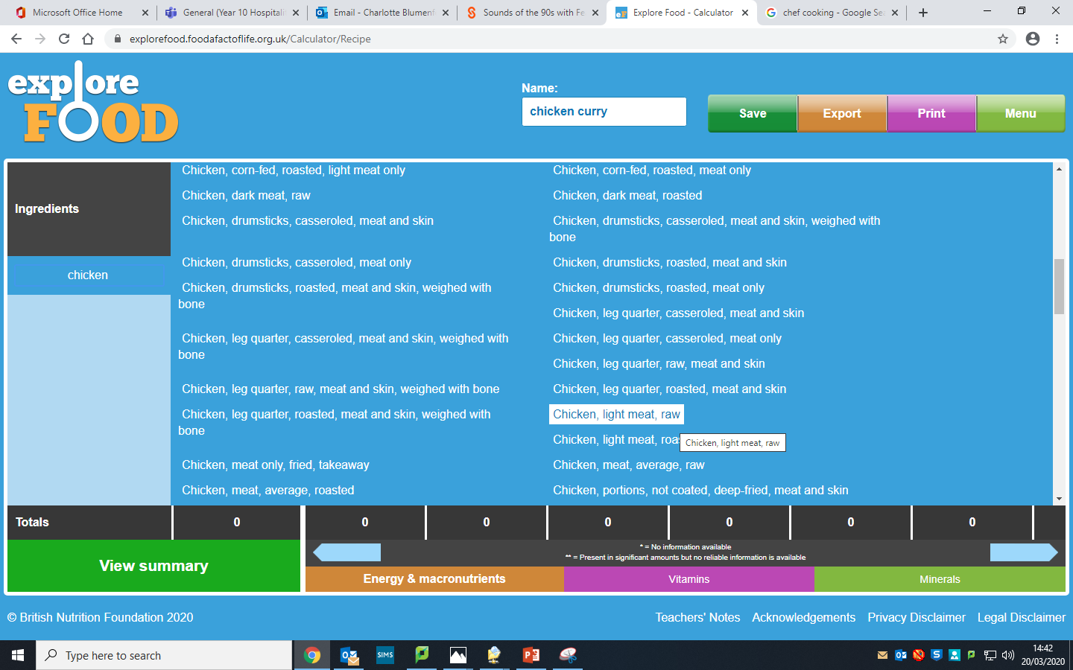
2) Enter a name for your dish
3) Start adding ingredients,
Search the name
Remember they may be called
‘chicken raw’
Or
‘flour plain’

Slide 7
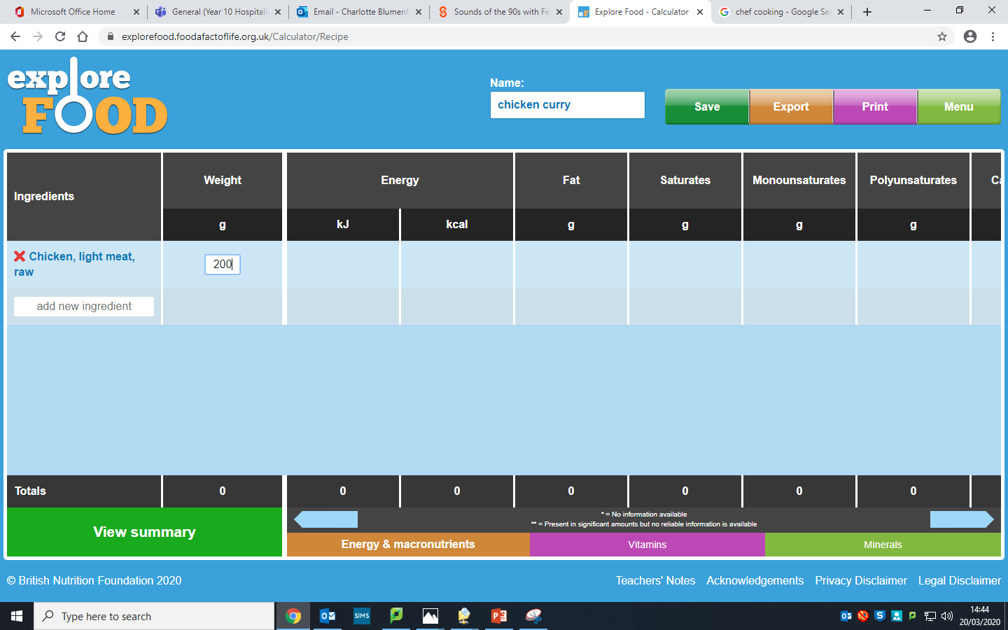
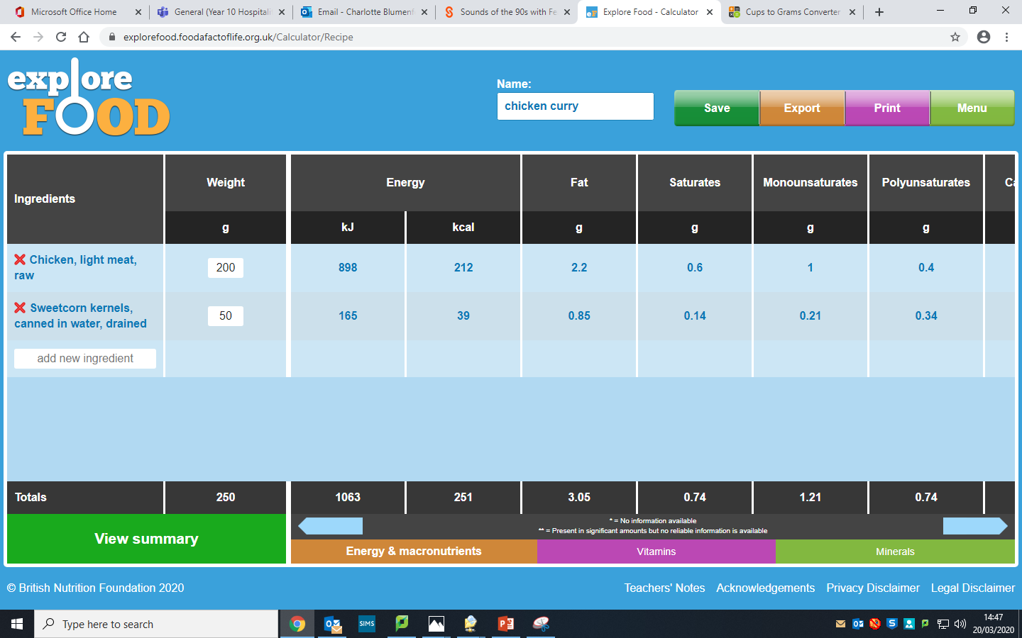
4) Add the number of grams needed
Remember:
1 teaspoon = 5g
1 tablespoon = 15g
Convert all ‘cups’ into grams
https://www.thecalculatorsite.com/cooking/cups-grams.php
5) When finished – click on view summary

Slide 8
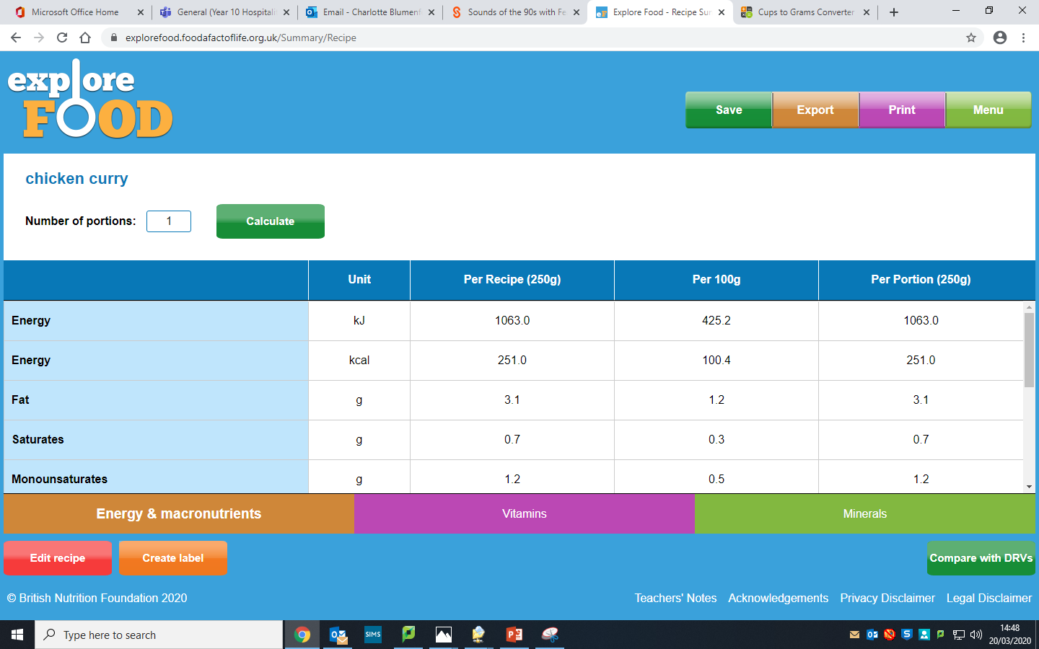
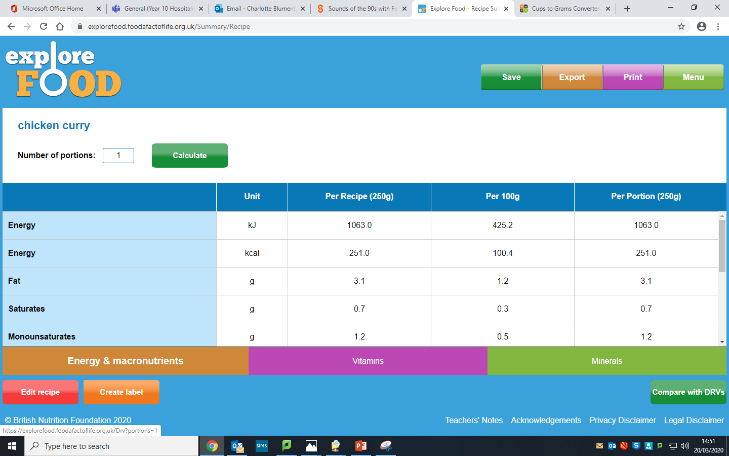
6) Remember to say the number of portions the recipe makes
7) Click on compare with DRV (Dietary reference values) which will show you a comparison with different groups nutritional needs

Slide 9
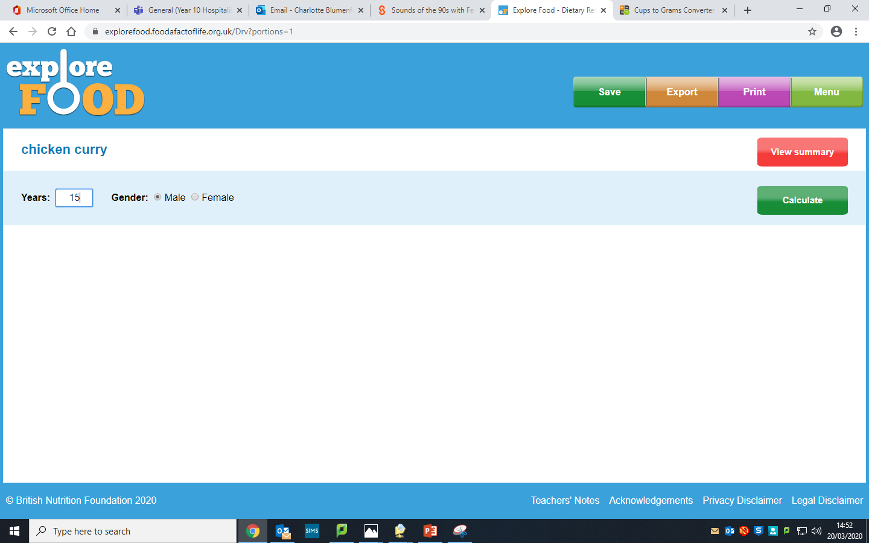
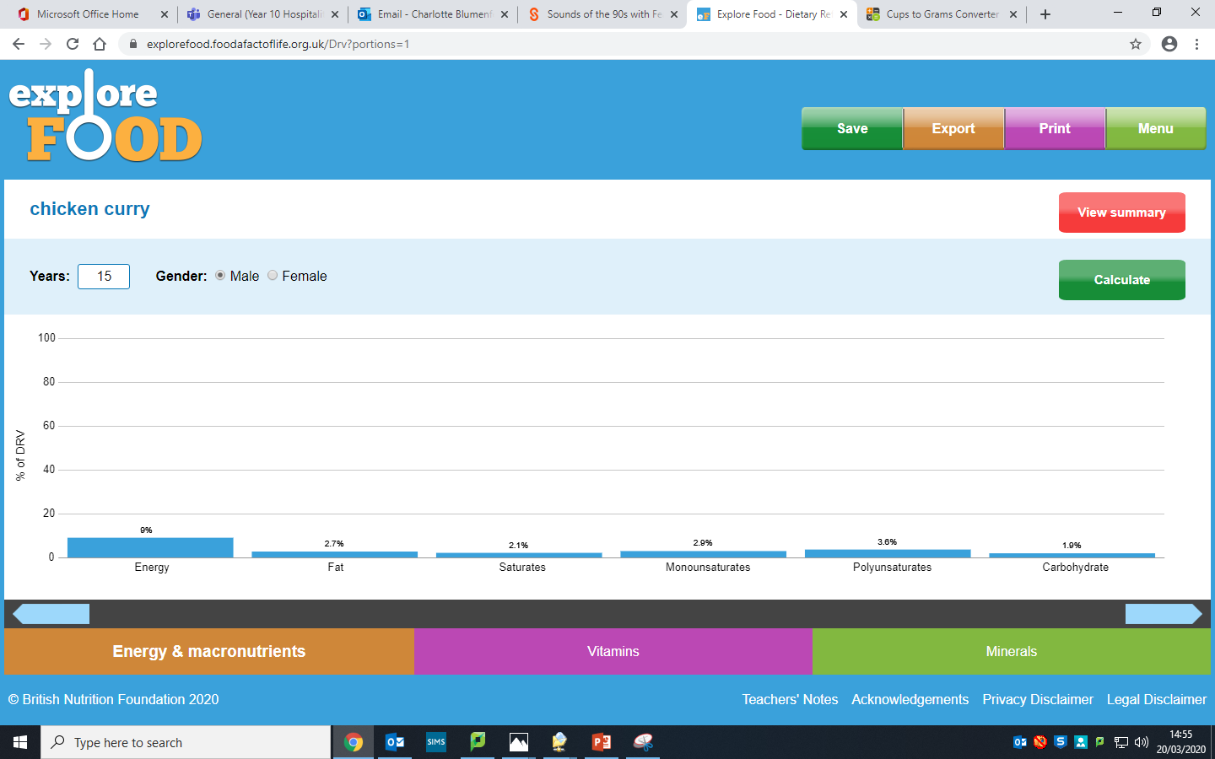
8) Set the age of the DRV (dietary reference values) you want to analyse
Set a teenagers or adults age, select male or female.
Click - calculate
9) Scroll along to see different nutrients and how they compare to the government guidelines for that group for your dish.
Analyse this data and write a paragraph explaining it.
Remember to focus on the key nutrients for your target group of ‘teenagers’ or adults
TIP: You can save and export this data!

Slide 10
More about how to carry out a nutritional analysis.
When you click on the compare with DRV’s tab, you get a percentage for each nutrient. The DRV is a Dietary Reference Value. This is an estimate of the amount of energy and nutrients needed by different groups of healthy people in the UK population, produced by the government.
The percentage that you can see next to each nutrient tells you how much of your days DRV is provided in that recipe.
A main meal should provide about a third of your days nutritional requirement.
Look at the percentage and decide if it is enough, too little or too much.
There are no set figures for each meal, as everyone has different eating patterns and needs and DRV’s are an average.
You need to say if you think the meal provides a suitable amount of each nutrient or not. If you decide it does not contain enough of a particular nutrient, using your work from part one, what could you do to increase the amount of that nutrient? Could you add a salad or serve with vegetables if there is a lack of Vitamin C? Could you add a drink of milk, a yoghurt or a dessert which has dairy in it, if there is not enough calcium? Could this nutrient be gained from breakfast (most breakfast cereals are fortified with the B group of vitamins)?
No meal is perfect, remember it is what we eat over a day /week/month that matters, not what we eat in one meal.
If there is too much of a nutrient in one of your recipes, does that matter? (Yes for fat and calories, no for any water soluble vitamin) Could you change the recipe to reduce the amount of this nutrient?

Slide 11
Explain how dishes meet customer needs
For each of your four recipes explain how it will meet customer needs.
You need to make a comment on the overall nutritional value, based on your nutritional analysis.
Explain what you would serve with the recipe to make it a complete meal.
You need to comment on the flavours, textures and appearance of the food, and why your family would want to eat it.
When you have completed this, explain which two recipes (EITHER a starter and main course OR a main course and dessert) you would cook for this work, remembering to comment on:
The nutritional needs of adults and teenagers,
The nutritional value of your chosen two recipes,
The time they will take
Your skills, the equipment needed
The enjoyment value/organoleptic qualities of your chosen dishes (taste, texture, appearance)

Slide 12
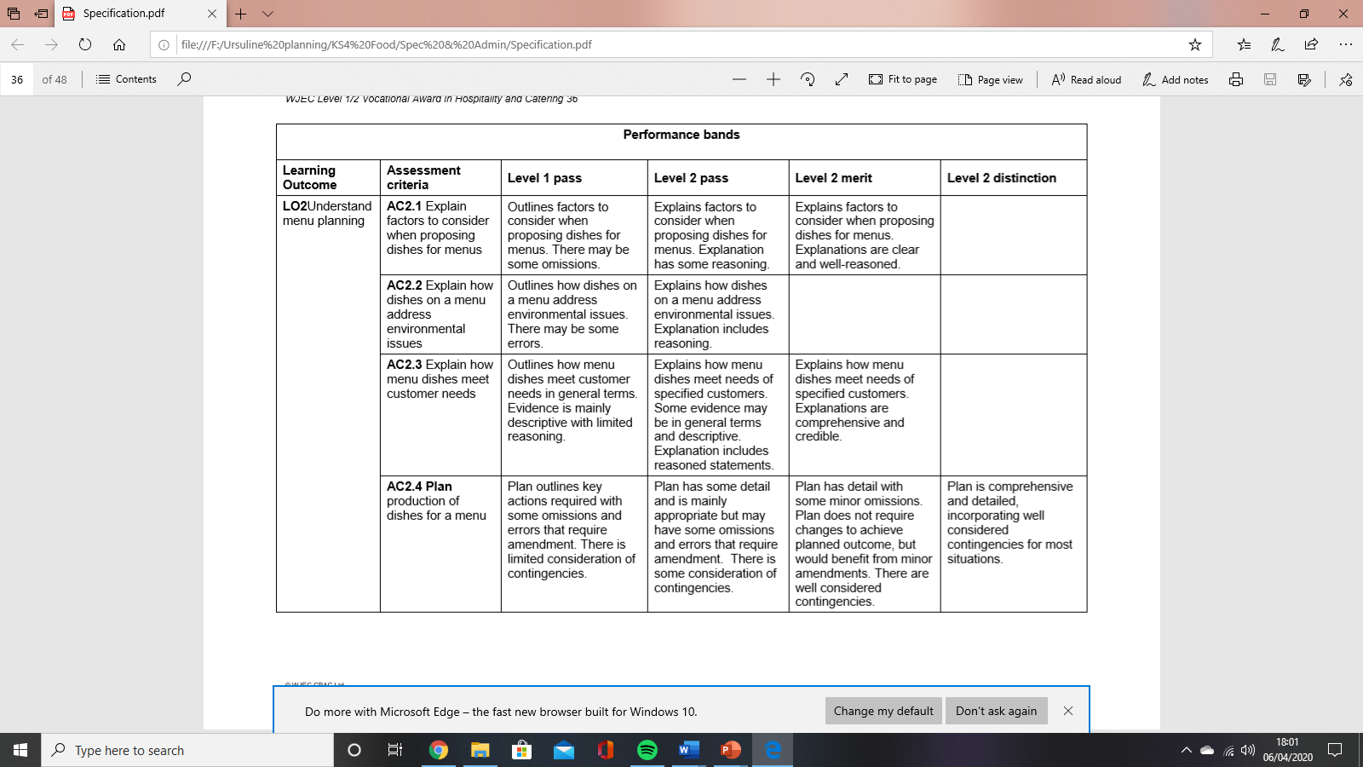
By the time you have completed this work you should have:
A list of four possible recipes that you could make for this assessment and the
reasons why each recipe is suitable
A nutritional analysis of each recipe
Your final choice of recipes, giving the reasons for your choice of recipes.

