Slide 1
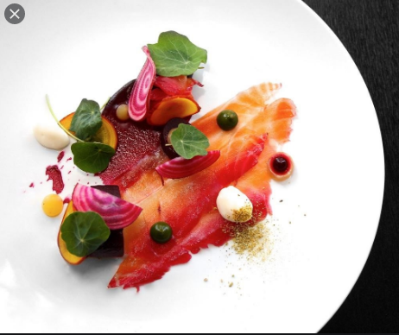
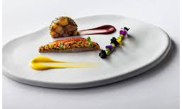
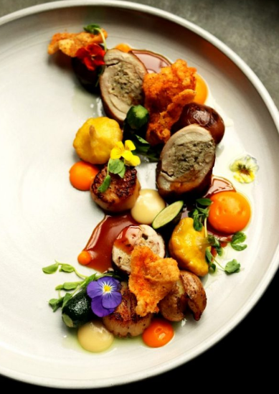
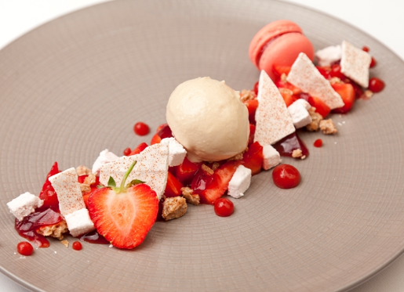
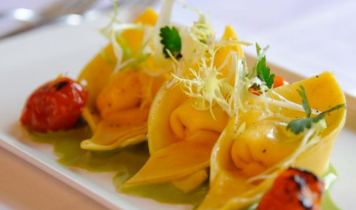
KS4 Hospitality and Catering Mini Coursework Practice Project
“Quarantine Cuisine” Part 3
18th May – 22nd May 2020

Slide 2
Your Brief:
You are being asked to stay at home for an extended period of time. During this time you have the opportunity to develop your cooking skills and work on creating exciting recipes from what is available in your fridge, freezer and cupboard.
You need to create a two course menu (starter and main course or main course and desert). The dishes you create should showcase your creativity, you need to analyse the nutrition in your dishes to discuss if they meet healthy eating guidelines for teenagers and adults.
Follow the instructions on the different slides. Remember to document all of your work and save it to hand in on 22nd May.

Slide 3
Writing a time plan/planning the production of your dishes
You need to decide how you will cook your two dishes (at the same time).
When you eat a meal at home, you are not given the meat first served on its own, then potatoes and vegetables 20 minutes later. Cooking more than one thing at the same time, so all the parts of a meal are ready at the same time is important.
This is called dovetailing.
Dovetailing means that all parts of a meal are served at their best and you do not waste time waiting for one part of a meal to cook, you prepare and/or cook another part of the meal and/or clear up.
See the example on next slide. The dishes have been colour coded.
You must say the time the step takes OR the time you will start cooking, the details of the step and any ‘quality checks’ ‘tips’ and health and safety points.
REMEMBER the time plan is all you should use when you are cooking, not the individual recipes, and you should present a meal at the end of the cooking, not two single dishes, for example, not just a shepherds pie, but shepherds pie, vegetables and gravy, not just apple crumble, but apple crumble and custard.
Tip: Start cooking at 4pm if you want to have dinner ready for 7pm

Slide 4
Time Plan:
Mise En Place
Sushi rolls
Gyoza dumplings and dipping sauce
Vegetable tempura with wasabi mayonnaise
Pickled carrot and radish
10:30-10:35 | While there is time before the elements of the curry sauce are ready, take some time to clean the work station. | Too much clutter on a work station means more stress and less room to be able to accurately prepare dishes.
10:35-10:45 | Add 2 tbsp plain flour and 4 tbsp curry powder and cook for 1 min. Gradually stir in stock until combined; add honey, soy sauce and bay leaf. Slowly bring to a boil. Turn down heat and simmer for 20 minutes until sauce thickens but is of pouring consistency. | Flour is used as a thickening agent so make sure that the curry sauce isn’t completely liquid to give it a more consistent texture.
10:45-10:50 | The curry sauce takes time to cook so begin to cook the dumplings. Heat up some oil in a pan and place the gyoza facing flat side down on a high heat until the bottom is crispy and golden which should take around 4-5 minutes. | Browning the dumplings on one side gives them a classic look, ensure they haven’t stuck to the pan
10:50-11:00 | To finish cooking the gyoza, add a small cup of water to the pan so the gyoza is half submerged. Place a lid on top and leave the heat on medium high to cook for 10 minutes. | The water allows the dumplings to steam and fully cooks the filling and the pastry
11:00-11:10 | Prepare sushi rolls using mat by pressing down finished sushi rice onto the seaweed exterior and adding the salmon and cucumber in a single strip at the beginning of the roll and proceed to roll the sushi by folding, tucking and pulling the mat at the top to tighten the roll. | Dip hands in water while making sushi rolls so that the rice doesn’t stick to your hands. Be careful while cutting the sushi roll as the sticky sushi rice may make it more difficult to cut through, cut diagonally once, then straight once and repeat.
11:10-11:20 | Mix all wasabi mayonnaise ingredients together in a food processor, except from oil, until well combined. Turn your mixer high and slowly, in a very thin stream, pour the vegetable oil until it is thoroughly emulsified and thickened. Put it in the fridge until needed. | Add the oil very slowly at a trickly pace to ensure that it emulsifies with the egg yolk. Taste for seasoning and adjust.
11:20-11:30 | Veg tempura- Put egg yolks and soda water in a bowl and mix lightly with a whisk. Sift the cornflour and flour into a bowl. Add sesame seeds and a good pinch of sea salt and mix well. Pour in soda water mixture and stir well with a fork until just combined but still lumpy. | Remember to separate the egg yolk from the egg and be careful while opening soda water as it fizzes up and is likely to explode or pour over due to the content so open it in the sink.
11:30-11:45 | Fill a deep fat fryer to one third full of oil and heat to 180*. Dip pairs of vegetables into the batter and cook in batches for 3-4 minutes. Drain on paper towels and sprinkle with sea salt. | Cook in batches to allow for the tempura to circulate in the oil. Be careful of the hot oil.
11:45-11:55 | Serve gyoza on a small black plate with dipping sauce on the side. Serve the mackerel and cucumber sushi rolls, tempura, wasabi mayonnaise and the pickled carrot and radish in 2 bento boxes- 1 for each person. | Ensure that each element of the course is served in an even amount in both bento boxes to show accuracy in serving.
Time | Steps | Quality check/Health and Safety
09:00-09:05 | Mise En Place- Get my area ready, gather equipment, put on an apron then wash my hands. | Ensure my area is clean and ready for food preparation. Washing down my surfaces ensures there is no cross contamination. Wearing an apron protects my clothing.
09:05-09:13 | Make the gyoza dough- sift 120g plain flour into a bowl. Add ¼ tsp salt to 120ml warm water measured in a jug. Stir the mixture together with a metal spatula while adding ½ tbsp. of water at a time until the texture can form a ball. | Only add enough water at a time that I need to avoid making the dough too sticky and moist, otherwise the dough will be less effective.
09:13-09:20 | Transfer the dough to the work surface and knead for 5 minutes, afterwards the texture should be much smoother. Wrap the dough in plastic wrap and leave in the fridge until needed. | Dough should be of a stretchy consistency, make sure that the surface you’re kneading on is clean and dusted with appropriate flour
09:20-09:30 | Begin preparing gyoza filling by finely slicing ¼ of the cabbage into small pieces along with finely slicing the garlic, the spring onions and the ginger. Add the sliced vegetables and the Quorn mince to a bowl and mix well with sesame oil and the soy sauce. | Use the knife assigned to your table and only your table.
09:30-09:40 | While the vegetables and the Quorn mince marinate so the flavours infuse, cut the eggplant, large onion and sweet potato into thin disks for the tempura. The gyoza filling will be ready after that. | Use the larger knife assigned to your table so that the cutting is quicker and more efficient.
09:40-09:50 | Roll out the gyoza dough and rotate it during the process so that it is slightly bigger than 3”. Spoon a small amount of the filling to the centre of the skin and dip my finger in some water to moisten the edge of the skin to make it easier to seal. | Don’t flatten the top and bottom of the dough to achieve a round shape. Be careful not to overfill the dumplings, only add as much as you need in order to make 6 dumplings.
09:50-09:55 | Fillet the mackerel by the video that you watched. | Make sure to remove bones to avoid a hazard.
09:55-10:00 | Chop and peel radish and carrot, making long ribbons from the carrot. Cut cabbage leaves into 2cm strips and put into the fridge to chill. | Wash the knife you’re using to avoid cross contaminating flavours between separate dishes.
10:00-10:15 | Make sushi rice as per packet instructions. Once the rice is prepared bring it to a boil in a saucepan and simmer for 10 minutes with the lid on. | Don’t over wash the rice otherwise it will become soggy.
10:15-10:25 | While the rice boils begin making curry sauce for the dumplings. Heat 2 tbsp sunflower oil in a medium non-stick saucepan and add onion and garlic, cook until soft. Stir in carrot and cook over a low heat for 10-12 minutes. | Ensure the oil is not to hot otherwise the garlic will burn.
10:25-10:30 | Turn off the heat of the sushi rice and leave to stand for 25-30 minutes and allow the curry sauce to cook. | Leave the lid on the sushi rice to allow it to steam and become glutinous and sticky.

Slide 5
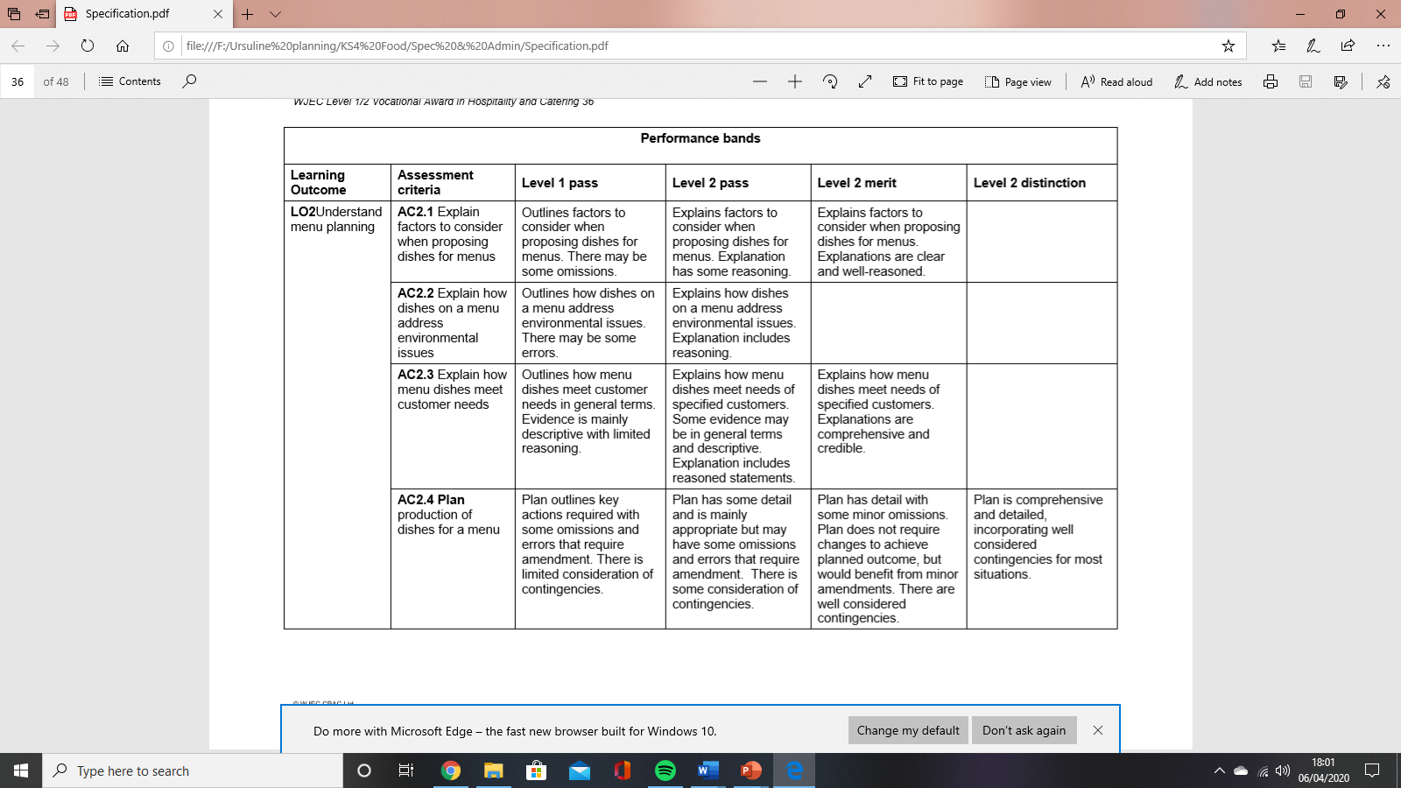
Your time plan will be assessed using the criteria below.
Remember to include the following:
Timings
Mise en place
Cooking times and temperatures
Cooling if required, state where the food will be cooled or chilled and for how long
Hot holding if required, keeping on part of a meal hot (e.g. Bolognese sauce) while you
finish cooking the pasta or making a salad
Completion
Serving (presented as if to be served)
Remember to include time for washing up and clearing your work space on your
timed plan.
LO2 Understand menu planning |  | Level 1 Pass | Level 2 Pass | Level 2 Merit | Level 2 Distinction

