Slide 1
Why is art and photography important? What skills are you learning?
https://www.youtube.com/watch?v=ubEadhXWwV4&feature=youtu.be&fbclid=IwAR2Jl5azohdugM3JFVaLOITbcA6rFgGMYbXtlHhvmwbhMRQTa4NqupoGxBg
Watch this video on ‘How art can help you analyse’ - Amy E. Herman

Slide 2
Analyse your photographs/edits for your idea development
Answer each of these questions on your photographs/edits
What is it? What does it mean/symbolise? Why have you created it? What is its purpose?
Who or what is the subject and why?
What do you want people to think/feel or how do you want them to react when they look at it?
What artist/s have you linked your work to? How have you documented this in your own outcome?
What is the significance of the composition of the image/s, viewpoint/background or foreground, etc.?
How are the formal elements used? (line, shape, colour, texture, space, etc.)
What has worked well and why?
What could be further improved or developed? How are you going to achieve this?

Slide 3
Key words
Use as much key words in your response. If you are unsure of some of these words mean use this time to find out.
Shape
Line
Space
Lighting
Composition
Negative space
Positive space
Colour
Texture
Foreground, middle ground, background
Pattern
Leading lines
Viewpoint
Rule of third
Movement
High angle
Low angle

Slide 4
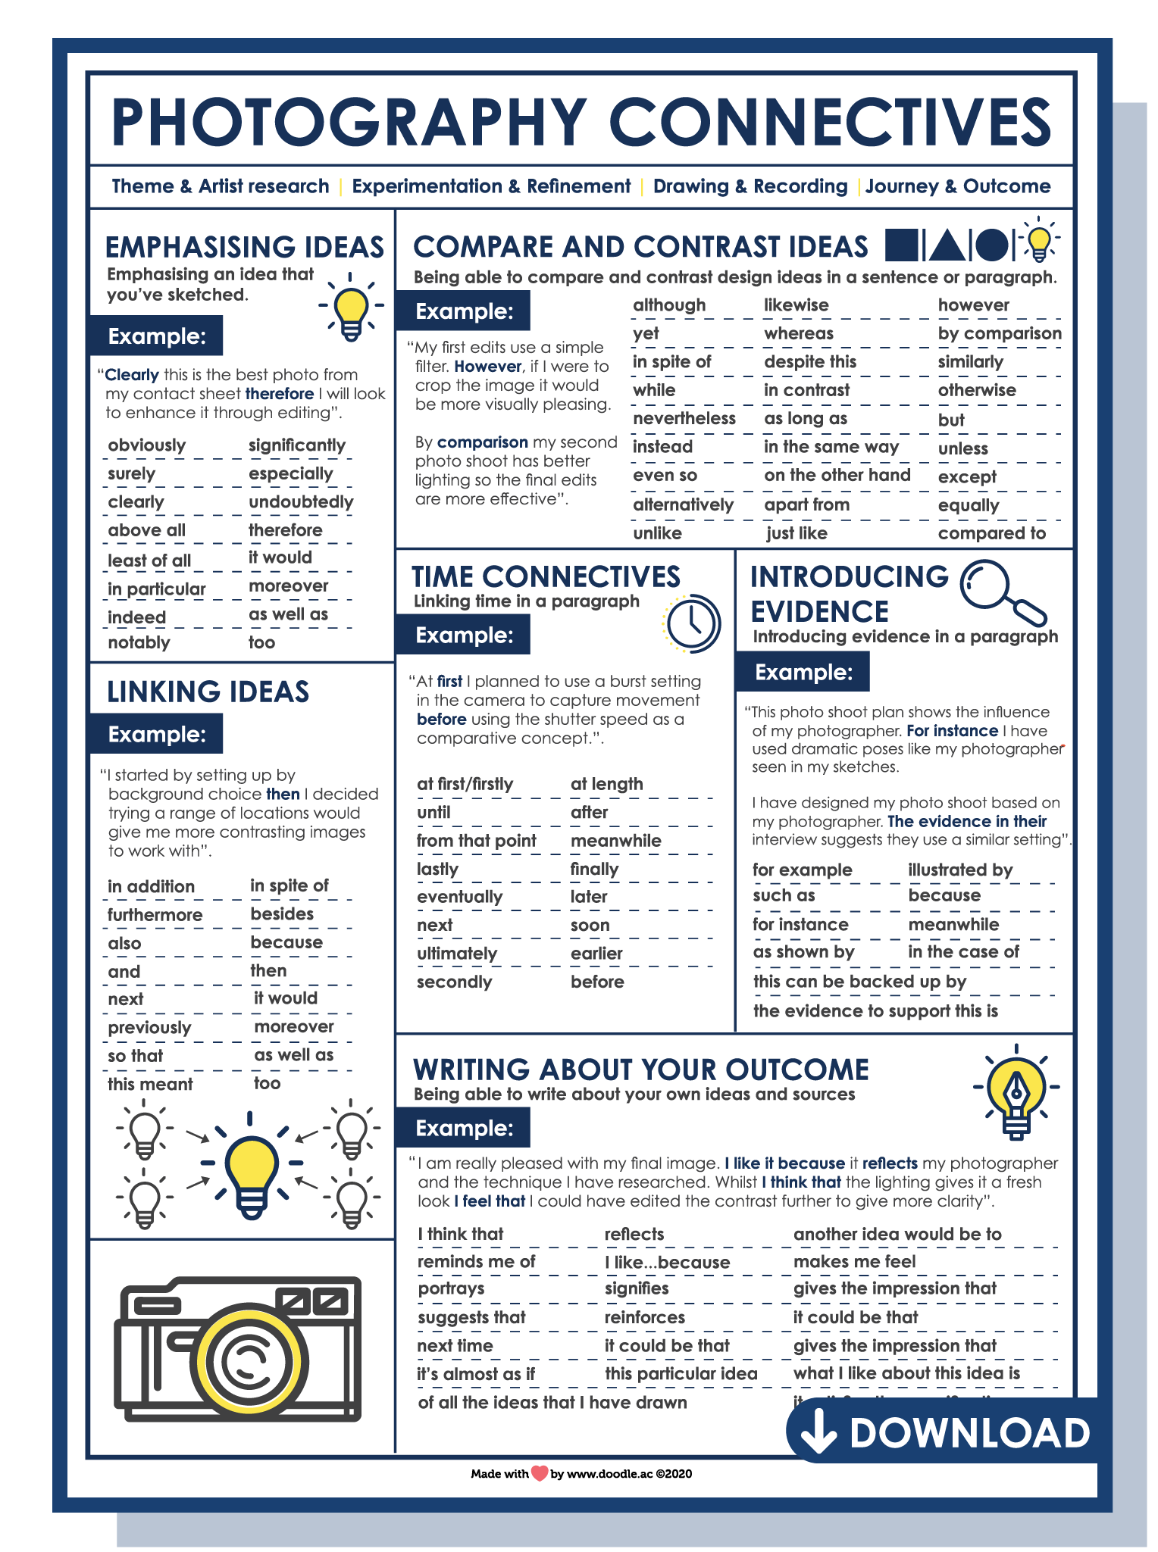
Help Sheet
Photography Connectives
You will find this in Files > Class materials

Slide 5
How to submit your work?
You can email your photograph and written annotations to me
You can include the annotations on your texture PowerPoint on the OneDrive (preferred way to submit work)
You can write your annotations on paper and email a clear image of the annotation

