Slide 1
Idea development to final piece

Slide 2

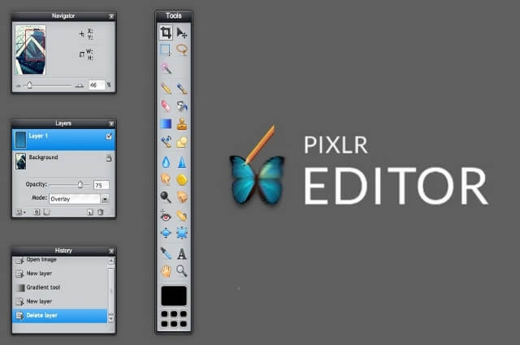
Photoshop
Pixlr
https://pixlr.com/e/

Slide 3
3 important things to remember moving forward
You need to be photographing texture
Photographers influence should be seen in your idea development
Consider your photographs – Are they clear?

Slide 4
Idea development
- You will explore the theme further by combing two artist techniques
To be successful:
Experiment and develop your ideas based on two photographers.
You will explore and experiment in a similar style to the artists you have already researched.
Take your work to the next level, try to push yourself to improve your skills and techniques.

Slide 5
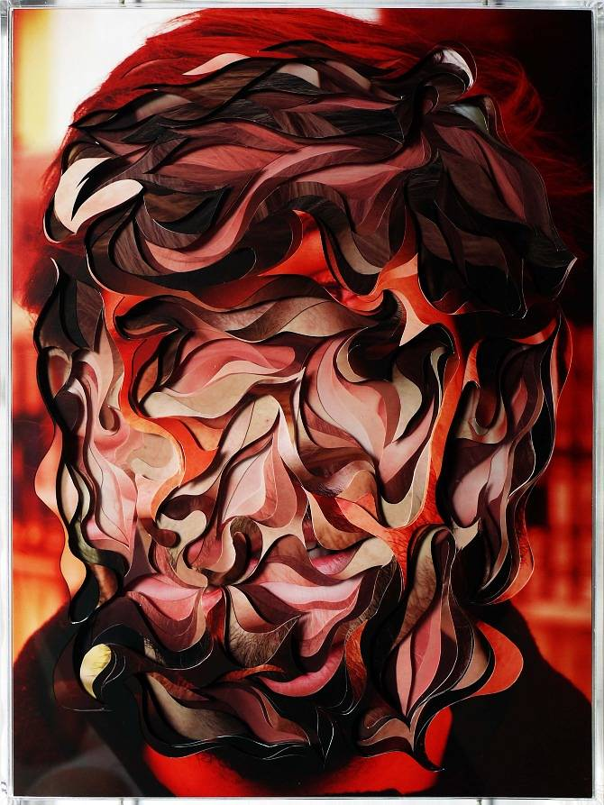
Artists you have looked at:
Trine Hisdal
Fills the frame
Photograph some unflattering, like a dying flower, and make it look more visually appealing.
What else could you photograph that has an interesting texture?
Extension: How can you use the camera/ Photoshop to change how someone views it?
Carol Sharp
Isolating textures
Blurring background
Focus on textures
If you don’t have flowers what else has an interesting texture?
Edward Weston
One main focus, one subject.
Removes colour from photographs, can texture be shown clearer if the image is in black and white?
Composition is very important
Lucas Simões
Created textures
Layered images
**Some of you looked at additional artists that you can also use in your idea developments.

Slide 6
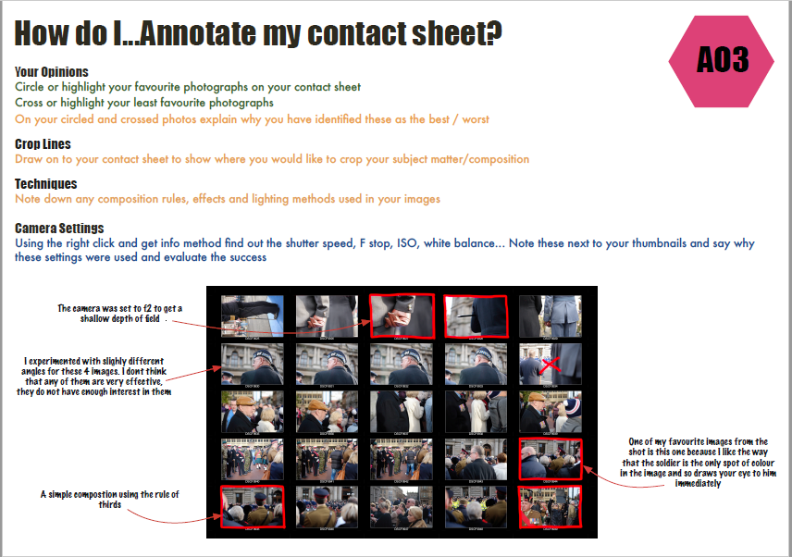
Key words
Discuss the colours
The angles
Composition

Slide 7
Editing images
Use what you already know
Improve on what you have already tried
Use the internet to get ideas
Ask me for help/tutorials
To find help on Annotations > to documents shared in files

Slide 8
Idea development
Explain what inspiration you are taking from two artists
Plan shoot
Contact sheet (20 photographs)
3 edits and annotations

Slide 9
Developing ideas further Part 1
Look at all of your photographs (mainly idea development)
What one stands out and why?
Remember: Is it clear? Does it show texture? Is it inspired by a photographer?
How can you improve this further?

Slide 10
Developing your ideas further Part 2
New contact sheet inspired by that photo
Experiment with edits
Final piece

Slide 11
Experiment with texture

Slide 12
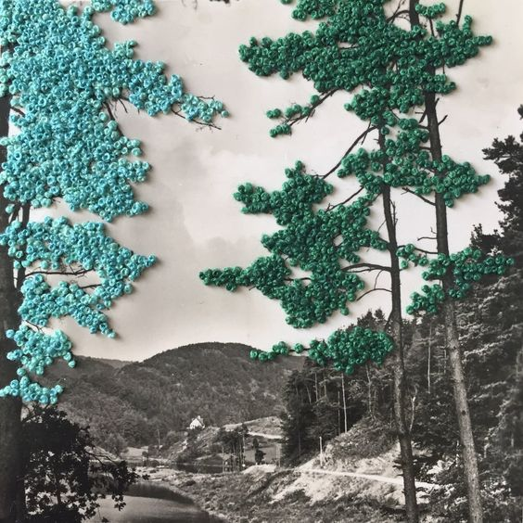
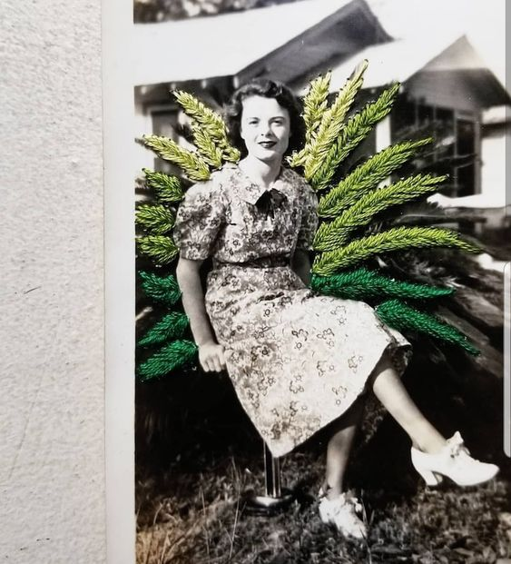
Stitching into photographs creates an interesting texture

Slide 13
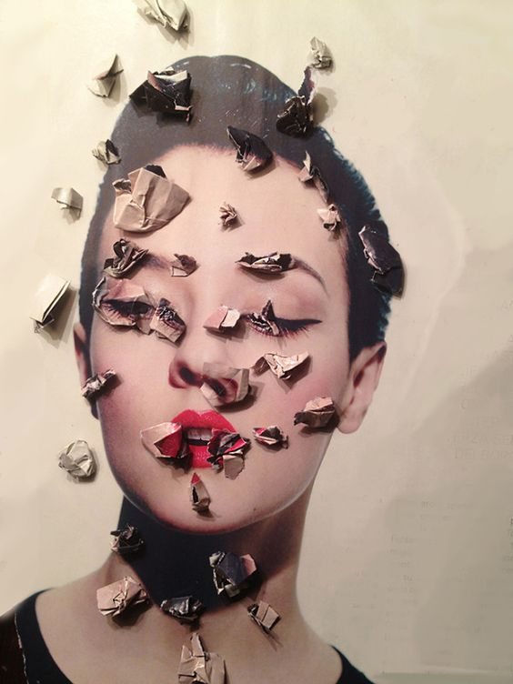
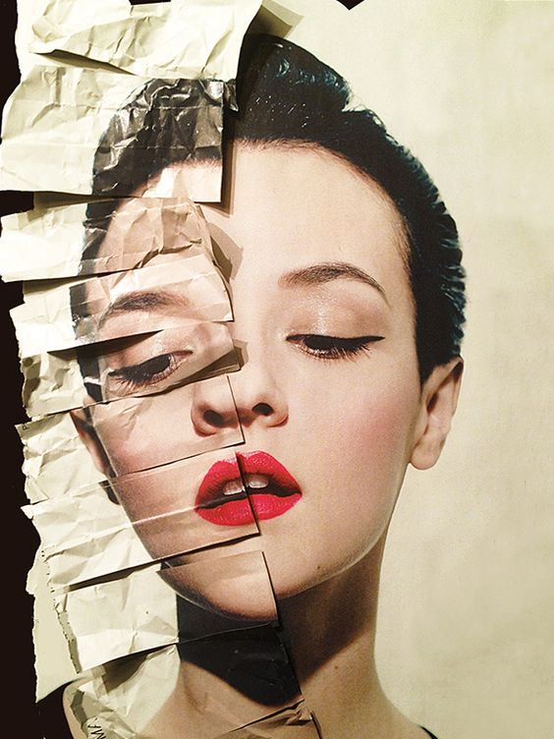
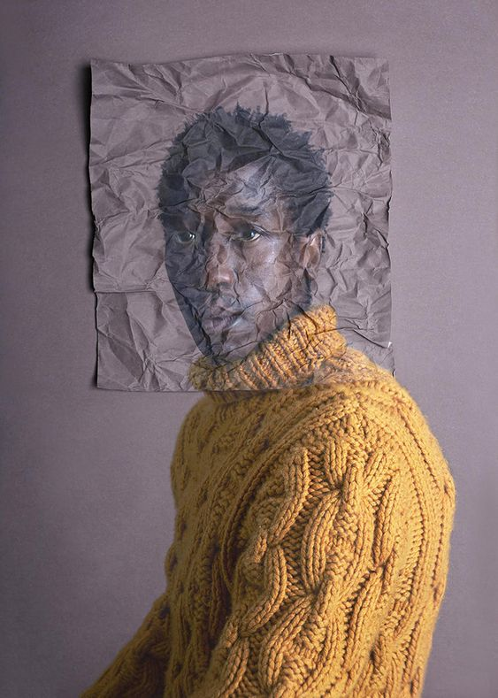
Physically manipulate photographs
Print them
Cut
Fold
Tare
Crumple
Scan them back in
This doesn’t have to be done with portraits. You can so this with any photographs
Creating texture
Alma Haser

Slide 14
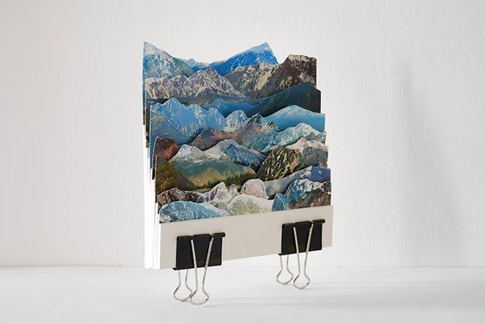
Start to think about how you might want your final piece to look
Do you want someone to touch it and feel texture?

Slide 15
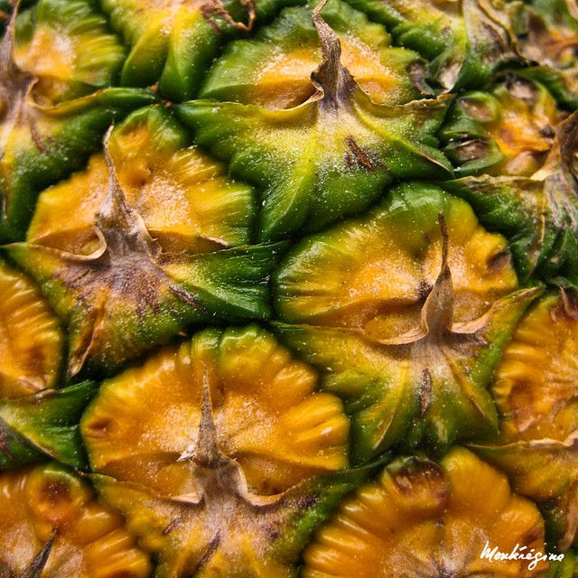
Maybe you want to concentrate on photographing texture in a simple and effective way

Slide 16
Some of you might not have the material or equipment at home, that is fine but you need to show me a written plan.

Slide 17

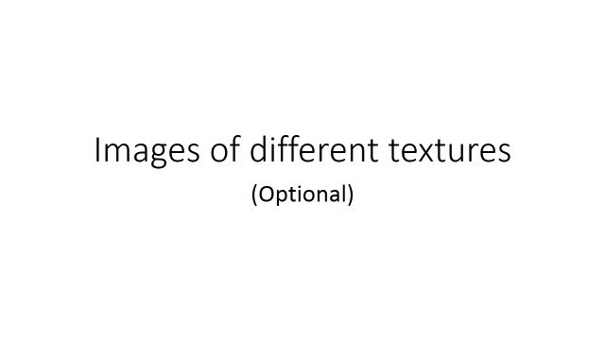
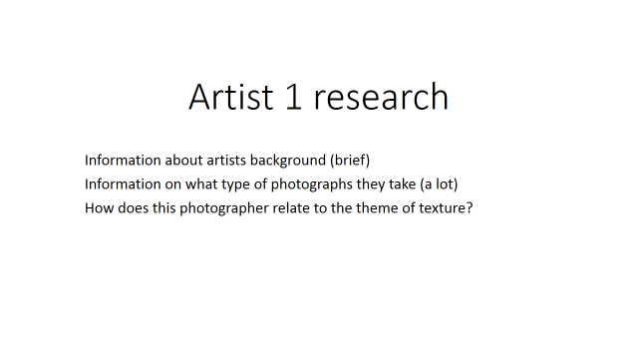
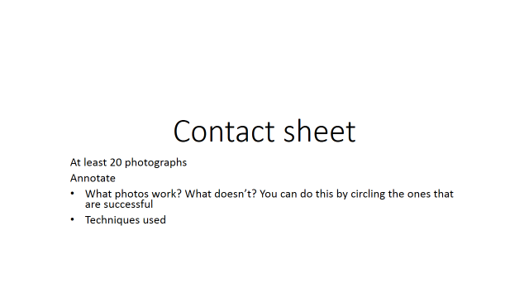
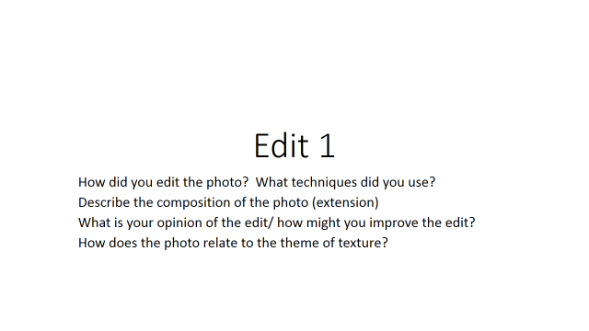
Files > class material > layout of slides

Slide 18
Every Friday Formal evaluation of your work

