Slide 1
Artist reseach
The first artist you are going to research is Julie Cockburn
Specifically you are researching how she uses shape in her photography work.

Slide 2
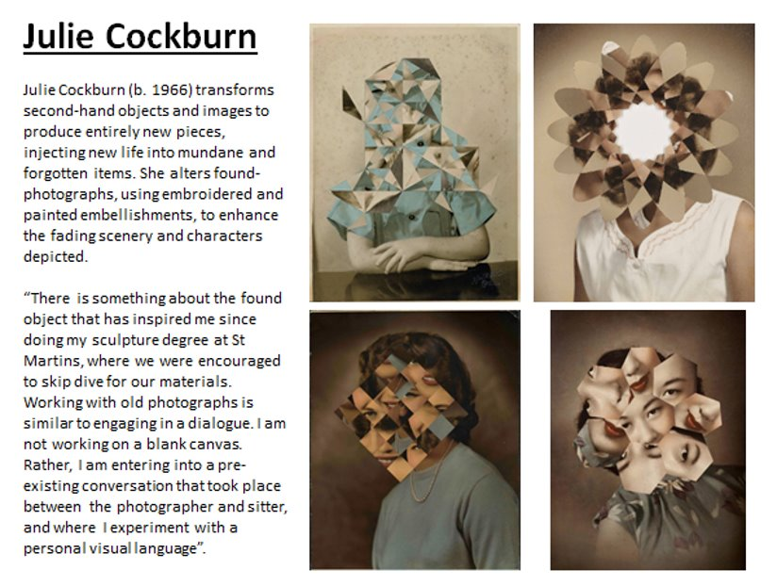

Slide 3
Artist Research
Your opinion of the artist
Must include good quality images (x6)
Information about the artist – brief
Information about their art – lots
Why they produce those kind of photographs and any meanings attached to them
What do you think of their work?
How will you use their work to inspire you?
How does their work link to the question?
You must remember to use key words throughout your annotations!!

Slide 4

Select one of Julie Cockburns pieces of art and analyse it.
Make sure it is a photograph that you can discuss the shape
Writing about a photographer’s work
To analyse a photographer's work, you need to talk about:
- what is in the picture?
- how they have taken the photograph?
- What camera or editing techniques have they used?
- how have they used the formal elements? (shape, colour, composition, lighting, viewpoint etc)
- what do you like about the work? Explain your answer.
- how could their work inspire your own photographs?
If you need help getting started, you can use these sentence starters but make sure you write a paragraph not bullet points...
Artist's Name takes photographs of...
He/she takes his/her photos by…
The photography techniques he/she uses are…
These are effective because...
This photographer considers formal elements in their work by...
Something I like about Artist's Name's photography style is...
I could take inspiration from this photographer in my own work by...

